Slide 1
Project 1 : Find me a recipe
Download a bunch of recipes on marmiton.org and organise them by time of cooking
Amélie Marichal
Lucas Baylé
Augustin Guillaud

Slide 2

Project : The main ideas
big database of recipes
print the main lines of a recipe
sort them by time of cooking -sed / regex
find new recipes on a website
retrieve the url of a recipe ranked n°1

Slide 3

Progress status (phase 1)
DONE:
sed -n "1 p" ~/recipe.txt → first line of the recipe book
grep “^.*$” recipe.txt → distinguish each line
sed -n "1 p;5 p" → print the lines 1 and 5
sed -n "5p" recipe.txt | sed -e "s/\(.*personnes)\).*$/\1/" | sed -e "s/.*\([0-9]\{2\}\).*\([0-9]\{2\}\).*/[\1,\2]/" → print [15,30]
TO DO:
script that :
show the first and fifth lines of each recipes
retrieve time of cooking and time of preparation
organise them by time of cooking

Slide 4

Progress status (phase 2)
DONE:
for i in {0..50..10}
do
curl -s http://www.marmiton.org/recettes/recherche.aspx?aqt=$1\&start=$i >> /tmp/raw
done
→ Loop retrieving the HTML content of the first six pages result and stores it in a temp file
/.*<div class="m_search_titre_recette"><a href=.*>\(.*\)<\/a><\/div>/ { s//\1/p;}
→ Research in the HTML content the elements corresponding to this regex.Same thing for preparation time, cooking time, type of recipe and votes. Differs from the regex for the number of persons
...{ s//\1\r\n\2/;H;} g s/\r\n/;/gp (example)
→ Use of the hold buffer and pattern buffer via h, H and g

Slide 5
Progress status (phase 2)
DONE:
sed -n -f total.sed /tmp/raw
→ Extract the wanted data from the HTML retrieved using the total.sed file. total.sed contains every regex
$ ./marmiton.sh cheesecake 2→ Does a curl request on the page result for cheesecake
sort --field-separator=';' -rn --key=$2 |column -t -s ";"
→ Sort decreasingly the data by votes, separating each element belonging to a certain column by a ‘;’
echo "What recipe are you searching for? :"
read recipe
→ Ask the user to type in the thing he wants to prepare. Read retrieves the words
case $num in
1)
sed -n -f total.sed /tmp/raw | sort --field-separator=';' --key=1 |column -t -s ";"
;;
2)
…
esac
→ According to what the user wanted to sort by, it launches the right command

Slide 6
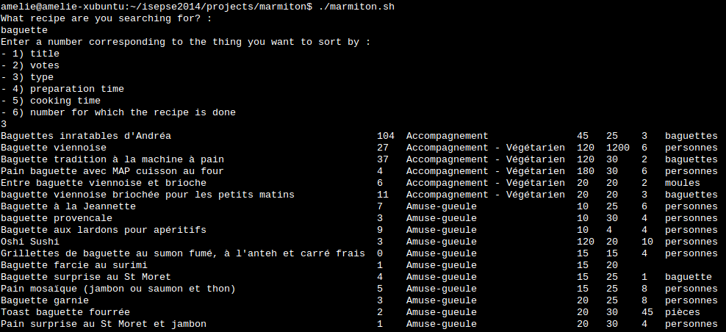
Script using baguette

Slide 7

Progress status (phase 3)
Add up preparation time and cooking time in order to ask how much time the user has to cook

