Slide 1
FLAME SPRAY INC
THERMAL BARRIER COATINGS FOR NUCOR ELECTRIC FURNACE SHELL

Slide 2
FLAME SPRAY INC.
TECHNICAL DISCUSSION
THERMAL BARRIER COATINGS (TBC)‏
MATERIALS/COATING THICKNESS
MICRO BALLOONS
TESTING
ORIGINAL APPLICATION
REPAIR/MAINTENENCE OF COATING
FLAME SPRAY INC’S CAPABILITIES
MICRO BALLOONS/ KAOWOOL/REFRACTORY
TECHNICAL & ECONOMIC SOLUTIONS

Slide 3
WHAT ARE THE ISSUES
REFRACTORY IS NOT PROVIDING SUFFICIENT THERMAL INSULATION TO PREVENT THE OUTER SHELL FROM DISTORTING
DETERMINE IF A PLASMA SPRAYED TBC COATING WILL REDUCE THE OUTER SHELL TEMPERATURE BY 300 DEGREES F
LOOK AT ADDITIONAL SOLUTIONS
LOOK AT THE APPLICATION FEASIBILITY
DETERMINE THE ECONOMIC FEASIBILITY
MAINTENANCE OF THE TBC COATING

Slide 4
FLAME SPRAY INC.
HISTORY
ESTABLISHED IN 1968
NUCLEAR COATING APPLICATIONS
AIRCRAFT ENGINE REPAIR APPLICATIONS
PWA, RR, AVCO LYCOMING, GE
US NAVAL MIL STD 2138SH & MIL 1687
FACILITY ENGINEERING
CONTAINERIZED TS FACILITIES
ON SITE APPLICATIONS
FACILITIES IN HOUSTON/MIAMI

Slide 5
FLAME SPRAY INC. HISTORY ESTABLISHED IN 1969
1970'S DEVELOPED 100'S OF NUCLEAR APPLICATIONS
1980'S RECEIVED OEM AIRCRAFT APPROVALS
1980'S DESIGNED AND BUILT OVER 70 CONTAINERIZED THERMAL SPRAY FACILITIES
1980'S DEVELOPED MACHINE ELEMENT REPAIR AND CORROSION CONTROL TSA APPLICATIONS AND SPECIFICATIONS FOR THE US NAVY
1990'S DEVELOPED PROCESS BOILER APPLICATIONS FOR THE POWER AND PAPER INDUSTRIES
2000 OPENED TWO SATELLITE FACILITIES IN MIAMI AND HOUSTON
DESIGNED , BUILT AND RECEIVED APCD PERMITS FOR THE ONLY KNOWN PORTABLE DUST COLLECTOR FOR USE IN SPRAYING TOXIC MATERIALS ON SITE IN CALIFORNIA
RECEIVED MULTI PATENTS FOR THERMAL SPRAY RELATED APPLICATIONS

Slide 6
FLAME SPRAY INC
QUALITY SYSTEM AS 9100/NADCAP
MIL STD 2138SH
PWA 70-46SP
MIL STD 1687
BOEING BAC 5851
UNITED SPACE ALLIANCE
SHELL OIL
LOCKHEED MARTIN
SUNDSTRAND
SOLAR
FAA REPAIR STATION

Slide 7
ELECTRIC ARC FURNACE

Slide 8
LADLE METALLURGY FURNACE

Slide 9
ASSEMBLY DETAIL OF NUCOR FURNACE

Slide 10
NUCOR FURNACE WITH INSULATING BRICK

Slide 11
NUCOR FURNACE DETAILS

Slide 12
NUCOR FURNACE LAYOUT

Slide 13
NUCOR AREA OF INTEREST

Slide 14

WHAT IS THERMAL SPRAYING
THERMAL SPRAYING IS THE PROCESS OF HEATING, ATOMIZING AND PROPELLING MOLTEN METALLIC OR CERAMIC PARTICLES TO A PREPARED SURFACE
FEEDSTOCK
HEATED
ATOMIZED & PROPELLED
TO FORM LAMINAR COATING
ON PREPARED SUBSTRATE

Slide 15
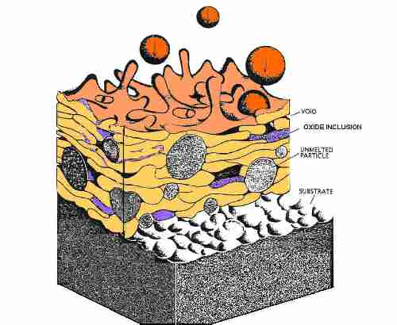
THERMAL COATING CROSS SECTION
ILLUSTRATING THE INTERFACE

Slide 16
THERMAL SPRAY METHODS
COMBUSTION POWDER
COMBUSTION WIRE
TWAS (TWIN WIRE ARC SPRAY)‏
NON TRANSFERRED ARC PLASMA
HVOF (HIGH VELOCITY OXYGEN FUEL)‏

Slide 17
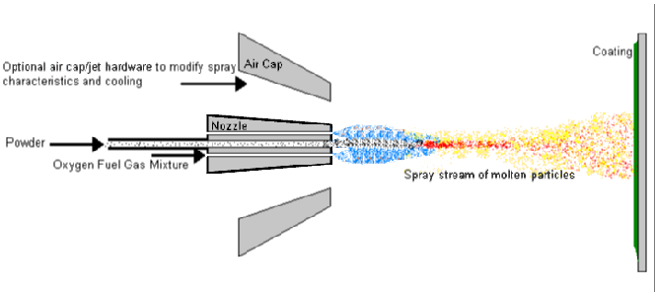
COMBUSTION POWDER SYSTEM
THIS SYSTEM CAN APPLY A WIDE VARIETY OF POWDER ALLOYS BY USING OXYGEN/ ACETYLENE OR HYDROGEN TO MELT POWDERS CREATING FINE MOLTEN DROPLETS THAT RAPIDLY SOLIDIFY ONCE DEPOSITED ON TO A PROPERLY PREPARED SURFACE FORMING A COATING

Slide 18
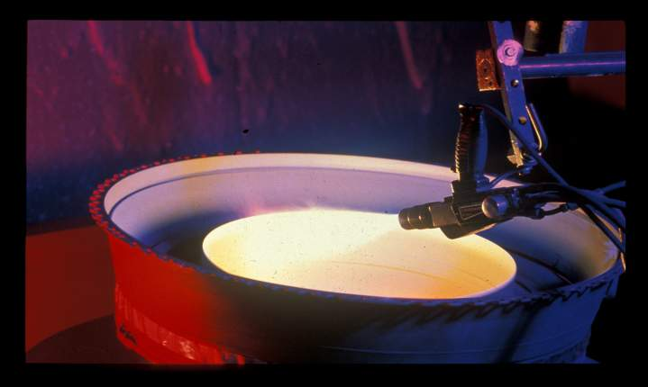
COMBUSTION POWDER

Slide 19
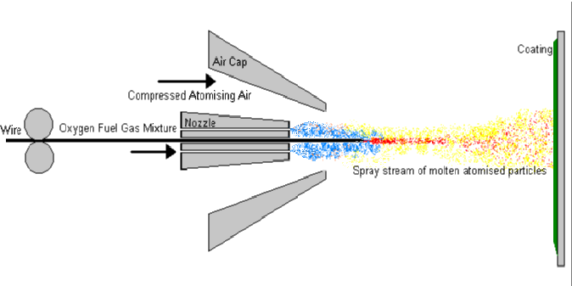
COMBUSTION WIRE SYSTEM
THIS IS THE OLDEST OF ALL THERMAL SPRAY SYSTEMS. MATERIAL IN A
WIRE FORM IS FED THOUGH THE GUN AND HEATED TO IT'S MELTING POINT
BY PASSING THOUGH A OXYGEN AND FUEL GAS FLAME (MOST COMMON IS
ACETYLENE) AND THE DROPLETS ARE FINELY ATOMIZED BY
COMPRESSED AIR THAT PROPELS THE PARTICLES ON TO A PROPERLY
PREPARED SURFACE.

Slide 20
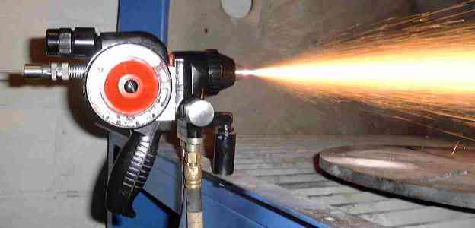
COMBUSTION WIRE

Slide 21
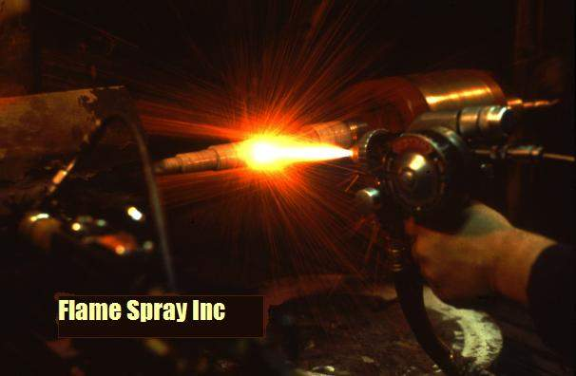
COMBUSTION WIRE SPRAYING

Slide 22
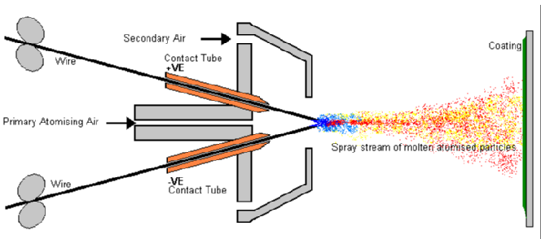
TWAS (TWIN WIRE ARC SPRAY)
IN THIS PROCESS A PAIR OF ELECTRICAL CONDUCTIVE
WIRES ARE MELTED BY MEANS OF AN ELECTRIC ARC. THE
MOLTEN PARTICLES ARE PROPELLED TO A PROPERLY
PREPARED SURFACE

Slide 23
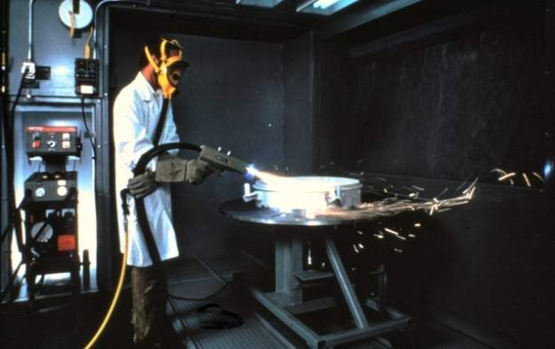
TWAS (TWIN WIRE ARC SPRAY)‏

Slide 24
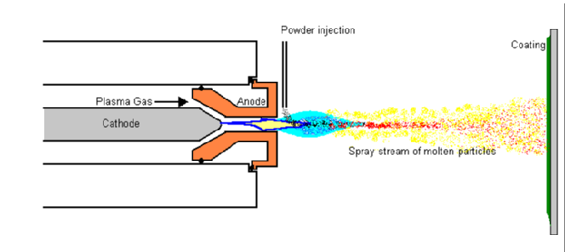
ARC PLASMA SPRAY
IN THIS PROCESS POWDER IS FED VIA A PRESSURIZED POWDER FEEDER THAT INJECTS THE POWDER INTO A VERY HIGH TEMPERATURE PLASMA ARC, WHERE THE POWDER IS RAPIDLY HEATED AND PROPELLED AT HIGH VELOCITIES TO A PROPERLY PREPARED SURFACE.

Slide 25
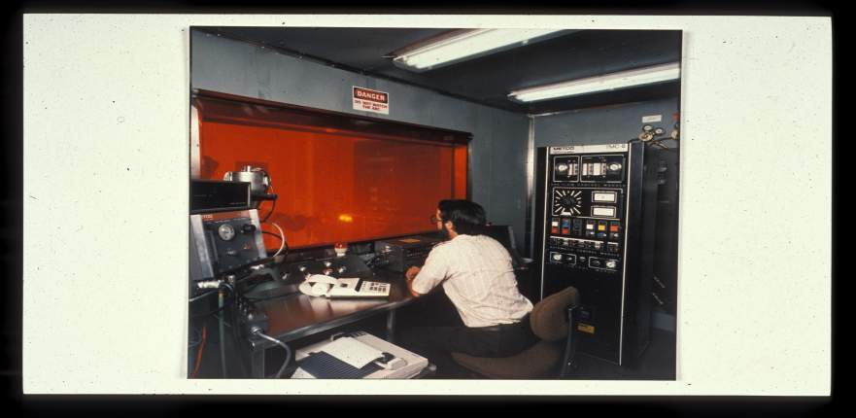
PLASMA SPRAY CONTROL
ROOM AUTOMATED
SYSTEM

Slide 26
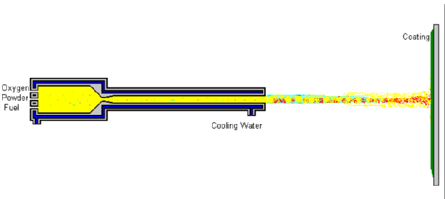
HVOF (HIGH VELOCITY OXYGEN FUEL)
HVOF USES EXTREMELY HIGH KINETIC ENERGY AND CONTROLLED THERMAL ENERGY OUTPUT TO PRODUCE HARD, DENSE AND VERY HIGH ADHESION STRENGTHS

Slide 27
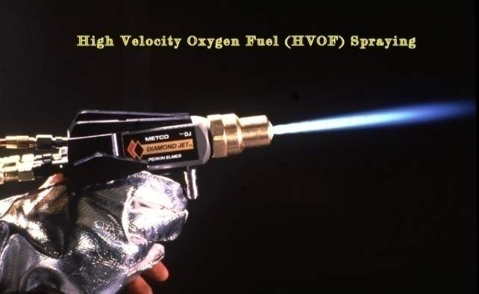
HVOF (HIGH VELOCITY OXYGEN FUEL)

Slide 28
THERMAL SPRAY COATING MATERIALS
ALUMINUM AND ITS ALLOYS
ZINC
COPPER AND ITS ALLOYS
ALUMINUM BRONZE
BRASS
MOLYBDENUM
TANTALUM
TUNGSTEN
LEAD
SILVER
TIN
STAINLESS STEEL 300-400 SERIES
INCONEL ALLOYS
HASTELLOY ALLOYS
CARBIDES, TUNGSTEN & CHROME
NICKEL CHROME ALLOYS
NICKEL
CHROME
TITANIUM
ALUMINUM OXIDE CERAMIC
CHROME OXIDE CERAMIC
ZICONIUM OXIDE CERAMIC

Slide 29
THERMAL SPRAY COATING CHARACTERISTICS
HOW THERMAL SPRAY COATINGS BOND
WHAT IS THE DENSITY
WHAT IS THE STRUCTURAL STRENGTH
WEAR RESISTANCE
CAVITATION RESISTANCE
ELECTRICAL CONDUCTIVITY
THERMAL BARRIERS
RFI/EMI SHIELDING
CORROSION RESISTANCE
NON SLIP SURFACES
BEARING SURFACES
ANODIC PROTECTION
ELECTRICAL RESISTANCE
THERMAL CONDUCTIVITY

Slide 30
THERMAL SPRAY COATING PROCESS STEPS
DEVELOP A DETAILED PROCESS CONTROL PROCEDURE
PREPARE BY DEGREASING
MASK THE AREAS NOT TO BE COATED
ABRASIVE BLAST THE AREAS TO BE COATED
SET UP THERMAL SPRAY EQUIPMENT AND PROGRAM ROBOT
APPLY THE COATING IAW THE INSTRUCTIONS ON THE ATTACHED PCP
ALL INSPECTION CHECK POINTS TO BE OBSERVED AND THE COATED PART IS VERIFIED TO HAVE CORRECT AMOUNT OF MATERIAL APPLIED.
DE-MASKING AND FINAL CLEANING

Slide 31
THERMAL SPRAY APPLICATION VALIDATION TESTS
DEFINE ACCEPTANCE CRITERIA
DEFINE SAMPLE TYPE , QUANTITY AND FREQUENCY OF COATED SAMPLES
PERFORM BEND TEST
PERFORM ADHESION TEST IAW ASTM 633
PERFORM HARDNESS TEST, VICKERS, DPH, ROCKWELL PERFORM THICKNESS CHECK
THICKNESS CHECK
PERFORM POROSITY CHECK
PERFORM COATING CROSS SECTIONAL EVALUATION
PERFORM SURFACE FINISH CHECK
PERFORM DIMENSIONAL CHECKS
CHECK COMPLIANCE TO BLUEPRINT TO FINAL DIMENSIONS

Slide 32
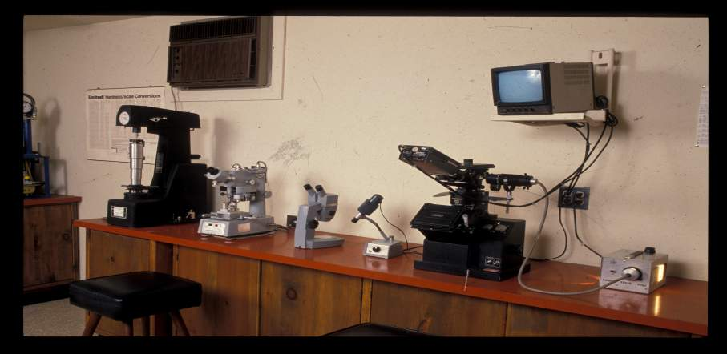
THERMAL SPRAY COATING
EVALUATION LAB

Slide 33
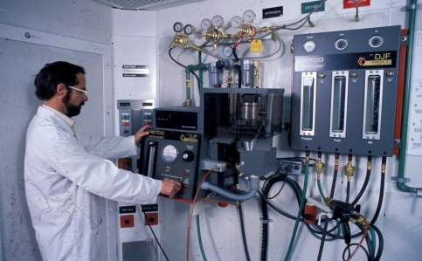
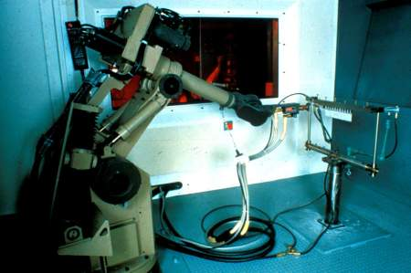
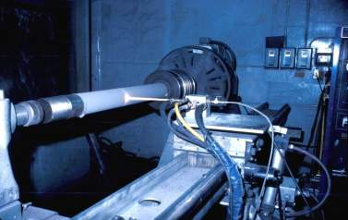
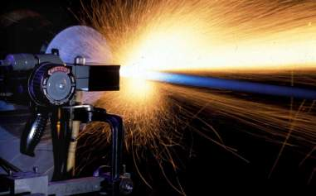
FLAME SPRAY INC. FACILITIES
7
Robotic
Cells
0

Slide 34
FLAME SPRAY INC. PRODUCTION CAPABILITIES
17,000 SQ FT FACILITIES
9 SPRAY BOOTHS THE LARGEST 12' X 40 '
10 PLASMA SYSTEMS
4 HVOF SYSTEMS
5 ARC WIRE SYSTEMS
12 COMBUSTION WIRE SYSTEMS
4 COMBUSTION POWDER SYSTEMS
3 SIX AXIS ROBOTS
8 EA TWO AXIS TRAVERSE UNITS
10 HORIZONTAL TURNTABLES 12,000 LB MAX CAPACITY
6 HEADSTOCK TAIL STOCK UNITS 24' LONG 48” DIA SWING LARGEST
4 MULTI HEAD AUTOMATIC TURNTABLES
4 LARGE SANDBLAST ROOMS AND 6 BLAST CABINATES

Slide 35
THERMAL SPRAY
OPERATOR TRAINING
FLAME SPRAY INC. PERPETUAL TRAINING PROGRAM
NEW HIRE INDOCTRINATION
WEEKLY TRAINING
WRITTEN TESTING
PHYSICAL TESTING
RE-OCCURRING TRAINING
NON CONFORMANCE/CORRECTIVE ACTION
EVALUATION OF EFFECTIVENESS OF THE TRAINING
CERTIFICATION OF OPERATORS

Slide 36
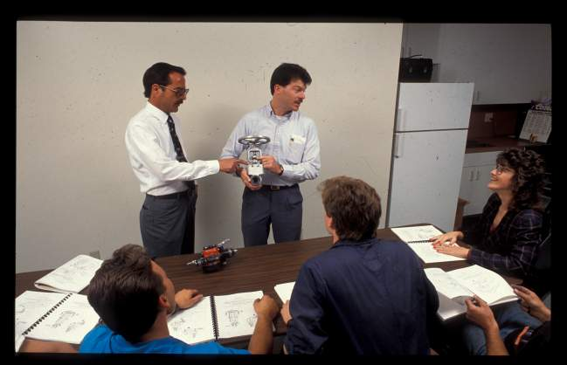
FLAME SPRAY TRAINING

Slide 37
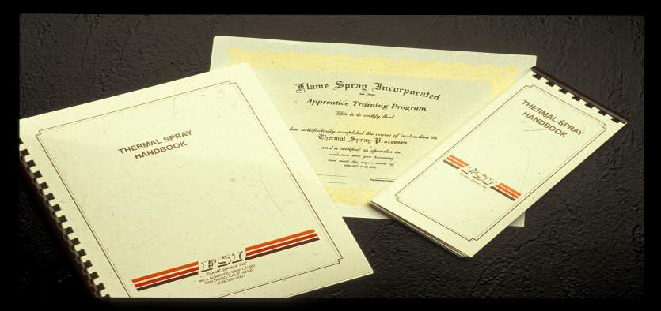
TRAINING CERTIFICATES
AND MANUALS

Slide 38
FLAME SPRAY INC'S QUALITY CONTROL SYSTEM
AS 9100 COMPLIANT
NADCAP PROCESS AND LAB CERTIFICATIONS
FAA INSPECTION MANUAL
CALIBRATION SYSTEM COMPLIANT WITH MIL STD 23467
THIRD PARTY ACCREDITATION
QUALITY/PROCEDURES MANUAL
DETAILED WORK INSTRUCTIONS
METALLURGICAL LAB

Slide 39

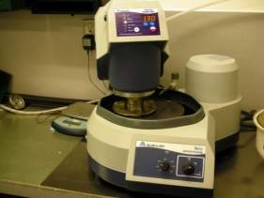
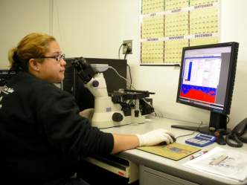
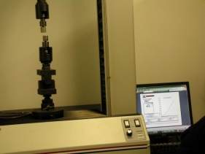
Metallographic Sample Preparation
Metallurgical
Analysis
Tensile Strength
Measurement
14

Slide 40

CROSS SECTIONAL
ANALYSIS OF COATINGS

Slide 41
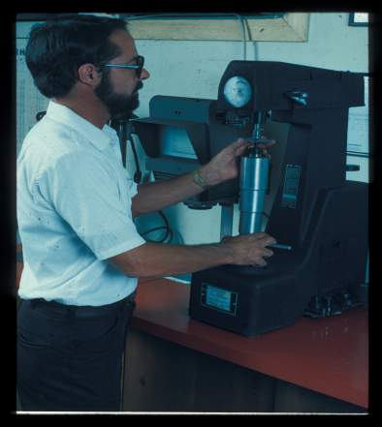
ROCKWELL HARDNESS
CHECK OF COATINGS

Slide 42
PROCESS CONTROL TRAVELER
DEFINES CUSTOMER PO AND OR CONTRACT REQUIREMENTS
DEFINES ALL PRODUCTION AND INSPECTION WORK INSTRUCTIONS
DEFINES ACCEPTANCE CRITERIA
DEFINES TESTS TO VALIDATE COATING APPLICATION

Slide 43
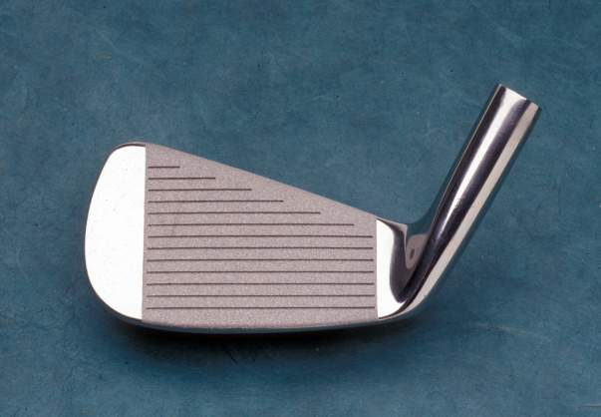
STRAIGHTER & LONGER
CARBIDE AND CERAMIC COATED FACES OF GOLF CLUBS

Slide 44
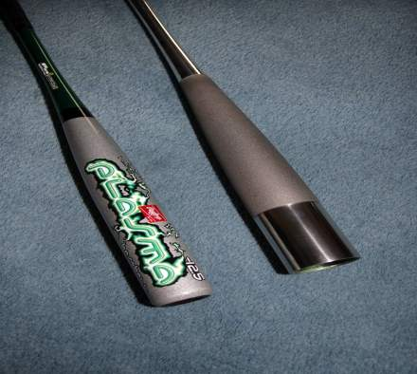
THERMAL SPRAYED
COATED BASEBALL BATS

Slide 45
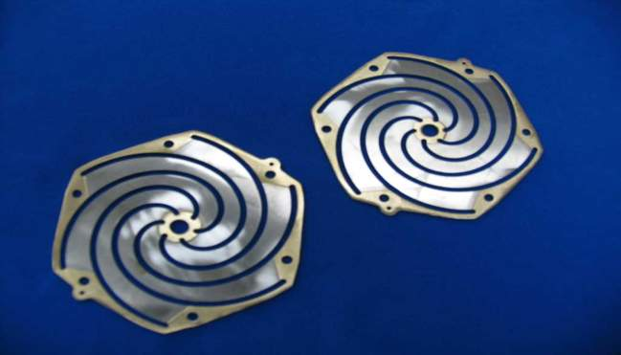
BRONZE COATING AS A SPACER ON STACKED STAINLESS PARTS

Slide 46
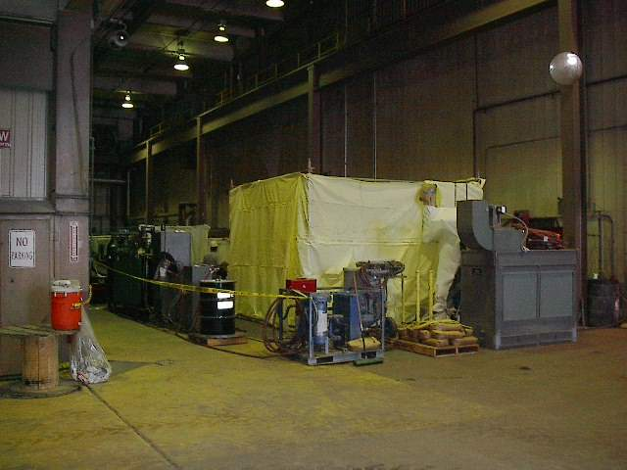
FLORIDA LIGHT & POWER TURBINE REPAIR

Slide 47
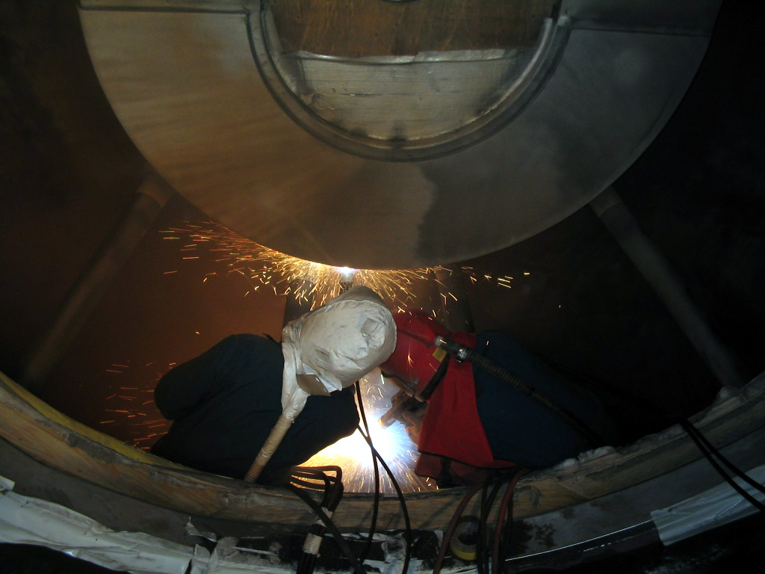
DIABLO CANYON NUCLEAR TURBINE CASING

Slide 48
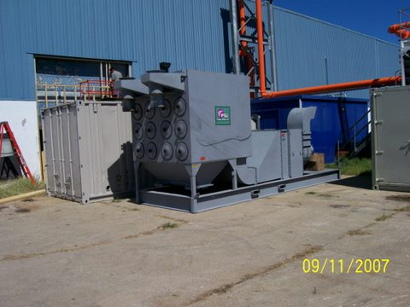
ROLLS ROYCE PLASMA CONTAINER

Slide 49
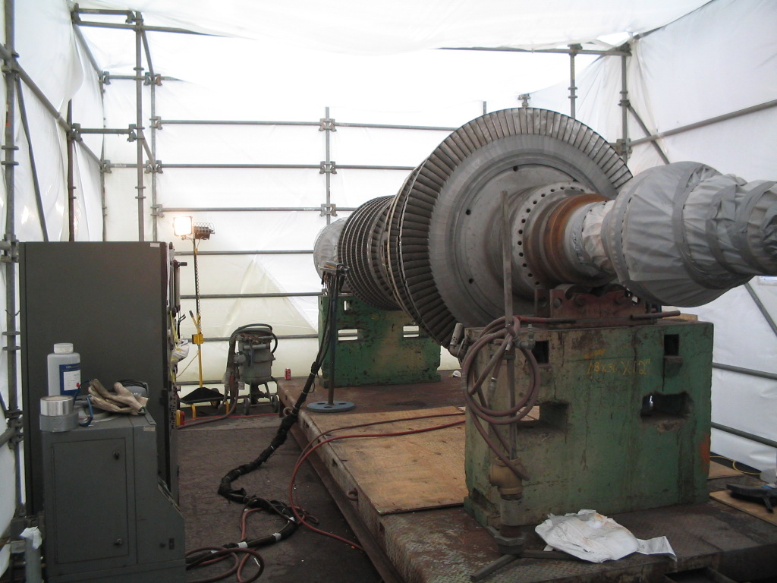
ONSITE GE TURBINE

Slide 50
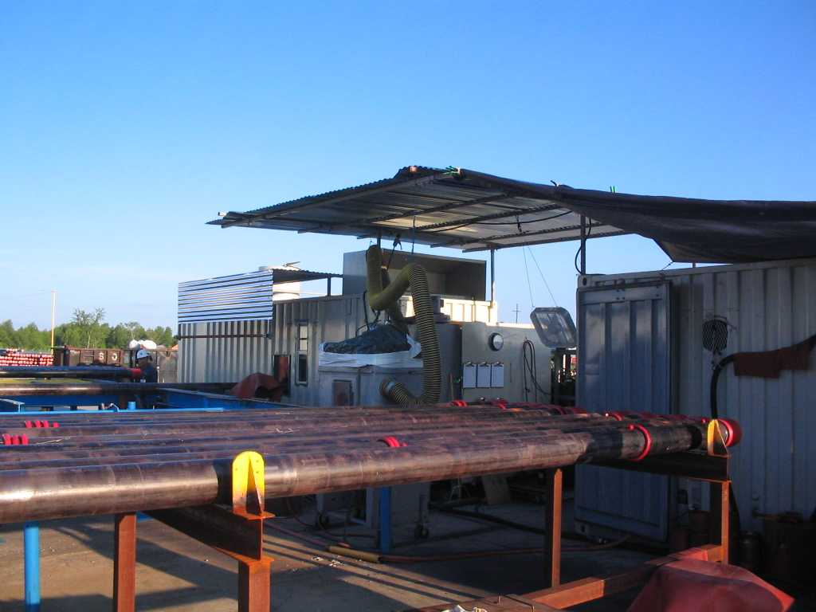
VIT TUBING CHEVRON

Slide 51
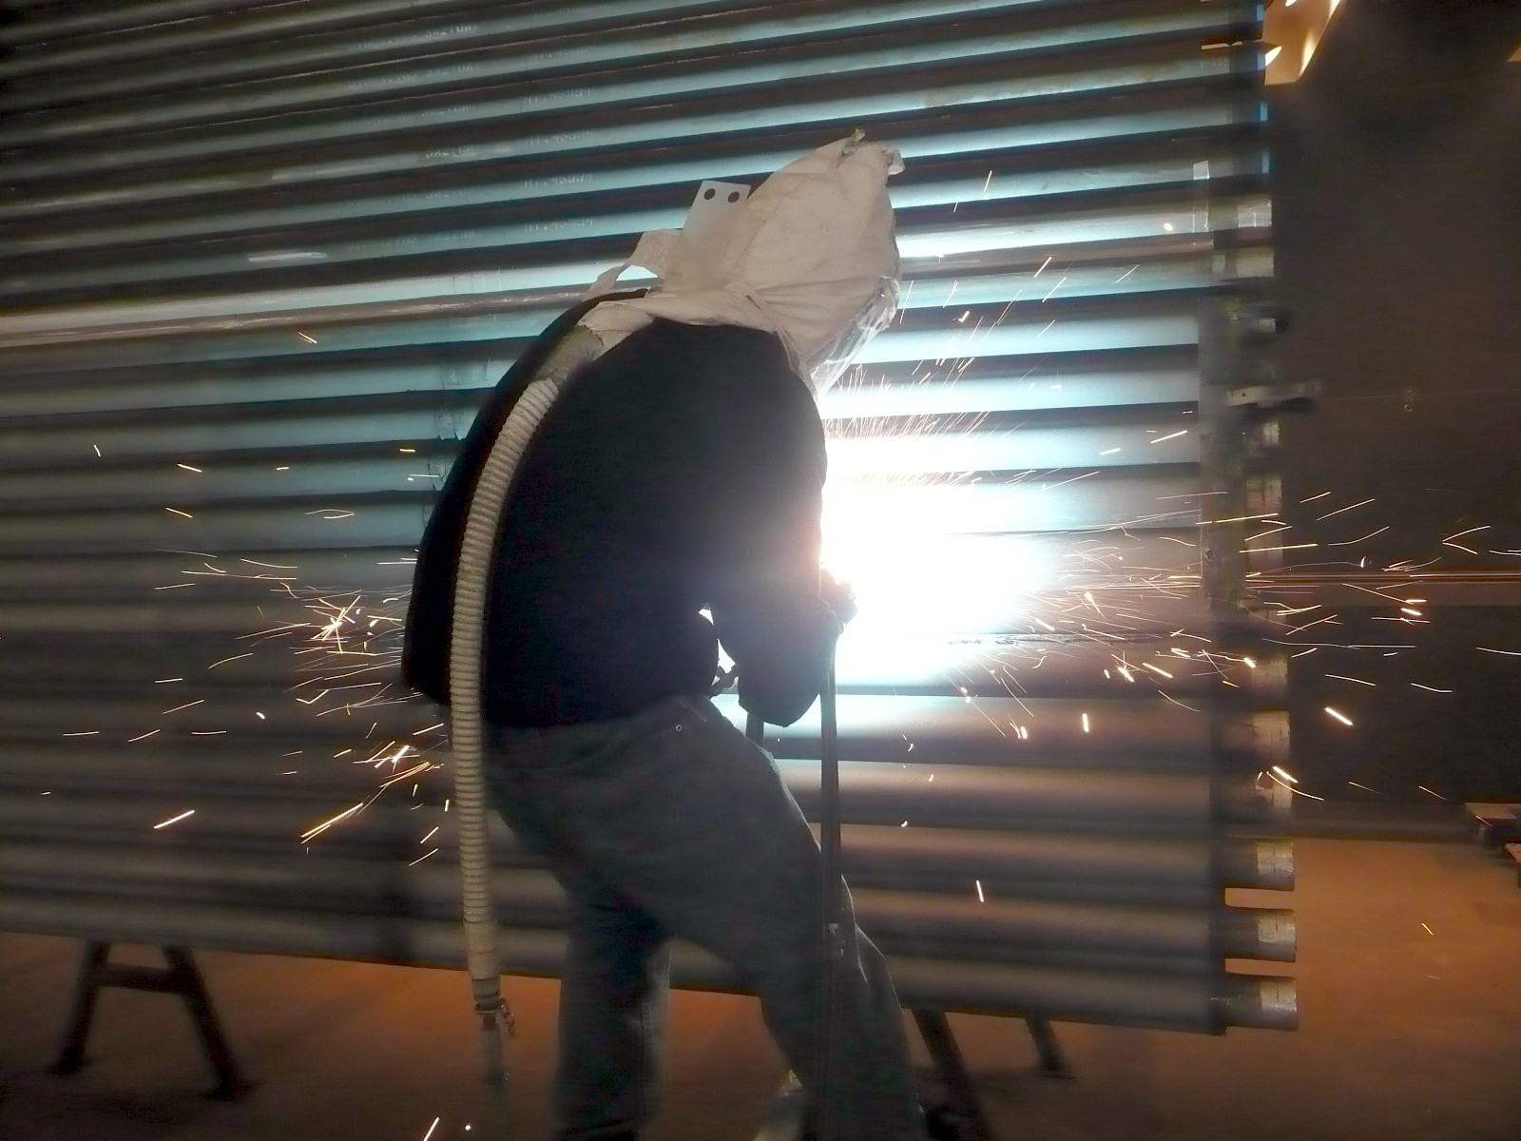
BOILER TUBES

Slide 52
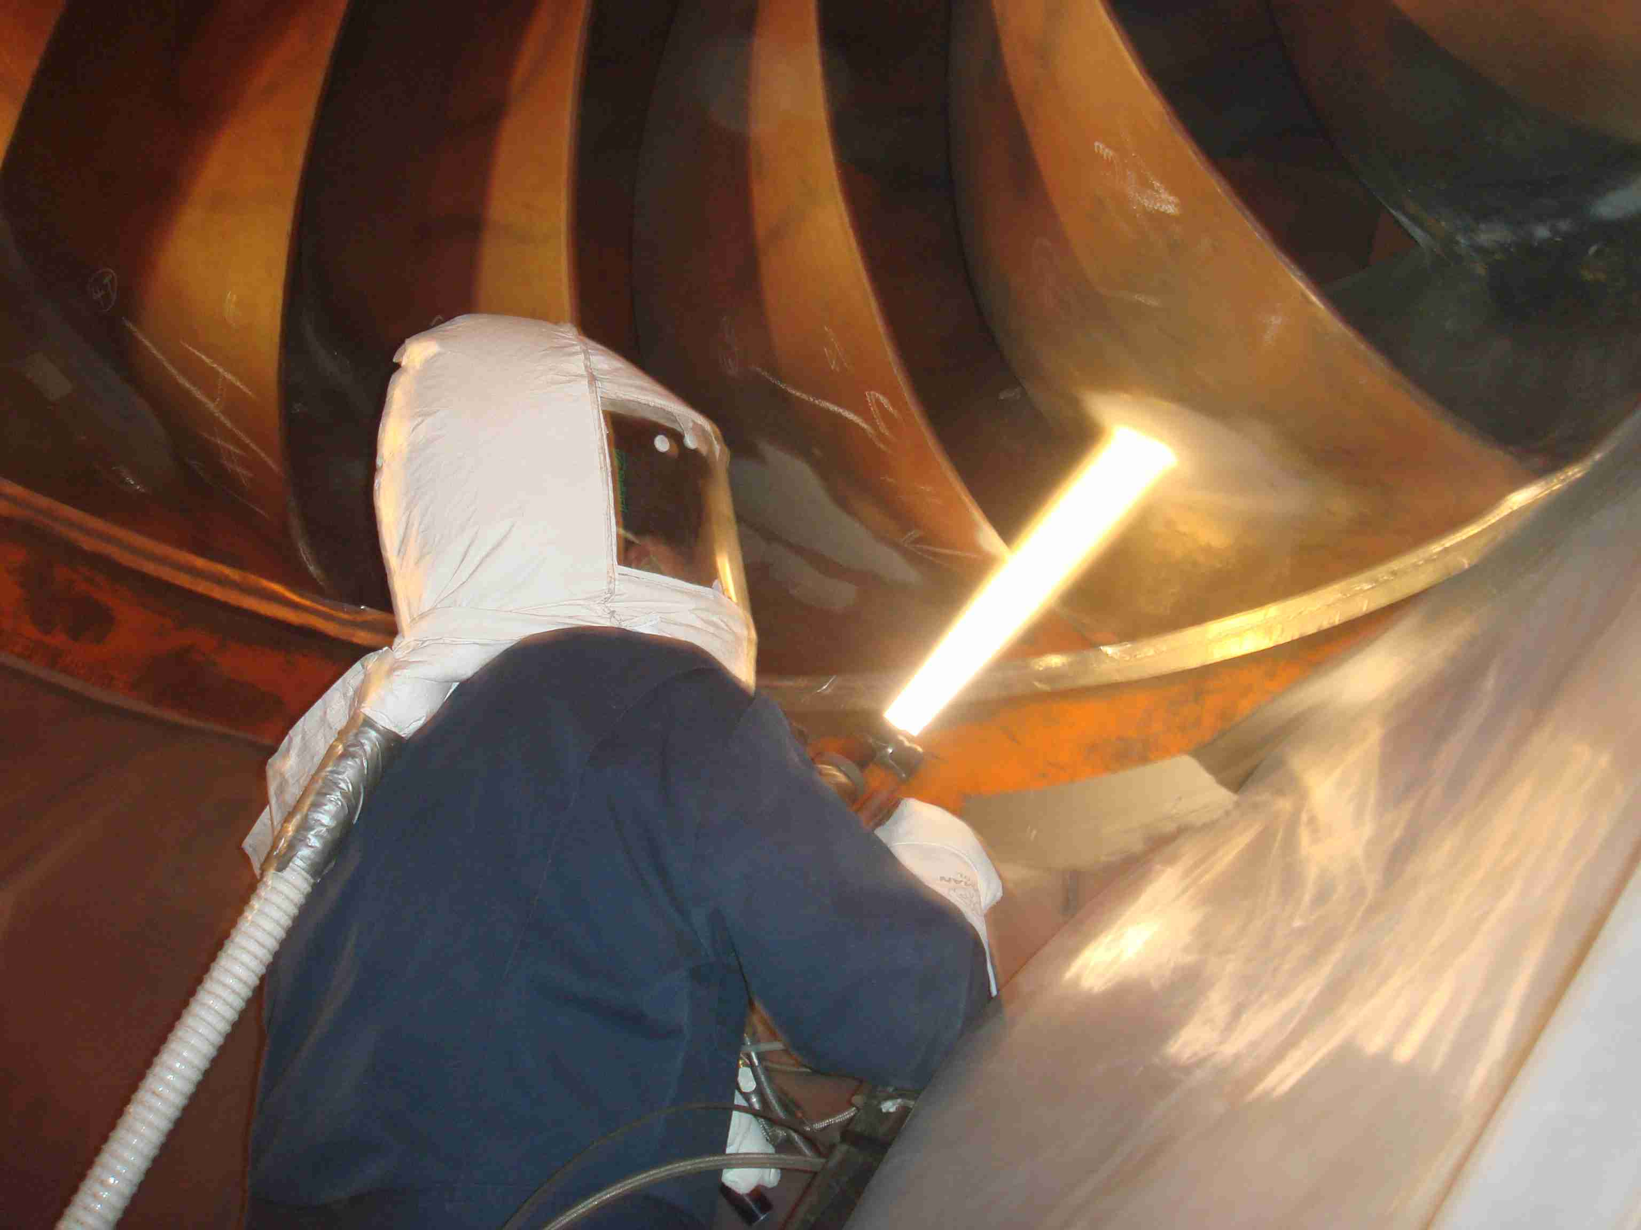
GREEN RIVER DAM PELTON WHEEL

Slide 53
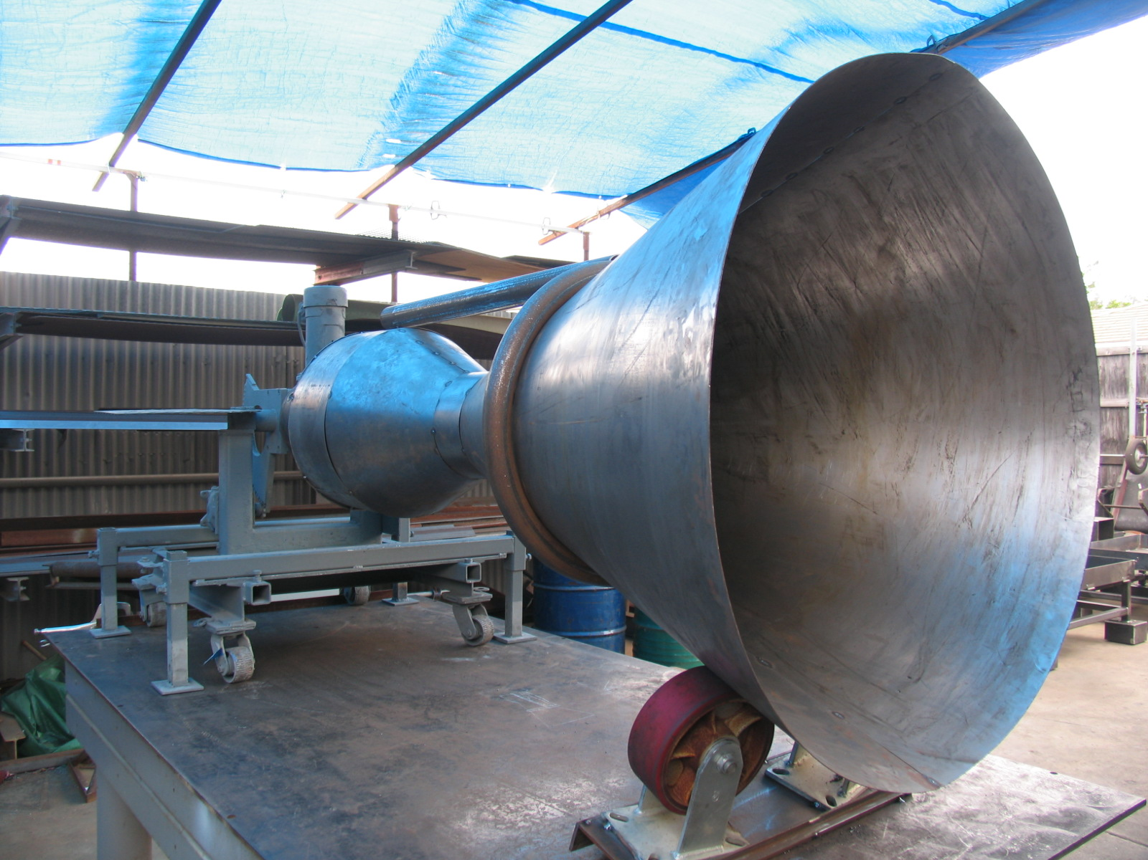
TBC COATING ROCKET NOZZLE

Slide 54
HISTORY OF TBC COATINGS
NASA ROCKET COMPONENTS
JET ENGINE COMBUSTION COMPONENTS
DIESEL PISTIONS
RACING GASOLINE PISTONS, COMBUSTION CHAMBERS & HEADERS
STATIONARY POWER TURBINE BLADES AND COMBUSTORS
POWER PLANT FUEL NOZZLES
US NAVY FLIGHT DECKS
SOLAR ENERGY COLLECTORS

Slide 55
TBC COATING LAYERS AND COATING THICKNESS
TBC COATINGS
2 LAYER: BOND COAT 5-8 MILS TOPCOAT 10-15 MILS
3 LAYER: METALLIC BOND COAT 5-7 MILS 50/50% METALLIC CERAMIC INTERMEDIATE LAYER 5-10 MILS TOP COAT CERAMIC 10-15 MILS
GRADUATED TBC: METALLIC BOND COAT 5-7 MILS A GRADUATED LAYER STARTING WITH 100% METALLIC AND GRADUALLY DECREASING THE METALLIC CONTENT AND PROPORTIONALLY INCREASING THE CERAMIC CONTENT IN A 8-12 MIL LAYER AND THE FINAL 100% CERAMIC LAYER A THICKNESS OF 12-15 MILS
2 LAYER: TBC WITH MORE OXIDATION RESISTANT BOND COATS APPLIED WITH HVOF AND OR IN A VACUUM WITH STABILIZED ZICONIA TOP COATS

Slide 56
TBC MATERIALS
NiCrAlY
NiCr
NiCrAl
CoNiCrAlY
TOP COAT
YITTRIA STABILIZED ZIRCONIA
ZICONIA OXIDE/ MAGNIZIUM OXIDE
BOND COATS
ALUMINUM OXIDE

Slide 57
Requirement for Thermal Spray Thermal Barrier Coatings
Strain tolerant
Resist thermal shock
High melting and sintering point
Low thermal conductivity
Erosion Resistant
Robust (last long time)
Thin and light weight (for Aero parts)

Slide 58
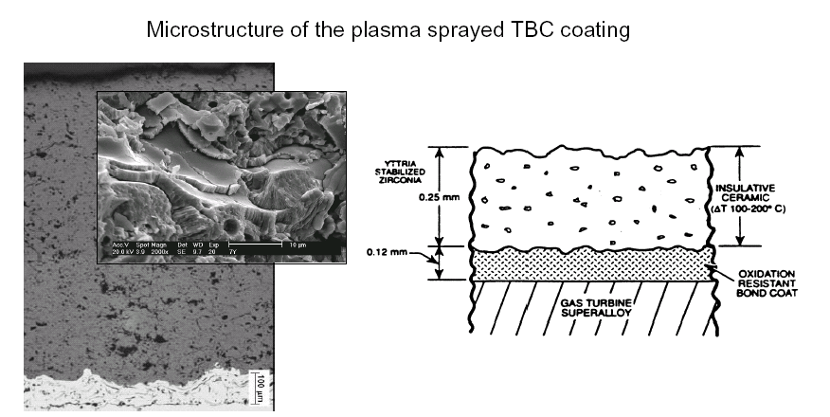
MICROSTRUCTURE OF PLASMA SPRAYED TBC COATINGS

Slide 59
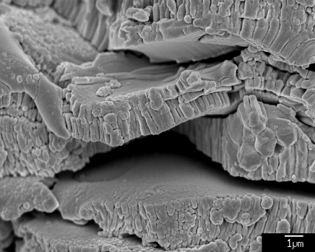
Typical Micro-structure of As-Sprayed TBC YSZ Top Coat

Slide 60
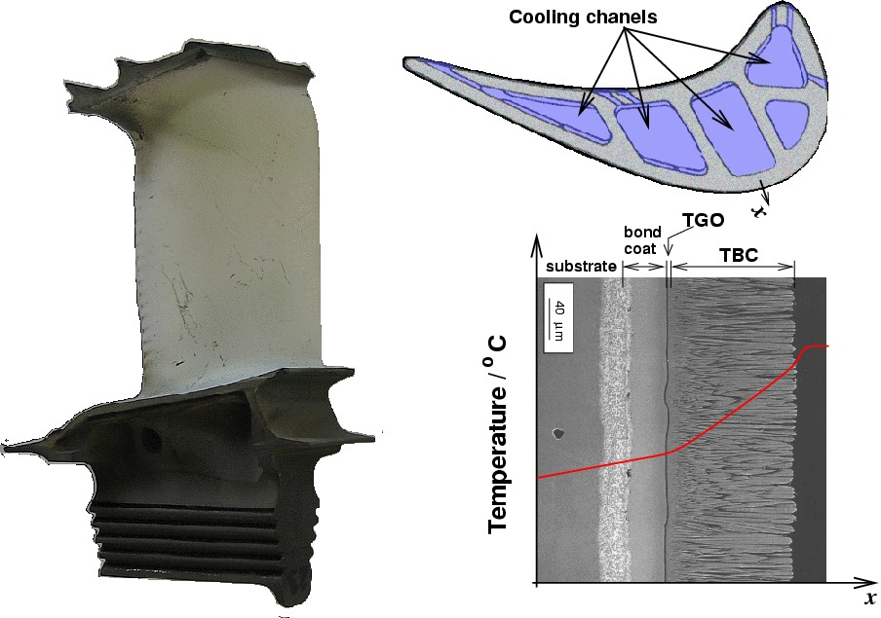
TBC Coatings in Aerospace
(Image Rolls-Royce Plc), and schematic Profile temperature, note the drop of temperature close to the blade surface due to the presence of a thin cooling air film.

Slide 61
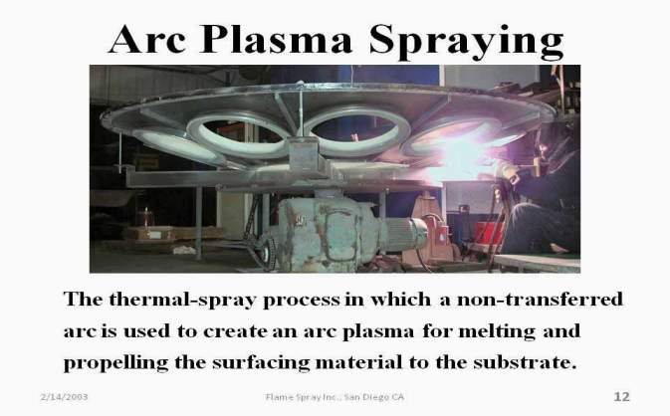
PLASMA ARC SPRAYING

Slide 62
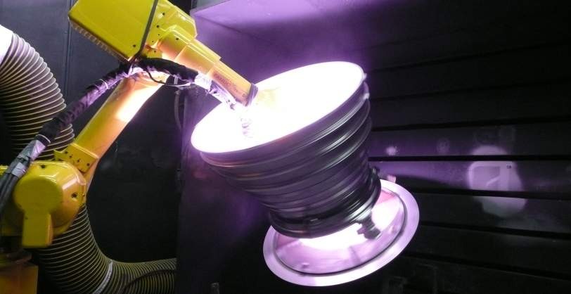
ROCKET NOZZLE COATED WITH A THERMAL BARRIER “TBC” COATING

Slide 63
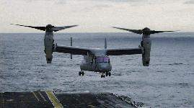
V-22 OSPREY LANDING ON SHIPS DECK PROTECTED BY A PLASMA APPLIED TBC & HIGH TEMPATURE NON SKID COATING

Slide 64
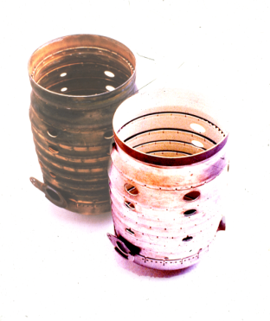
PRATT & WHITNEY COMBUSTION CHAMBERS TBC COATED

Slide 65
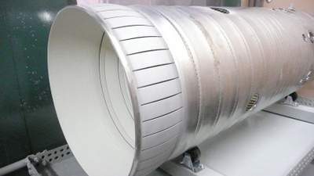
TBC COATED GAS TURBINE LINER

Slide 66
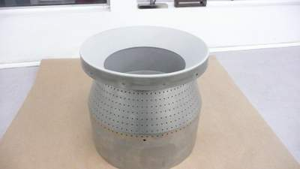
TBC COATED VENTURI

Slide 67
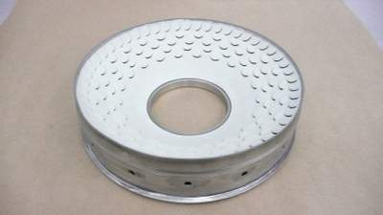
TBC COATED STD CAP

Slide 68
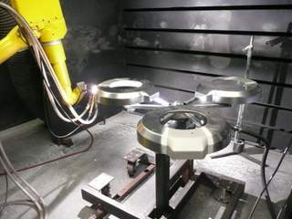
PLASMA SPRAY TBC
SOLAR RECEIVER FACE PLATES

Slide 69
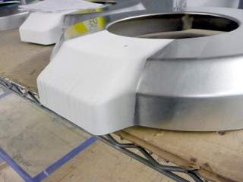
TBC COATED SOLAR
RECEIVER

Slide 70
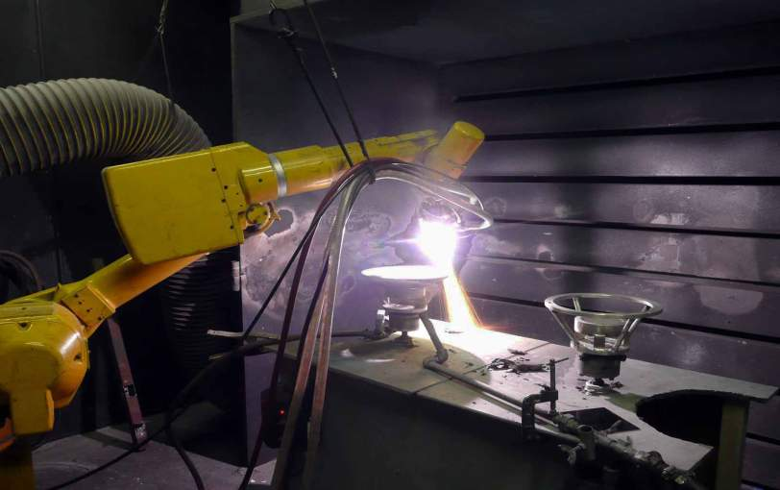
TBC OF SOLAR CONE

Slide 71
Design of Furnace/Vessels
Design of furnace/vessels -The performance and stability of the refractory lining depends on the structural design of the furnace and its configuration.
Sometimes adequate attention is not given to the refractory lining and its engineering related issues during early plant equipment design. This may lead to several compromises as there is limited scope for change in vessel design, operating conditions and the process to reduce the impact of these factors on lining performance during later stages of detailed engineering. The refractory lining failure may occur due to insufficient combustion volume. The heat released within the system is generally more than absorbed by the process and is dissipated through walls or exhausted with flue gases. In such cases, there are possibilities of the lining approaching the flame temperature and causing several problems. The burner type, its design, location, flame shape, possibilities of flame impingement, flowing pattern of flue gases, etc., may affect the lining. In many cases, limited vessel dimensions, inaccessibility and complicated configuration restricts the best lining practices during initial construction as well as subsequent maintenance and repair.

Slide 72
Refractories
Refractories are heat resistant materials used in almost all processes involving
high temperatures and/or corrosive environment.
These are typically used to insulate and protect industrial furnaces and vessels
due to their excellent resistance to heat, chemical attack and mechanical
damage.
Any failure of refractory could result in a great loss of production time,
equipment, and sometimes the product itself. The various types of refractories
also influence the safe operation, energy consumption and product quality;
therefore, obtaining refractories best suited to each application is of supreme
importance.

Slide 73
Examples of Refractory Brick Use

Slide 74
Types of Refractories
Refractories are classified as dense or insulating types. The most high-temperature refractories, such as firebricks, are high-density (>120 lb/ft3).
They offer excellent resistance to environments such as slags with different chemical compositions, fumes, dust, and gases.
Insulating refractories have lower densities (4 to 70 lb/ft3) and provide insulating properties, while offering resistance to corrosion and chemical reactions with the operating environment.

Slide 75
Refractory Use
Refractories are used by the metallurgy industry in the internal linings of
furnaces, kilns, reactors and other vessels for holding and transporting metal
and slag.
In non-metallurgical industries, the refractories are mostly installed on fired heaters,
hydrogen reformers, ammonia primary and secondary reformers, cracking furnaces,
incinerators, utility boilers, catalytic cracking units, coke calciner, sulfur furnaces, air
heaters, ducting, stacks, etc. Majority of these listed equipment operate under high
pressure, and operating temperature can vary from very low to very high (approximately
900°F to 2900°F). The refractory materials are therefore needed to withstand
temperatures over and above these temperatures. Listed below is the sample melting
temperatures of key metallurgical elements where refractory application is critical.

Slide 76
POROSITY
Porosity is a measure of the effective open pore space in the
refractory into which the molten metal, slag, fluxes, vapors etc
can penetrate and thereby contribute to eventual degradation of
the structure. The porosity of refractory is expressed as the
average percentage of open pore space in the overall refractory
volume.
High porosity materials tend to be highly insulating as a result of high volume of air they trap,
because air is a very poor thermal conductor. As a result, low porosity materials are generally used
in hotter zones, while the more porous materials are usually used for thermal backup.
Such materials, however, do not work with higher temperatures and direct flame impingement, and
are likely to shrink when subjected to such conditions. Refractory materials with high porosity are
usually NOT chosen when they will be in contact with molten slag because they cannot be
penetrated as easily.

Slide 77
Thermal Conductivity
Thermal conductivity is defined as the quantity of heat that will flow through a unit area in direction normal to the surface area in a defined time with a known temperature gradient under steady state conditions. It indicates general heat flow characteristics of the refractory and depends upon the chemical and compositions as well as the application temperature.
High thermal conductivity refractories are required for some applications where good heat transfer is essential such as coke oven walls, re generators, muffles and water cooled furnace walls. However, refractories with lower thermal conductivity are preferred in industrial applications, as they help in conserving heat energy.
Porosity is a significant factor in heat flow through refractories. The thermal conductivity of a refractory decreases on increasing its porosity.
The porosity with affect the thickness of brick work.

Slide 78
FSI 3 Part Solution
Part 1: Use better insulator than 85% MgO.
The current pack has ~5% Fe and this may be
too high

Slide 79
FSI 3 Part Solution
Part 2: Install KAO Wool between refractory brick
and steel shell

Slide 80
FSI 3 Part Solution
Part 3: Thermal
Spray TBC
coating on
Steel Shell

Slide 81
Thermal Barrier (TBC) Product Benefits
Controlled Particle Size and Uniformity
Coating- Single or Multi-Phase
Ni, Cr, Al, Al₂O₃
0
.
5
to
500
m
i
c
r
o
n
s
(For ex: Hollow Mullite
Microspheres)
Consolidated Plasma Spary Coating
Encapsulated Powder Concept
Control phases, segregation, composition, &
chemical interactions during processing

Slide 82
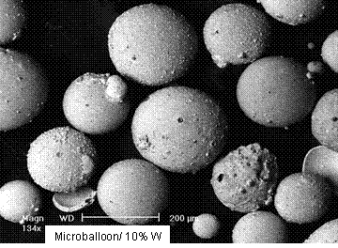
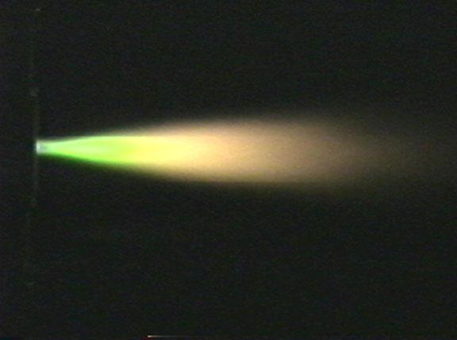
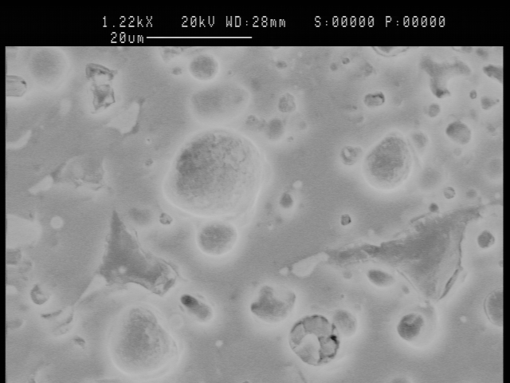

Thermal Barrier (TBC) Product Benefits
Combination of Light Weight, Low Thermal Conductivity Hollow Mullite Microspheres coated with Nickel, Aluminum, Alumina, or Chromium Bond-layer combinations to add coating strength and provide oxidation/corrosion protection.
Powder
Surface
Powder
cross
Section
Coating cross section
Thermal Spray

Slide 83
Thermal Barrier (TBC) Product Benefits
Coating Property Data

Slide 84
Thermal Barrier (TBC) Product Benefits
C
o
a
t
i
n
g
P
r
o
p
e
r
t
y
D
a
t
a
T
h
e
r
m
a
l
E
x
p
a
n
s
i
o
n
o
f
P
l
a
s
m
a
S
p
r
a
y
C
o
a
t
i
n
g
F
F
P
l
a
s
m
a
S
p
r
a
y
:
C
a
t
e
r
p
i
l
l
a
r
,
M
o
s
s
v
i
l
l
e
,
C
T
E
T
e
s
t
i
n
g
:
T
P
R
L
MEAN CTE
n
MEAN CTE
)
n
)
n
n
E
/
E
/
C
T
C
/
T
/
(
(
N
i
N
i
0
0
8
8
0
1
0
1
.
/
.
6
/
6
0
0
0
.
0
i
.
i
A
A
M
M
N
N
i
i
C
C
o
o
a
a
t
t
e
e
d
E
d
E
Z
Z
e
e
o
o
s
s
p
p
h
h
e
e
r
r
e
e
s
s
(
(
G
G
-
-
8
8
0
0
0
0
)
)
7
7
.
.
2
2
0
4
0
4
.
.
0
0
0
0
(
(
P
P
l
l
a
a
s
s
m
m
a
a
S
S
p
p
r
r
a
a
)
y
)
y
( in/in/C)
( in/in/C)
2
2
.
.
0
0
0
0
3
3
.
.
6
6
0
0
0
0
.
.
0
0
0
0
0
0
2
2
0
0
0
0
4
4
0
0
0
0
6
6
0
0
0
0
8
8
0
0
0
0
1
1
0
0
0
0
0
0
T
T
/
/
F
F

Slide 85
WHAT CAN FLAME SPRAY DO FOR NUCOR
COMBINED EXPERIENCE OVER 200 YEARS IN TBC APPLICATIONS
ON SITE APPLICATION CREWS WITH 20 YRS EXPERIENCE
PROVIDE THE QUALITY, DELIVERY AND COSTS THAT WILL MAKE THIS PROJECT VIABLE

