Slide 1
Mojaloop Business Model
Setting up a scheme that matches all stakeholders' business models: hard lessons from Myanmar.
Steve Haley, Mojaloop Foundation
Nyi Aye, ThitsaWorks

Slide 2
Mojaloop in Myanmar
Deployment in progress

Slide 3










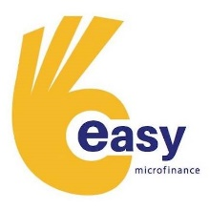











The Project: Interim Governance
Co-Chairs
Scheme Council
Scheme Advisory
Lead scheme and set agenda for decision making
Represent the scheme and approve or reject decisions
Criteria: Integrate with UAT environment
Provide input into key decisions (includes tech. vendors as well)
Criteria: Sign letter of commitment to participate in the scheme

Slide 4
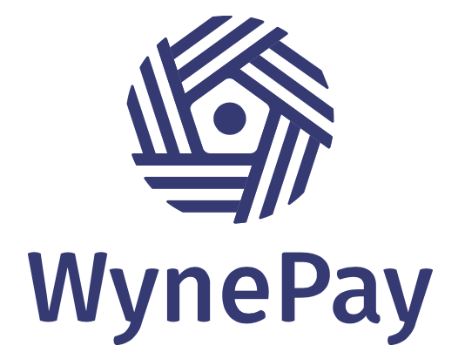
The Scheme: WynePay
Scheme Name
Purpose
Values
To expand the digital payment ecosystem in Myanmar by connecting the dots.
Inclusive
User-Centric
Honest
WynePay in Burmese means
“Let’s pay together”.

Slide 5
Path to Sustainability
Keep costs down
Keep revenue up
Maintain cash flow

Slide 6
Challenges: Costs
Biggest challenge: so many costs are unknown
Onboarding DFSPs
New Technology
Infrastructure
Integration
Version Control
Impact of environmental uncertainty: political instability, market fit & industry-readiness
Exposure to fluctuations in foreign exchange rate
Notes:
New Tech: cost to build & cost to maintain
Need to bring down infrastructure cost
Onboarding cost
Version control cost
Costs for DFSPs to integrate with the Hub and manage the operation

Slide 7
Challenges: Revenue
Biggest challenge: participation fee does not sell well
How do we pitch a not-for-loss model to stakeholders… when you don’t know what the costs will be?
Building products people care about….How do we prioritize use-cases?
Details of decisions - hard to discuss before it’s real but plenty of room for divergence
Participation fee might make sense in theory but difficult to sell to DFSPs
India UPI complaints and how to overcome them

Slide 8
Challenges: Cash Flow
Biggest challenge: revenue will not come until later.
Building a hub is a high risk investment - particularly for the last mile.
Mojaloop for a new scheme
Opportunity to use Mojaloop from the beginning to demonstrate value — but has to demonstrate real value to convince stakeholders
Mojaloop for an existing scheme
Opportunity to take advantage of traction and demonstrated value of an existing scheme but it comes with challenges and risks to deploy Mojaloop in a running operation
If someone funds your upfront costs, they may not be focused on the products that will drive revenue now.

Slide 9
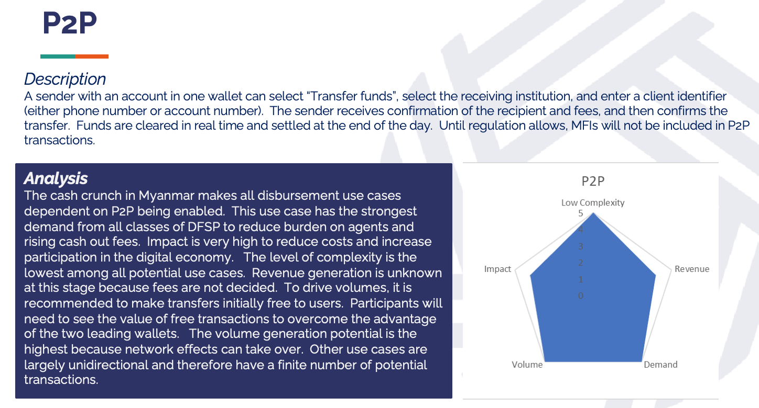
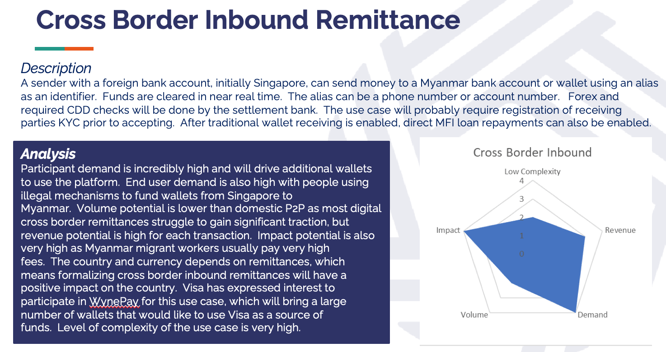
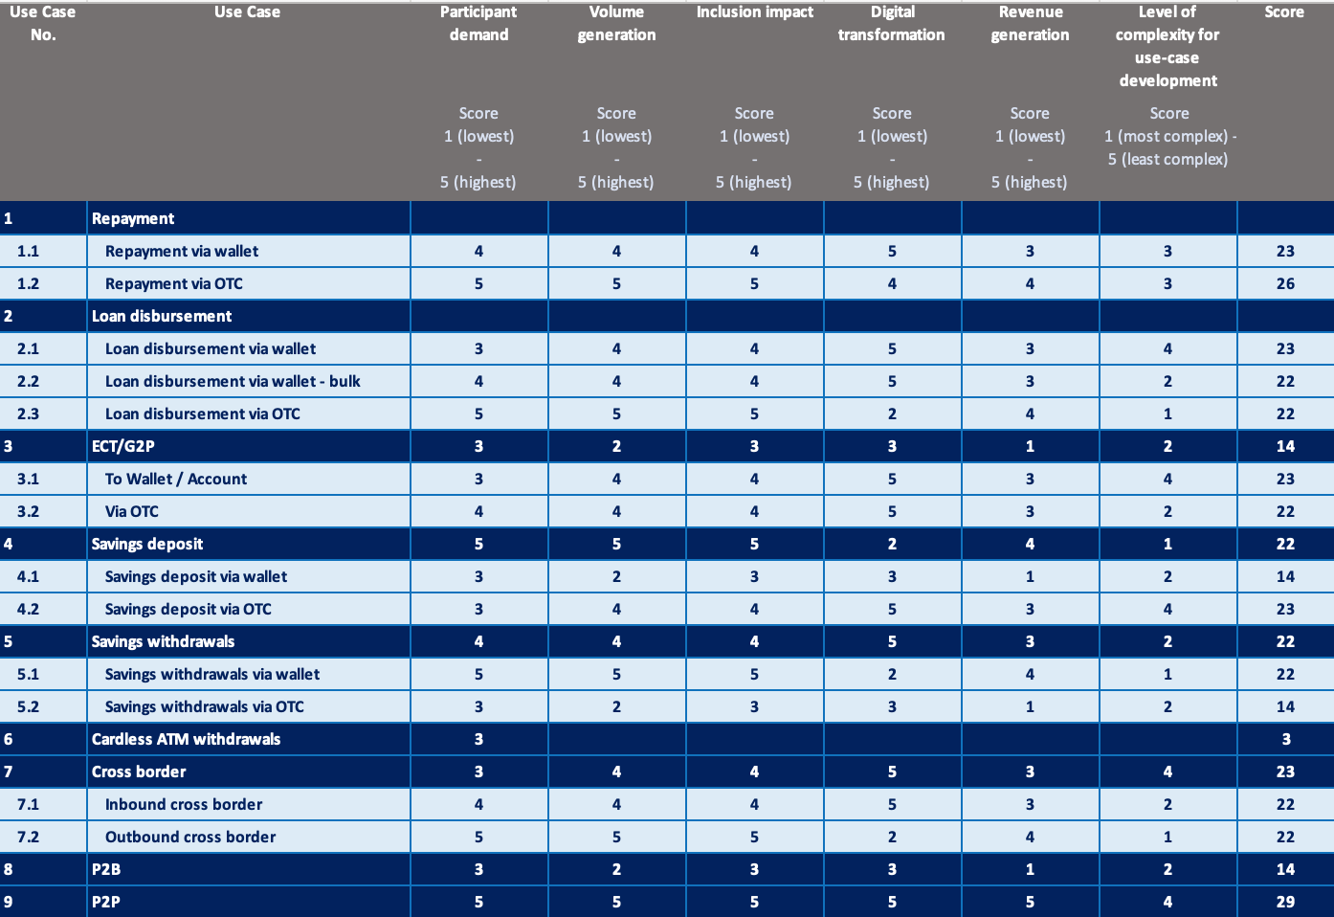
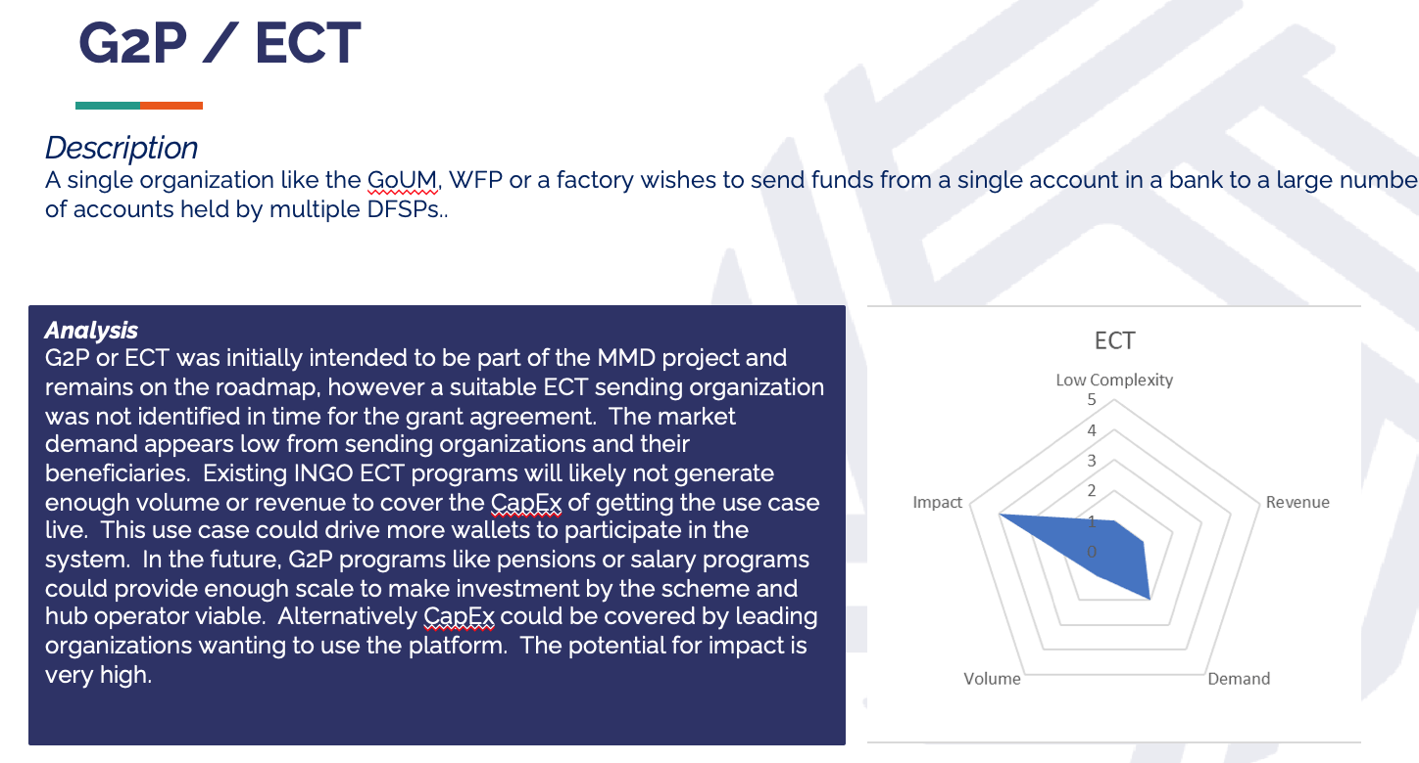
Setting priorities
Mechanism
WynePay must prioritize limited resources on use cases with specific criteria in mind. Lower priority use cases will be delayed until resources, internal or external, are available. Scheme Council will approve use cases to develop.
Tools
Use Case Prioritization Criteria
Participant demand
Volume generation
Inclusion impact
Revenue generation
Level of complexity

Slide 10
Chicken and egg conversations
VS.
Reality
Theory
On willingness to pay and on priority problems
Notes:
On willingness to pay
On priority problems

Slide 11
Changing personalities
At the Regulator
At the Scheme
At the DFSP
Notes:
On willingness to pay
On priority problems

Slide 12
Thank you!

