Slide 1
Merchant Scheme Extensions + QR Support
Lewis Daly, Justus Ortlepp, Paul Makin
PI18 - April 2022
Notes:
Lewis

Slide 2
Agenda
Progress Report
Demo
Notes:
Lewis

Slide 3
PI 16 Goal - Merchant Blocklisting Showcase
Confidence: ?
Goal | Mocked Merchant Registry + Blocklist Prototype
Key Epics |  | 1. Demonstration of the blocklist & document CRUD processes - change the state to facilitate interdiction A - Actio do up date blocklist state B - (Hub/Discovery/other) to recognise state and block a lookup; identify best place for this | 2. Build out backlog for full merchant registry/ALS/Oracle implementation
 |  | 3. Roadtest our thinking at hackathon event in Jan/Feb to get more contribution
Not Doing now but important next & Risk / Issues |  | 1. Any changes to APIs for merchant lifecycle management; but we’ll know the gaps by the end of this work in more detail 2. Maybe Static QR demo | Extra resource/skills that would be valuable: PROTOTYPERS wanting to support Lewis to imagine the demo in the real world Product/Biz analysts - to specify the demo storylines in detail Github folk - to help us create the gap backlog for PI-17 We could consider a Mojaloop Community Hack Week to get this done end to end like the ISO20022 week? A design challenge? Risks you might need to track: AVAILABILITY OF SME AND RESOURCES TO ACHIEVE THIS - ITS AMBITIOUS
Success Defined How? |  | Able to demonstrate merchant blocklisting in action | Do we have a backlog of tasks to do this properly?
Notes:
Lewis

Slide 4
PI 16 Goal - Merchant Blocklisting Showcase
Confidence: ?
Goal | Mocked Merchant Registry + Blocklist Prototype
Key Epics |  | 1. Demonstration of the blocklist & document CRUD processes - change the state to facilitate interdiction A - Actio do up date blocklist state B - (Hub/Discovery/other) to recognise state and block a lookup; identify best place for this | 2. Build out backlog for full merchant registry/ALS/Oracle implementation
 |  | 3. Roadtest our thinking at hackathon event in Jan/Feb to get more contribution
Not Doing now but important next & Risk / Issues |  | 1. Any changes to APIs for merchant lifecycle management; but we’ll know the gaps by the end of this work in more detail 2. Maybe Static QR demo | Extra resource/skills that would be valuable: PROTOTYPERS wanting to support Lewis to imagine the demo in the real world Product/Biz analysts - to specify the demo storylines in detail Github folk - to help us create the gap backlog for PI-17 We could consider a Mojaloop Community Hack Week to get this done end to end like the ISO20022 week? A design challenge? Risks you might need to track: AVAILABILITY OF SME AND RESOURCES TO ACHIEVE THIS - ITS AMBITIOUS
Success Defined How? |  | Able to demonstrate merchant blocklisting in action | Do we have a backlog of tasks to do this properly?
Didn’t Happen
In Progress
Didn’t Happen
Didn’t Happen
In Progress
Notes:
Lewis

Slide 5
Learnings from a National Deployment
Initially focussed on interoperable merchant payments in a complex customer environment
For now, customer-initiated; merchant-initiated (MRTP) and fintech/app initiated (PISP/3PPI) are further down the roadmap
Customer uses either static QR or USSD: Merchant receives payment “instantly”, releases the goods
Interoperable across all connected DFSPs (banks, MFIs, MMOs, SACCOs etc)
Notes:
Paul

Slide 6
What We’ve Been Doing
Merchant Payments
Developing customer-initiated merchant payments infrastructure as a modular extension around a Mojaloop Hub
Underlying Concepts
Using a merchant registry and merchant IDs to support fraud/ML detection
Independent of front-end tech; initially to support USSD and QR Codes (static and dynamic)

Slide 7
Principles
Merchant payments aren’t straightforward. We took the decision to start at the “simple end”, and build from there, using the following principles:
Build on Mojaloop P2B instant payments
Expose merchant payment details, but “anonymise” them using merchant IDs
Require merchant registration, so we can (1) support merchant IDs, and (2) identify and control fraudulent activity
Develop an approach that supports multiple customer payment initiation methods, as appropriate to each customer (QR Code obviously, but also app, USSD)

Slide 8
Dynamic QR Payments: Architectural Elements
Customer App
Merchant App
Customer DFSP
Merchant DFSP
QR Code Generator
QR Code Processor
Merchant Registry
Mojaloop Hub

Slide 9
Envisaged Merchant Payments Ecosystem
Customer Front End
Merchant Payments Extension Module
Fraud and Money Laundering Module
Merchant Registry Module
Mojaloop Hub

Slide 10
Considerations: Merchant Registry
Looked at the Mojaloop ALS/Oracle as a candidate for implementation
Looks good – but will need extension
Firm up on additional data requirements
Looks in three directions
Supports transaction routing
Validates individual transactions against AML, Fraud assessment
Works with an external fraud/ML/KYB engine to evaluate merchant status dynamically

Slide 11
Considerations: Customer Front End
Merchant Payment Extension Module can support multiple payment front ends
(1) Customer-initiated; (2) MRTP and 3PPI/PISP coming later
Currently validated against USSD and static QR; design in place for dynamic QR
Need to engage with major in-country retail payments ecosystem players
Push; not pull

Slide 12
Lessons for a Successful Merchant Payment Solution
Separate Rails from Services
Interoperability – business, as well as technical
Make it free
Make sure customers can use it

Slide 13
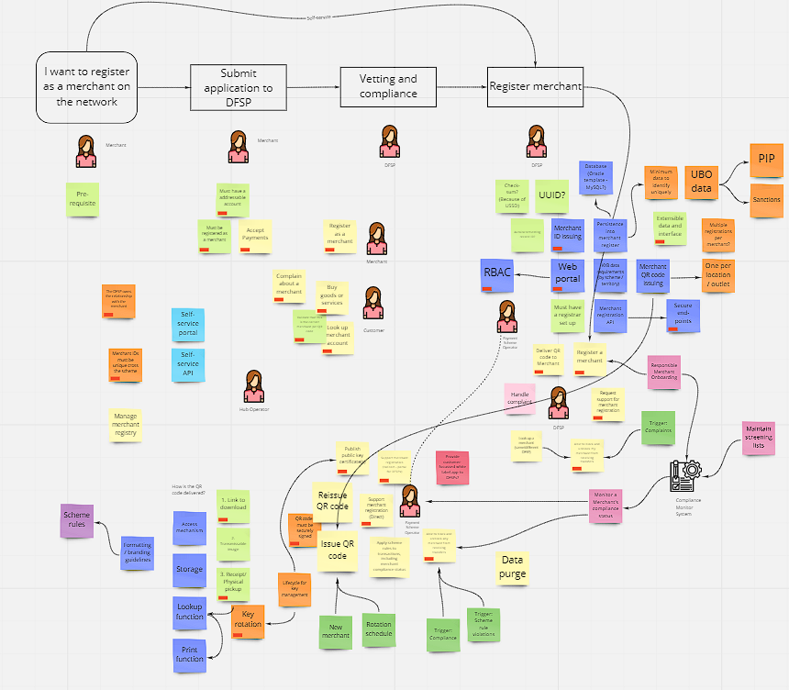
Merchant Backlog - Approach
Stakeholder definition
Merchants
Customers
DFSPs
Payment Scheme Operator
Use Case identification
Stakeholder objectives
Enabler specification
Infrastructure, services, processes
Notes:
Justus

Slide 14
Merchant Backlog - Use Cases
Register a merchant
Buy goods & services
Issue QR code
Scan merchant QR code
Complain about a merchant
Customer
Look up merchant DFSP
DFSP
Register as a merchant
Look up merchant information
Block merchant from receiving payments
Update merchant information
Request support
Accept payments
Unblock merchant from receiving payments
Provide administrative support
Merchant
Request QR code
Publish public key certificates
Scheme Operator
Request QR code reissue
Monitor merchant compliance status
Purge historical data
Notes:
Justus

Slide 15
Merchant Backlog - Features
API accessible micro-services
Online portal for user interaction
Role-based access control
Multiple mechanisms for QR code delivery
Extensible data and interface
Centralised merchant registration and ID issuing
Securely signed QR codes
Notes:
Justus

Slide 16
Demo
Goal: Simple Static QR Code demo payment flow:
Customer ➝ Scan QR Code ➝ Enter Price ➝ Pay Merchant ➝ Release Goods
Assumptions:
Pre generated static QR code that encodes a Merchant ID
No Merchant Registry: just reuse our existing oracle
Notes:
Lewis/Sam

Slide 17
Thank you!
Comments/Questions?

