Slide 1
ML IaC update
PI-18 Community event
Notes:
David Fry

Slide 2
Infrastructure Purposes
Infrastructure for Mojaloop has different use cases
Dev who wants to quickly kick the tires
TTK mocking the switch and other participants - can run standalone on docker
Potential switch operator whose development team needs to experiment with a full dev env
miniloop version
Sandbox for hackathon/etc
IaC from mojaloop
Vendor specific quick start
PoC for country wide switch
IaC from mojaloop
Vendor specific quick start
Production Grade switch
Consult vendors to provide production capabilities for fault-tolerance, security and throughput.
Notes:
⚙

Slide 3
IaC History
Sandbox Infrastructure for Mojaloop has evolved over the years
Initial Mojaloop Infrastructure efforts started on AWS
We leveraged this as starting point so base IaC has been implemented on AWS.
We have also made use of early adopters' choice of components but we have gradually been replacing these with best of breed open source components.
Notes:
⚙

Slide 4
IaC Principles
Core principles guiding the development of the Sandbox IaC effort
Open Source and standards based components ✅
Cloud Provider Agnostic (striving for this, not quite there)
Fit for purpose:
Sandbox ✅
Fake Money/Fake Rails ✅
Striving for pluggable architecture to achieve multi-cloud capability including bare-metal
Support lower resource requirements
Elimination of all manual steps (scripts/etc) to provision switch, rely on idempotent operations to reach desired infrastructure state. (pretty close to 95%)
Provide upgrade path for most components
These principles provide the following benefits:
All capabilities can be tested without reliance on licensed components
Anyone can use as a starting point for their infrastructure without licensing issues.
Notes:
⚙

Slide 5
IaC Current Components
Bootstrap provides tenancy components for base networking (VPC, subnets, DNS, CI, configuration management and VPN). This is highly cloud provider specific.
Environment IaC is layered terraform modules that first builds VMs (cloud provider specific) after which the rest of the architecture is built in a mostly cloud agnostic fashion.
These cloud agnostic components include:
Hashicorp Vault
Certificate Manager
External DNS
WSO2 ISKM (moving to keycloak)
WSO2 API Manager (moving to ambassador/ORY)
Nginx Ingress Controller
HAProxy (for forward proxying requests to DFSP callbacks)
Connection Manager
Bizops Framework (leveraging ORY)
Notes:
⚙

Slide 6
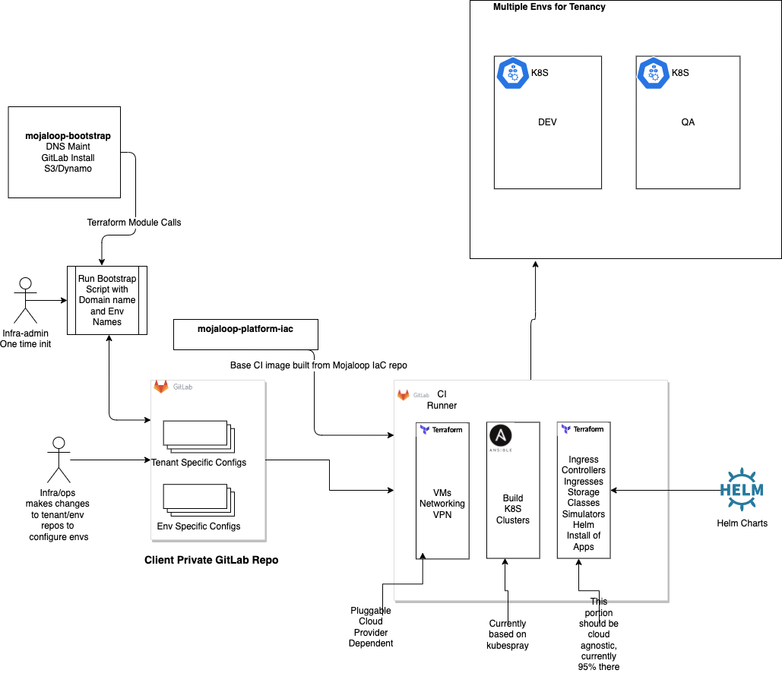
Supporting Multiple Cloud Providers
Notes:
⚙

Slide 7
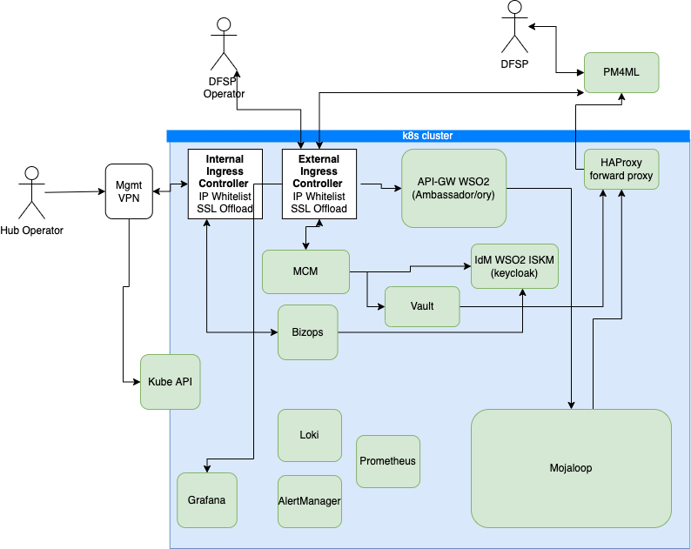
Mojaloop Operating Environment
Major Components
Notes:
⚙

Slide 8
IaC PI-17 status summary
Currently working on finalizing release of
Creation of Stateful Resources separate from the helm releases that make use of them in preparation for release v14.
Kafka
MySQL
MongoDB
Full removal of manual certificate and DNS provisioning, completed move to
External DNS
Cert Manager (using LetsEncrypt and Vault issuers)
Moved off of EFK to use Loki along with Grafana stack
Next Steps
Make cloud provider choice pluggable
Move from WSO2 ISKM to Keycloak
Move from WSO2 APIM to Ambassador
Convert ESP to make use of grafana stack
Move away from s3/dynamo for terraform and ci state to gitlab/minio
Notes:
⚙

