Slide 1
Mini-loop update (v4.x)
Tom Daly Crosslake Technology
(tomd@crosslaketech.com)
Mojaloop Conf Oct 2022 – Zanzibar
1

Slide 2
Agenda
What is it / what is it for => recap
Demonstration Try it !
Status & Next Steps
Summary
2

Slide 3
What is mini-loop and what is is for ?
3

Slide 4
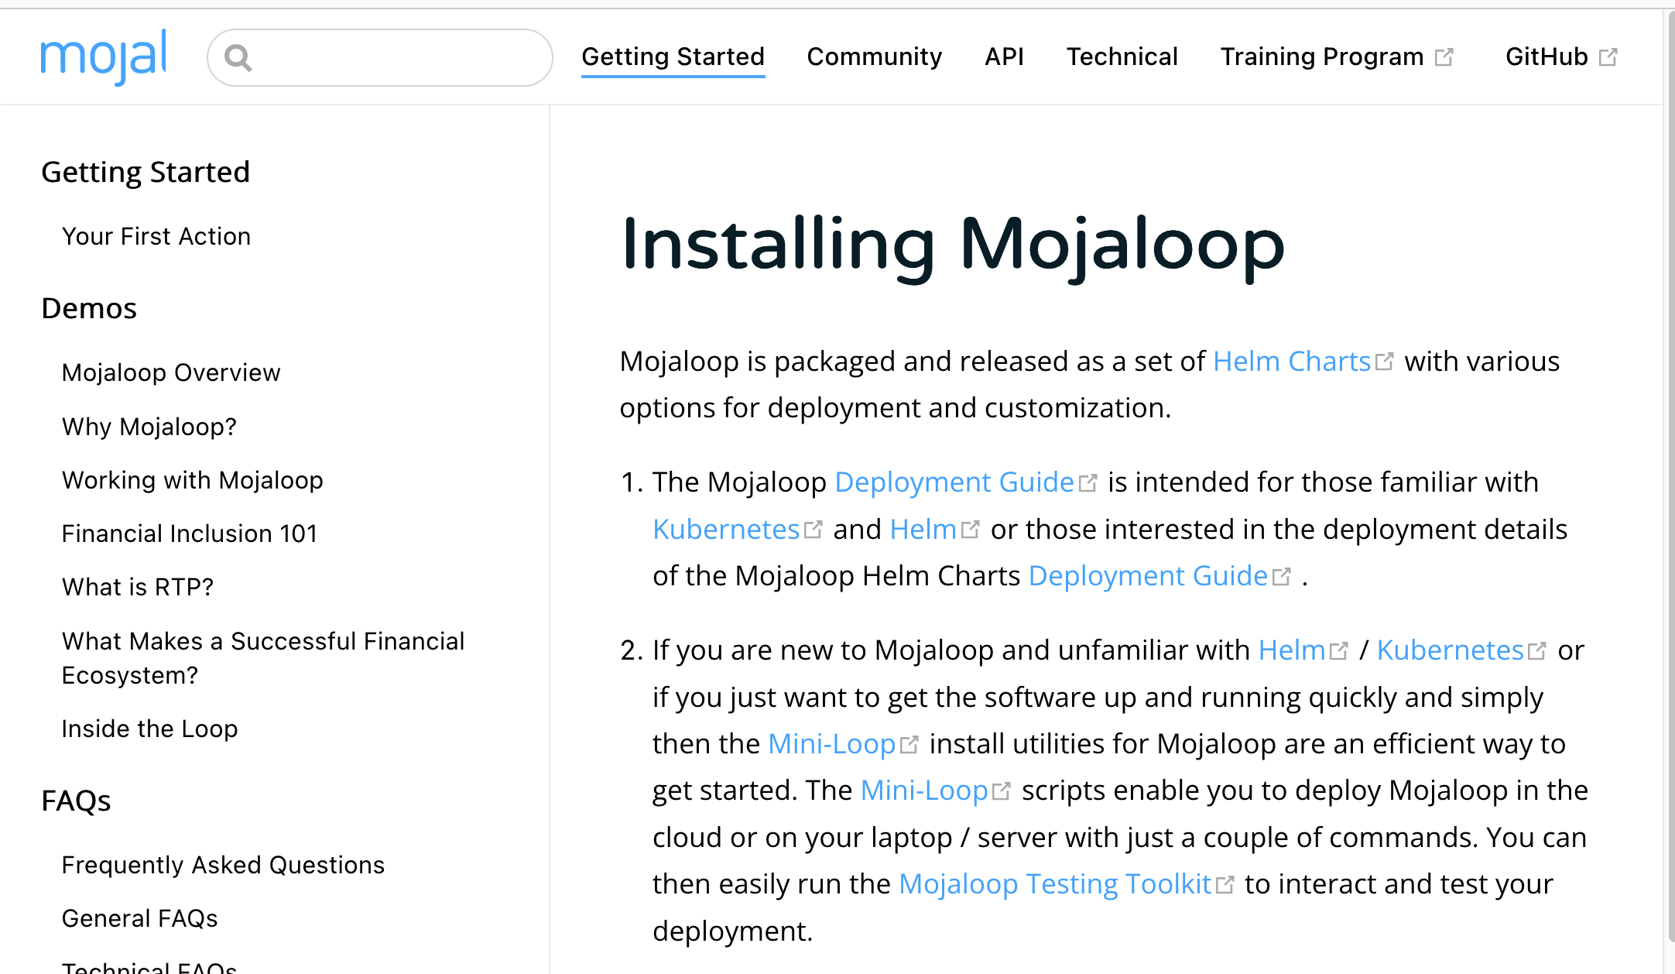
What is mini-loop and what is it for ?
Automation of the
Mojaloop “Deployment Guide”
https://docs.mojaloop.io/getting-started/installation/installing-mojaloop.html
Option #1 type install and configuration commands
Option #2 mini-loop scripted install
4

Slide 5
What is mini-loop and what is it for ?
OOTB (out of the box) Mojaloop installation
Complete Mojaloop hub (almost) including 3PPI
Repeatable and scriptable
Opinionated / Simplified config
Ubuntu OS , 6GB RAM and X86/AMD processor (pentium or better)
Tooling to help manage significant volume of configuration information
5

Slide 6
What is mini-loop and what is it for ?
Make it easier to access Mojaloop !
Demonstrations
Teaching / Learning and lab environments (spin up / down rapidly)
Testing
Q/A
Run entire TTK Golden Path tests
Performance experiments (vNext )
Increase familiarity with Mojaloop => increase our community
Quick (15-20 mins for entire hub and services)
Cheap !
Make Adoption Easier
Achieve Scale
Connect to other systems
Quality Product
6

Slide 7
What is mini-loop and what is it for ?
Mojaloop Kubernetes Release Testing
Kubernetes platform releases every 3 months
=> we need to help everyone move with kubernetes !
Each new Mojaloop release will be tested (by us)
On most current kubernetes release (DA #93 process decision)
Mojaloop release 14.1 tested on latest kubernetes release
Helping to keep up with Kubernetes and providers
mini-loop provides / quick convenient / isolated way for users to try latest Mojaloop to assist in determining their upgrade path.
7

Slide 8
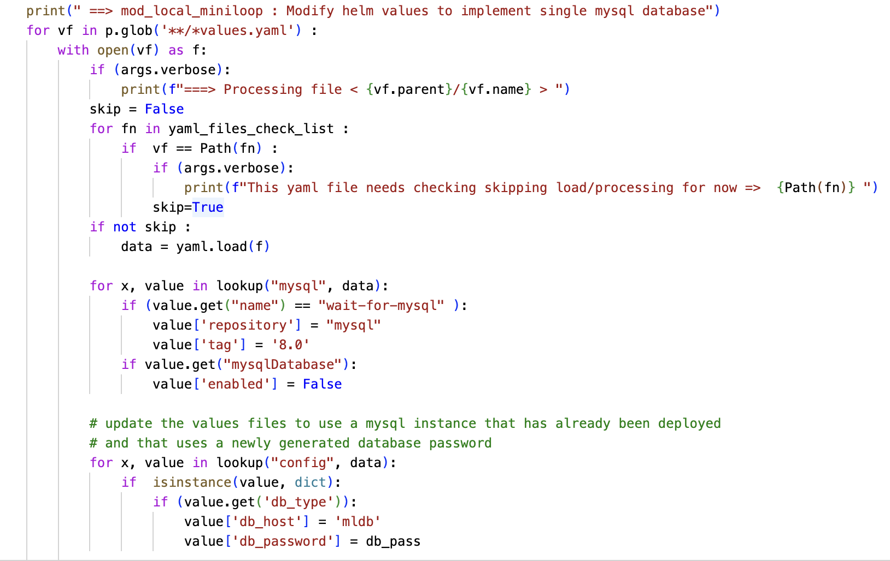
What is mini-loop and what is it for ?
Also some build tooling
e.g. mod_local_minloop.py
Process all the value.yaml files in all directories
Read and parse .yaml
Make config changes
=> Used this approach to move to latest kubernetes networking API in Mojaloop version 14.1 RC
8

Slide 9
What is mini-loop and what is it for
Benefit of tooling (mod_local_miniloop.py) is we can make consistent changes
cd helm ; cat **/*yaml | wc -l
We have more that *26,000 lines of values.yaml configuration in 55 distinct values.yaml files
=> need tooling to manage
*includes comments
9

Slide 10
What is NOT for
mini-loop does NOT enable “production ready” deployments of Mojaloop
10

Slide 11
Demonstration
Try it
How many folks in the room have actually RUN Mojaloop
How many folks think they “WOULD BENEFIT” from running Mojaloop
11

Slide 12
You can try it out
Laptop Requirements
Intel/AMD (pentium or better)
Min 6 - 8 GB free ram
Able to run VirtualBox 6.1
Cloud Instance
Intel/AMD instance
Min 8 Gb free ram(16Gb is better)
Ubuntu 16.x – 20.04
Internet access
12

Slide 13
Try it out !
https://github.com/tdaly61/mini-loop
Laptop
Install VirtualBox 6.1 (from USB)
Import Mojaloop appliance (from USB) and “start”
ssh -p 2222 vagrant@127.0.0.1 (passwd: vagrant)
kubectl get pods
Add the list of ML hosts to VM HOST local hosts file
Run the Mojaloop TTK Mobile Emulator by browsing to http://testing-toolkit.local
Transfer some funds
Cloud Instance (use mini-loop)
https://docs.mojaloop.io/getting-started/installation/installing-mojaloop.html
https://github.com/tdaly61/mini-loop
<your ip> ml-api-adapter.local central-ledger.local account-lookup-service.local account-lookup-service-admin.local quoting-service.local central-settlement-service.local transaction-request-service.local central-settlement.local bulk-api-adapter.local moja-simulator.local sim-payerfsp.local sim-payeefsp.local sim-testfsp1.local sim-testfsp2.local sim-testfsp3.local sim-testfsp4.local mojaloop-simulators.local finance-portal.local operator-settlement.local settlement-management.local testing-toolkit.local testing-toolkit-specapi.local
13

Slide 14
Using mini-loop installer
Login (e.g. as mluser)
git clone https://github.com/tdaly61/mini-loop.git
sudo ./mini-loop/install/mini-loop/scripts/k8s-install-current.sh -m install -u mluser -k microk8s -v 1.24
source $HOME/.bashrc
./mini-loop/install/mini-loop/scripts/miniloop-local-install.sh -m install_ml
[Need 8GB Ram, 40GB disk and a running Ubuntu 16,18 or 20 instance]
14

Slide 15
Status & Next Steps
15

Slide 16
Status
Mini-loop v4.x
Deploys Mojaloop v14 to kubernetes v1.24
1
Download install and configure kubernetes (microk8s,k3s)
1
2
Download Mojaloop helm repo
Modify local helm charts
Values.yaml, requirements.yaml, template files
3
Approx 20-30 minutes on a well configured well connected laptop or cloud instance
deploy MySQL
Dynamically generate new database password
deploy MySQL
Dynamically generate new database password
4
deploy local configured and modified Mojaloop
5
16

Slide 17
Next steps
Mini-loop firstly
When Mojaloop v14.1 and 15 release “many” of the modifications will be removed
=> not needed
Modify local helm charts
Values.yaml, requirements.yaml, template files
3
When Mojaloop v14.1 and 15 release will automate deployment of the DB,Kafka,Mongo etc
17

Slide 18
Next steps
Mini-loop then ...
Use mini-loop to help finalise dev of Mojaloop v14.1 and v15.0
Automate deployment of kafka,mongo , redis similar to mysql
Finalise addition of thirdparty chart deployment (just needs doc)
Automate deployment of Mojaloop v14 & v15 to kubernetes v1.25, then 1.26
Start mini-loop support for Mojaloop vNext deployment
Investigate / start using mini-loop for enhancing CI/CD testing
e.g. incorporating vNext
e.g. Incorporating performance sizing – including pods to nodes association
There is surprisingly not a massive amount of mini-loop work to do here !
18

Slide 19
Next steps
mini-loop
(connect to other systems)
Enable some demonstrations
For instance could mini-loop incorporate say “Mifos” and create concrete demo's ?
Download install and configure kubernetes (microk8s,k3s)
Download Mojaloop helm repo
Modify local helm charts
Values.yaml, requirements.yaml, template files
deploy MySQL
Dynamically generate new database password
deploy MySQL
Dynamically generate new database password
deploy local configured and modified Mojaloop
Seems like this should not be too hard or expensive.
Mifos folks already updating integration that they did 2 years ago
Mifos Deployment and integration with data input
Other(s) …
19

Slide 20
Next steps
mini-loop
(assist transition to vNext )
mini-loop tools
Current Hub Code
vNext
20

Slide 21
Next steps
Mini-loop
Something for free
I did have this “pet project” => port mojaloop, deploy to ARM
Why : Enable developers/testers (M1 MAC) productivity
Cost : e.g. AWS graviton instances, various (always) free cloud offerings
Raspberry PI (offline/remote/low cost clusters – test / dev )
…. However :
vNext obviates the “porting” as we get as part of vNext activities outlined in previous slide
21

Slide 22
Summary
Mini-loop is an installer for Mojaloop
Simple tool and toolkit
Make it easier and possible to access / learn / test / experiment with Mojaloop in various ways
Is facilitating Mojaloop development
Really want to help grow Mojaloop community
largest hope for right now
contribute to making abstract conversations ==> concrete !
Make Adoption Easier
Achieve Scale
Connect to other systems
Quality Product
22

