Slide 1
Mojaloop Application Security Summary
Core Quality\Security Core Team – Kim, Pedro, Lewis, Godfrey, Miguel, Sam & Victor
Community Contributors – Karim, Azeem & Aime

Slide 2
Application Security Initiative Overview
In order to address application security issues Mojaloop, we have a dedicated security stream consisting of the members the core team and community contributors with the key focus of building security into the development cycle of the Mojaloop platform as much as possible following the below principles.
Underpinning Principles:
Deep integration into DevOps and CI\CD processes ( All security must be automated gates to keep the DevOps workflow from slowing down)
Developer centric and inclusive ( Empower and delegate with trust security integration activities to the devops teams )
Open source first approach to tooling (Commercial tools to be considered only if open source tools does not fulfil the requirements)
Adapt Application Security to Cloud Native Technologies (Containers and Microservices)

Slide 3
Our Prescriptive Security Approach
Prescriptive in the sense that we require the use of certain security practices and techniques (delivered as guidelines).
For some areas we will have reference technology implementations in place, like npm dependency, docker image vulnerability and license scanning, for other areas we require certain policies or standards to be adhered to and verifiable.

Slide 4
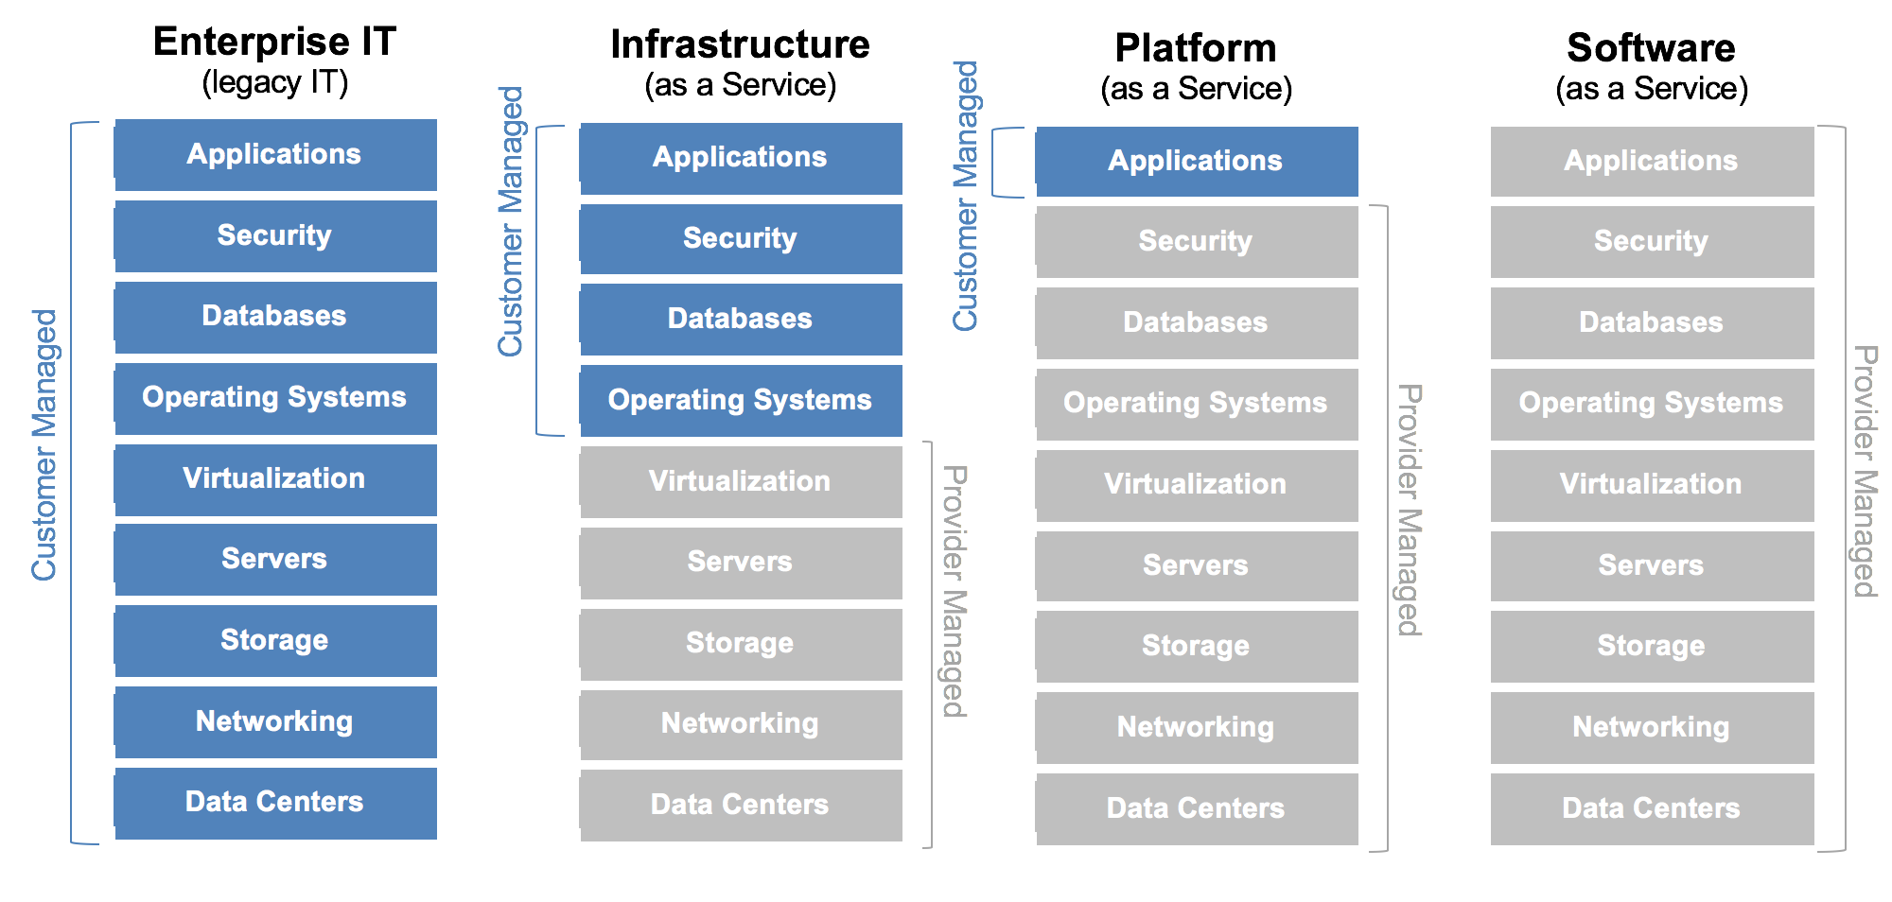
Mojaloop DevSecOps Approach Focus is on the application layer not underlying infrastructure layer
On Premise
Cloud
Container
SaaS
Implementor Managed
Implementor Managed
Implementor Managed
Trust gap
Trust gap
Trust gap
4
Output:
Provision of a security guidelines based on the Platform as a Service Model – Implementers to adapt to their own environment and policies
Alignment to CIS benchmarks and CSA cloud security essentials for IaaS and PaaS

Slide 5
Application Security Domains
Our application security programme covers the four domains briefly descripted below.
Open Source Vulnerability Management – To enforce consistent use of non-vulnerable and non-obsolete open source components and dependencies.
Open Source License Compliance – To ensure compliance with Mojaloop open source license policy
Static Code Analysis – To ensure custom code is free of well known high and medium vulnerabilities before any code merging.
Container Security – To ensure secure image configuration and also find\fix in container based vulnerabilities and kerbunates applications
There are more solutions under investigation in this PI and will be added to these or new domains once they fully implemented, tested and signed.

Slide 6
Open-Source Vulnerability Management
Objectives | Perform vulnerability assessment on open source components (composition analysis) before every commit, pull request and release as per our CI\CD pipeline workflow and security gates
Tools | NPM - https://docs.npmjs.com/cli/audit Archery ( Under Evaluation) Snyk (Under Evaluation)
Policies and Standards | Default tool policies has been applied and busy investing best practices polices as a basis to adopt a Mojaloop specific policy No standard has been adopted yet for this domain – Still under investigation
Recommendation to Implementors | Custom-tuned policies to your use case using the outcome of your threat and risk assessment.

Slide 7
Static Code Analysis
Objectives | Perform code level vulnerability assessment and code quality analysis with every commit, pull request and release as per our CI\CD pipeline workflow and security gates.
Tools | NodeJsScan - https://github.com/ajinabraham/NodeJsScan SonarQube - https://github.com/SonarSource/sonarqube Owasp Dependency Check - https://owasp.org/www-project-dependency-check/
Policies and Standards | Default tool policies has been applied and busy investing best practices polices as a basis to adopt a Mojaloop specific policy No standard has been adopted yet for this domain – Still under investigation
Recommendation to Implementors | We advise implementors to custom-tuned their policies to your use case using the outcome of your threat and risk assessment.

Slide 8
Container Security
Objectives | Ensure only secure container configuration is used in Mojaloop and find and fix container based vulnerabilities before any release.
Tools | Dockerfile Security Anchore AppArmor
Policies and Standards | Default tool policies has been applied and busy investing best practices polices as a basis to adopt a Mojaloop specific policy CIS Cloud Security Benchmark (141 Checks)
Recommendation to Implementors | We advise implementors to custom-tuned their policies to your use case using the outcome of your threat and risk assessment.

Slide 9
Open Source License Compliance
Objectives | Ensure compliance with the Mojaloop open security license policy before every commit, pull request and release as per our CI\CD pipeline workflow and security gates
Tools | NPM License check Snyk ( under investigation)
Policies and Standards | Apache 2.0 and the ones compatible to it are allowed / conforms to the Apache 2.0, whereas GPL / GNU aren’t?
Recommendation to Implementors | Custom-tuned policies to your use case using the outcome of your threat and risk assessment.

Slide 10
Thank You For Queries feel free to contact sam@modusbox.com lewisd@crosslaketech.com victor.akidiva@modusbox.com godfreyk@crosslaketech.com
More coffee stains
Oh no! A spill!

