Slide 1
Shoes On Containers
Presented by
Alain El Khoury
Melody Abi Khalil
Saint Joseph University, Faculty of Engineering

Slide 2
Outline
Introduction
Microservices
Docker
RabbitMQ
Project implementation
Run project
Results
References

Slide 3
Context of the Project
Introduction

Slide 4
Introduction
Shoe E-Commerce website
3 microservices:
Catalog microservice
Ordering microservice
Basket microservice
API Gateway

Slide 5
Microservices

Slide 6
Microservices
Building single-function modules
Independently developed, tested, deployed, monitored, scaled

Slide 7
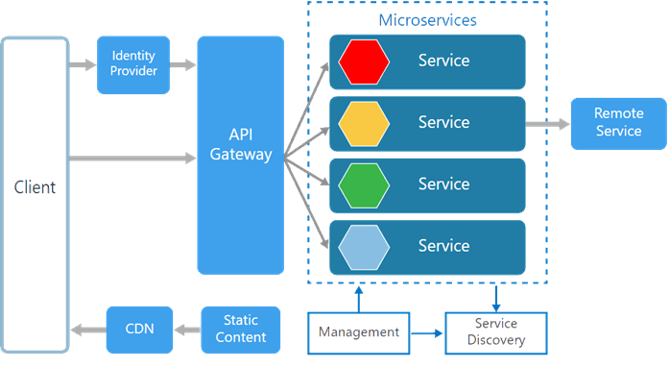
Microservices

Slide 8
.NET Core
Free and open-source, managed computer software framework
Supports C#, F# and VB

Slide 9
C#
General-purpose, multi-paradigm programming language
Developed as part of .NET initiative

Slide 10
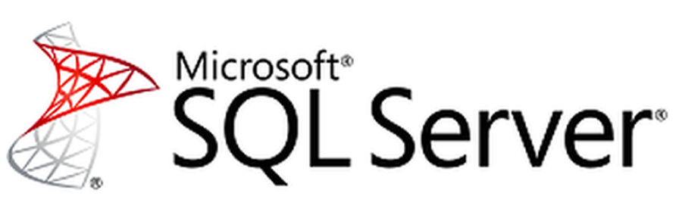
MS SQL Server
Relational Database Management System by Microsoft
GUI and command based software

Slide 11
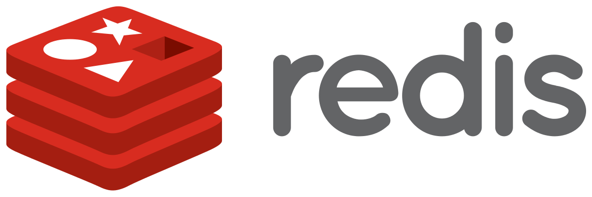
Redis
Open source, in-memory data structure store
Used as database, cache and message broker

Slide 12
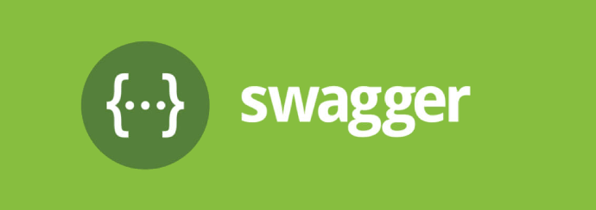
Swagger
Allows to visualize and interact with the API’s resources
Automatically generated from the OpenAPI Specification
Human Friendly
Dependency Free
All browser support

Slide 13
Docker

Slide 14
Docker
Open-source project for automating the deployment of applications

Slide 15
Containerization
Software approach in which the application, its dependencies and configuration are packaged as a container image
Containers = isolate applications
Isolation, portability, agility and scalability

Slide 16
Fundamental Docker concepts

Slide 17
HumanTech website
RabbitMQ

Slide 18
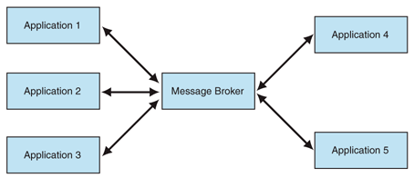
Message Broker
Program that translates a sender format message to a receiver format message

Slide 19
RabbitMQ
Open-source message-broker software
Way to exchange data between different platform applications
Supports multiple OS and Programming Languages

Slide 20
Project Implementation

Slide 21
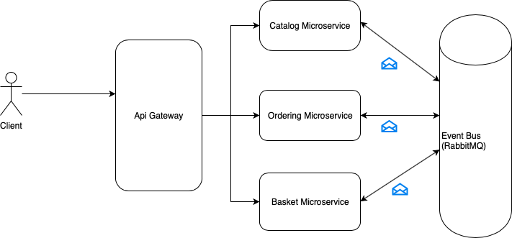
Overview

Slide 22
Basket Microservice
Singleton service
Adding cross-origin resource sharing service
Model creation
Redis configuration
Creation of APIs

Slide 23
Catalog & Ordering Microservices
Creation of entities
Creation of context class
Registration of context
Database migrations
Adding cross-origin resource sharing service
Creation of APIs
Messaging

Slide 24
Dockerization of microservices
7 docker images inside Docker compose file:
Catalog
Basket
Mssqlserver
Redis
Ordering
Gateway
Rabbitmq

Slide 25
Dockerization steps
Specify image name
Define configuration options that are applied at build time
Define environment variables
Specify container name
Specify external and internal port of Docker container
Specify network
Specify which container should be available before running service

Slide 26
API Gateway

Slide 27
API Gateway
Why?
Simplify usage of microservices
How?
Ocelot: open-source .NET Core API Gateway
Add ocelot.json to give Ocelot direction for microservice redirects
Add Ocelot plumbing

Slide 28
API Gateway
Configure ocelot.json file
Configure host: localhost:5000
Define redirects

Slide 29
Swagger

Slide 30
Swagger
Add Swashbuckle.AspNetCore package
Add SwaggerUI in Startup.cs
Access swagger using: localhost:5100/swagger

Slide 31
Run the Project

Slide 32
Run the Project
Run each of the following command on different terminal
1. Build docker images
```docker-compose build```
2. Start MSSQL server
```docker-compose up mssqlserver```
3. Start Redis
```docker-compose up basket.data```
4. Start rabbitmq
```docker-compose up rabbitmq```
5. Start the catalog microservice
```docker-compose up catalog```
6. Start the ordering microservice
```docker-compose up ordering```
7. Start the basket microservice
```docker-compose up basket```
8. Start the api gateway
```docker-compose up gateway```

Slide 33
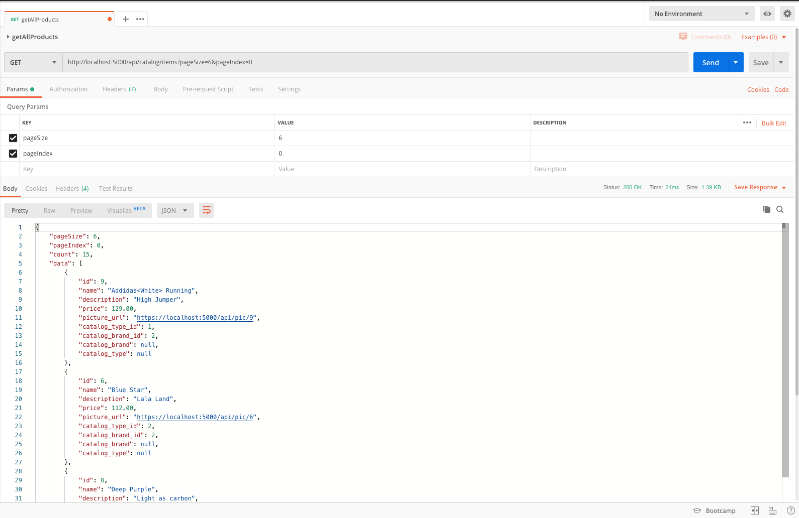
Get Products
To get the first 6 products, you need to send a GET request to the Catalog Microservice through the API Gateway

Slide 34
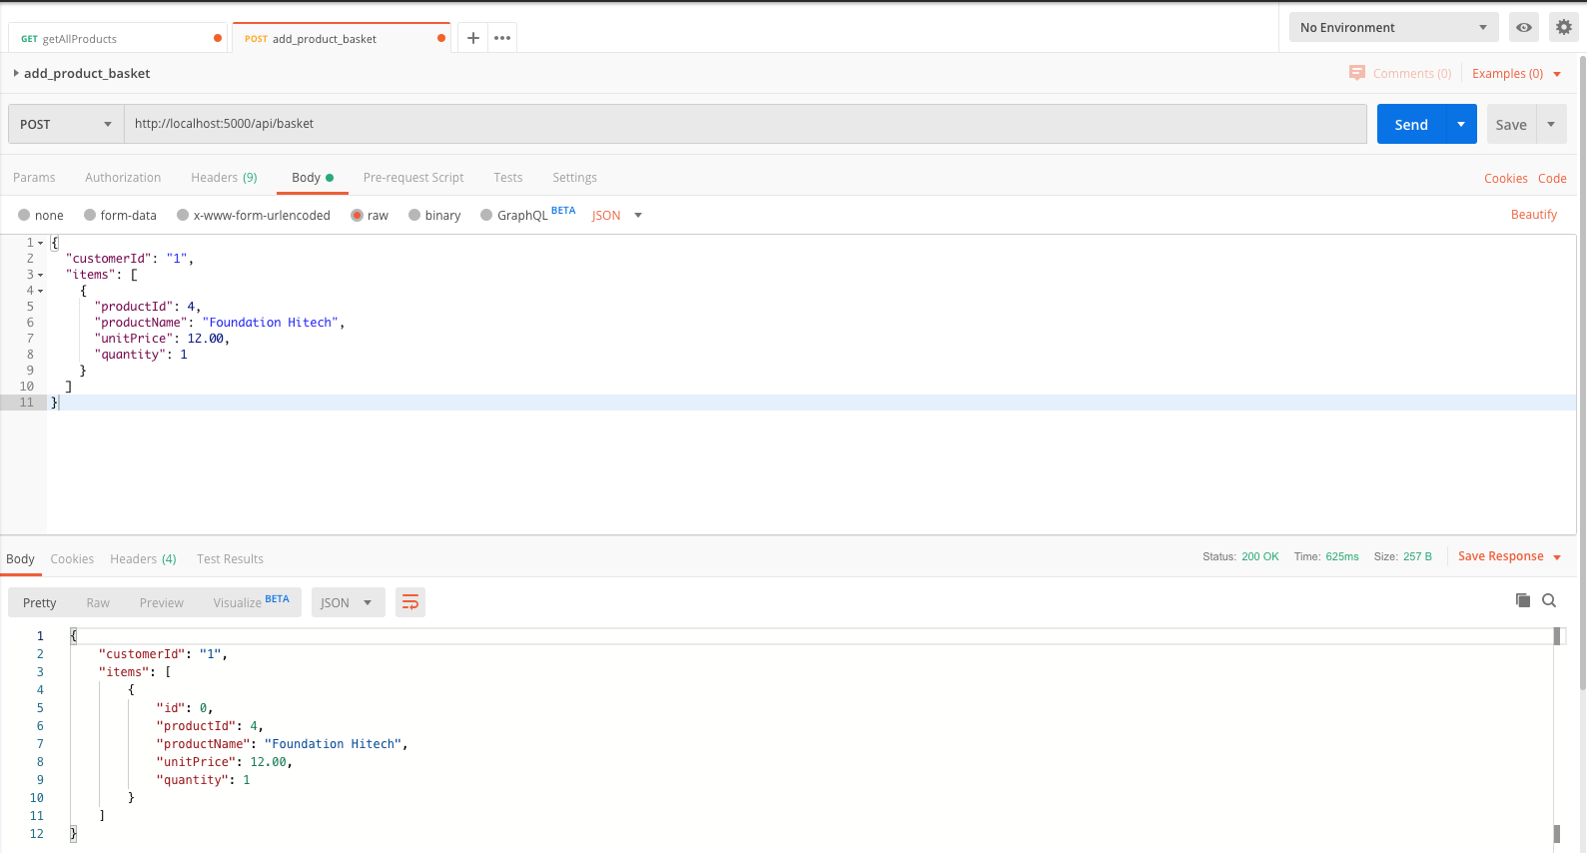
Add a Product to Basket
To add a product to the basket , you need to send a POST request to the Basket Microservice through the API Gateway

Slide 35
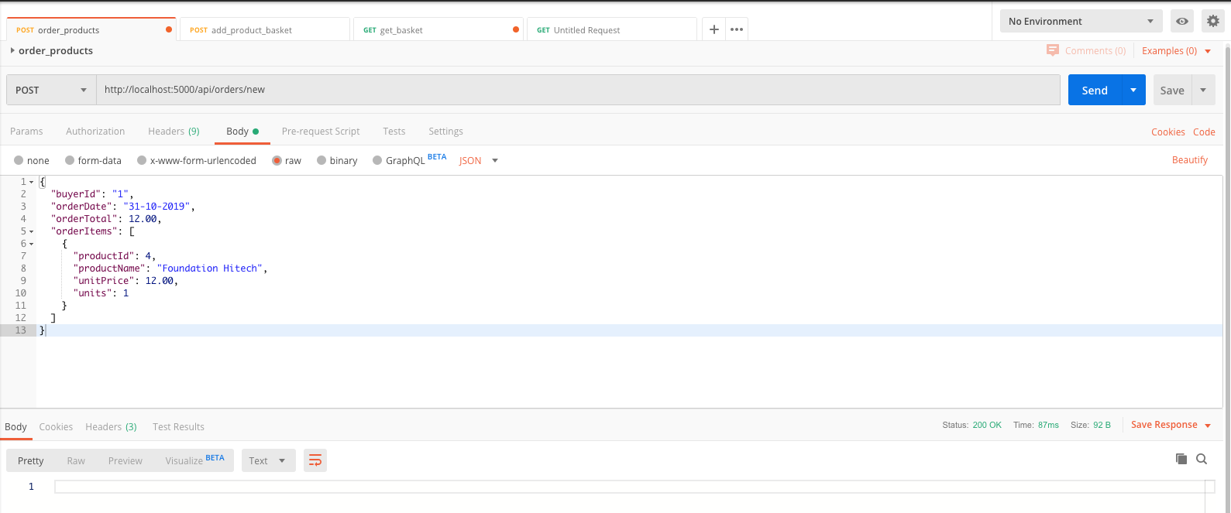
Order Products
To order a product, you need to send a POST request to the Ordering Microservice through the API Gateway

Slide 36
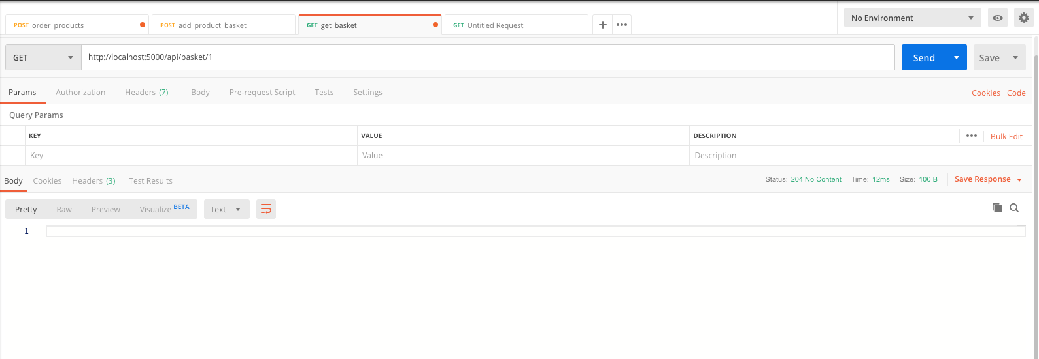
Clearing the Basket
The ordering microservice will publish a message that the customer with customerId = 1 ordered his products, then the basket microservice will catch this message and it will remove all items from his basket.

Slide 37
References
1. “Why Use Microservices?”, DZone. [Online]. Available: dzone.com. Accessed: 23/9/2019
2. “What is Microservices?”, Smart bear. [Online]. Available: smartbear.com. Accessed: 15/7/19
3. “.NET Microservices: Architecture for Containerized .NET Applications”, Microsof. [Online]. Available: docs.microsoft.com. Accessed: 23/9/19
4. “What is Docker?”, Open Source. [Online]. Available: opensource.com. Accessed: 24/9/2019
5. “C#”, Tutorials Point. [Online]. Available: tutorialspoint.com. Accessed: 24/9/2019
6. “MS SQL Server – Overview”, Tutorials Point. [Online]. Available: tutorialspoint.com. Accessed: 24/9/2019
7. “Introduction to Redis”, Redis. [Online]. Available: redis.io. Accessed: 5/10/2019
8. “An introduction to Message Brokers”, Medium. [Online]. Available: medium.com. Accessed: 5/10/2019
9. “Introduction to RabbitMQ”, Tutlane. [Online]. Available: tutlane.com. Accessed: 5/10/2019
10. “Swagger UI”, Swagger. [Online]. Available: swagger.io. Accessed: 13/10/2019
11. “ASP.NET Core 2.0 E-Commerce website based on microservices”, Udemy. [Online]. Available: udemy.com. Accessed: 25/9/2019

