Slide 1


EarthArXiv.org
A preprint server for Earth and Planetary sciences
Giacomo Falchetta
EarthArXiv advisory board member
___
International Institute for Applied Systems Analysis, Austria
Ca’ Foscari University of Venice, Italy
EGU 2022
Preprints Townhall

Slide 2
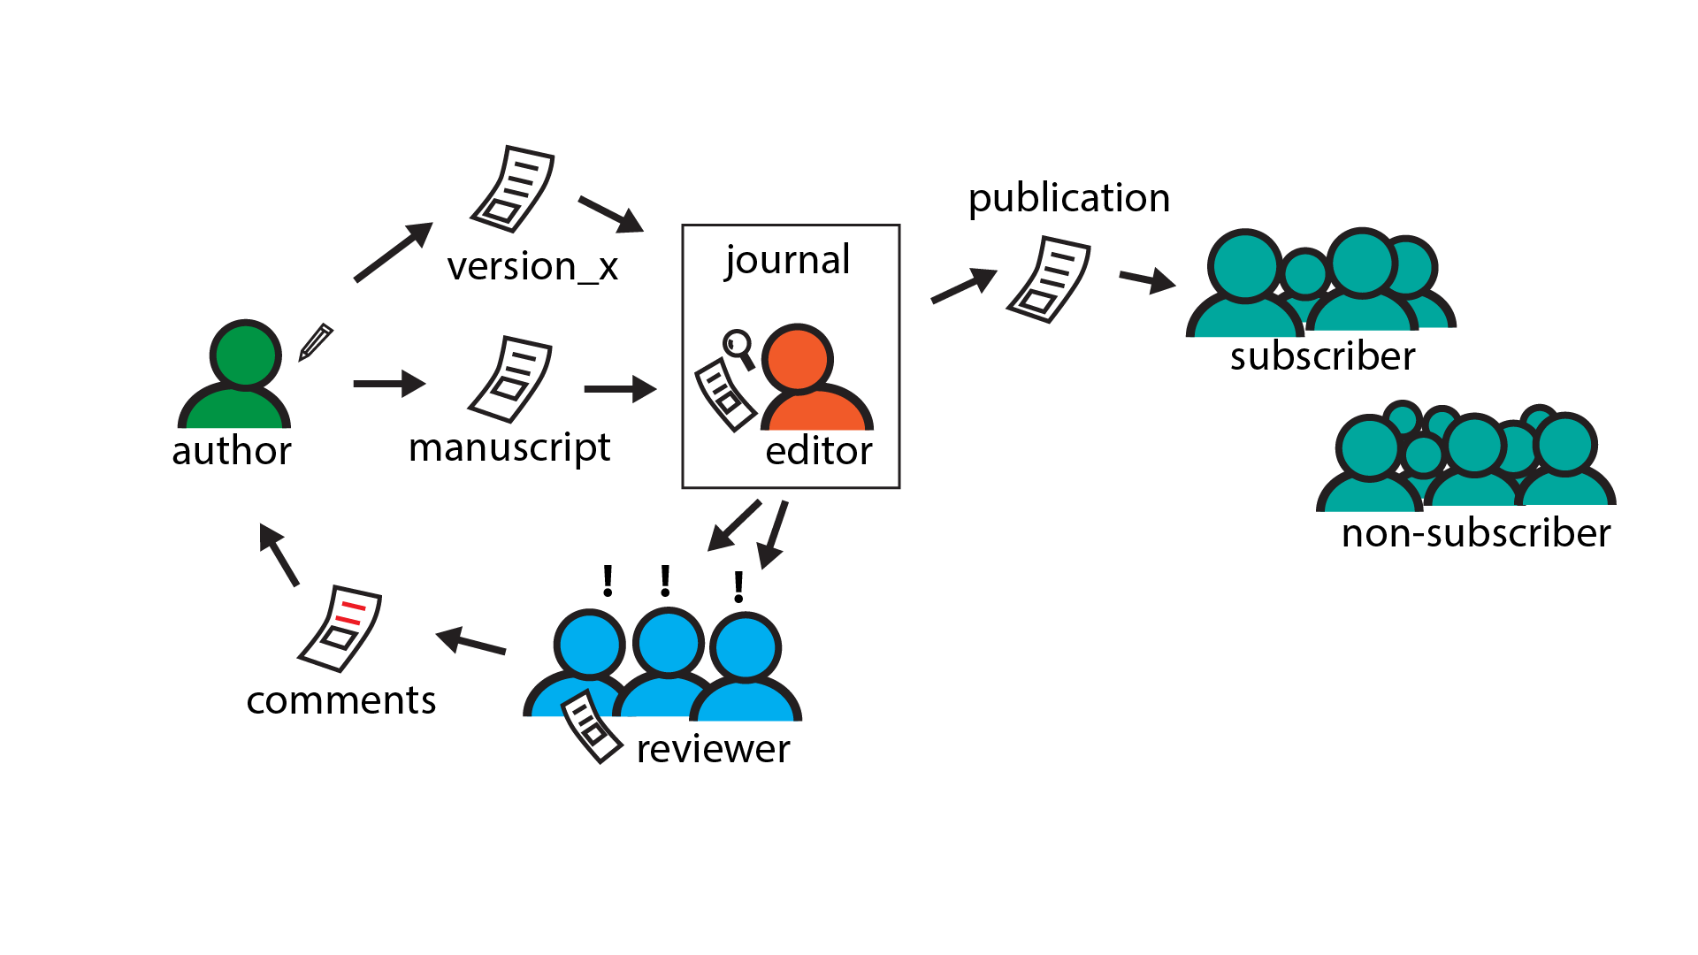
publication pathway(s)

Slide 3
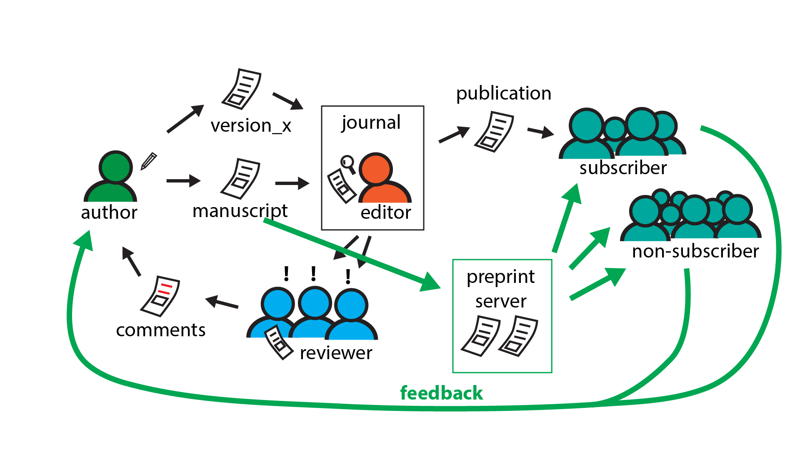
publication pathway(s) with preprints

Slide 4

2017
EarthArXiv founded
2020
Moved to the California Digital Library (CDL)
EarthArXiv.org
A preprint server for Earth and Planetary sciences
A preprint is a version of a scholarly paper that precedes publication in a peer-reviewed journal, typically prior to the formal, journal-led peer review process
Preprints are:
free to submit;
fast to publish;
open access; and
established in many natural sciences
Preprints are:
free to submit
fast to publish
open access
established in many natural sciences
A platform built to host pre/postprints for the Earth and Space Sciences
CDL manages the technical infrastructure
A global community of volunteers handles moderation and governance
We do no peer-review. We moderate for scope/metadata

Slide 5
What does EarthArXiv accept?
Research articles
Review papers
Case studies
Technical notes (e.g. new instrumentation)
Confirmatory studies
So-called ‘null’ results (i.e. results that not
supporting a hypothesis)
Dataset description papers
What does EarthArXiv not accept?
Papers reading as a personal attack, airing of
grievances, or insulting to a group/class of
people. Racist and derogatory language will not
be tolerated
Commentaries and opinion pieces
Posters (cf. ESSOAr)
Theses and course projects (see www.thesiscommons.org)
Software articles
EarthArXiv encourages the publishing of data and software alongside your paper

Slide 6
EarthArXiv.org
moderation policy
Publication and hosting of your paper
Upon moderation, EarthArXiv agrees to publish your paper by assigning a DOI
EarthArXiv is not a journal and does not evaluate the scientific quality of a paper. Once a paper passes moderation and is published, it persists on the system indefinitely.
EarthArXiv will provide free online hosting of your paper as long as it is operational
Fraud and Plagiarism
EarthArXiv takes fraud and plagiarism very seriously.
Should the Board deem fraud or plagiarism to have occurred, the paper will be immediately removed from EarthArXiv

Slide 7

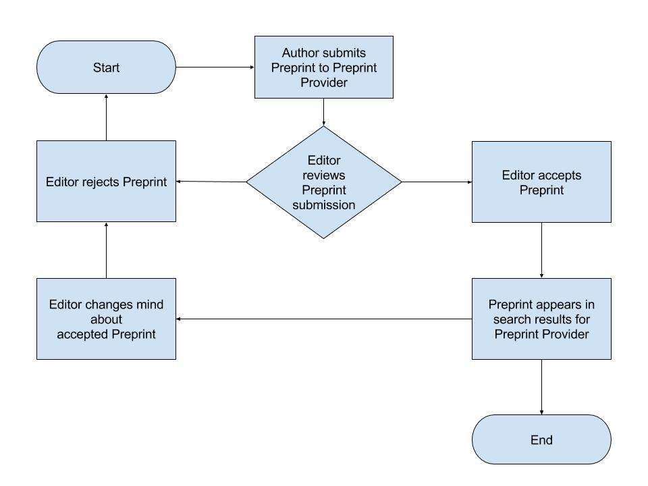
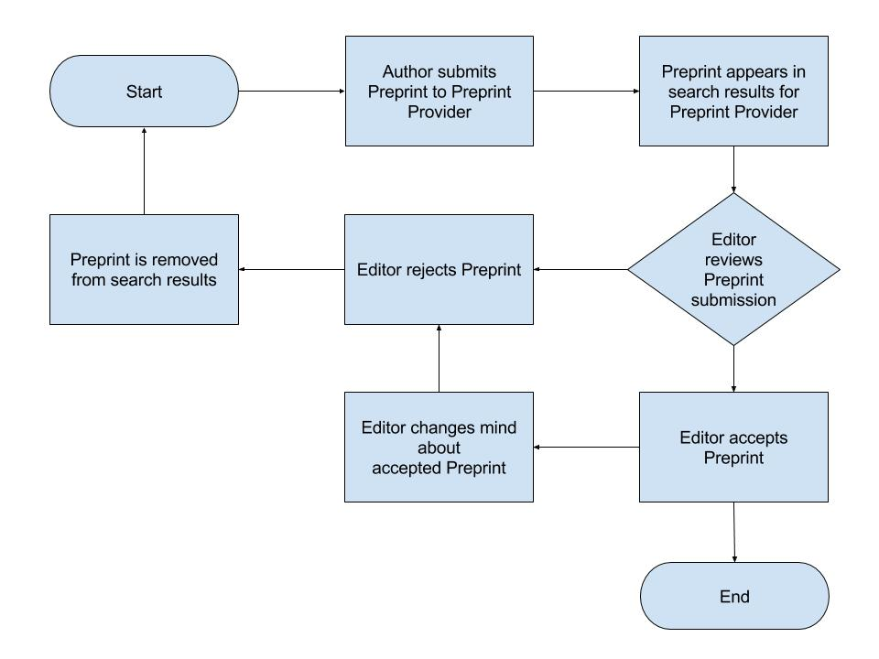
EarthArXiv.org
moderation policy – 2 potential approaches
Pre-Moderation
Post-Moderation
Preprints are not evaluated on scientific content. Preprints are only rejected for being out of scope or missing required metadata

Slide 8
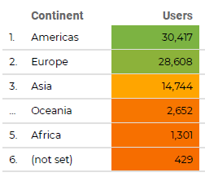
2018
391
2020
684
2019
608
Submissions per Year
Usage Over the Past Year

Slide 9
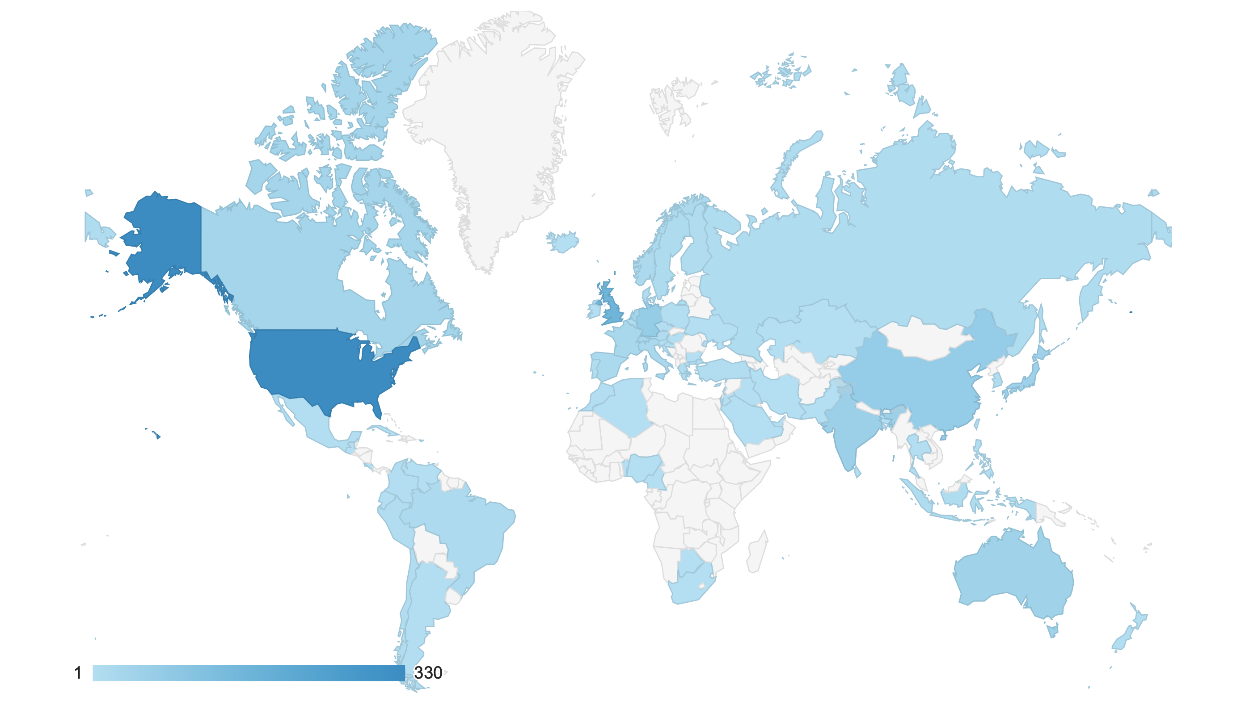
EarthArXiv is global!
Unique number of registered users

Slide 10
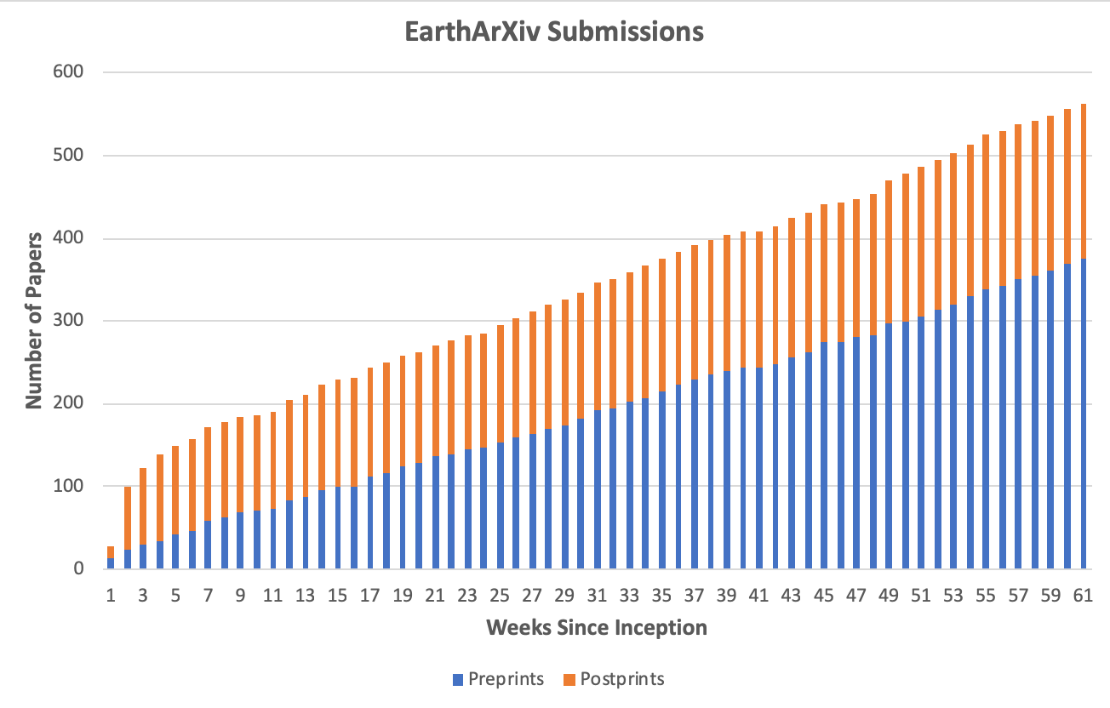
Submission statistics

Slide 11


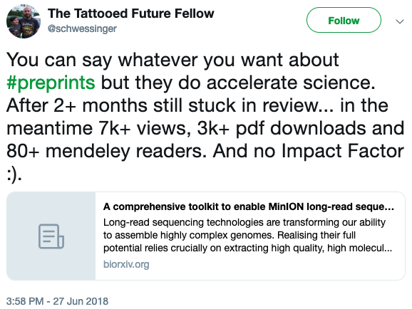
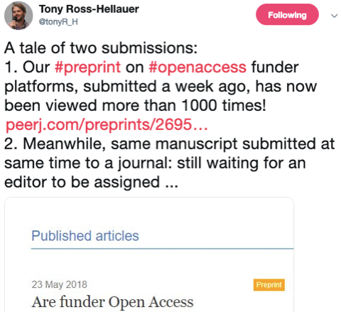
@eartharxiv
Join us, follow us!
Make your work VISIBLE!

Slide 12
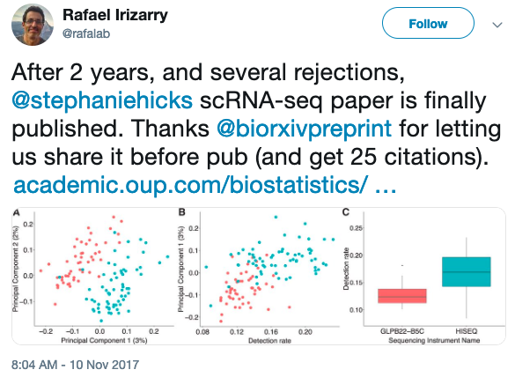
@eartharxiv
Join us, follow us!
Make your work VISIBLE!
Preprints have a
DOI & are citable

Slide 13



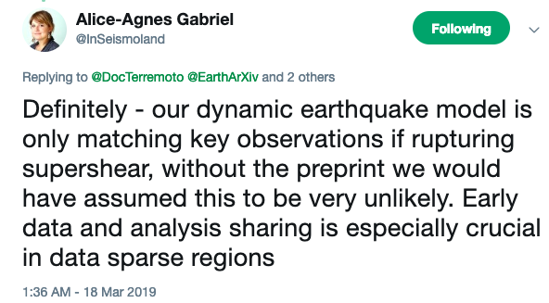
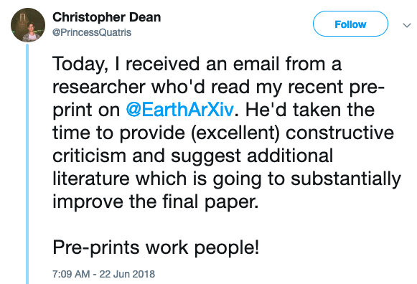
@eartharxiv
Join us, follow us!
Make your work BETTER!
Preprints lead to feedback
& improve your work

Slide 14
EarthArXiv and EGU
Questions to the audience and debate
In your opinion, what is the biggest obstacle (if you see any) to preprinting earth science research?
Where should preprints expand their parameters to support specific earth science resources?
Which communities within Earth science are still not using preprints?
NOTE: we DO accept software articles that conform to certain standards <https://eartharxiv.github.io/moderation.html>

Slide 15
Resources
Get in touch!
@eartharxiv
@eartharxiv
www.eartharxiv.org

