Slide 1
E-Commerce Website
Emmanuel Rukundo, MIS

Slide 2
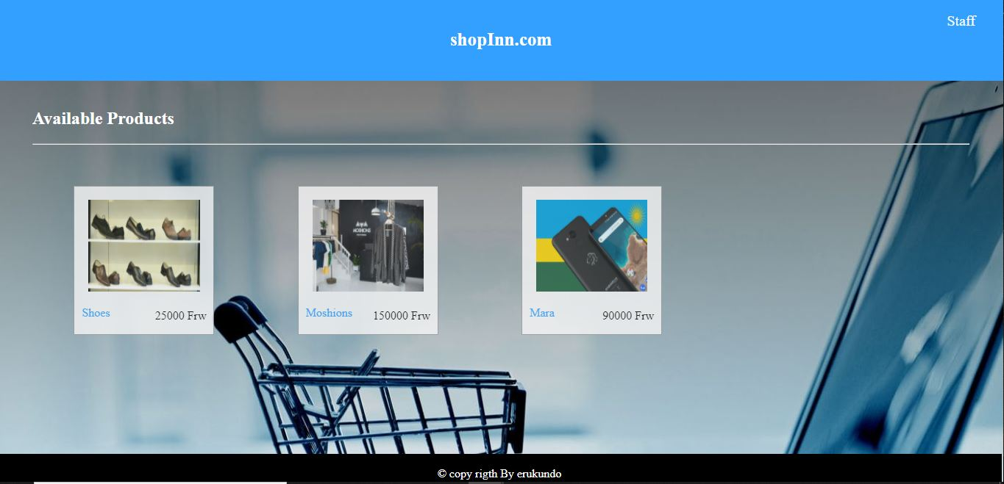
shopInn.com
ShopInn E-Commerce website is online portal that aims to facilitate online transactions of goods that are made in Rwanda through means of the transfer of information and funds. ShopInn will made possible that anything and that is made in Rwanda can be found and executed online.

Slide 3
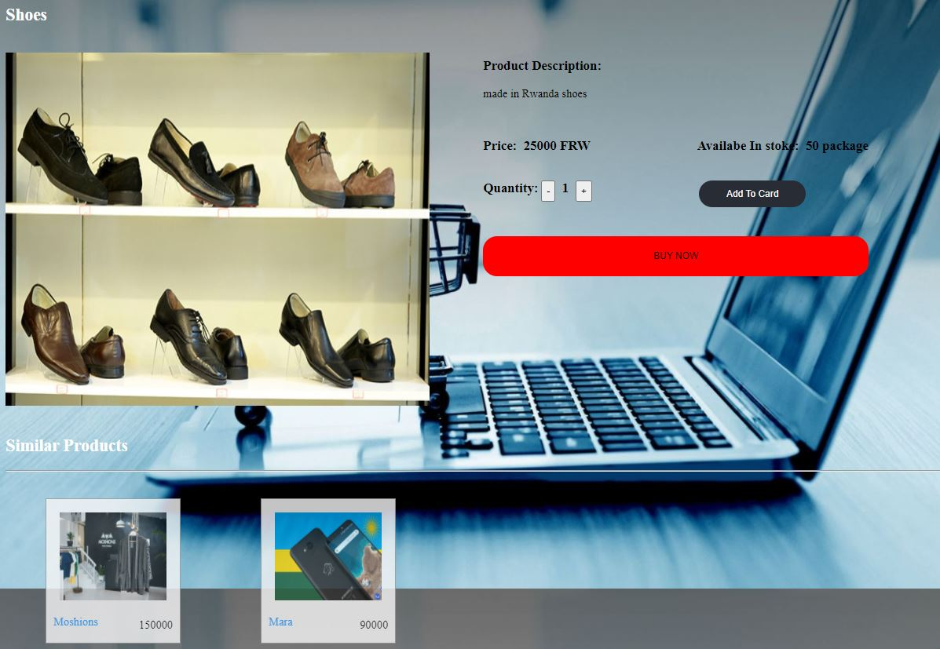

Product Details
Login

Slide 4
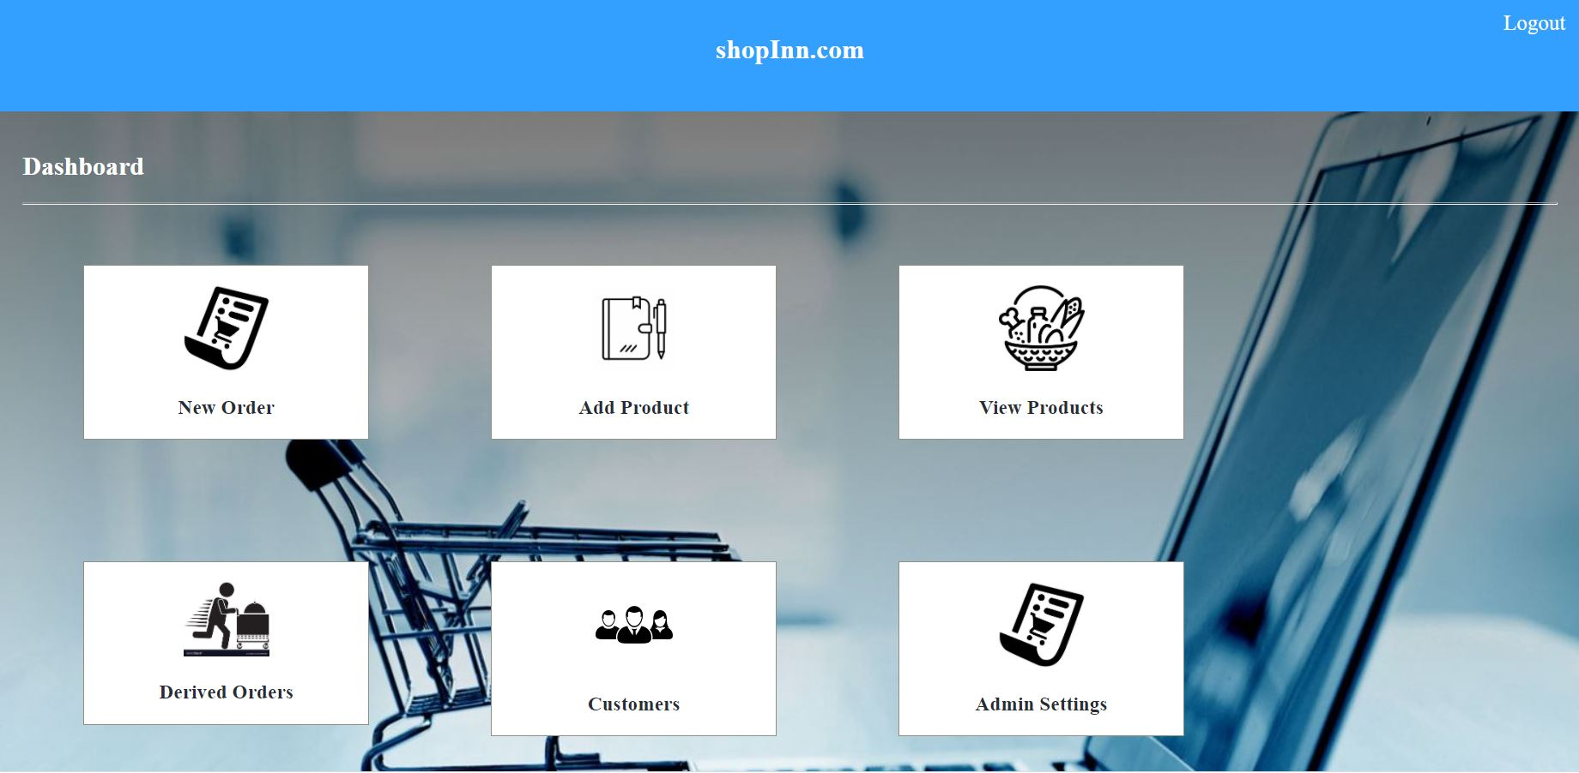
DASHBOARD

Slide 5

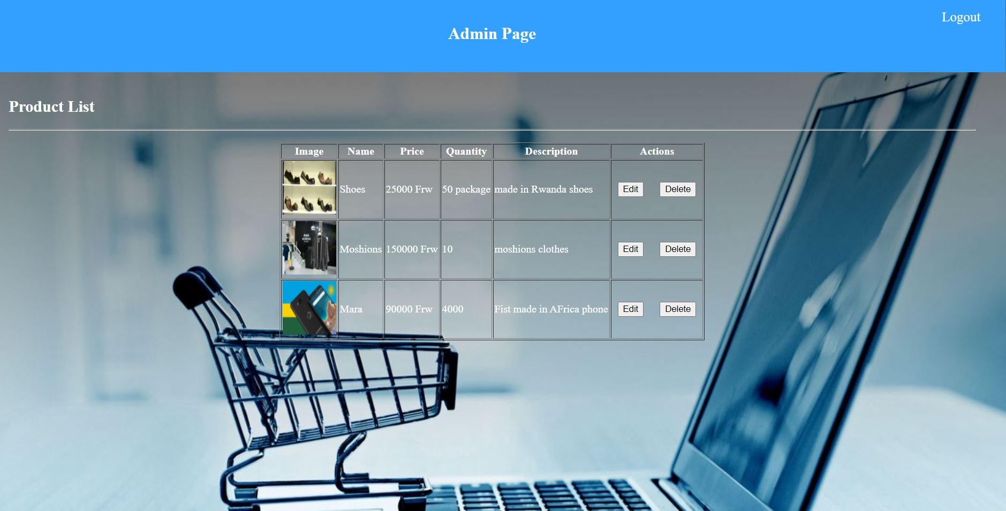
NEW PRODUCT
Product List

