Slide 1

Europe Code Week 15-23 October 2016
A week to celebrate
creating with code

Slide 2
What is the aim of Europe Code Week?
To bring basic programming skills and digital literacy to everybody in a fun and engaging way
"Since the beginning of times, humans have created with stone, iron, paper and pencil. Now we live in a different era where we mould our world in code. Different eras demand different skills. During Code Week we want to give everyone the opportunity to discover coding and have fun with it. Let’s learn coding to shape our future!"
Alessandro Bogliolo, EU Code Week coordinator

Slide 3
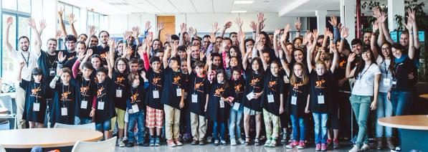
When is Europe Code Week?
Creating with code is celebrated on 15-23 October 2016
…but "every week is Code Week"

Slide 4
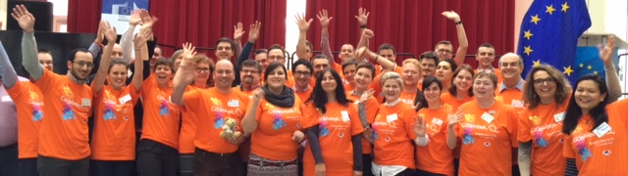
Who organises Europe Code Week?
A grass-root movement run by volunteers – the Code Week Ambassadors
Supported by the European Commission
Anyone who organises coding events adds their event to the events.codeweek.eu map

Slide 5
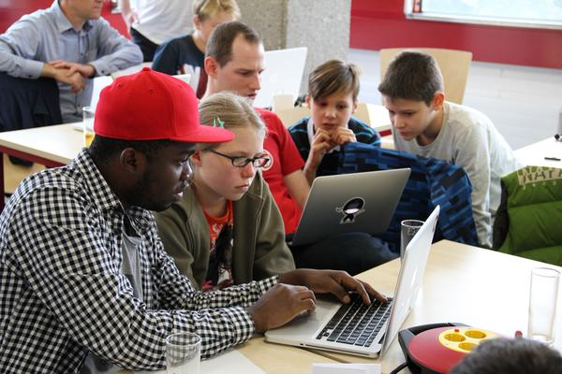
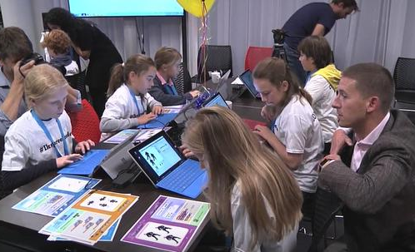
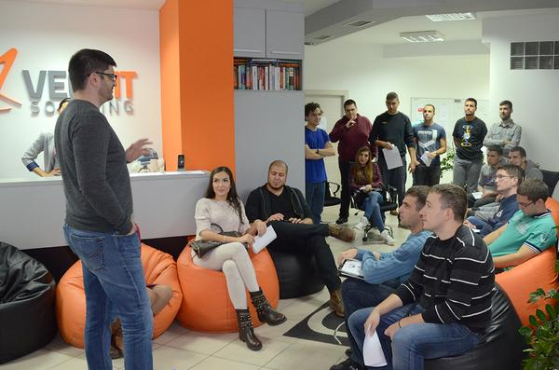
Who participates?
EU Code Week is for everyone, by everyone
Children, pupils, students, young adults, adults, seniors, parents, teachers, entrepreneurs and policymakers can organise and participate in coding events.

Slide 6
Get involved
Organise your own coding event – in school, in the local library, at your office!
Check out the Code Week map and take part in a coding event.
Spread the word – on Facebook and Twitter
CodeWeek4All challenge - Challenge your school to engage all its students in coding events and get a Certificate of Excellence in Coding Literacy from the European Commission.
Ode to Code video contest - Dance the Ode to Code and share your video on Youtube

Slide 7
Europe Code Week supporters
European Commission - supports EU Code Week as part of its strategy for a Digital Single Market
EU Code Week - backed by coding movements such as CoderDojo and RailsGirls
Public Libraries 2020 – 65.000 public libraries in the EU
Youth and student organisations such as Think Young, ESTEEC, JADE.
Partners of the Grand Coalition for Digital Jobs organise events during EU Code Week.
Members of the European Parliament e.g. Sean Kelly and Eva Paunova

Slide 8
Europe Code Week in 2013, 2014 & 2015
2015
570,000 people
7,600 coding events
46 countries in Europe, Africa, Asia, Australia, and the US
2014
150,000 people
4,200 coding events
36 countries in Europe and beyond
2013
10,000 people
3,000 coding events
26 European countries

Slide 9
Join us!
CodeWeek.eu
Contact your ambassador
Check out events in your country and organise events in schools, libraries or other spaces
Spread the word about Code Week
Read and contribute to the Code Week blog
Follow on Twitter and Facebook
@CodeWeekEU #codeEU
CodeEU
Contacts
info@codeweek.eu

