Slide 1
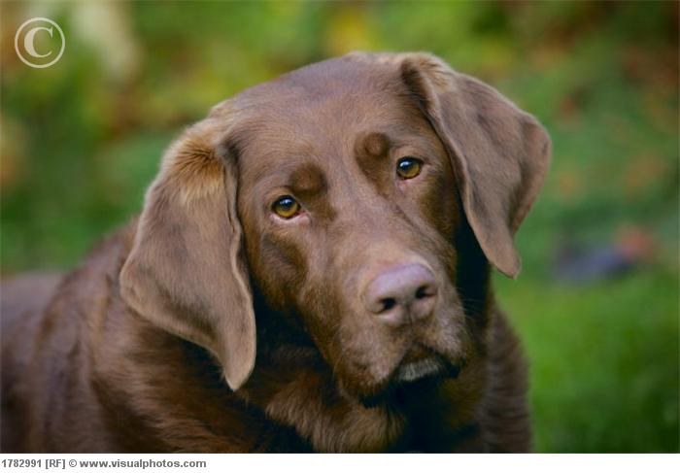
Image
Dog detector
(VGG16)
False
Face detector > 0
PRINT:
Not human
Not dog
False
True
Dog breed detector
(Transfer Model)
True
PRINT:
Dog breed predicted
(even to humans)

