Slide 1
ASPLOC Project Lecture 2
Shiming Li (TA)

Slide 2
Content
Goal: To use I/O
Part 1: Controlling PS I/O pins
Part 2: Controlling PL I/O pins with simplest PS-PL communication

Slide 3
Pt. 1: Preparation--installing board def. file
A guide is uploaded. In short, copy the extracted folder to:
<Your Xilinx folder>\Vivado\<Your version number>\data\boards\board_files
To test: you should be able to select Minized for new projects
Make sure you downloaded: MiniZed-HW-UG-v1-0-V1_0.pdf, ug585-Zynq-7000-TRM.pdf

Slide 4
Pt. 1: I/O Tutorial application using PS
A guide is uploaded.
Step 8: An HDL wrapper is a .v file. It connects your design’s I/O pins to those defined in the constraint file.
Step 9: Verilog describes Register-Transfer Level design. Synthesizing turns RTL code into netlist (gate level). Implementing figures out concrete routing and placement on the board.
Step 10: This step exports your HW spec for the software developing tool in the next step.

Slide 5
Pt. 1: I/O Tutorial application using PS
From step 11 on, you will be programming the PS using C/C++.
Step 20 and 21 instructs you how to see the printed msgs.
Note: to see prints you need to set the BSP setting as in step 21 (choose ps7_uart_1), even if you don’t want to use the UART example.

Slide 6
Pt. 1: What have we done?
Zynq 7000: a (series of) SoC by Xilinx.
Processor system + PL + I/O peripherals.
Minized: the board by Avnet.
Zynq SoC + LED, button, Arduino interface, etc.
Go to step 7, look at table 13:
Minized has the SoC’s MIO pin 52&53 wired to the LED.
the Board
the SoC
MIO pin 52
A simple graph of the connection between the SoC’s MIO pin and the LED.
MIO pin 53

Slide 7
Pt. 1: What have we done?
MIO: Multiple-use IO / Multiplexed IO
Which peripherals to expose can be configured.
Go to ug585-Zynq-7000-TRM.pdf, 1.2.3: “Up to 54 GPIO signals …routed through the MIO”.
Go to step 7 or double-click the PS ip block (in the block design window) and see how the pins are configured.
X-axis: 54 MIO pins. Y-axis: all I/O peripheral of PS.
the SoC
It’s a mux
I/O Peripherals
USB
SD
54
Pins
MIO
UART
CAN
…
GPIO
A simple graph of I/O and MIO of the SoC. Chapter 1.1.1 (pg. 28) in ug585-Zynq-7000-TRM.pdf has a full SoC graph.

Slide 8
Pt. 1: What have we done?
Summary: we had just written to one of the PS’s MIO pins.
Question: Look at your board: beside “PS LED” is a “PL LED”.
Are those pins that only the PL can access?
Can we light up the PL LED?

Slide 9
Pt. 2: Lighting up the PL LED
Goal of this part:
More understanding of the I/O and pins on the SoC
An example of the simplest PS/PL communication (using EMIO)
An example of configuring Verilog module’s pins

Slide 10
Pt. 2: Can we do this? & How?
Go to MiniZed-HW-UG-v1-0-V1_0.pdf, pg. 32
Admire the typo: “are be connected” (s.i.c.)
If one can make mistakes while writing a doc, one can make mistakes printing the PDB. “PL LED” is thus suspicious.
Is this statement true: “There are pins that only the PL can access”?
Go to ug585-Zynq-7000-TRM.pdf, 2.1.1, figure 2.1
Look at the grouping of pins, interfaces and signals
Yes, some signals/pins are only available to the PL

Slide 11
Pt. 2: How do we do this? (no jokes in this pg.)
Remember: LED is on the board (not the SoC).
Go to MiniZed-HW-UG-v1-0-V1_0.pdf and look for the LEDs!
Pg. 32, 3.11.2 (last item): PL LED is wired to Arduino pins A3 and A4.
Then, pg. 28, table 5: Arduino A3 and A4 corresponds to Zynq pinout E13 and E12.
Writing to E13 and E12 on Zynq will switch the LEDs.

Slide 12
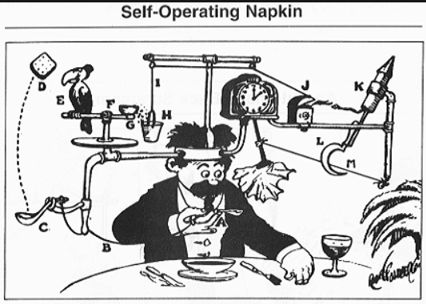
Pt. 2: Rube Goldberg machine
A type of machine intentionally designed to perform a simple task in a overly complicated way.
We will write some Rube Goldberg code: sending signal from PS to PL in order to control PL’s LEDs.
A Rube Goldberg machine, by cartoonist Rube Goldberg (taken from wikipedia)

Slide 13
Pt. 2: Learn about EMIOs
There are pins between PS and PL
Go back to ug585-Zynq-7000-TRM.pdf, 2.1.1, figure 2.1
EMIO: Extended MIO
Go back to the same doc, pg. 28. Note that I/O peripherals can go either to MIO or EMIO. Also look at chapter 2.5, fig 2-2 (pg. 48).
You can also find the configurations in Vivado. Double click the IP block, and see in “Peripheral IO Pins” you can configure which pins go to EMIO.
Enable “GPIO EMIO” in row “Peripherals” on the above Vivado window (by default enabled).
Go to “MIO configuration” (select on the left of the window) and set EMIO GPIO pin width to 4.
Summary: MIO is what PS exposes to the outside. EMIO is what PS exposes to the PL.

Slide 14
Pt. 2: Use EMIOs in Vivado block design
(In block design window) Double click the PS IP block, go to “Peripheral IO Pins”
In row “Peripherals”, enable “GPIO EMIO” (by default enabled).
Go to “MIO configuration” (select on the left of this small window), expand “I/O peripherals” -> expand “GPIO”, and set EMIO GPIO pin width to 2. This is because we only need 2 pins.
Now, you have opened some EMIO GPIO ports to the PL.
Look at your block design. You will see “GPIO”, a [1:0] bus.
Note that in this block design window, the only in/out ports you can see on the PS IP are those between PS and PL. These are EMIO ports that are open to PL.

Slide 15
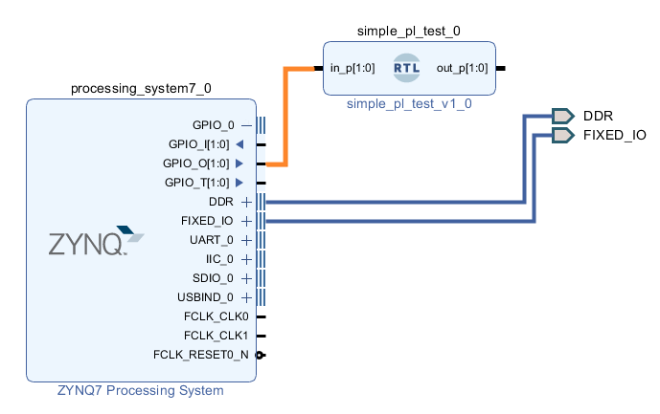
Pt. 2: Add a LED-controller module
Add a new .v file with a 2-bit input bus and 2-bit output bus.
In its verilog code, assign the out ports to the in ports.
In the block design window, right click to add the module. Expand GPIO_0 on the PS IP and connect GPIO_O to it.
It should look like this

Slide 16
Pt. 2: Add a LED-controller module
Right-click the new IP’s out port and “make external”. Otherwise, they will not become pins after synthesis, since they are not connected to anything.

Slide 17

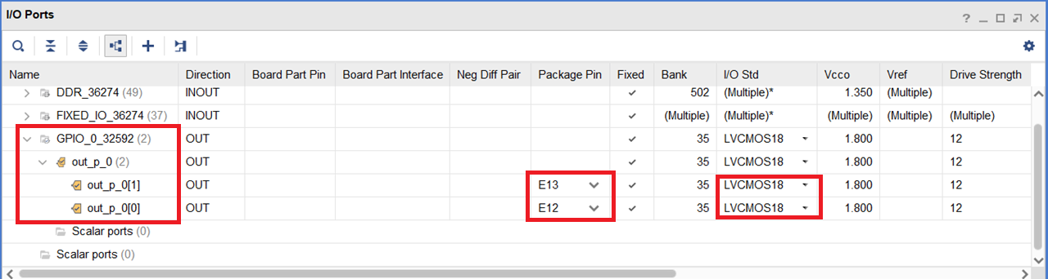
Pt. 2: Configure PL pins
We want the new module’s out ports to connect to PL LEDs (E13 and E12.)
This can be done in the Schematic (expand “RTL Analysis” on the left most “Flow Navigator”). After you open this, on the top right of Vivado you can select layout. Switch to ”I/O planning”. Set as the pic below:

Slide 18
Pt. 2: Write the C code & test
The only thing left is the PS code! Do the same as in part one: generate bitstream, export hardware and launch SDK.
In the code, change Output_Pin to 54 or 55.
Output_Pin was 52 in part 1.
We are using EMIO pin 0 and 1 (remember when you set the width to 2 bits?) for the PL LEDs. This SoC has 54 MIO pins, and the EMIO pin number should be consecutive to that. I.e. EMIO 0 has a pin number of 55. (I really cannot find reliable source in the documents to prove this, but only found this discussion)
Admire the blinking of your PL LED

Slide 19
Hint: Ways of PS-PL communication
Chapter 1.4.2 of ug585-Zynq-7000-TRM.pdf describes the PS-PL interfaces.
Using EMIO is one way to implement this communication. It is simple but slow, and the data throughput is low.
In the next lecture, another (faster, higher-throughput) method will be introduced: AXI buses + DMA.
So far I only know these two ways of PS-PL communication, but you can always explore/create your own black magic.

