Slide 1
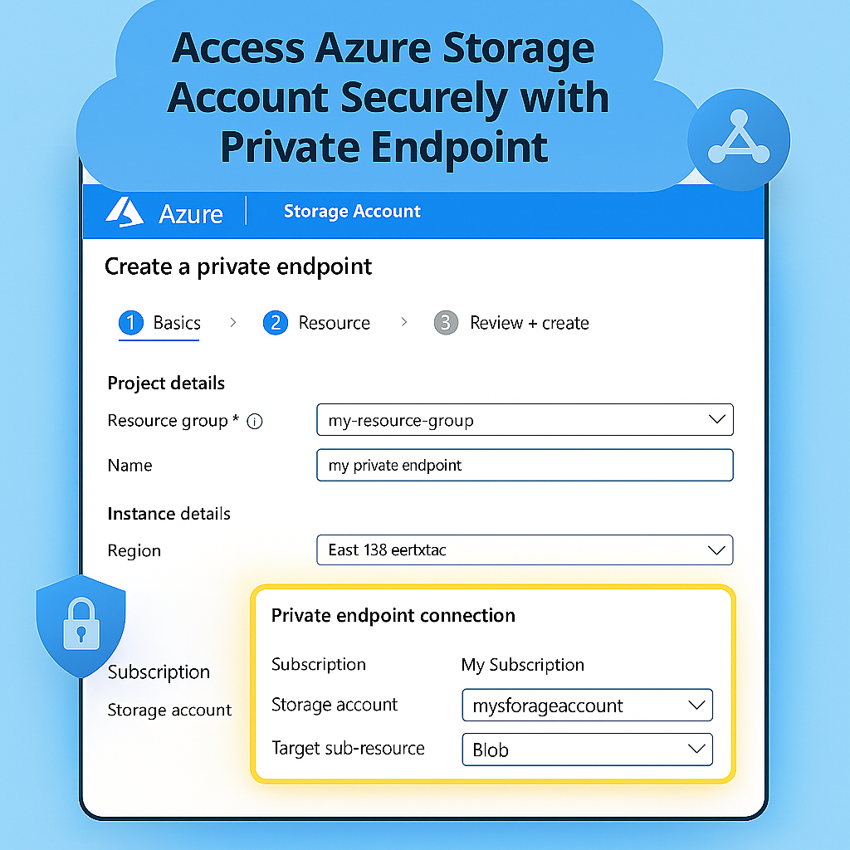

Slide 2
Internet
1.
On Premise System
Connected to
Public Internet

Slide 3
Internet
On Premise System
Connected to
Public Internet
1.
2.
Connect Azure Client VPN

Slide 4
Az
3.
Public IP of Azure Virtual Network Gateway
Internet
Azure
Data
Center
Azure Virtual Network Gateway
1.
VPN Configuration
On Premise System
Connected to
Public Internet
2.
Connect Azure Client VPN

Slide 5
3.
Internet
Az
Public IP of Azure Virtual Network Gateway
4.
Azure
Data
Center
Azure Virtual Network Gateway
1.
VPN Configuration
Private IP:
172.0.0.0
On Premise System
Connected to
Public Internet
2.
Connect Azure Client VPN

Slide 6
Az
Public IP of Azure Virtual Network Gateway
Public Internet
Azure Virtual Network Gateway
Azure
Data
Center
Private IP:
172.0.0.0
5.
Connect Azure Client VPN
VPN Configuration

Slide 7
Virtual network link
Private
DNS
Zone
Virtual Network
Public Internet
Gateway Subnet
Public IP of Azure Virtual Network Gateway
6.
https://<mystorageaccount>.blob.core.windows.net
DNS Resolver Inbound Subnet
Connect Azure Client VPN
Private IP:
172.0.0.0
Azure Virtual Network Gateway
Private Endpoint Subnet
Azure
Data
Center
Storage
Account

Slide 8
Virtual network link
Private
DNS
Zone
Virtual Network
7.
Public Internet
Gateway Subnet
Public IP of Azure Virtual Network Gateway
https://<mystorageaccount>.blob.core.windows.net
DNS Resolver Inbound Subnet
Connect Azure Client VPN
Private IP:
172.0.0.0
Azure Virtual Network Gateway
Private Endpoint Subnet
Azure
Data
Center
Storage
Account

Slide 9
Virtual network link
Private
DNS
Zone
Virtual Network
8.
Public Internet
Gateway Subnet
Public IP of Azure Virtual Network Gateway
https://<mystorageaccount>.blob.core.windows.net
DNS Resolver Inbound Subnet
Connect Azure Client VPN
Private IP:
172.0.0.0
Azure Virtual Network Gateway
Private Endpoint Subnet
Azure
Data
Center
Storage
Account

Slide 10
Virtual network link
Private
DNS
Zone
Virtual Network
Public Internet
https://<mystorageaccount>.blob.core.windows.net
Gateway Subnet
Public IP of Azure Virtual Network Gateway
9.
Storage Account
Private Endpoint IP address
x.x.x.x
DNS Resolver Inbound Subnet
Connect Azure Client VPN
Private IP:
172.0.0.0
Azure Virtual Network Gateway
Private Endpoint Subnet
Azure
Data
Center
Storage
Account

Slide 11
Virtual network link
Private
DNS
Zone
Virtual Network
Public Internet
https://<mystorageaccount>.blob.core.windows.net
Gateway Subnet
Public IP of Azure Virtual Network Gateway
Storage Account
Private Endpoint IP address
x.x.x.x
10.
DNS Resolver Inbound Subnet
Connect Azure Client VPN
Private IP:
172.0.0.0
Azure Virtual Network Gateway
Private Endpoint Subnet
Azure
Data
Center
Storage
Account

Slide 12
Virtual network link
Private
DNS
Zone
Virtual Network
Public Internet
https://<mystorageaccount>.blob.core.windows.net
Gateway Subnet
Public IP of Azure Virtual Network Gateway
Storage Account
Private Endpoint IP address
x.x.x.x
DNS Resolver Inbound Subnet
Connect Azure Client VPN
Private IP:
172.0.0.0
Azure Virtual Network Gateway
Private Endpoint Subnet
11.
Azure
Data
Center
Storage
Account

Slide 13
Virtual network link
Private
DNS
Zone
Virtual Network
Public Internet
Access
Storage Account
Container
Blob object
Gateway Subnet
Public IP of Azure Virtual Network Gateway
12.
DNS Resolver Inbound Subnet
Azure Virtual Network Gateway
Private Endpoint Subnet
Azure
Data
Center
Storage
Account

