Slide 1

Augmented Reality-assisted Human Robot Interaction
Final Year Project Presentation
Monday 24th June 2019
Student:
Aufar P. Laksana
CID:
01093575
Project Supervisor:
Professor Yiannis Demiris
Second Marker:
Dr. Tae-Kyun Kim

Slide 2
Motivation
What is “Augmented Reality-assisted Human Robot Interaction”?
Augmented Reality
Human Robot Interaction
Personal Robotics Lab
Personal Interests
Mobile Robotics
Self Driving Cars/Drones
Notes:
What is Augmented Reality-assisted Human Robot Interaction?
A very broad title
A broad title gives one the freedom to explore whatever they feel like, within the theme of robotics and augmented reality
This is an undergraduate project, time limited, what do we do when one has too much freedom?
We have to Narrow, Down, The scope
So we begin with a definition, Augmented Reality:
An interactive experience of real-world environments where the objects that reside in the real-world are enhanced by computer generated information, in the form of visualizations, sound, haptic feedback among other sensory
Different from VR, which shuts out the physical world
I recently went to Central Saint Martins, the design college at UAL, and one of the students had made an AR exhibit whereby you download an app on your phone and it transformed a 2D painting on a wall to a 3D experience you could walk through/around
For instance, tourists in a city, using a map and you can look through your phone to see big arrows pointing where you should turn next
Human Robot Interaction
Self explanatory, it’s the interaction between humans and robots
Can be things like remote interaction, such as the Mars rover, where a team of scientists and engineers are controlling something millions of kms away.
Or a proximate interaction, such as using the humanoid robots to help people in day to day tasks
Vast area of research, lots of cool, interesting things to explore
Combining the two:
Using augmented reality to enhance a humans understanding, control and interaction with robots
Personal Robotics Lab
Research focused on the interaction between these intelligent robotic devices and the users operating them
Some examples include:
Teaching a humanoid robot to learn an action by copying the operator
Using augmented reality to alert users to the state and intentions of a robot
Assistive control by the intelligent system to help users complete tasks.
Personal Interests
Participated in robotics competitions in high school (Botball)
Build and program robots to complete tasks in a scenario, like recognized coloured objects and sort them to gain points
Throughout University, became more interested in self-driving cars/drones
Advanced Robotics course involved using the mounted camera to recognize AR markers so that the drone could locate itself in the room
Humanoid Robots are not really my interest, they actually sort of intimidate me, a bit too lifelike

Slide 3
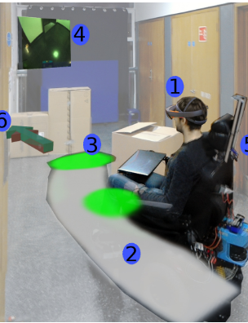
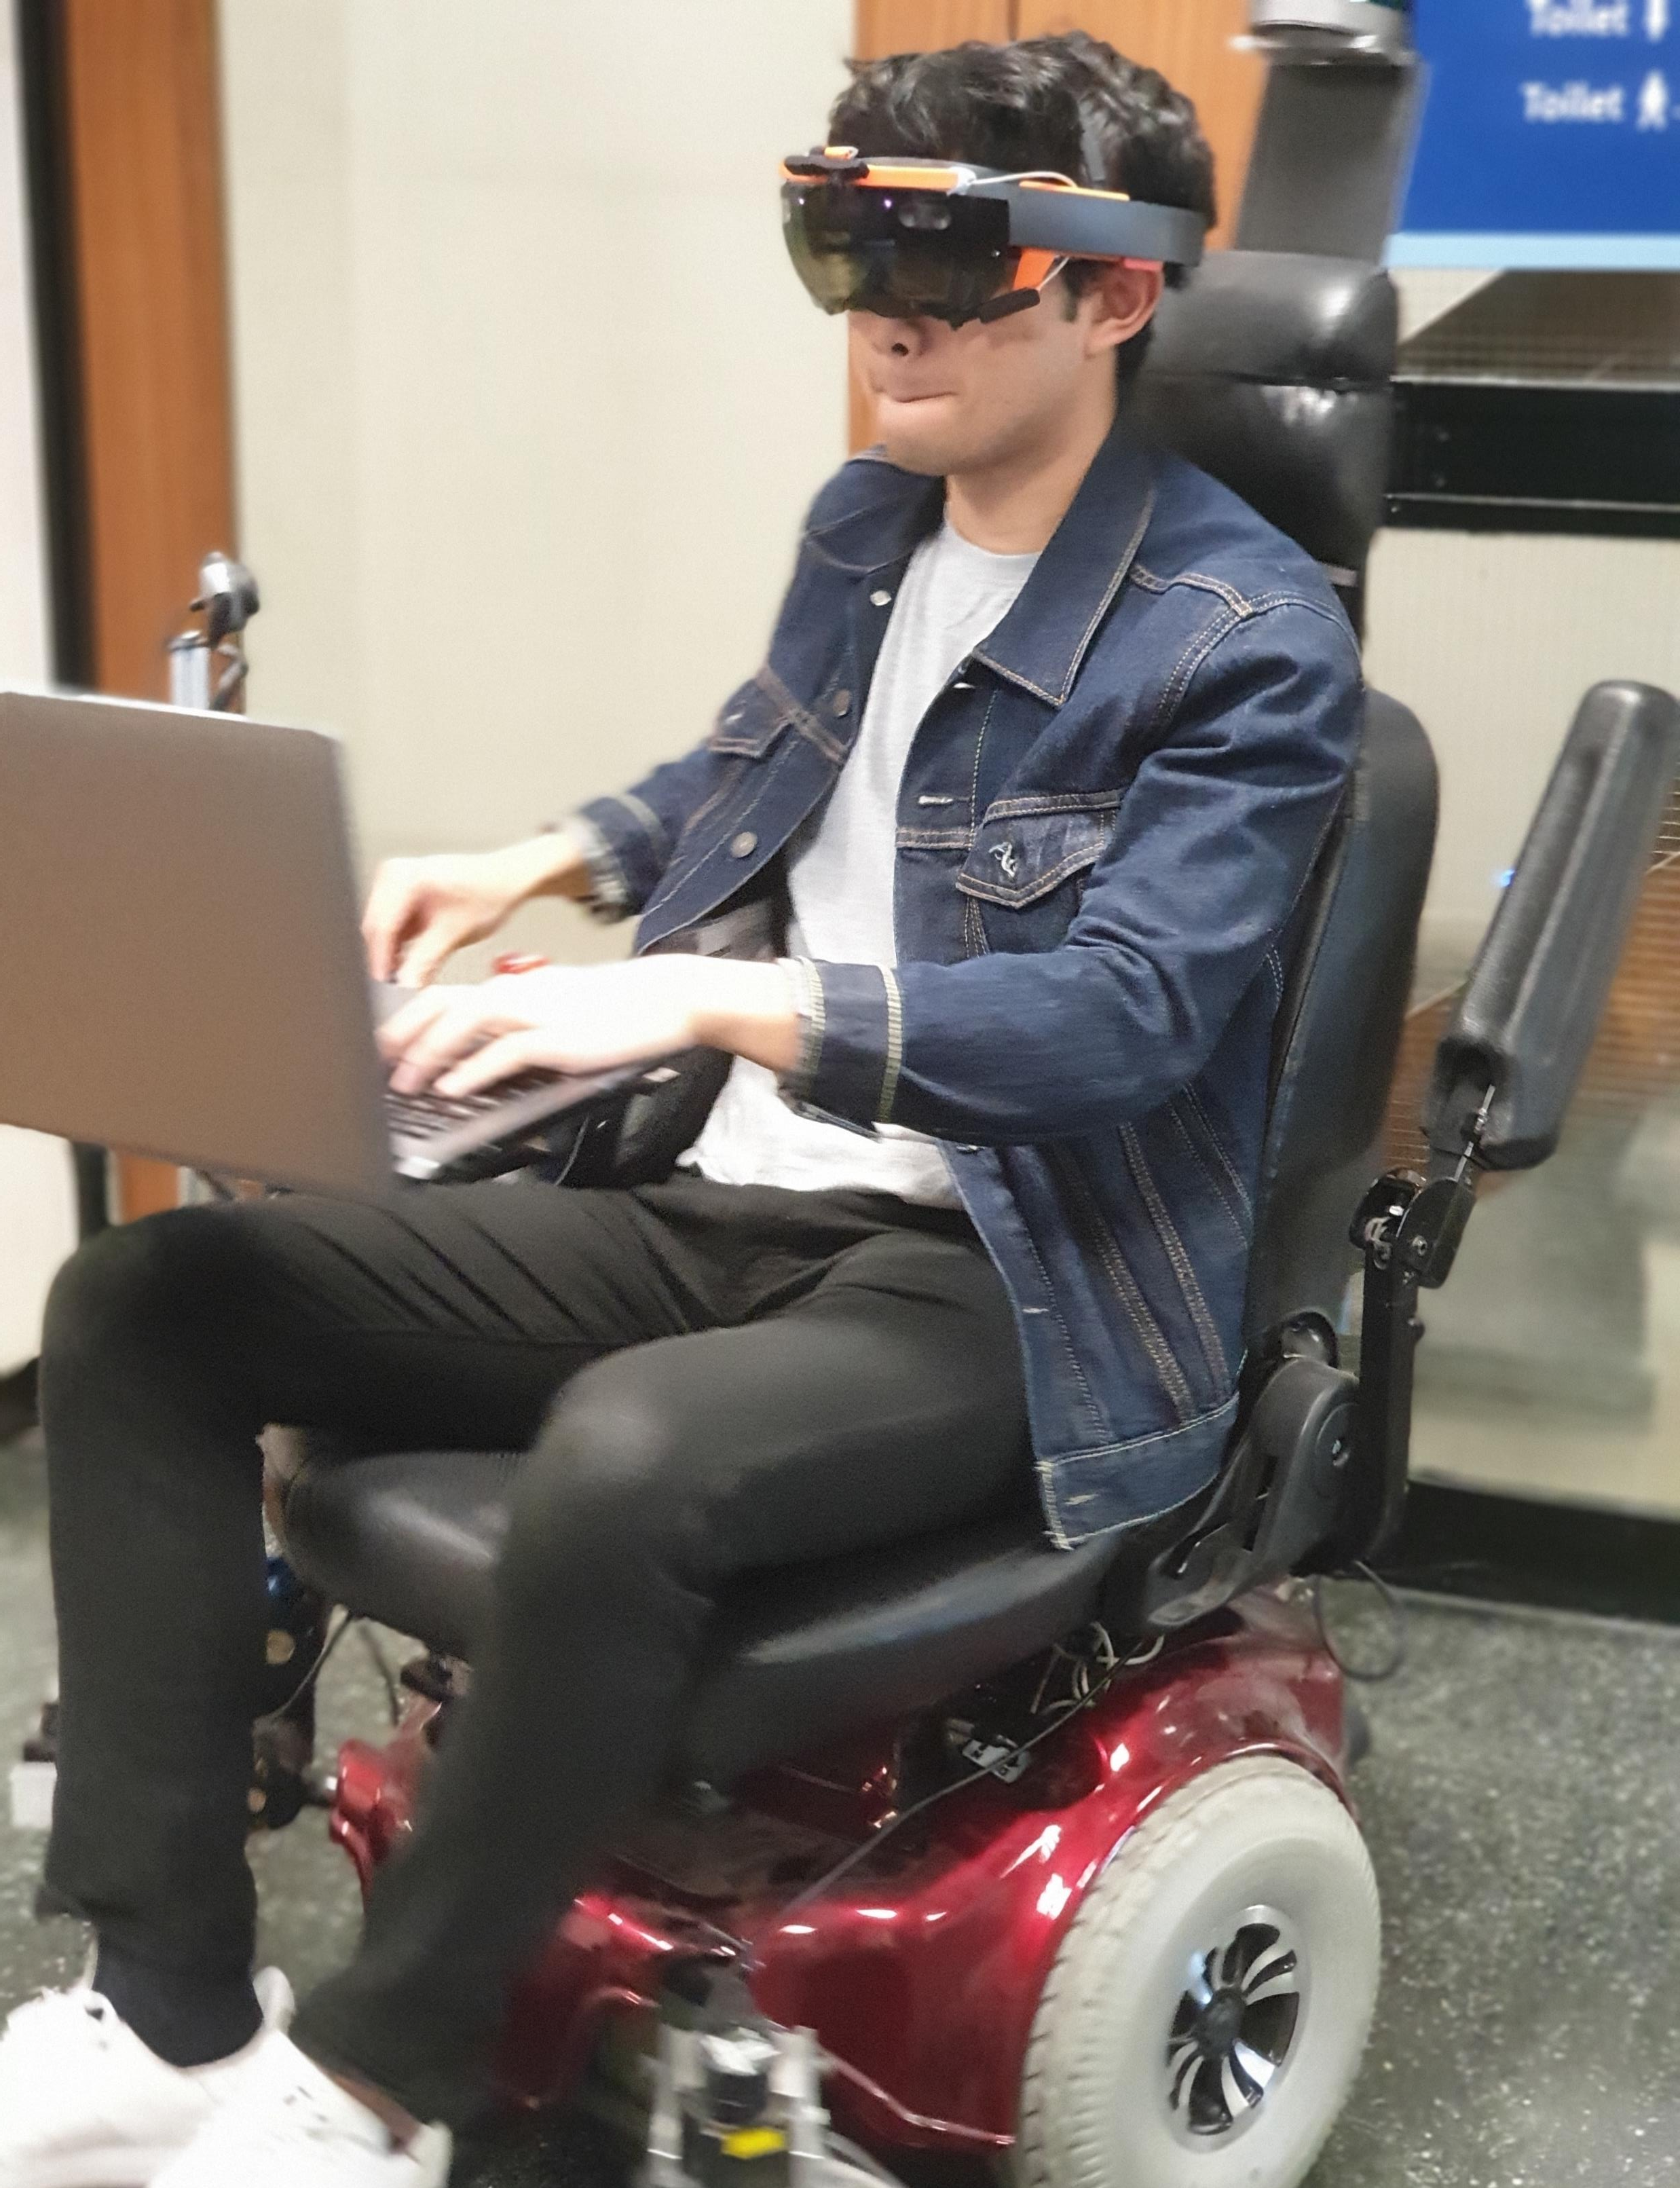
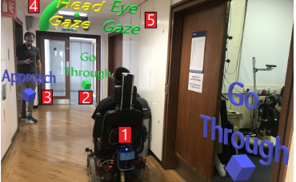
Motivation (cont.)
Narrowed the scope down to:
Augmented Reality visualizations.
Interaction with a mobile robot.
A bit of computer vision.
PRL Research Inspiration:
Head-Mounted Augmented Reality for Explainable Robotic Wheelchair Assistance.
Augmented Reality Control of Smart Wheelchair Using Eye-Gaze-Enabled Selection of Affordances.
“Power wheelchair users (PWUs) report being afraid to navigate in crowded spaces with their device”
[1] M. Zolotas, J. Elsdon, and Y. Demiris. Head-mounted augmented reality for explainable robotic wheelchair assistance
[2] Rodrigo Chac´on-Quesada and Yiannis Demiris. Augmented Reality Control of Smart Wheelchair Using Eye-Gaze-Enabled Selection of Affordances
[3] Kairy, D., Rushton, P. W., Archambault, P., Pituch, E., Torkia, C., El Fathi, A., … Gourdeau, R. (2014). Exploring powered wheelchair users and their caregivers’ perspectives on potential intelligent power wheelchair use: A qualitative study. International Journal of Environmental Research and Public Health, 11(2), 2244–2261. https://doi.org/10.3390/ijerph110202244
Notes:
Factoring in all these motivations and interests, we have narrowed down the scope to:
Augmented reality
Interacting with a mobile robot
Something with a bit of computer vision
In the PRL, a few of the PhD students have used the Hololens and smart wheelchair ARTA in their research
Mark: displaying the internal states such as the planned path of the assistive control
Rodrigo: using the Hololens to provide an interface to the user for controlling the wheelchair, such as recognizing the positions of doors and giving the user the option to go through the door using eye tracking

Slide 4
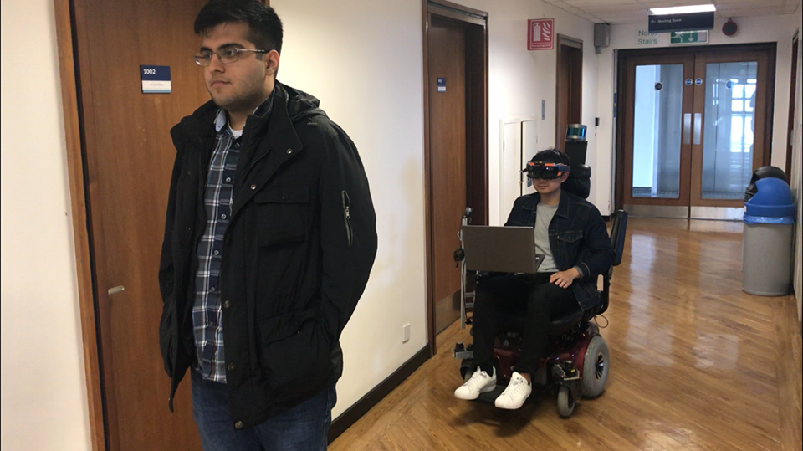
Project Description
Augmented Reality experience using the Microsoft Hololens.
Provides assistance to powered wheelchair users (PWUs) by:
Locating people in the surroundings.
Displaying holograms to PWU.
Reactive control system to prevent collisions with people when operating wheelchair manually.
1
Notes:
We wanted to follow the theme of robotic interaction using the powered wheelchair ARTA and the Microsoft Hololens
We also want to begin solving the problem of PWUs being afraid to navigate their devices in crowded areas.
This project involved developing an augmented reality system using the Microsoft Hololens that assists powered wheelchair users in navigating around people in crowded areas.
We utilize the Hololens as a visual input to detect and determine the positions of people in the surroundings
Using these positions, we can then use the augmented reality capabilities of the Hololens to display information to the powered wheelchair user, such as their position and the direction they are walking in relative to the PWU
We also use the knowledge of their positions to provide a simple reactive control system that prevents collisions during manual control of the wheelchair, by manipulating the speed of the device.

Slide 5
High-level System Description

