Slide 2
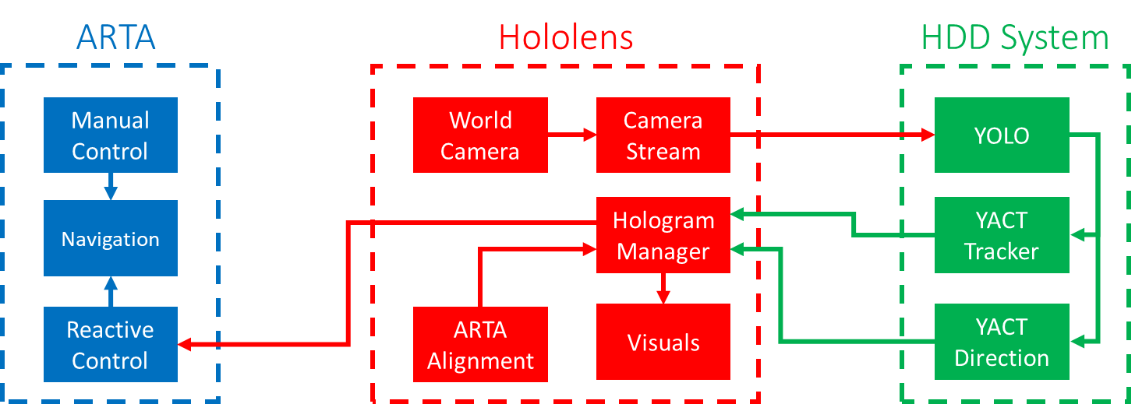
ARTA
Hololens
HDD System
Manual Control
World Camera
Camera Stream
YOLO
Navigation
Hologram Manager
YACT Tracker
Reactive Control
ARTA Alignment
Visuals
YACT Direction

