Slide 1
ARTA
Manual control through Joystick.
Navigation & Localization.
Reactive control responding to Hololens.
Hololens
Visual input.
Mapping object detections.
Manages hologram visualizations.
Communicates objects in surroundings to ARTA.
Human Detection & Direction
Receives image frames from Hololens.
Object detector
Infers direction of walking.
Sends detection/direction pairs to Hololens.

Slide 2
ARTA
Hololens
HDD System
Manual Control
World Camera
Camera Stream
YOLO
Navigation
World Manager
YACHT Tracker
Reactive Control
ARTA Alignment
Visuals
YACHT Direction

Slide 3
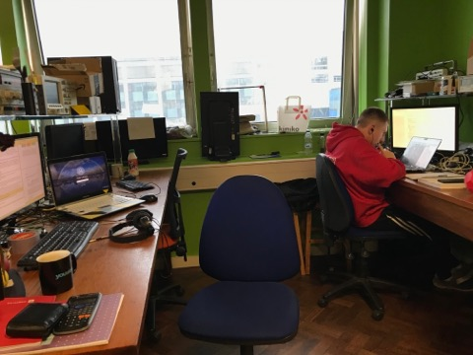
HDD System
1
YOLO
Bounding Box Detections
YACHT
JPG Image
DeepSort
Tracker
Detector
Tracking ID
OpenPose
Towards/Away

Slide 4
YOLO
Head and Body Detections
YACHT
DeepSort
Tracker
Tracking ID
Detector
OpenPose
Body Direction
HeadPose
Head Direction

Slide 5
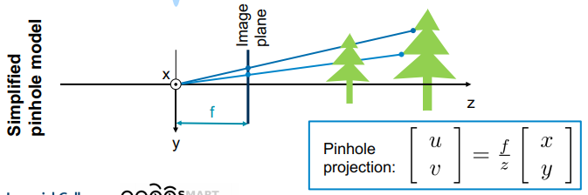

Slide 6
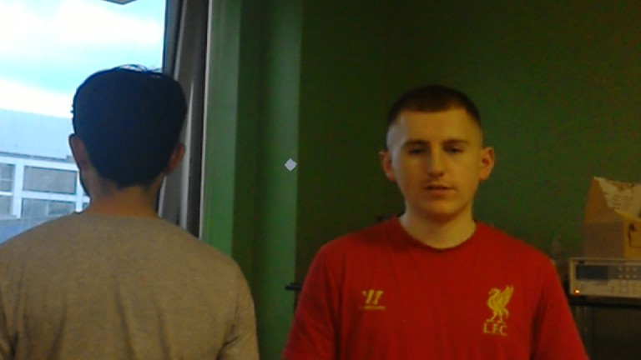
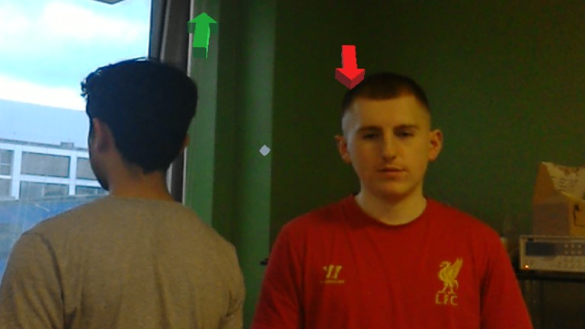
Hololens Unity Application
Hololens World View
HoloCamera
JPG Image
World Camera
Vulcan CameraStream
JPG Encoding
HDD Data
ARTA Alignment
World Manager
Holograms
World Positions of People
Displayed Holograms
HoloWorld

Slide 7
HoloCamera
ARTA
HDD
ROS#
ROS#
HoloWorld

Slide 8
z
y
x
Z_{Holo}
X_{Holo}
Y_{Holo}
Key
ARTA
Hololens
View
Object
Z_{ARTA}
Y_{ARTA}
X_{ARTA}

