Slide 1
ARTA
Hololens
HDD System
Manual Control
World Camera
Camera Stream
YOLO
Navigation
World Manager
YACHT Tracker
Reactive Control
ARTA Alignment
Visuals
YACHT Direction

Slide 2
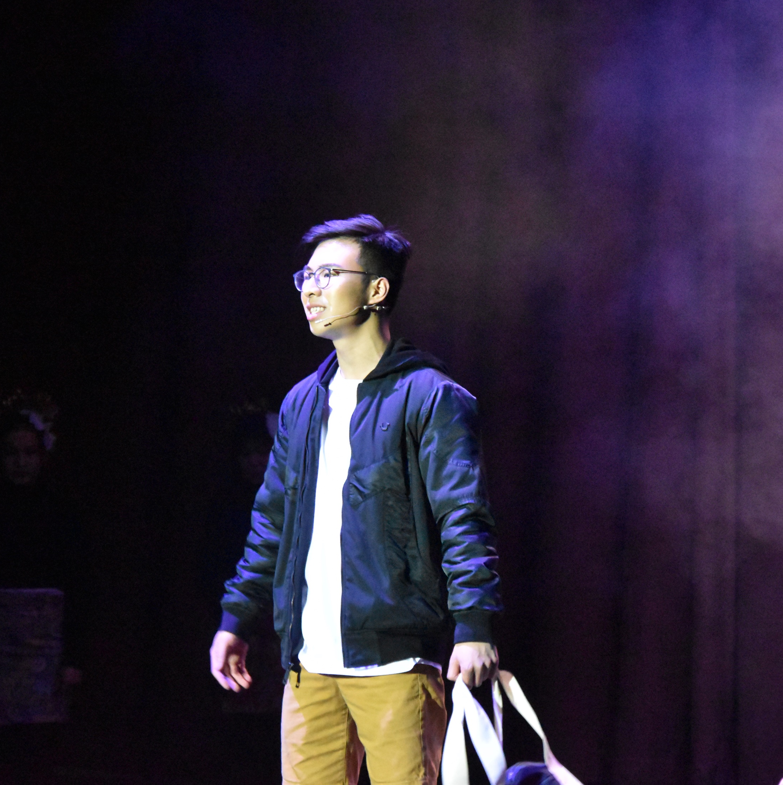
person

