Slide 1
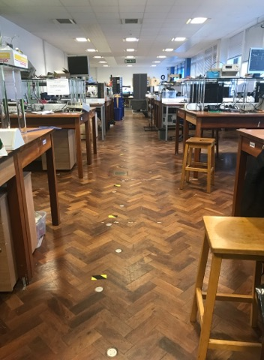
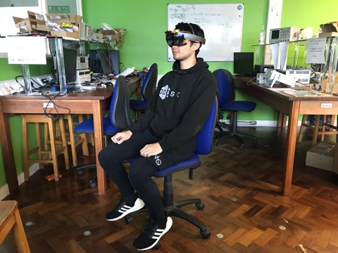
Distance to Target
6m
5m
4m
3m
2m
Facing Target

