Slide 1
ML Lec6. Softmax Regression
2020.01.02

Slide 2

Logistic regression
$H_{L}\left(X\right)=WX$
Z= $H_{L}\left(X\right), g(Z)$
g(Z) = 1 / (1+$e^{−2}$)
$H_{R}\left(X\right)=$ $g\left(H_{L}\left(X\right)\right)= \overline{y}$

Slide 3
Logistic regression
Logistic regression를 학습
→구분하는 선을 찾아낸다는 것
x1
x2

Slide 4
Multinomial classification
여러 개의 클래스 존재
B or not
X1 (hours) | X2 (attendance) | y (grade)
10 | 5 | A
9 | 5 | A
3 | 2 | B
2 | 4 | B
11 | 1 | C
x1
A
C or not
A
B
B
C
A or not
x2

Slide 5
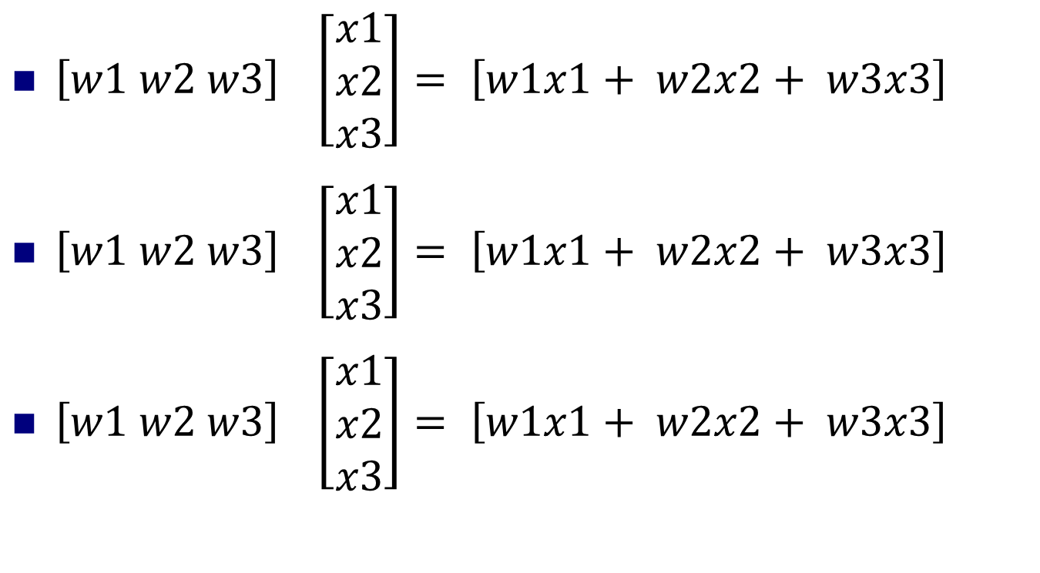
Multinomial classification
$\left[w1 w2 w3\right] \left[\begin{aligned}x1 \\ x2 \\ x3\end{aligned}\right]= \left[w1x1+ w2x2+ w3x3\right]$
$\left[w1 w2 w3\right] \left[\begin{aligned}x1 \\ x2 \\ x3\end{aligned}\right]= \left[w1x1+ w2x2+ w3x3\right]$
$\left[w1 w2 w3\right] \left[\begin{aligned}x1 \\ x2 \\ x3\end{aligned}\right]= \left[w1x1+ w2x2+ w3x3\right]$

Slide 6
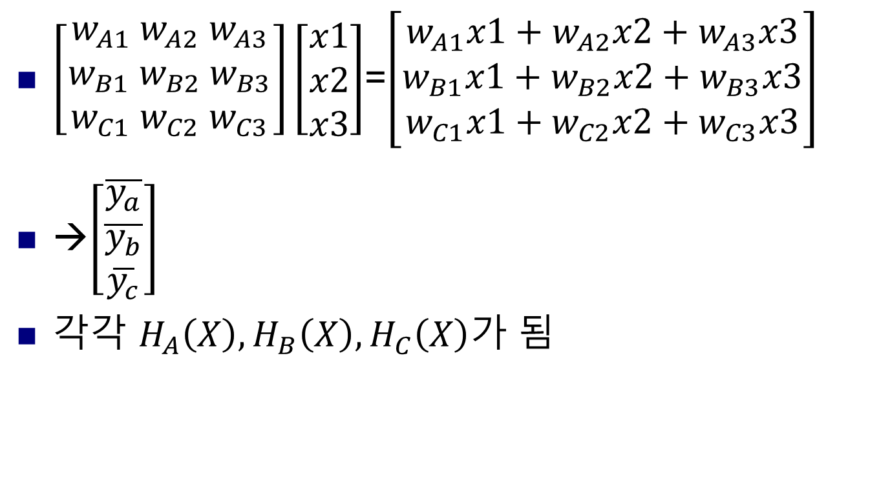
Multinomial classification
$\left[\begin{aligned}w_{A1} w_{A2}{ w}_{A3} \\ w_{B1}{ w}_{B2} w_{B3} \\ w_{C1}{ w}_{C2}{ w}_{C3}\end{aligned}\right]\left[\begin{aligned}x1 \\ x2 \\ x3\end{aligned}\right]$=$\left[\begin{aligned}w_{A1}x1+w_{A2}x2+w_{A3}x3 \\ w_{B1}x1+w_{B2}x2+w_{B3}x3 \\ w_{C1}x1+w_{C2}x2+w_{C3}x3\end{aligned}\right]$
→$\left[\begin{aligned}\overline{y_{a}} \\ \overline{y_{b}} \\ \overline{y_{c}}\end{aligned}\right]$
$각각$ $H_{A}\left(X\right),H_{B}\left(X\right),H_{C}\left(X\right)가$ 됨

Slide 7

Softmax
$XW$= $\left[\begin{aligned}2.0 \\ 1.0 \\ 0.1\end{aligned}\right]$→ S($y_{i})= \frac{e^{yi}}{\sum_{j}{e^{yi}}}$
0 ~ 1 사이의 값
전체의 합 = 1 → 확률로 볼 수 있음
0.7
0.2
0.1
Softmax function
1.0
Notes:
0~1사이의 값
전체의 합이 1이됨으로 확률로 볼수 있다.

Slide 8

Softmax
$\left[\begin{aligned}2.0 \\ 1.0 \\ 0.1\end{aligned}\right]$
0.7
ONE-HOT ENCODING
1.0
S(Y)
0.2
0.0
0.1
0.0

Slide 9

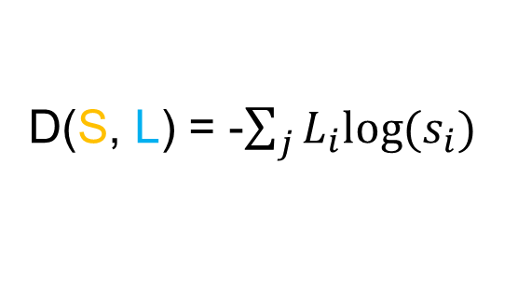
Cost funtion
Cross – entropy
S(y)= $\overline{y}$
L=Y
0.7
1.0
D(S, L) = -$\sum_{j}{L_{i}log⁡(s_{i})}$
0.0
0.2
0.1
0.0

Slide 10
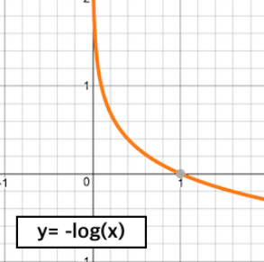
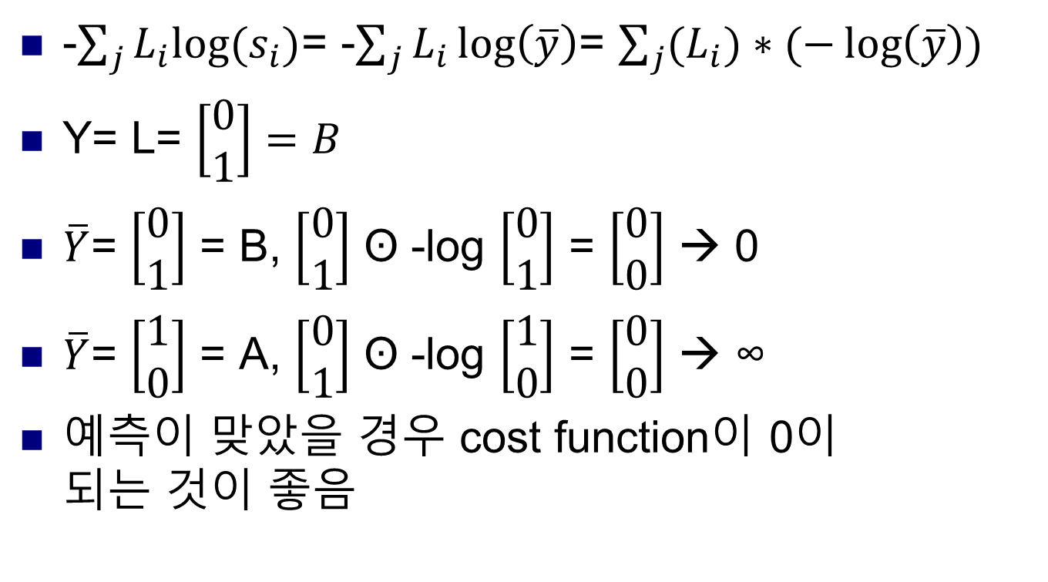
Cross-entropy cost funtion
-$\sum_{j}{L_{i}log⁡(s_{i})}$= -$\sum_{j}{L_{i}\log\left(\overline{y}\right)}$= $\sum_{j}{{(L}_{i})∗(−\log\left(\overline{y}\right))}$
Y= L= $\left[\begin{aligned}0 \\ 1\end{aligned}\right]=B$
$\overline{Y}$= $\left[\begin{aligned}0 \\ 1\end{aligned}\right]$ = B, $\left[\begin{aligned}0 \\ 1\end{aligned}\right]$ ʘ -log $\left[\begin{aligned}0 \\ 1\end{aligned}\right]$ = $\left[\begin{aligned}0 \\ 0\end{aligned}\right]$ → 0
$\overline{Y}$= $\left[\begin{aligned}1 \\ 0\end{aligned}\right]$ = A, $\left[\begin{aligned}0 \\ 1\end{aligned}\right]$ ʘ -log $\left[\begin{aligned}1 \\ 0\end{aligned}\right]$ = $\left[\begin{aligned}0 \\ 0\end{aligned}\right]$ → ∞
예측이 맞았을 경우 cost function이 0이 되는 것이 좋음
A
B

Slide 11

Cost funtion
Loss= $\frac{1}{N}\sum_{J}{d(S\left(WX_{i}+b\right), L_{i})}$

Slide 12
ML Lab6. Softmax Regression
2020.01.02

Slide 13
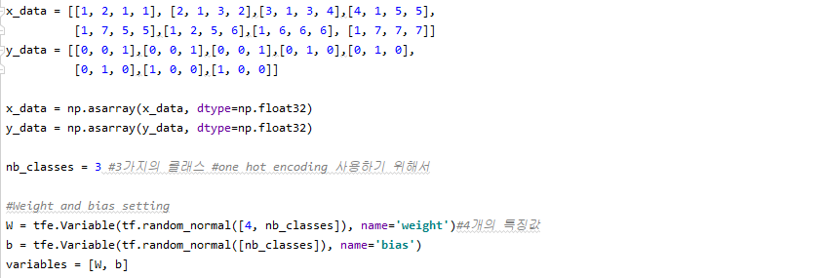

Slide 14

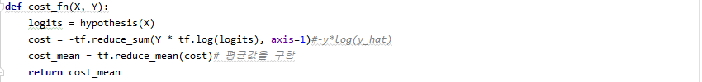



Slide 15
