Slide 1
Open University Learning Data Analysis
Presenter: Alaleh Razmjoo
May 2018

Slide 2
Goals
Use the data provided by the Open University to improve the performance of seven proposed courses
Improvement in performance is defined by the following:
Predict and reduce the number of withdrawals
Predict and reduce the number of failures
Increase the revenue
Increase in the spending of current students
Increase in the number of new comers

Slide 3
Descriptive analysis
Task: Getting to know the demographic of registered students
Goal: The results could be used for
Targeted advertisement
Better course planning/accommodation

Slide 4
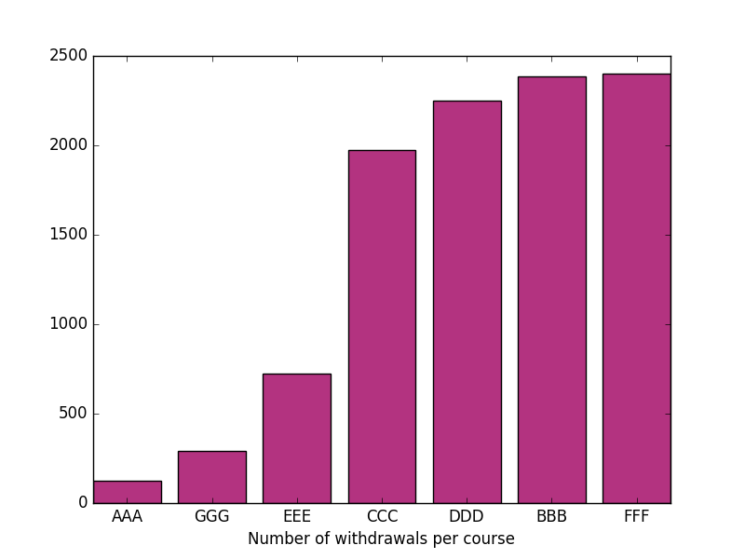

Slide 5
Insights
There are 4 courses with high number of withdrawal which needs to be further examined. Even though this graph does not provide a rate for comparisons.

Slide 6
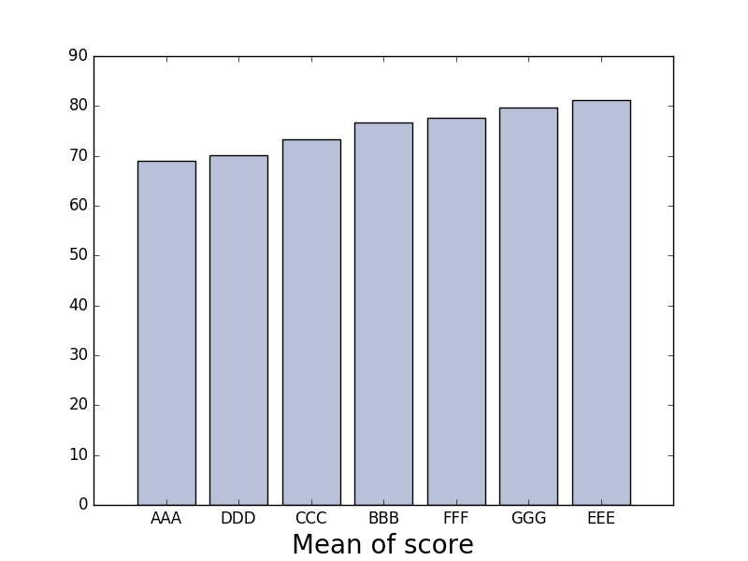

Slide 7
Insights
Based on the assessment data, AAA students have the lowest score among all the seven courses.
However, without a knowledge on the type of the course (e.g. math vs art?) direct comparison of the scores is not recommended.

Slide 8
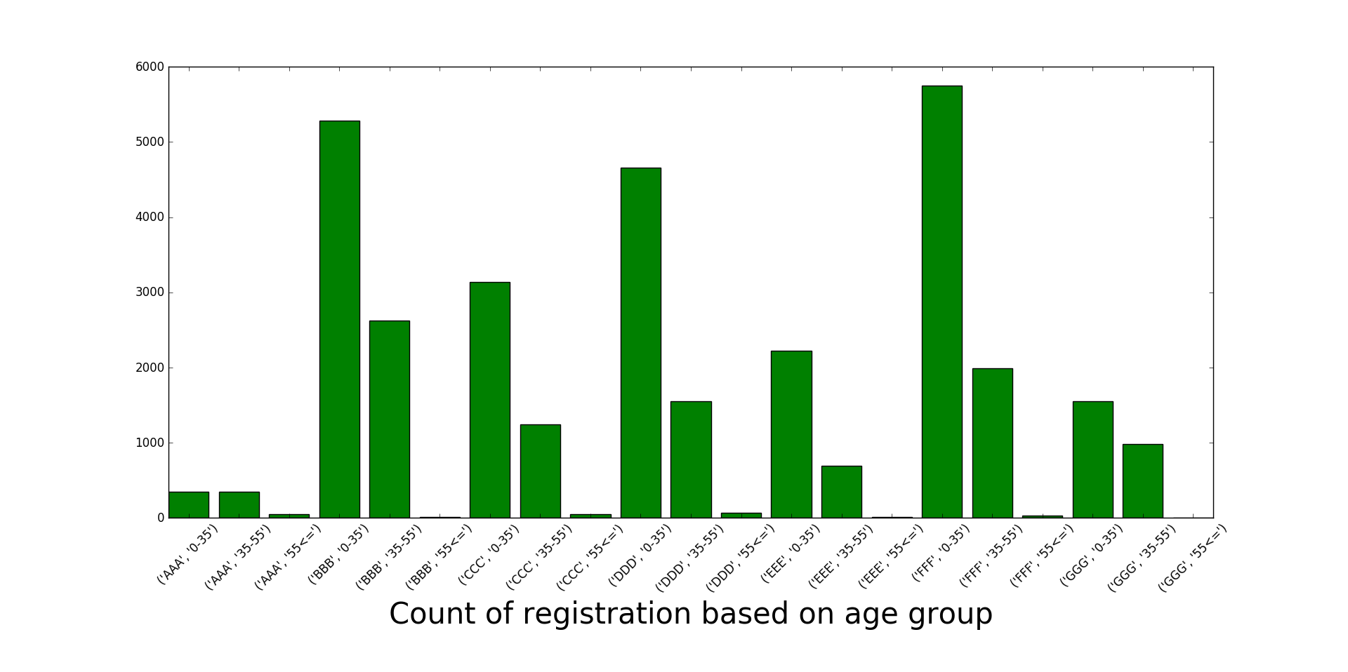

Slide 9
Insights
Knowing the audience of each course could help with targeted advertisement.
For instance in the courses with very young age group students advertisement on social media sites such as SnapChat results in better outcomes. On the contrary the middle age students respond better to Facebook ads (disclaimer: this is merely my initial speculation, more research needs to be done).

Slide 10
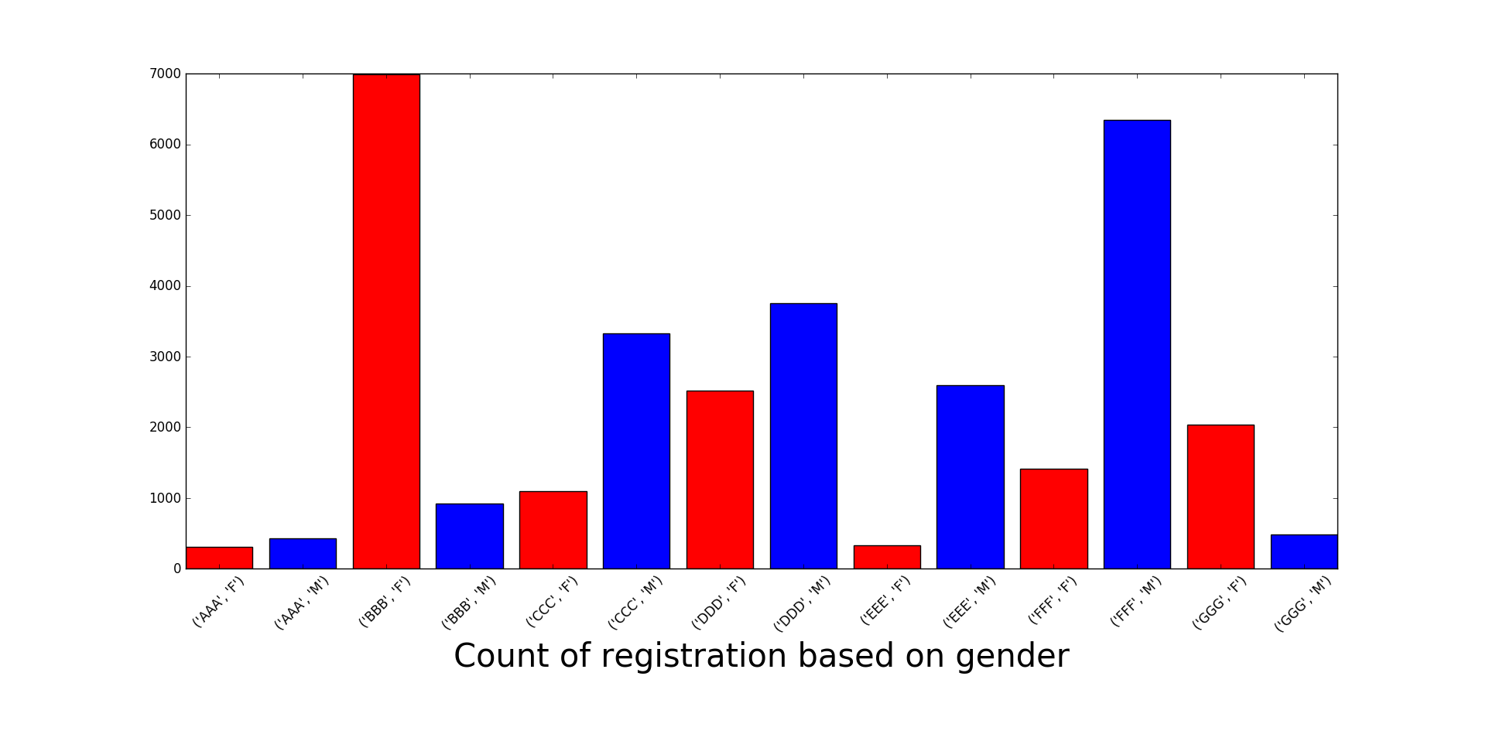

Slide 11
Insights
BBB is very popular with women. This result could help with the course planning such as type of advertisement, coloring, etc. In case that the course material is based toward both genders, it needs to be evaluated why men are not getting attracted to the current version of the course?
FFF is more popular with men. More analysis could be done into the subject of the course to make it more attractive to women, etc.

Slide 12
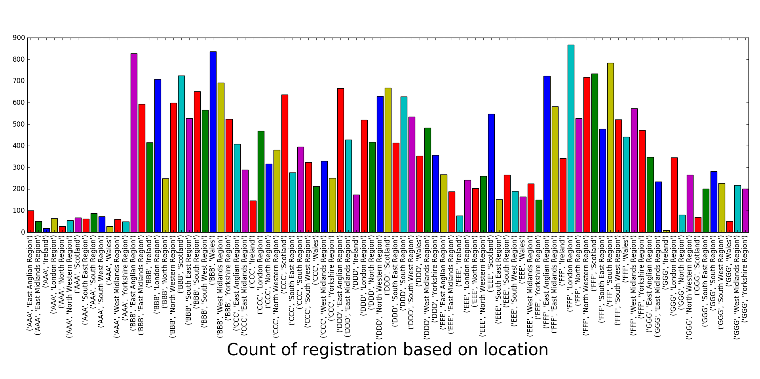

Slide 13
Insights
Highest locations for each is to be identified, this will help with targeted advertisement through social media channels.
Language assistant programs such as real-time translation could be offered to locations with high audience where English is not the primary language(assuming the course is being taught in English)

Slide 14
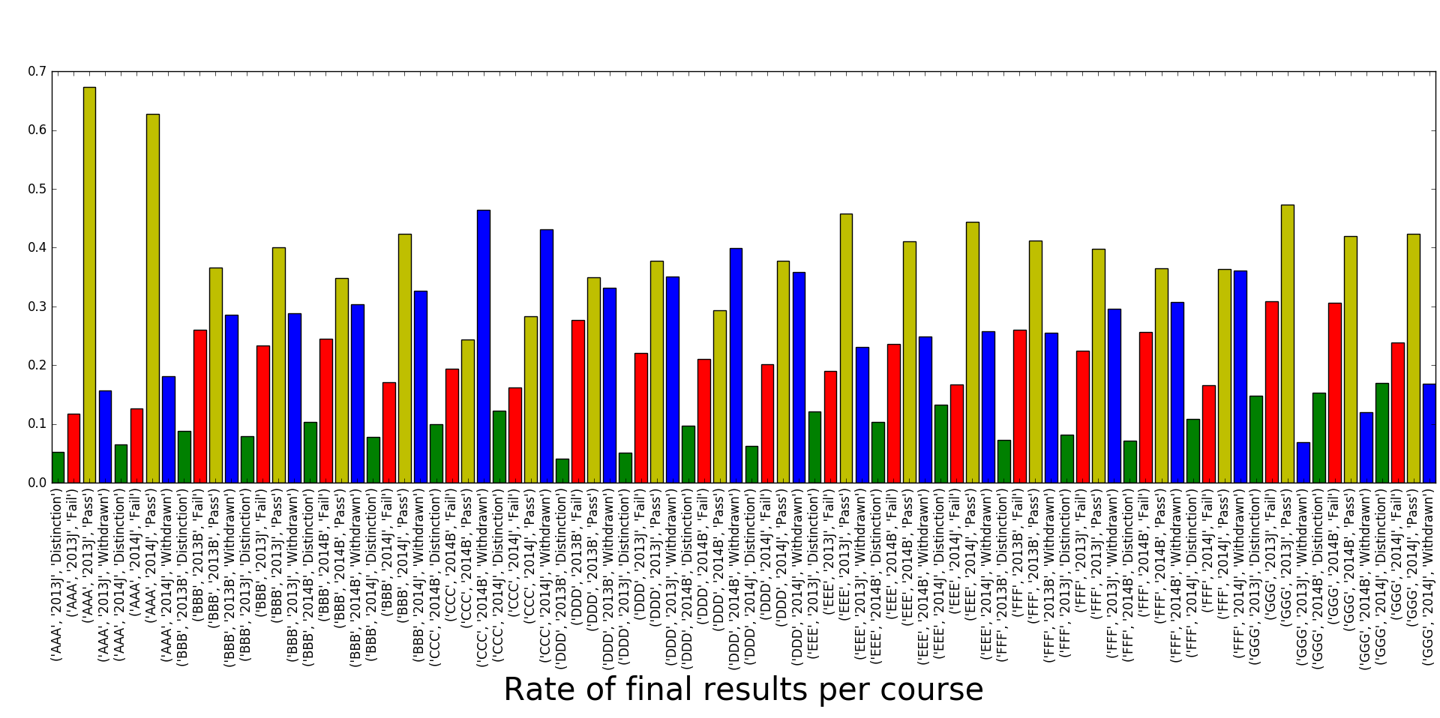

Slide 15
Insights
Rate of final results could be used as a tool to identify courses with high rate of withdrawal/Failures to better plan for future.
For instance course CCC and DDD have an alarming level of withdrawal. More research needs to be done to understand why.

Slide 16
VLE analysis
For comparison purposes, the following graphs show the average sum click on different course grouped by final result.

Slide 17
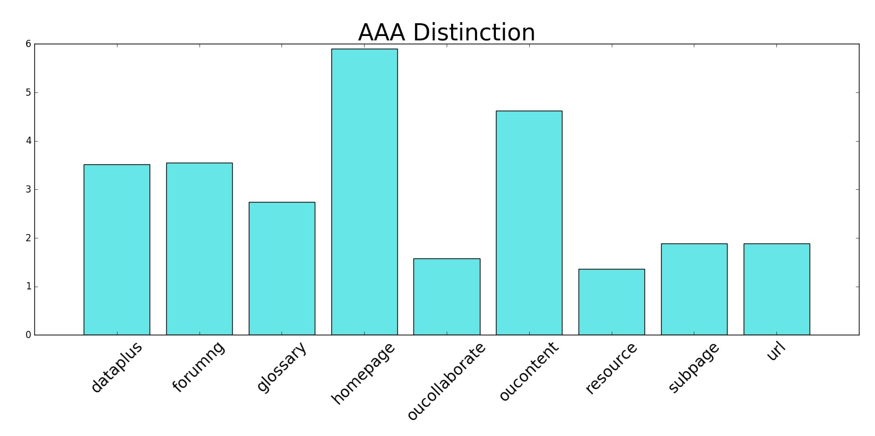
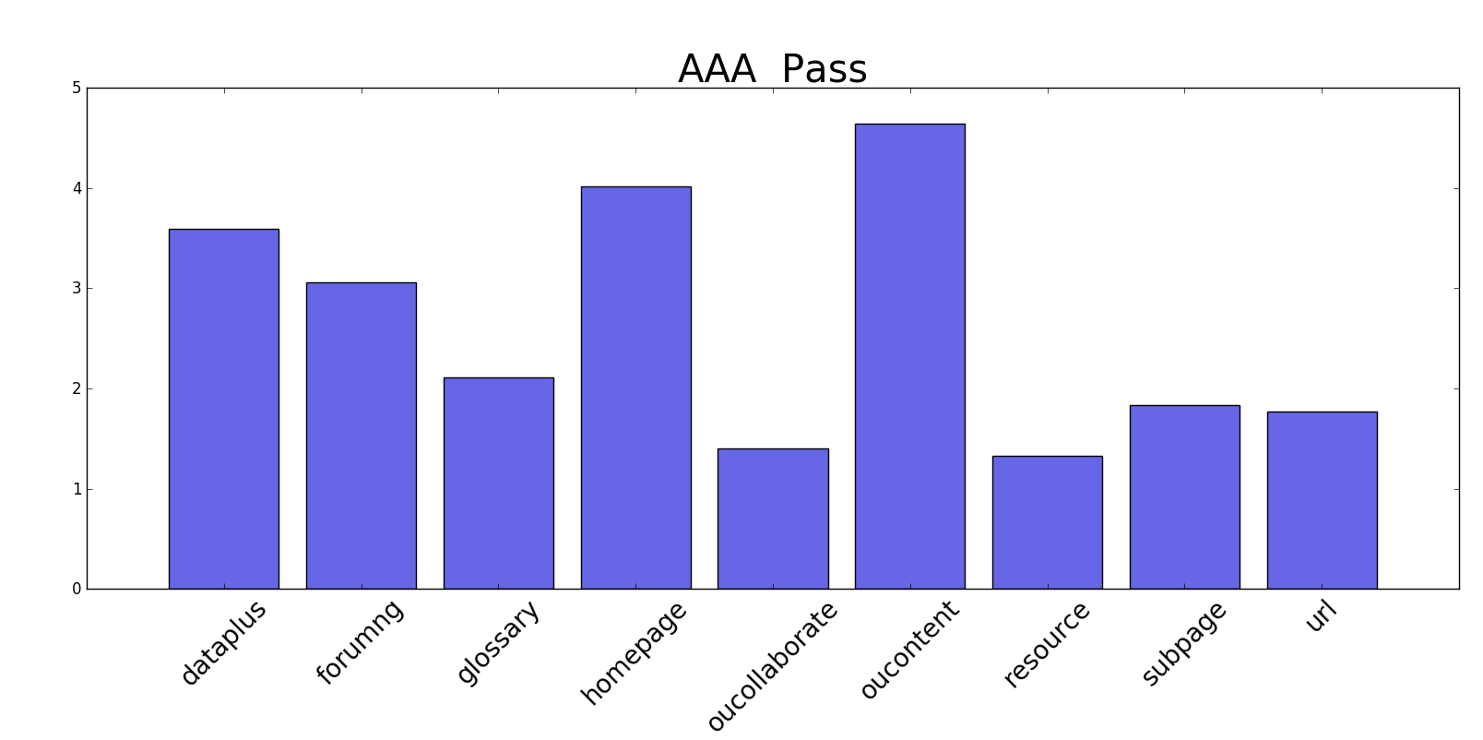
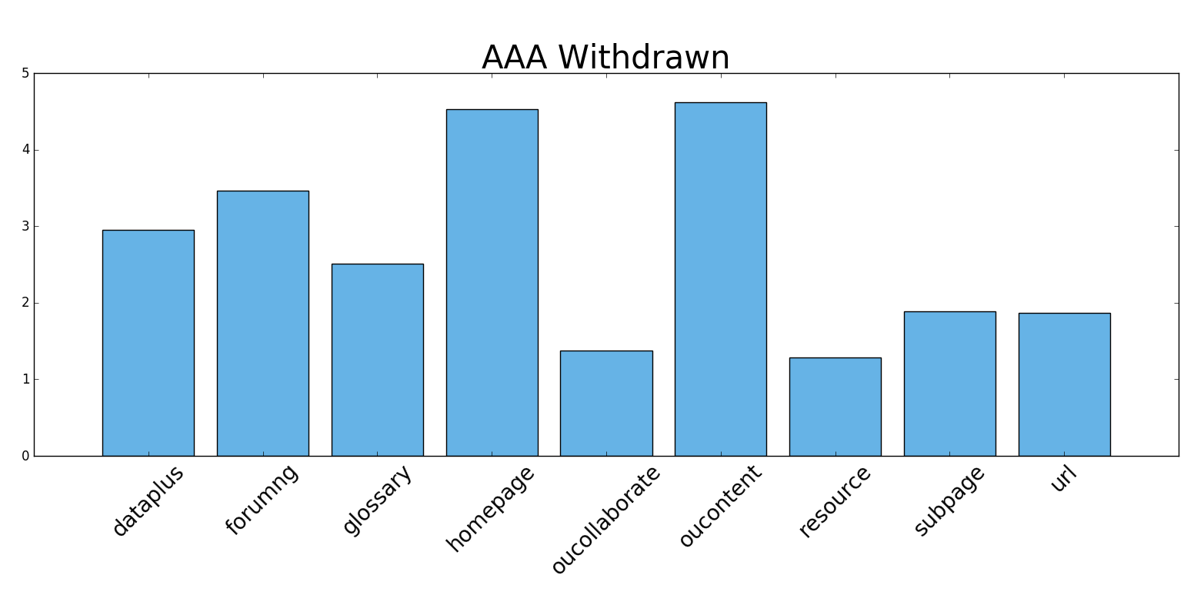
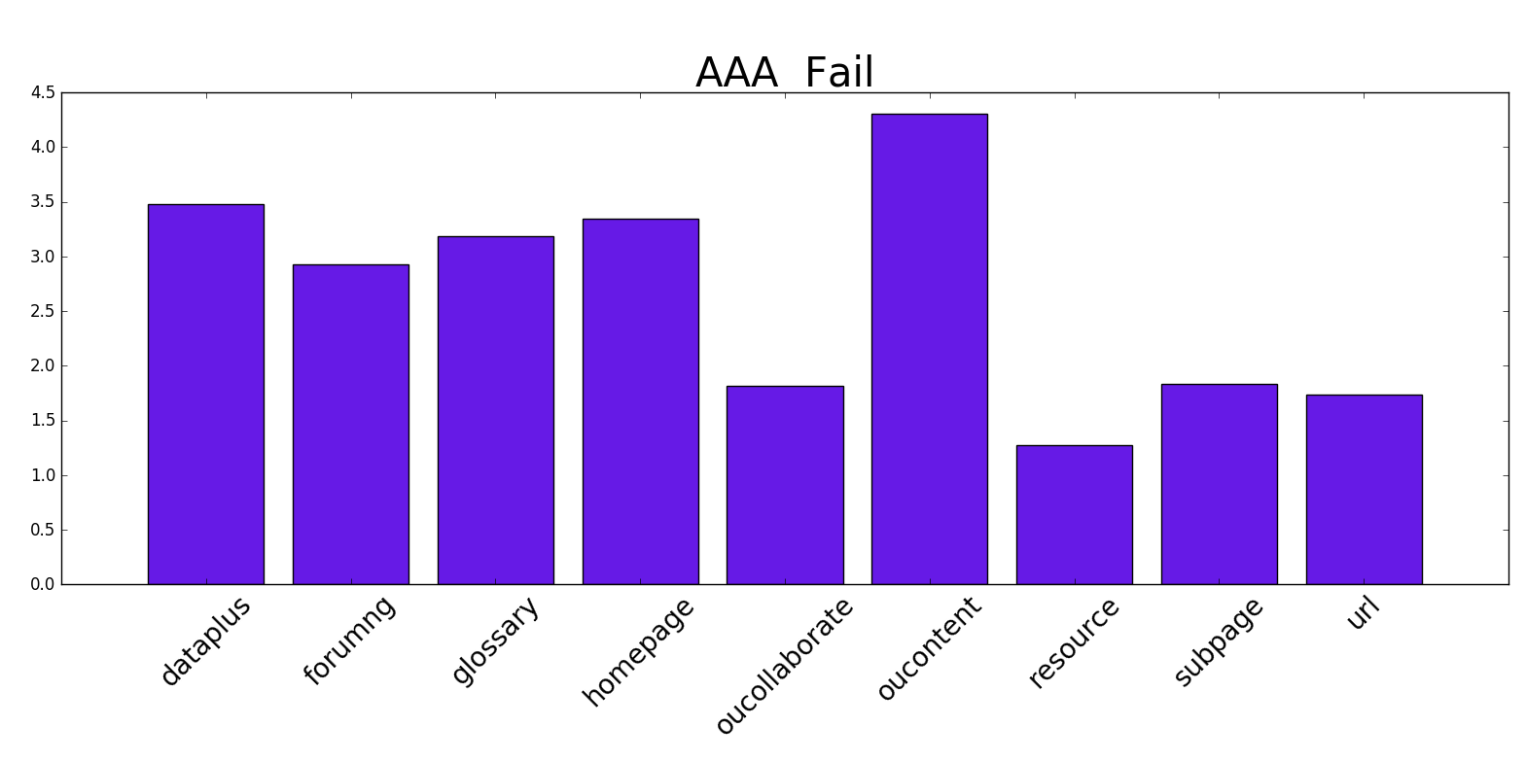

Slide 18
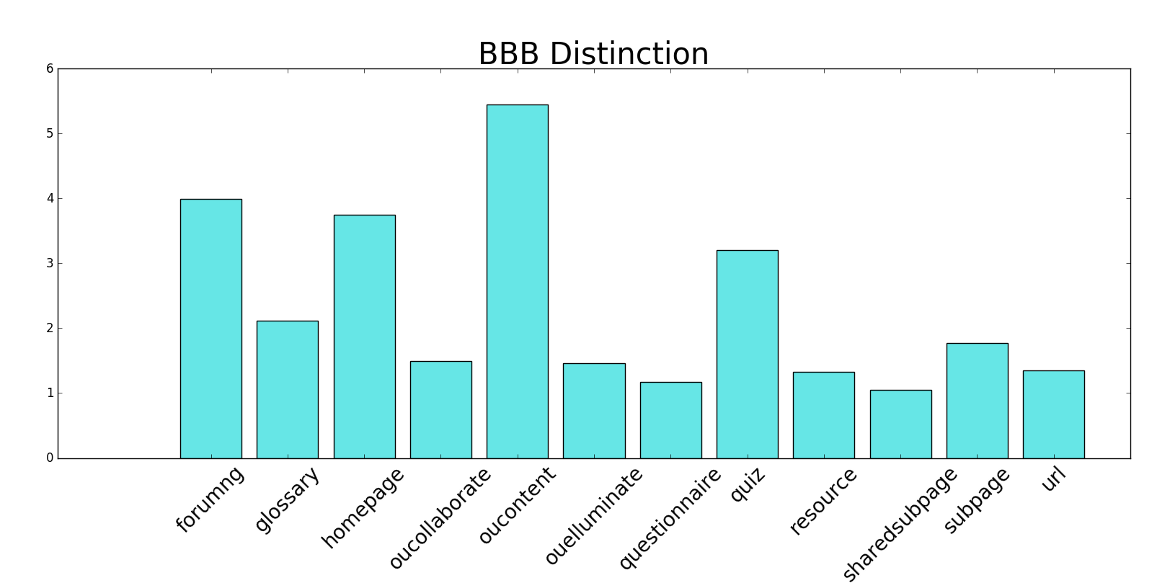
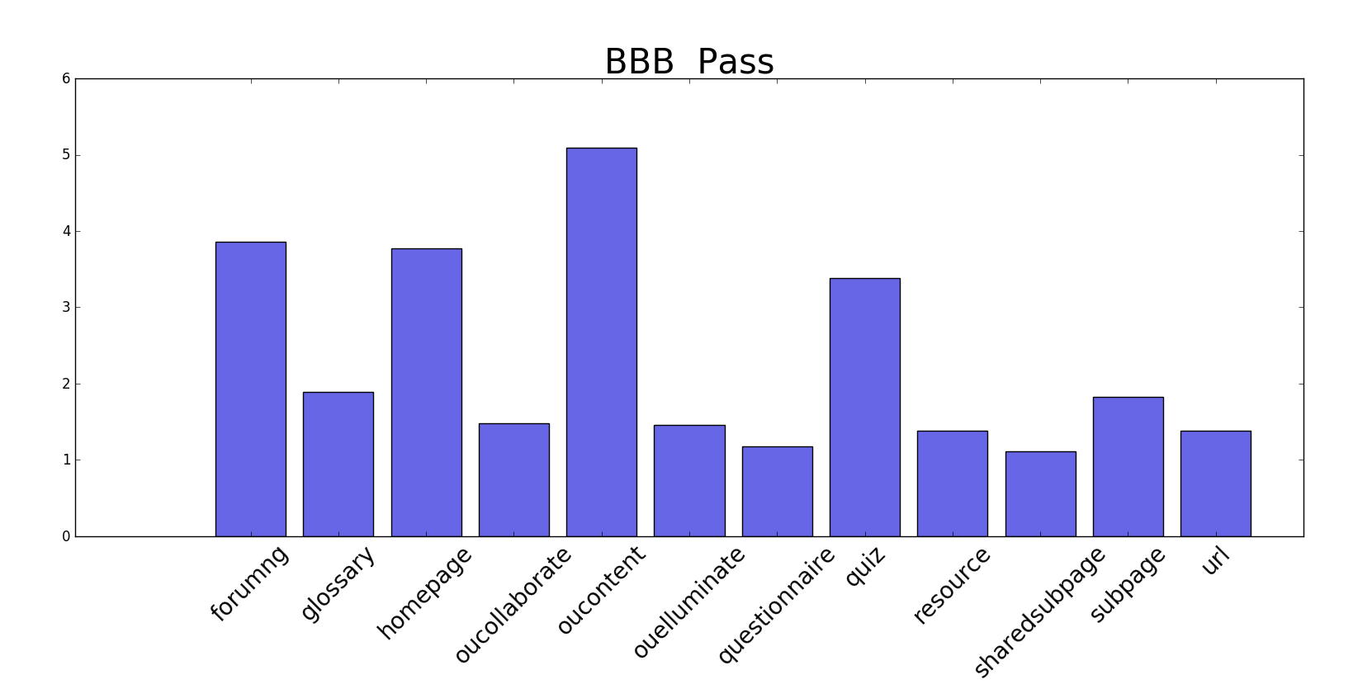
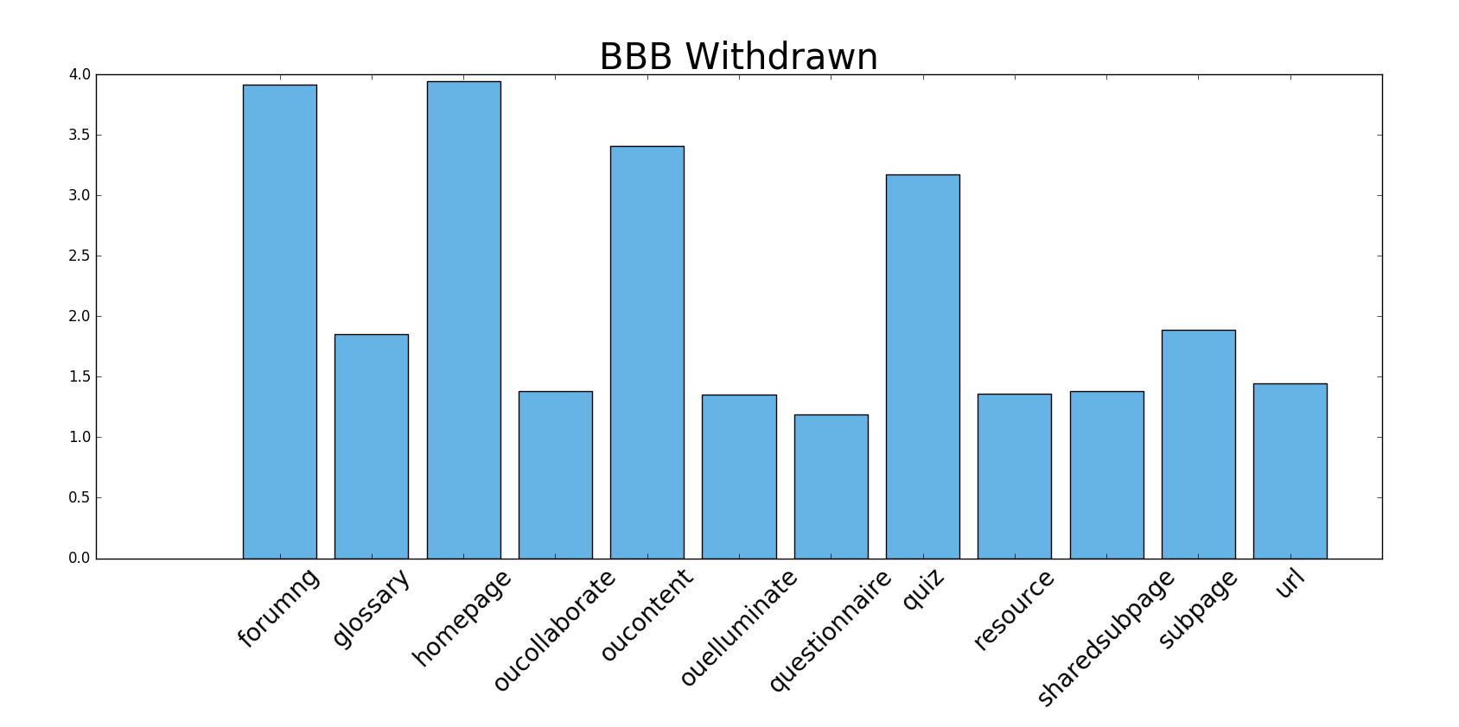
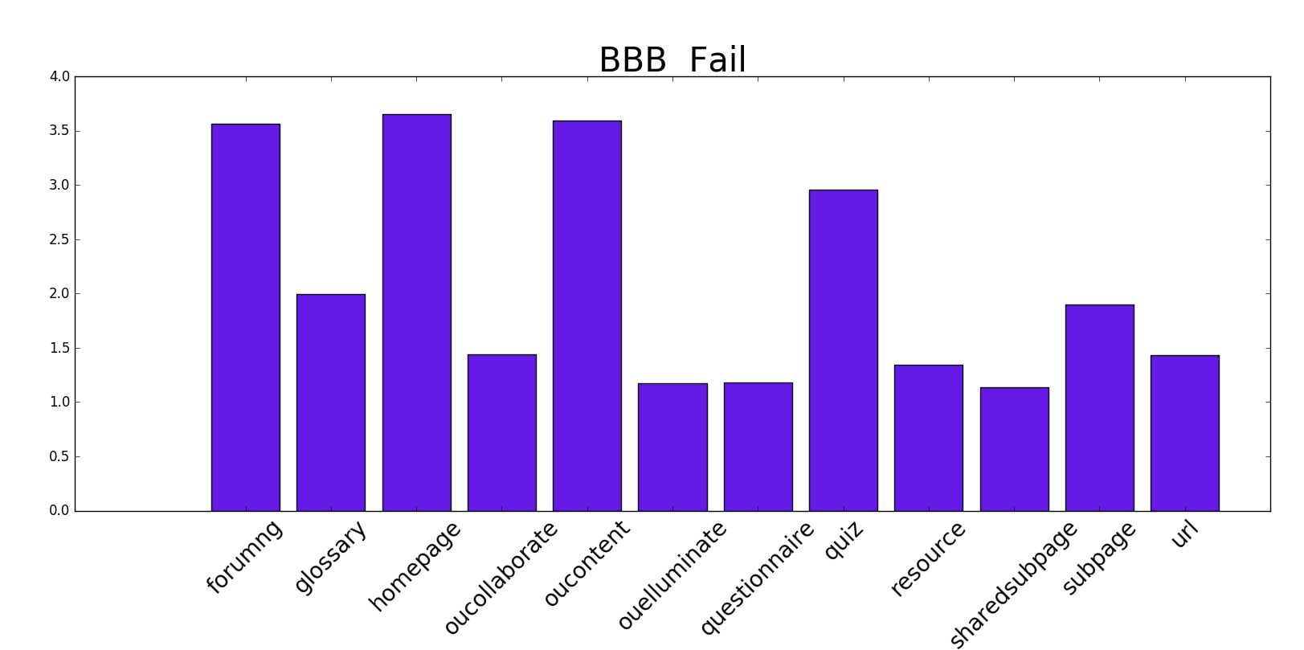

Slide 19
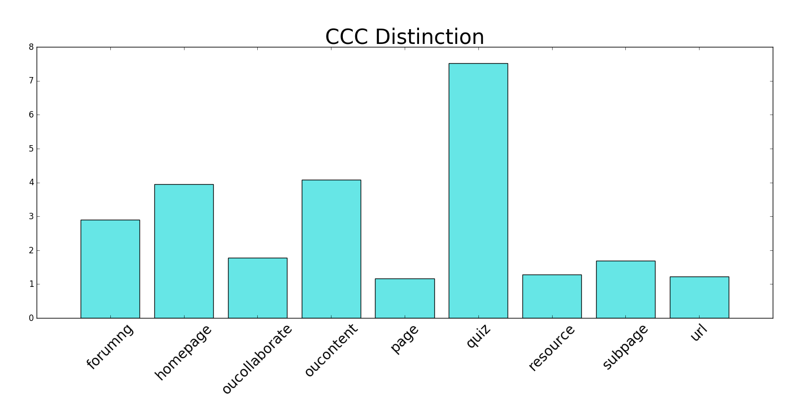
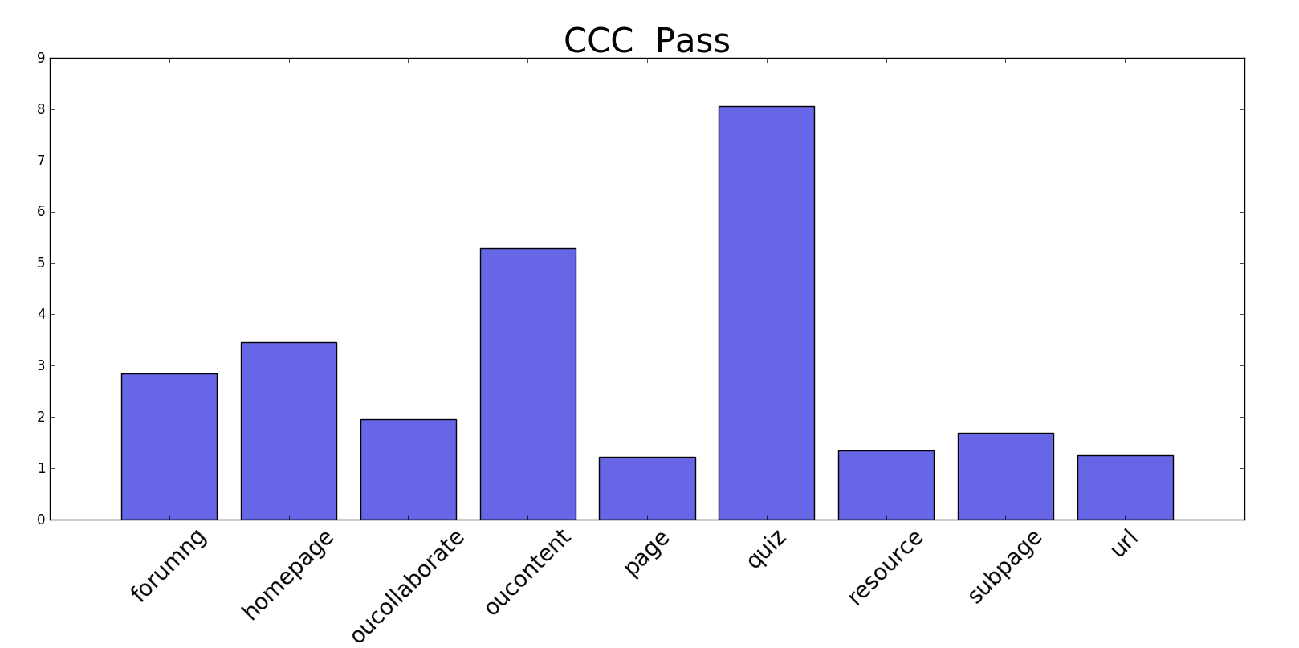
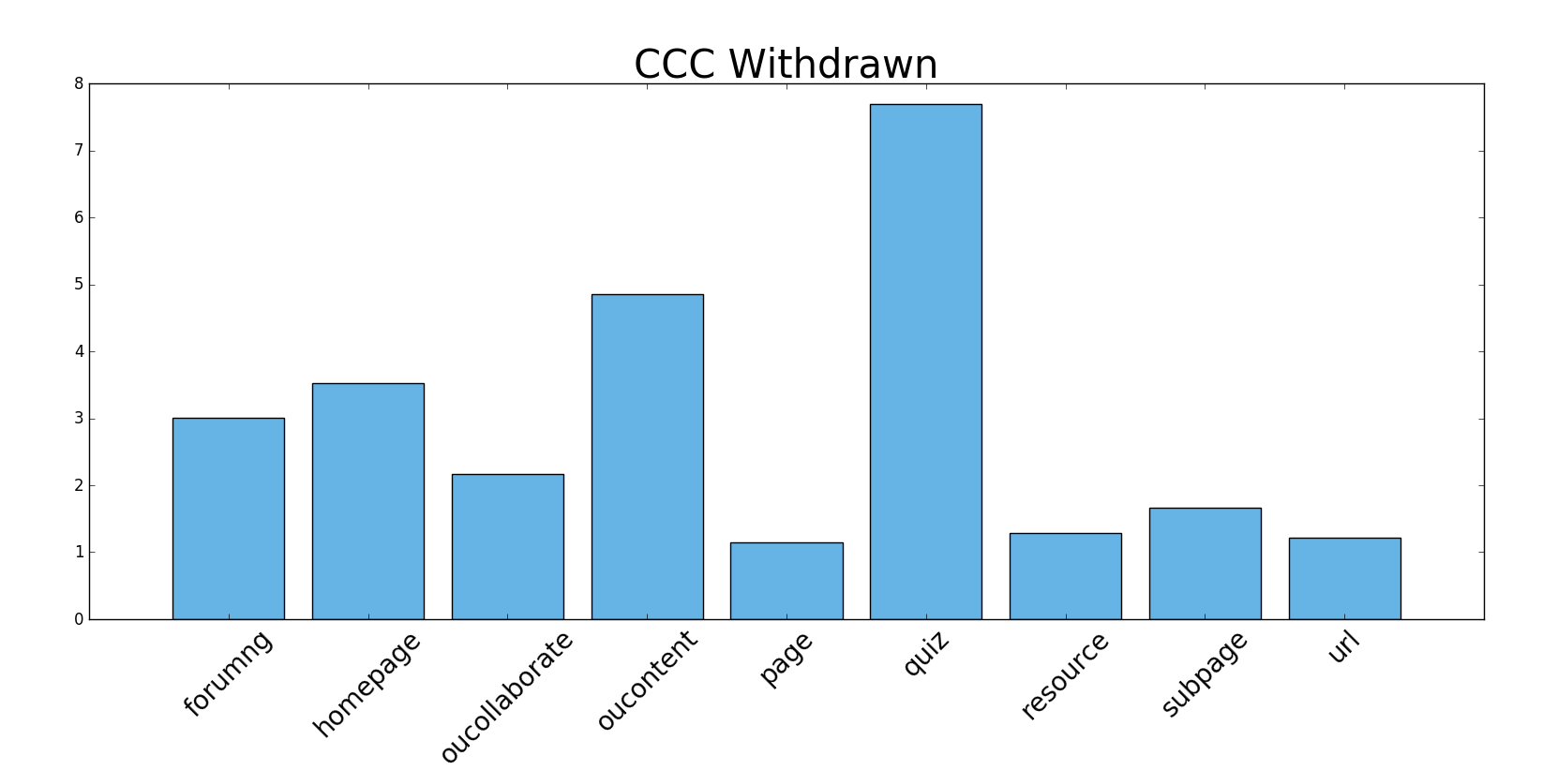
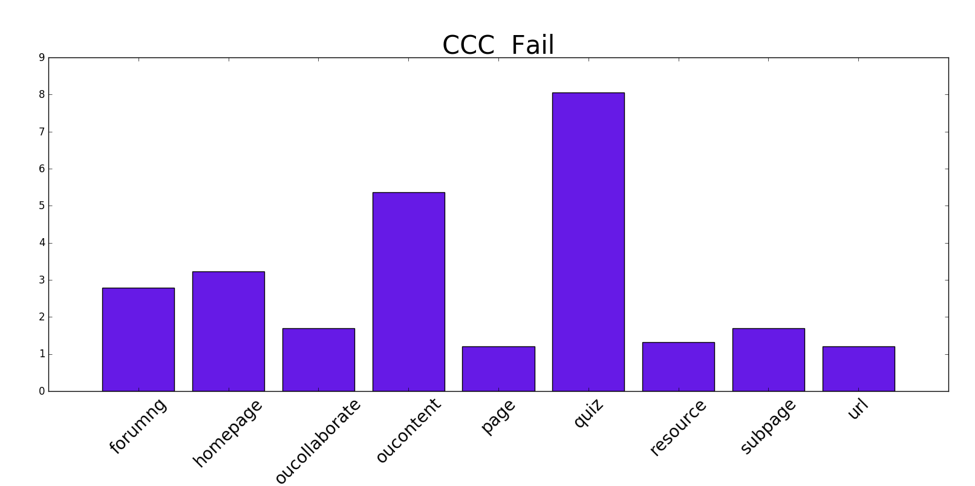

Slide 20
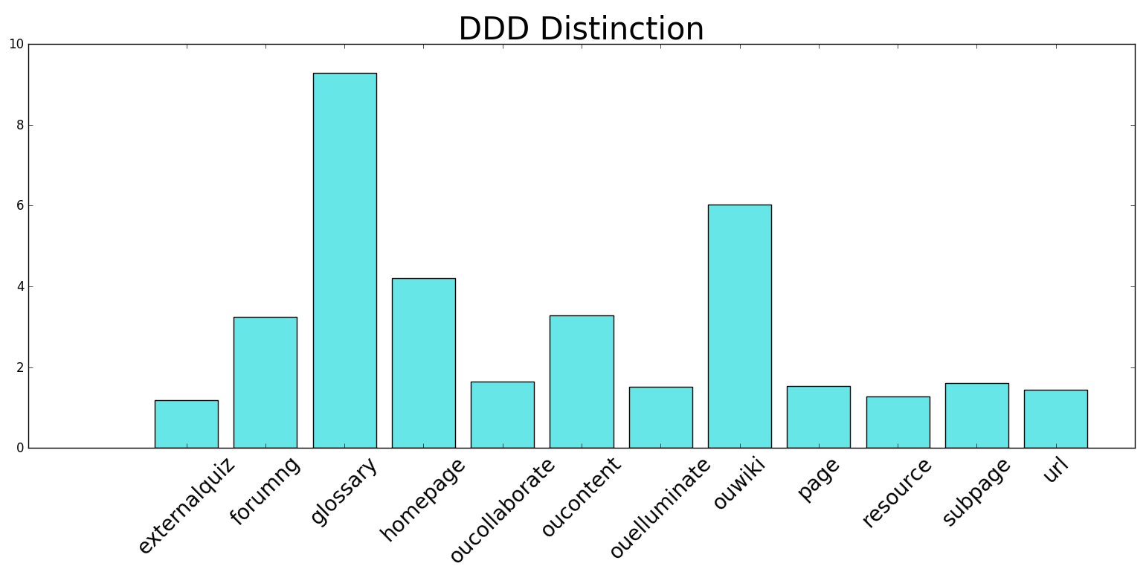
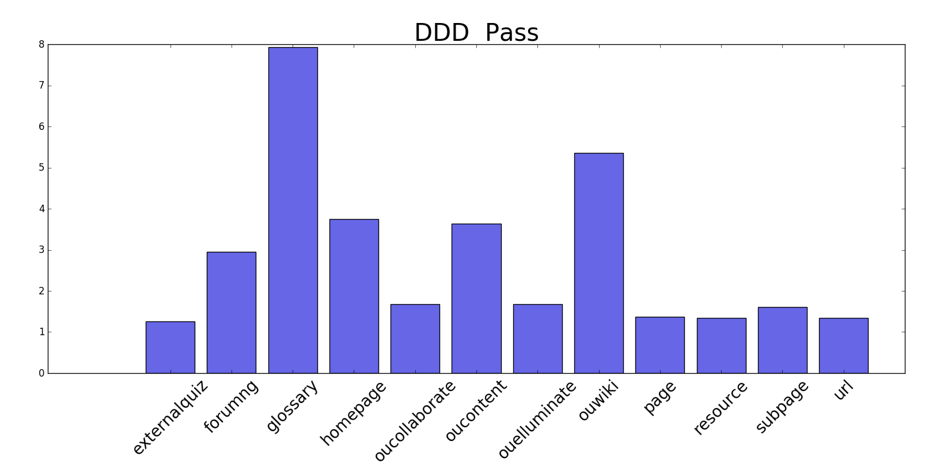
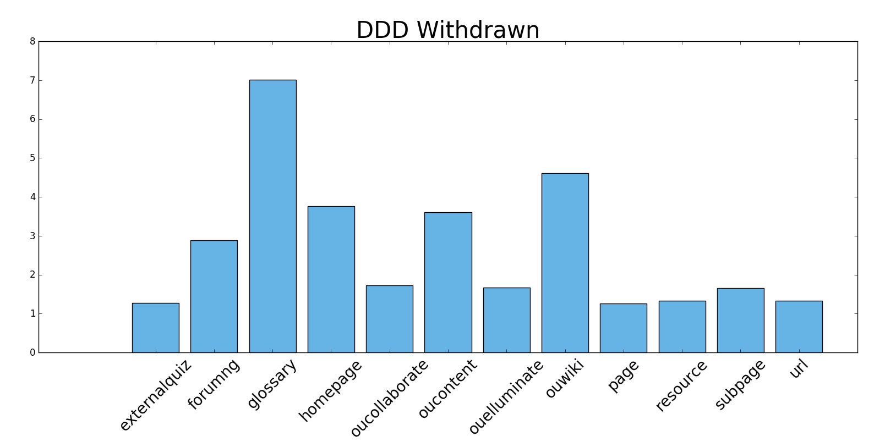
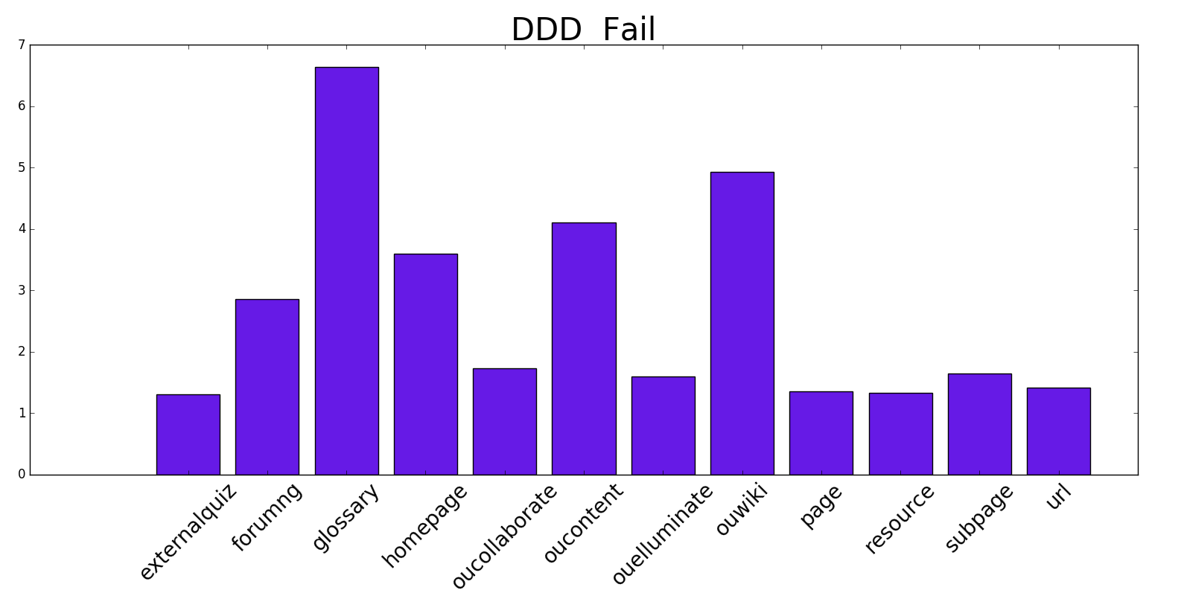

Slide 21
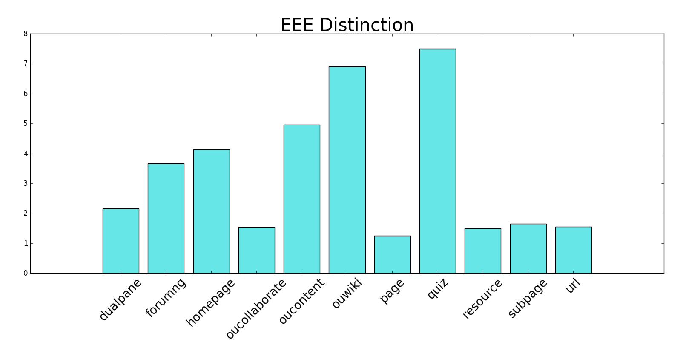
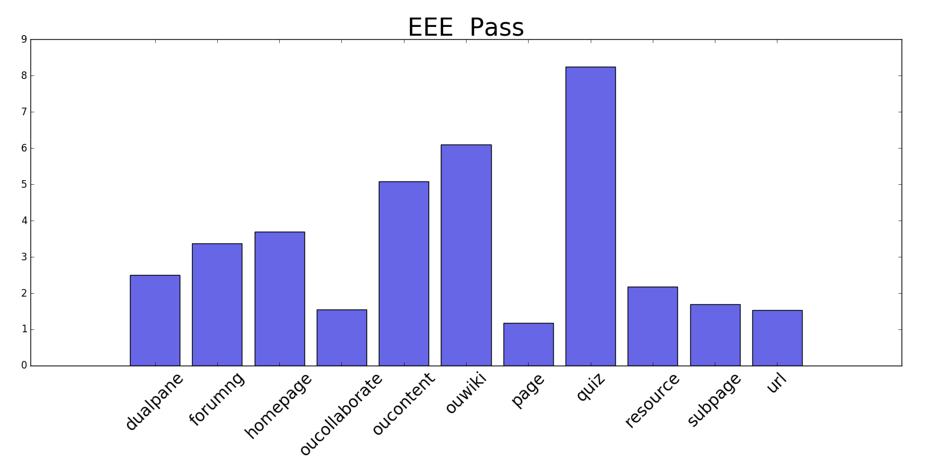
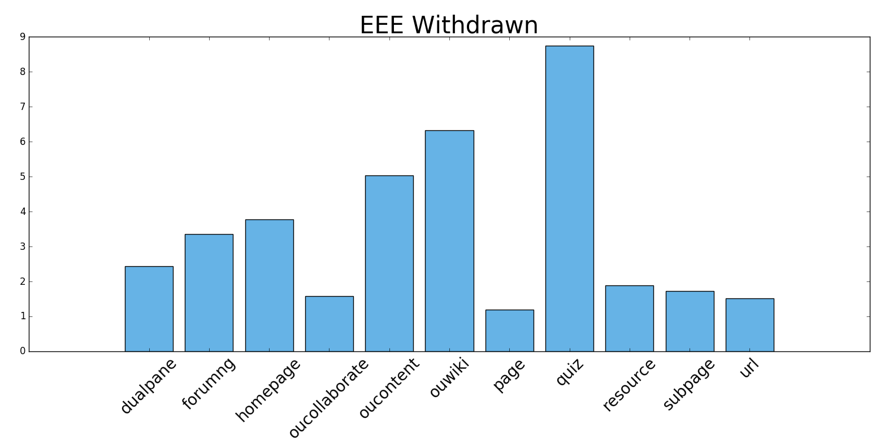
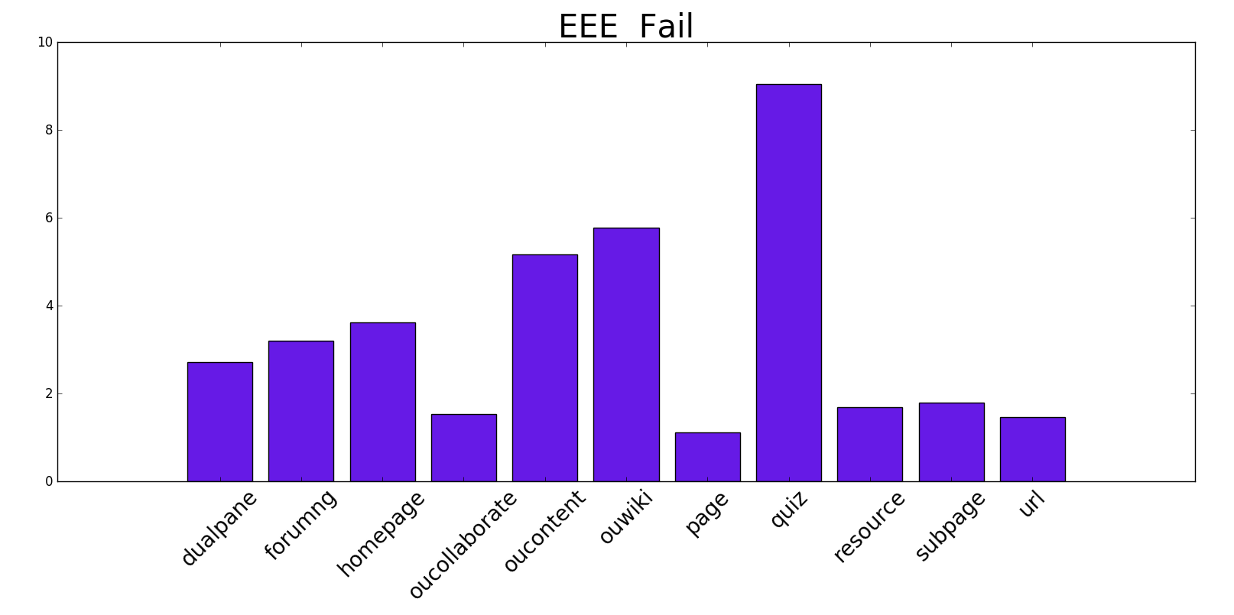

Slide 22
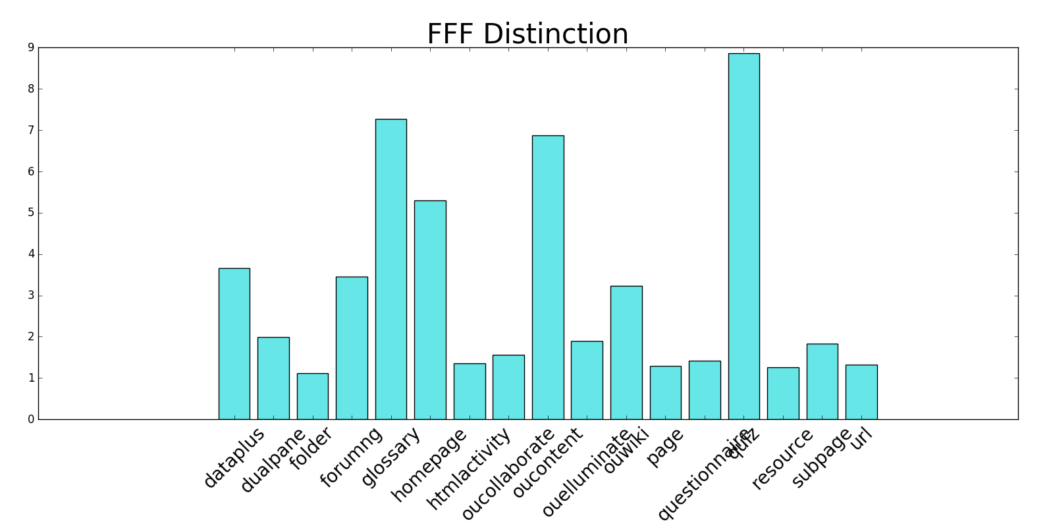
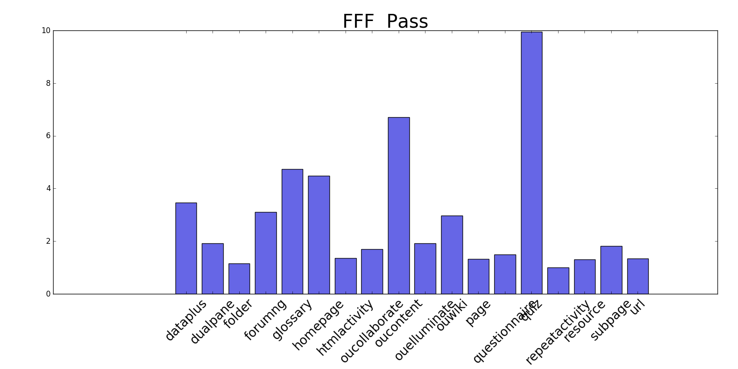
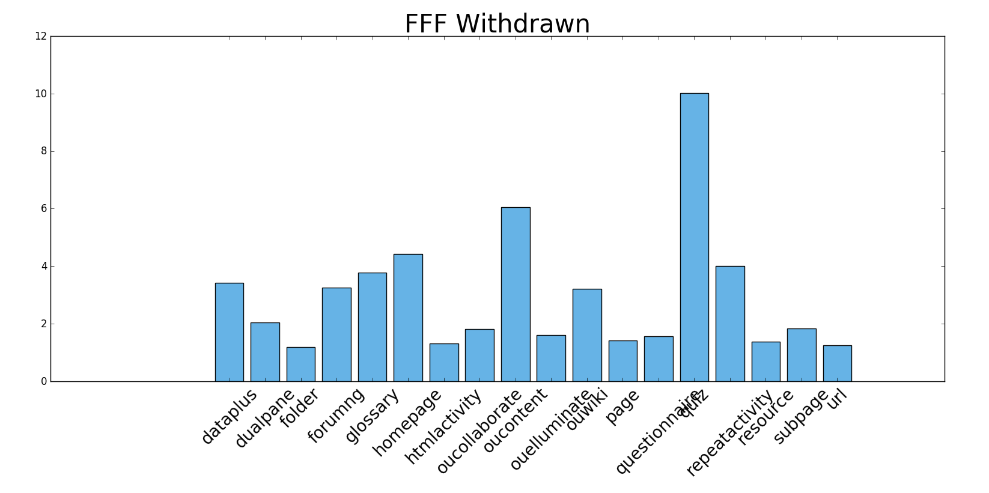
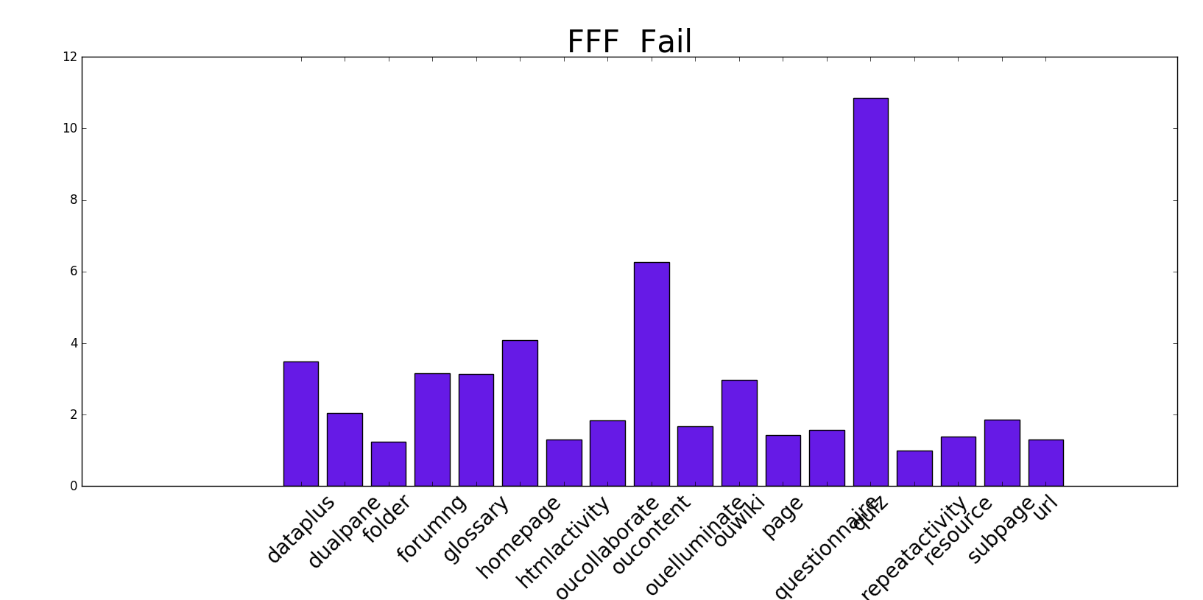

Slide 23
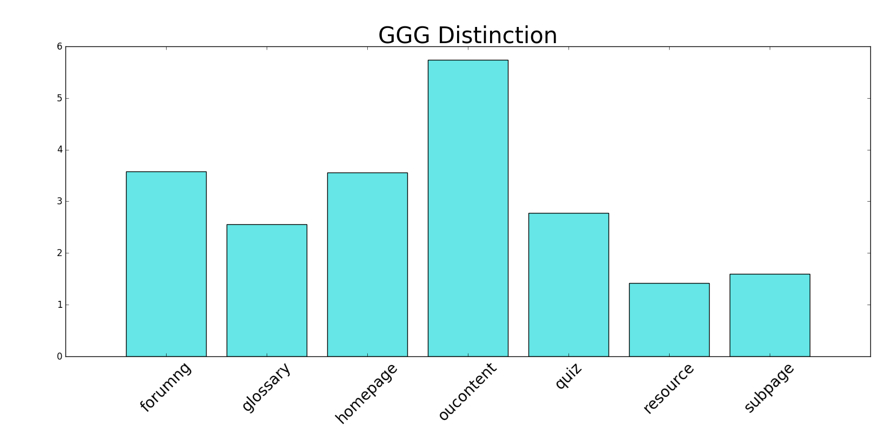
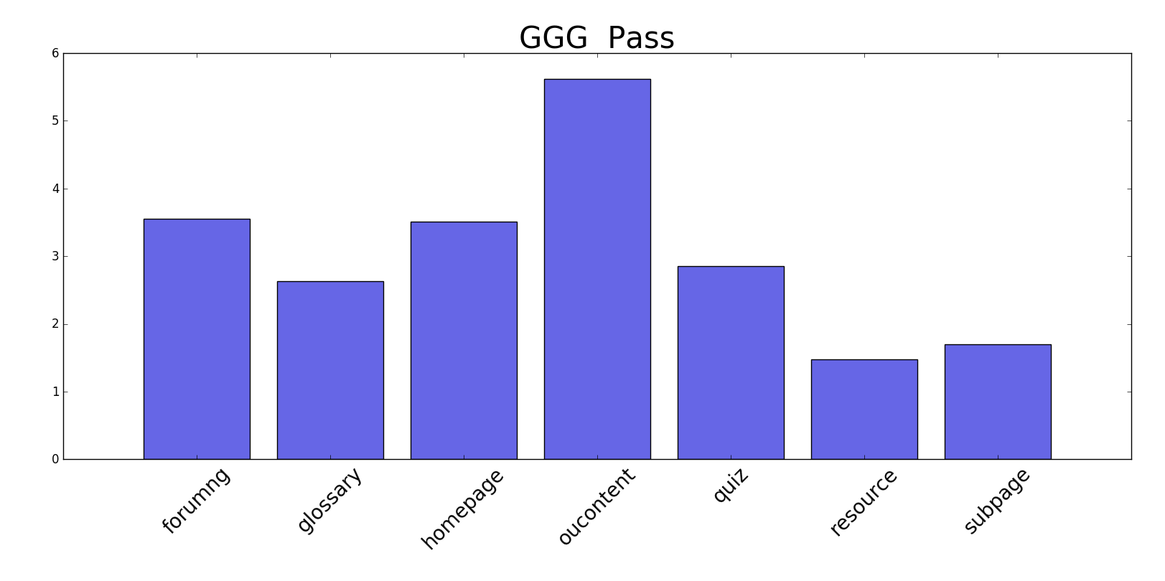
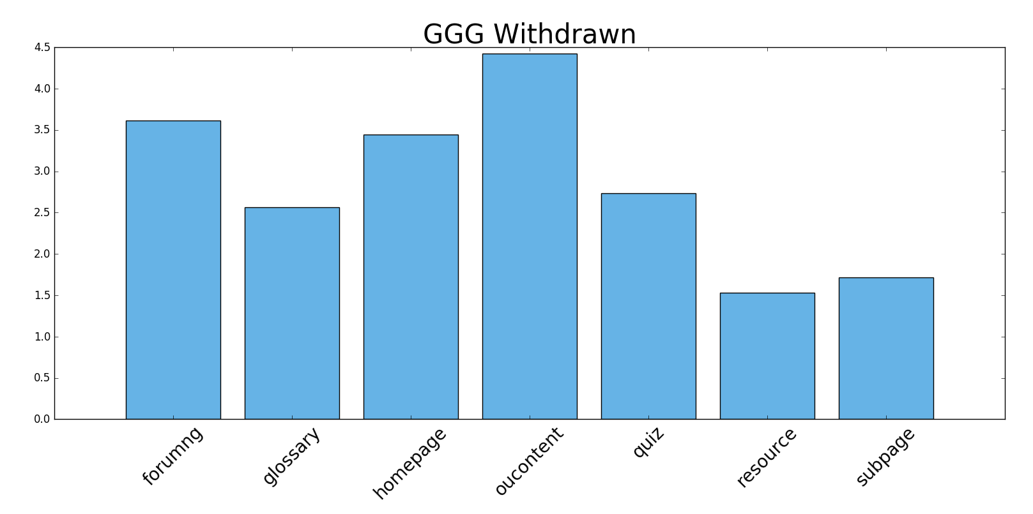
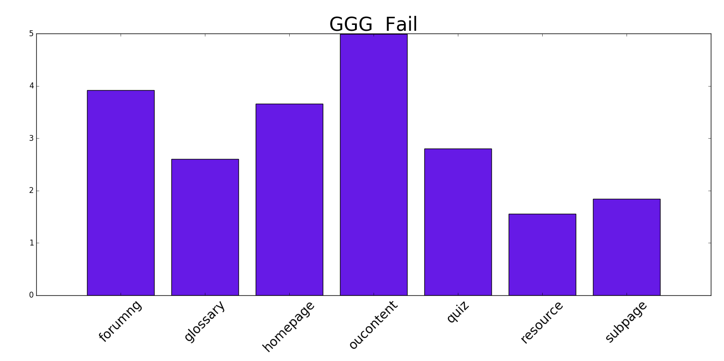

Slide 24
Key findings from the graphs
The first look at the graphs shows that there are little difference between the click pattern of students among categories of fail, pass, withdrawn and distinctions.
The patterns are different from course to course which is intuitive considering the type of the course being taught and types of VLEs being available.
For instance programming courses will rely more on forum discussions. Art courses rely more visual content
Therefore we should be cautious in comparing courses that are completely different in nature.

Slide 25
Predictive Analysis

Slide 26
Will a student withdraw from the course?
A predictive classification model is trained to identify the potential students who will eventually withdraw from the course
Features include the demographic info on the registered students
Accuracy of the XGBClassifier with 100 estimators is 70%
Further tuning could potentially improve the accuracy
Over-sampling/under-sampling may help with the imbalanced data

Slide 27
Suggestions
Using the predictive model, the identified withdrawal student could be sent incentive packages to motivate them to continue to finish the work:
Example 1: could be a discount on future courses which is potentially interesting to the particular student and the current course is a prerequisite
Example 2: Motivational handouts about the usefulness of the current course and its impact on the career of the student.

Slide 28
Will a student fail the course?
A predictive classification model is built and trained to identify failures before the semester starts.
The model, a XGBClassifier with 100 estimators, works with accuracy of 78%
The accuracy could be improved with further tuning of parameters
Features are the demographic data of students.

Slide 29
Suggestions
Identification of failures before the start of the semester help to reduce the potential failures by
Sending out motivational packages to identified students
Sending discount offers for one-on-one tutorial packages to help the students with the course material for two reasons:
Reducing the number of failures
Bringing in more cash flow

Slide 30
VLE predictive model
To see the effect of VLE methods on the performance of students the following model is developed:
Average sum click of students on different types of VLE activity in first 50 days of semester is retrieved.
The new features are added to the demographic features of students.
A classification model is built and trained to predict
Withdrawn vs the rest, RandomForest classifier with 75% accuracy
Failure vs the rest, RandomForest classifier with 78% accuracy

Slide 31
Goal
The goal of these models is to identify potential failures and withdrawals early in the semester to apply remedies to reduce these numbers and improve the performance (possible remedies as discussed in previous models)
Also, the importance of the classification features (demographic and VLE interactions) are obtained as following:

Slide 32
0.34301921006908082, 'studied_credits’
0.24026411728979385, 'code_module’
0.10219815353969898, 'forumng’
0.075054162302255506, 'homepage’
0.04874498676710403, 'url’
0.037452177945429779, 'disability’
0.033965104216421106, 'imd_band’
0.033603810269656746, 'subpage’
0.027801786679941133, 'oucontent’
0.027225644633525625, 'highest_education’
0.0097191198134190422, 'resource’
0.0084552034597073396, 'gender’
0.0081079461006127781, 'num_of_prev_attempts’
0.0025443011023215871, 'region’
0.0014147908872083643, 'code_presentation’
0.0004294849238233319, 'age_band'
Feature importance for Withdrawal vs other. Among VLE types, forumng, homepage and url are the most important ones.

Slide 33
0.21983294356909908, 'highest_education’
0.21490305295714279, 'num_of_prev_attempts’
0.12669528704423119, 'imd_band’
0.10766521622281239, 'homepage’
0.062960305515281464, 'forumng’
0.050806433820104767, 'oucontent’
0.041976516015754396, 'subpage’
0.039987071627910833, 'code_presentation’
0.03915180571219018, 'age_band’
0.032171684016401227, 'url’
0.017324356334231485, 'code_module’
0.016378539207643386, 'resource’
0.016201901356134966, 'studied_credits’
0.012114033467197518, 'region’
0.0016895722403669862, 'gender’
0.00014128089349726991, 'disability'
Feature importance for Fail vs other. Among VLE types, homepage, forumng and oucontent are the most important ones.

Slide 34
Suggestions
Identifying the most important VLE activity types could help us with an experimental design to improve the course performances.
The experiment could be randomized block design of influential parameters at different levels which will be tested on samples of students.
The results expressed in failure/ withdrawal, overall score and student evaluation of the course could be used as a base to compare different designs of the courses according to presented VLE activities.
Also, to better evaluate the impact of VLEs on the performance of a course, a survey needs to be conducted on the experience of students with the material.

Slide 35
Conclusion
In this research I analyzed the OULAD datasets to better understand the performance of 7 presented courses based on demographic data of students as well as their interactions with the applied VLEs.
Disclaimer: This analysis is not an exhaustive work on the data and there are many more insights to be discovered.

Slide 36
References
Kuzilek J., Hlosta M., Zdrahal Z. Open University Learning Analytics dataset Sci. Data 4:170171 doi: 10.1038/sdata.2017.171 (2017).

