Slide 1
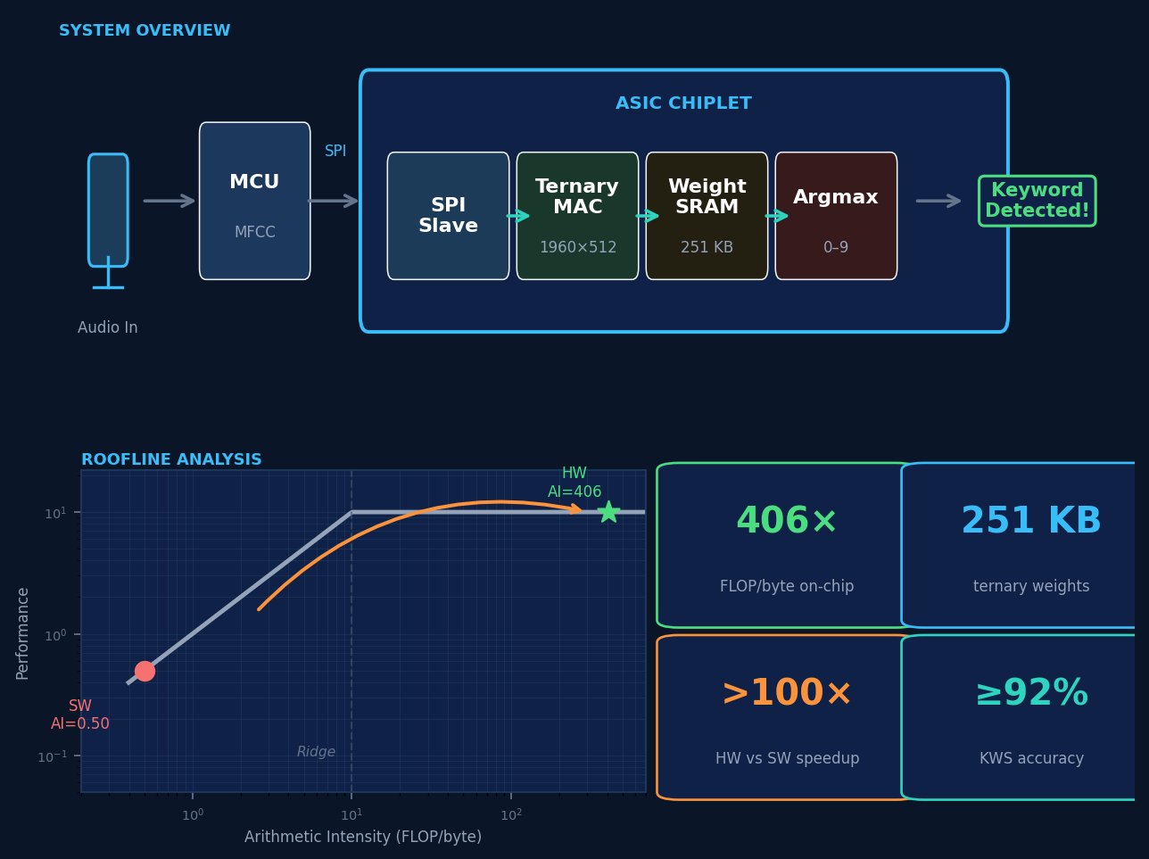
TERNARY KWS ACCELERATOR
Always-On Keyword Spotting on Silicon · ECE 410/510 · Spring 2026 · Manaf Alali
1
What Am I Doing?
Custom chip: hears a spoken keyword, always-on, battery-powered
Weights are only −1, 0, or +1 — no multiplication needed
2
How's It Done?
Standard approach: CPU/GPU — accurate but power-hungry
Key insight: keep weights on-chip, avoid slow external memory
3
What Am I Doing Differently?
On-chip storage flips the bottleneck: memory → compute (see roofline)
Weights ±1/0 replace all multipliers with add or subtract
4
Accomplished So Far
SW: 0.44 ms/inference, confirmed bottlenecked by memory
Math core + SPI interface written and working in simulation
5
What's Next?
Run synthesis → real chip area, power & speed numbers
Compare HW vs SW — target more than 100× faster
FC1: 1960→512, 2M FLOPs, 251 KB ternary weights on-chip | AI = 0.50 (SW) → 406 FLOP/byte (HW) | github.com/alali1o/ECE-410

