Slide 1
Problem Identification
Problem Statement: How can Big Mountain Resort capitalize on their facilities through pricing their tickets based on important factors in their market segment and cut costs without impacting ticket prices?
Context: Current pricing and the market
Success Criteria: Identifying important factors affecting ticket prices
Scope of Solution Space: Extent of analysis
Constraints: Data limitations
Key Data Sources: Data from the client

Slide 2
Recommendation and key findings
Big Mountain Resort is one of the best equipped ski resorts in the market
Current ticket pricing strategy does not capitalize on the resort’s facilities
Ticket price can be increase to $94.22 (expected mean absolute error of $10.39)

Slide 3
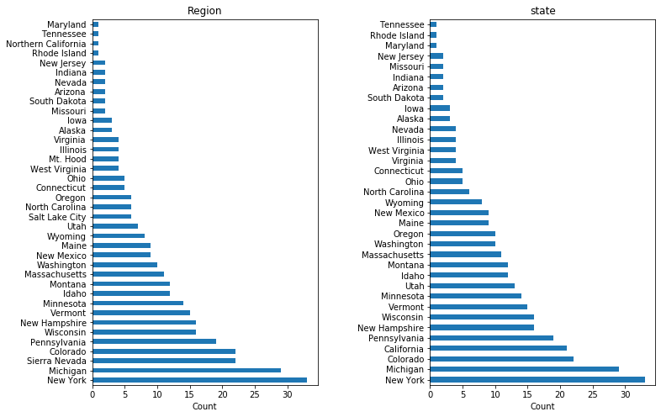
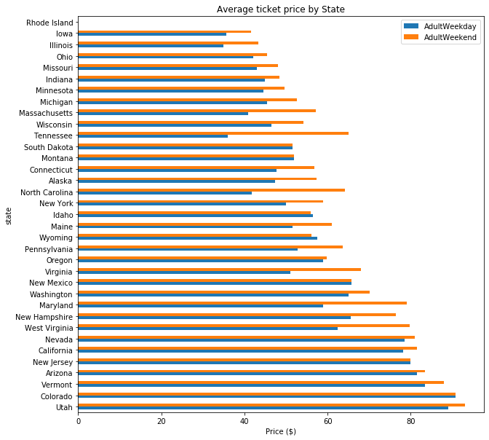
Available Data and assumptions
Available data covered 330 resorts located in 35 different states / 38 different regions
Assumption of a free market

Slide 4
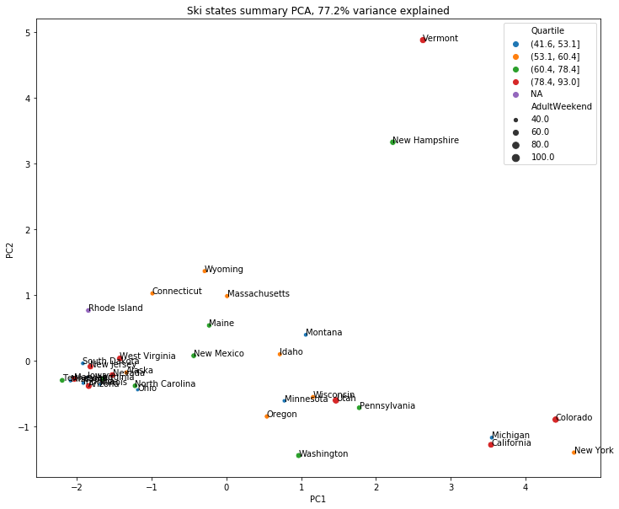
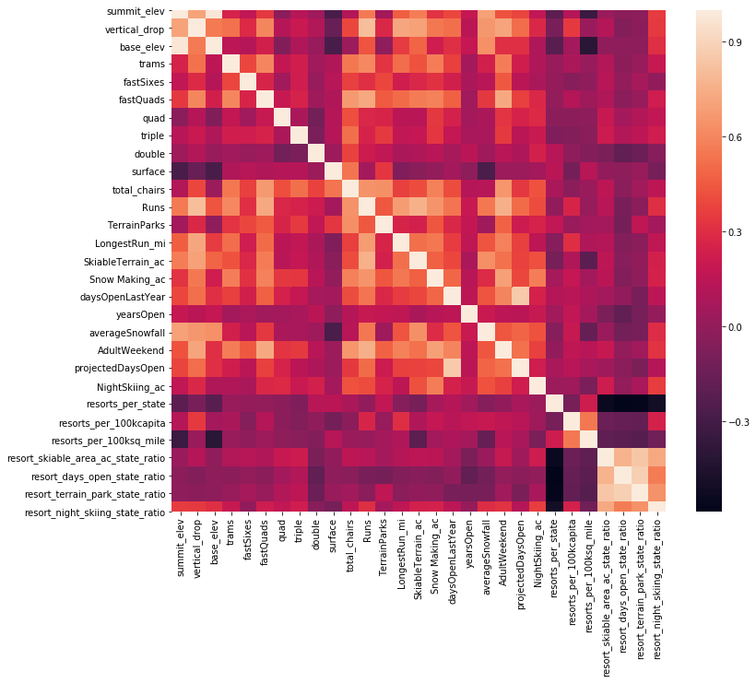
Patterns and correlation in data
There was not a clear pattern indicating state dependent ticket pricing
Some features were highly correlated

Slide 5
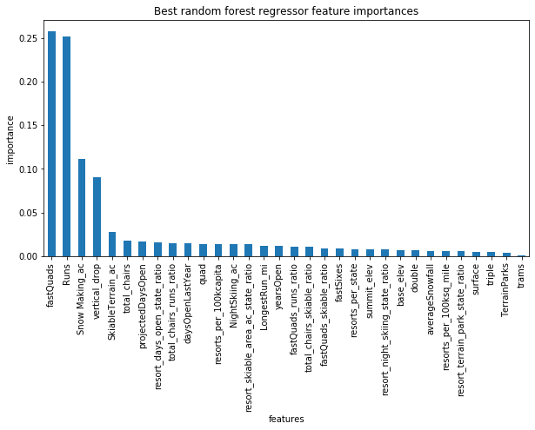
Model selection
Best Linear Regression and Random Forest models
Selected model performance and important features

Slide 6
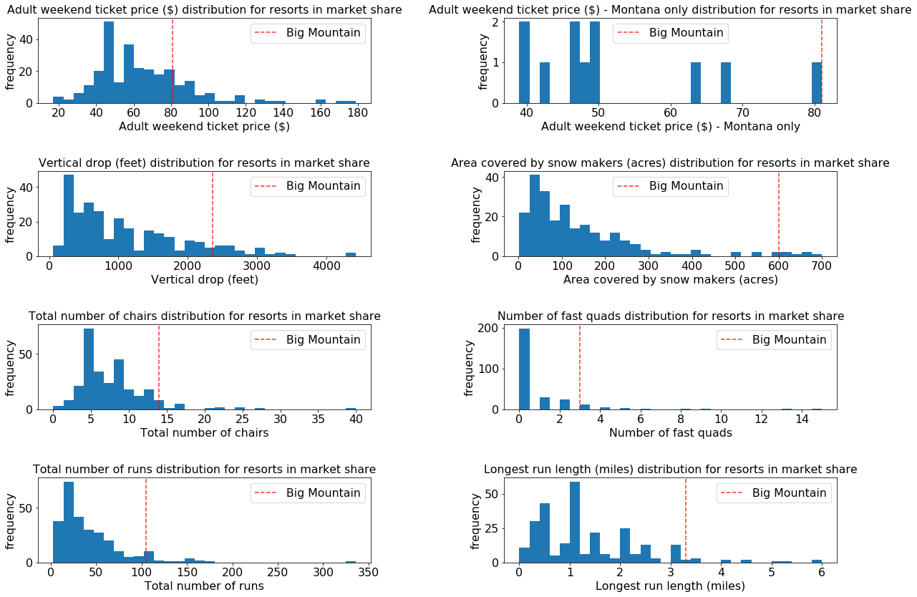
Price prediction and other scenarios
Big Mountain Resort’s position in the market
Predicted price ($94.22, MAE of $10.39) and pricing under proposed scenarios

Slide 7
Summary and conclusions
Big Mountain Resort’s position in the market requires a strategy based on market conditions for pricing tickets to capitalize on existing facilities
There is substantial room for increasing ticket prices given the resort’s facilities
Some important features impacting the ticket prices in the market include number of fast quads and number of runs followed by the ski area supported by snow making equipment and vertical drop
The model developed can be utilized to analyze how ticket prices would be affected under different scenarios for cutting costs and/or investing in new facilities

