Slide 1
GCIS – Software Development and Problem Solving
Final Exam - Written
Take Quiz – Final Exam
Password -EndOfJava
Practicum
Accept assignment Final Exam under Instructor -> Alam -> Exam and Clone the repository for Final Exam
Auto Commit is enabled for your repository. DO NOT disable it. Disable code completion/co-pilot. Reach out to instructor or TA if you need help.

Slide 2
GCIS – Software Development and Problem Solving
Quiz
Take Quiz 13.3: BackTracking
Password - backTotheFuture!!
Next →
After completing the Quiz
Clone/Pull Unit12 – git hub classroom repo for class activities

Slide 3
GCIS – Software Development and Problem Solving
Quiz
Take Quiz 13.1: Greedy Algorithm
Password –PotOfGreedyAlgorithm
Quiz 13.2 Dijkstra Algorithm
Password - cantSpellDijkstra
Next →
After completing the Quiz
Clone/Pull GitHub Classroom Assignment for Unit 13, if not done already.

Slide 4
GCIS – Software Development and Problem Solving
Quiz
Quiz 10.2: HTTP2
Password – ProtoCall
Quiz 10.3 Networking and HTTP Review
Password - PacketFrames
Next →
After completing the Quiz
Accept GitHub Classroom Assignment for Unit 11
Clone GitHub classroom repo for Unit 11 under softdevII folder.

Slide 5
GCIS – Software Development and Problem Solving
Quiz
Take Quiz 9.2: Protocol
Password - ThreadingTheNeedle
Next →
After completing the Quiz
Accept GitHub Classroom Assignment for Unit 09
Clone Unit9 – git hub classroom repo for class activities

Slide 6
Git Commands
Git Configuration
git config –global user.name “NAME”
git config –global user.email “EMAIL Address”
PyTest Installation
pip install -U pytest
python -m pip install -U pytest

Slide 7
GCIS – Software Development and Problem Solving
Take Quiz | After Quiz
Quiz 12.2 Queues Password: nodesAreGood Quiz 11.3 More Stack & Queues Password: whamBamQuizMan | If you have not taken survey for this class (Section 13), Take survey at https://rit.smartevals.com ============================================ Clone Git Repository for assignment “Assignment-Unit13” Steps Click on Assignment Link and copy the git repo URL Execute following command cd ~ cd softdev1 git clone <Replace with Assignment URL> ➔ Open the cloned repository folder in VS Code Editor

Slide 8
GCIS – Software Development and Problem Solving
Take Quiz | After Quiz
Quiz 12.1 Stacks Password: nodeNodeNode | Git Pull Assignment-Unit-12 for class activities

Slide 9
GCIS – Software Development and Problem Solving
Quiz
Take Quiz 13.1 –10QuestionQuiz
Take Quiz 13.2 – Review Part 2- 10MoreQuestions
Next →
After completing the Quiz
Clone or Pull Assignment-Unit13 for class activities
Fill Out the CLASS EVALUATION if you have not done yet.

Slide 10
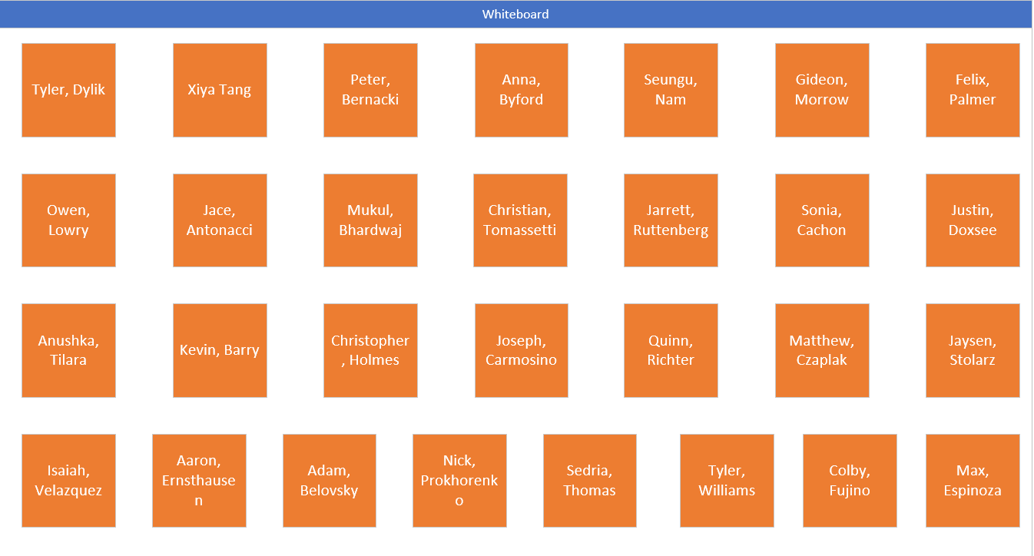
Use Assigned Seat

Slide 11
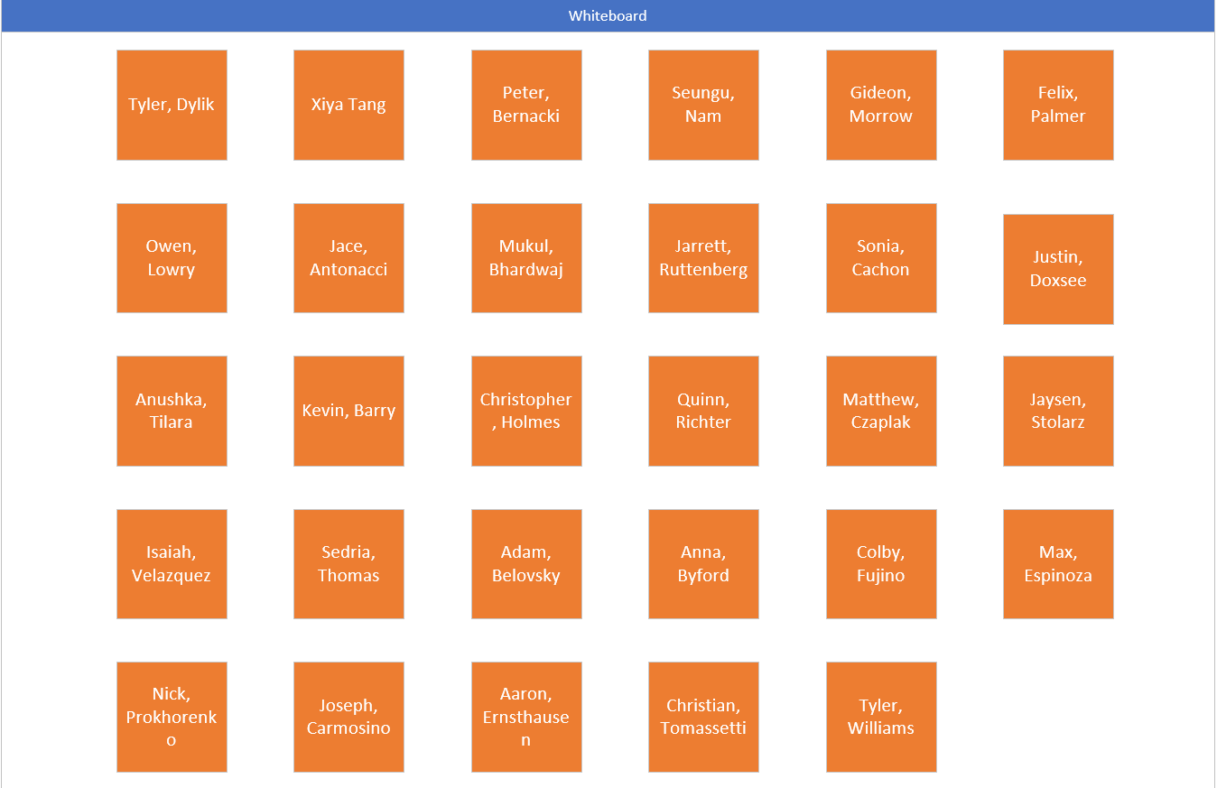
Use Assigned Seat

Slide 12
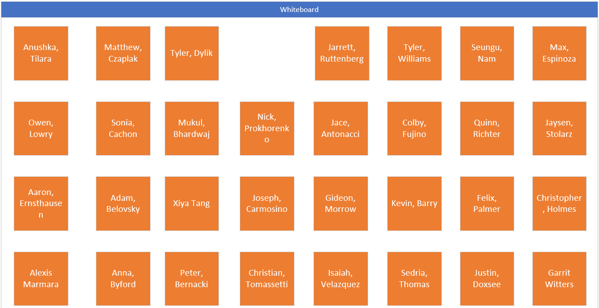
Use Assigned Seat

Slide 13
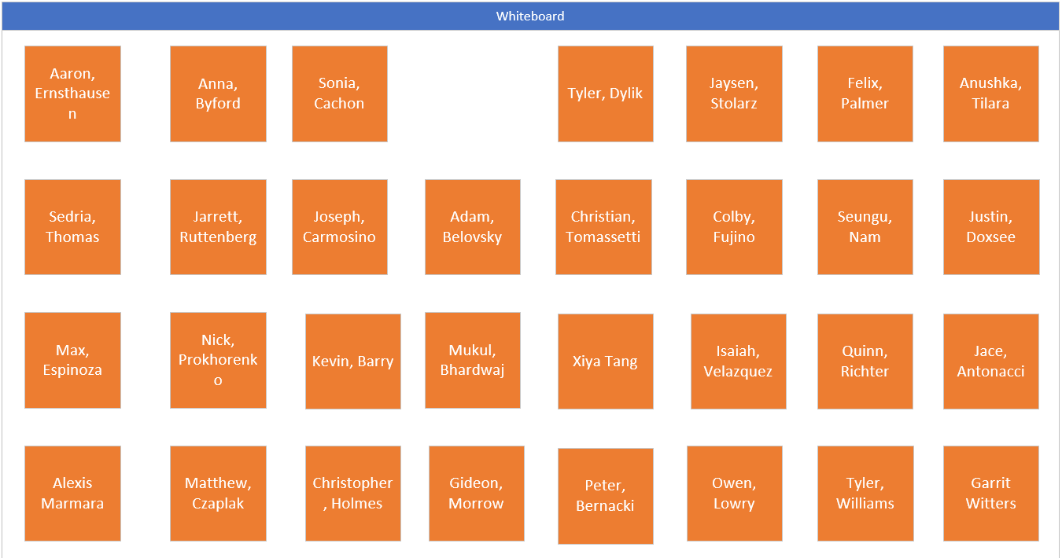
Use Assigned Seat

