Slide 1
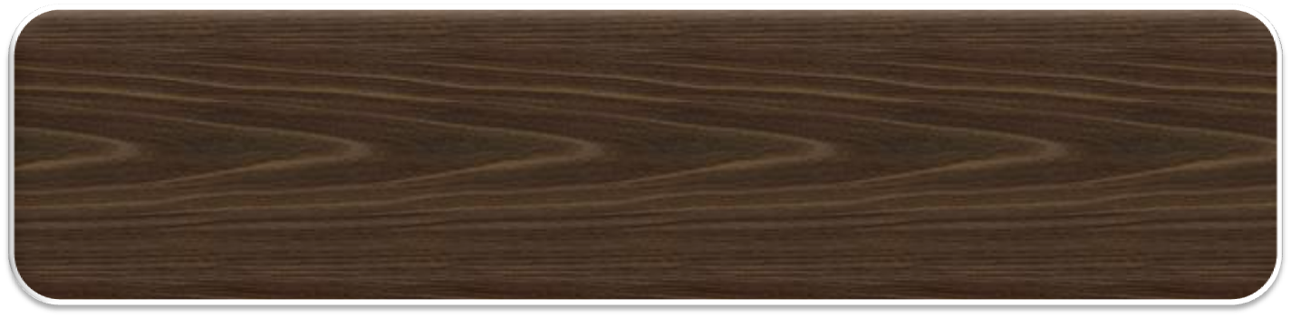
Presentation On
Mobile Phone Operating System
Prepared by
Name: Alamgir Hossain
Roll: 110122
Name: Bijoy Podder
Roll:110143
Name: Fahim Foysal Kamal
Roll:110145
Supervised by
Kamrul Islam
Assistant professor,
Dept. of Computer Science and
Engineering,
Jessore University of Science &
Technology, Jessore.

Slide 2

Introduction
Motivation
Purpose
Objectives
Development Process
Benefits
Conclusion

Slide 3

An operating system is very important for any hard ware. To run a mobile, PC or table an operating system is compulsory. A mobile operating system is referred to as mobile OS, is an operating system that operates a smart phone, tablet, PDA, or other mobile device. Modern mobile operating systems combine the features of a personal computer operating system with other features. Many mobile application can be paly through this mobile operating system.

Slide 4
As the time increase , various types of OS is increasing day by day, the people are also using them. People has no limit of demand . So, they need new thing and want to use them more and more . To make comfort newer operating system is needed. So every one is trying to get a new OS. This realization inspired us to develop such an operating system that will be secured, digital, easier, reliable and dynamic.

Slide 5

To save any number in the data base
To save and send any sms
To calculate BMI
To use simple calculator
To play a Tic-Tac game
To protect information’s making password for user.

Slide 6

The development process composed of 4 steps-
  System Definition.
  Requirement Analysis.
  Design.
  Implementation.

Slide 7

A MOS is process where we can save any number ,send & save sms , calculate BMI & our useful value .Besides we can gain entertainment by playing the Tic Tac game and etc . And Also secure our system by providing a strong password.

Slide 8

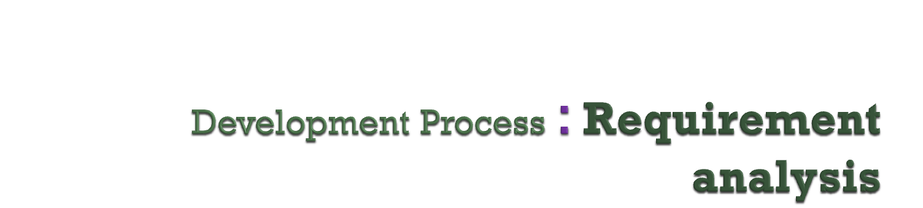
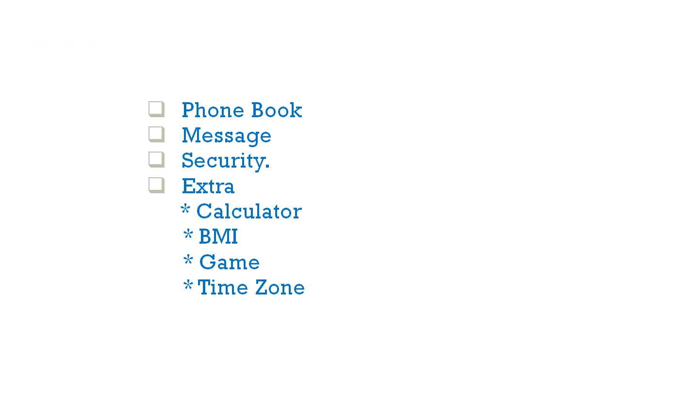

Slide 9
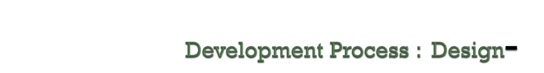
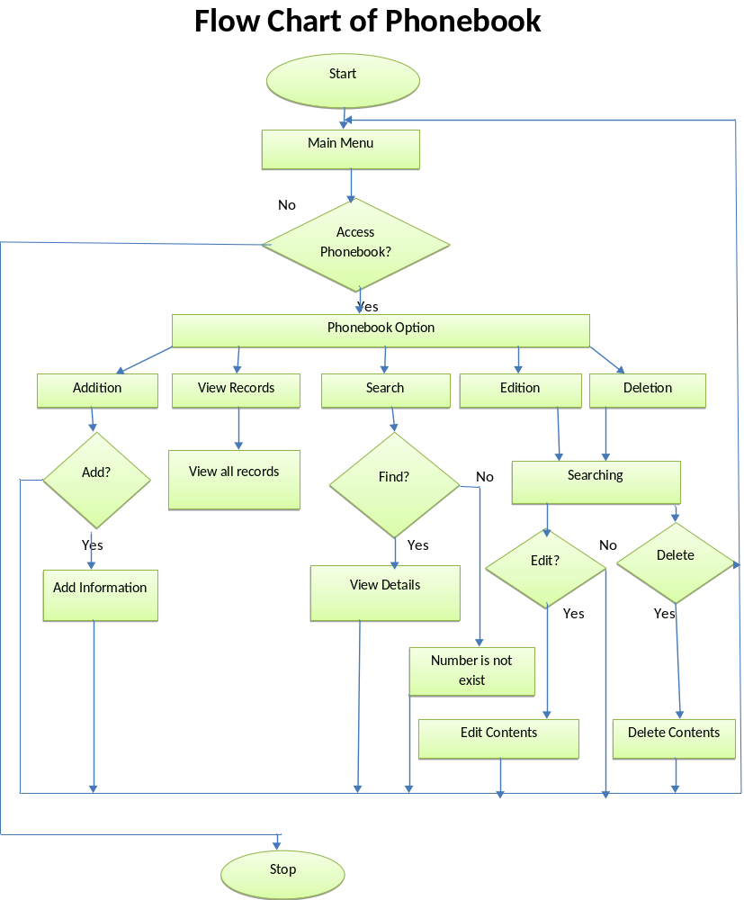

Slide 10
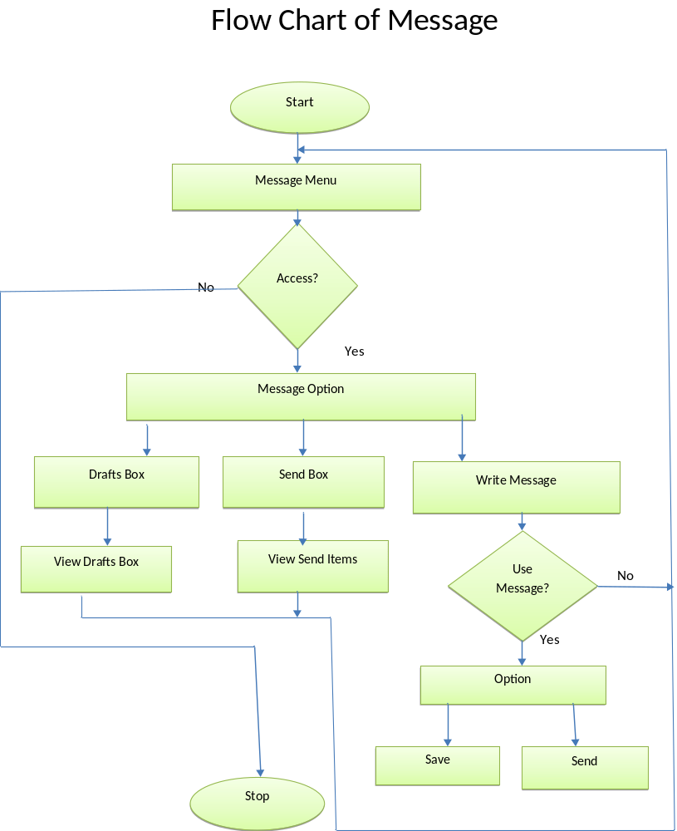

Slide 11
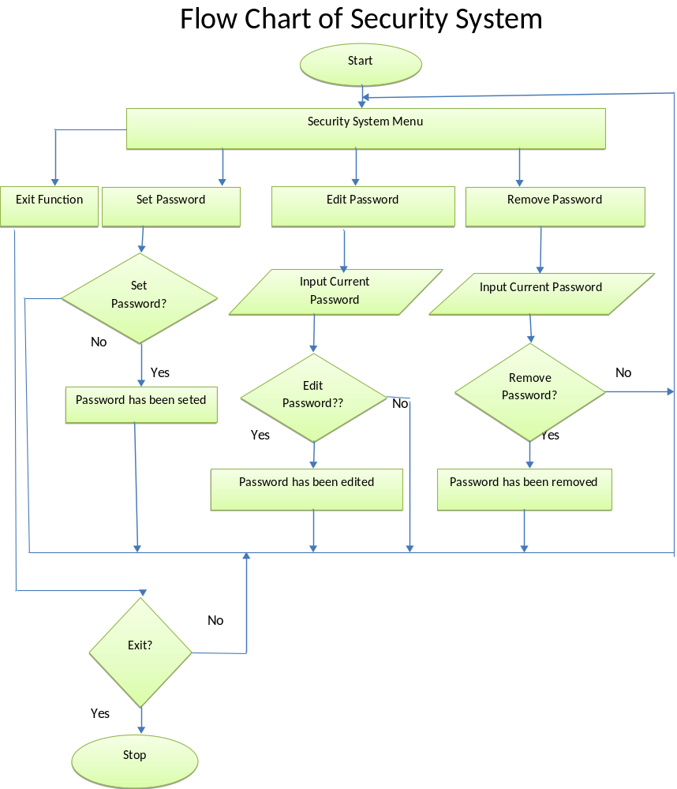

Slide 12
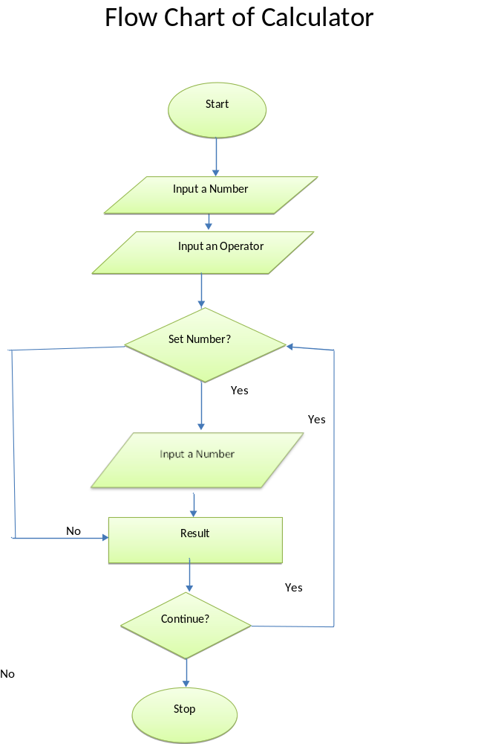


Slide 13
This project is useful to operate the Mobile phone operating system. For an user we create 4 option and the implementation of these are almost same.
Phone Book
  Add phone number
  Search phone number
  View all phone numbers
  Modify phone number
  Delete phone record
  View the number of record
Message :-
  Send
  Write Massage
  Draft
  Inbox :

Slide 14

Security :-
  Set password
  Edit password
  Remove password
Extra :-
Calculator
        Addition
        Root
        Multiplication
        For division
        Power
        Subtraction

Slide 15
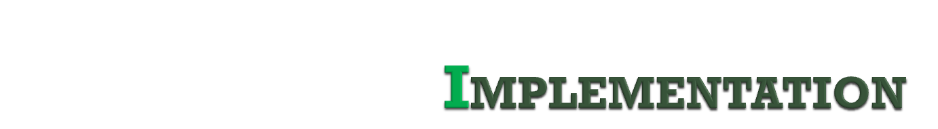
BMI (Body Mass Index)
  Here X= mass (kg) * 2.205
  BMI = (X*703)/ height² (inch)
  Tic Tac Game
  --Select any option from manu
  --Select the user
  --Maintain the rule
  --Play the game

Slide 16
Our Operating System has the following benefits-
Password protected.
It is realistic.
Easy to operate.
It is less time consuming.
Very effective.
It provides easy but protected access to information
It is faster, less error and reliable.

Slide 17
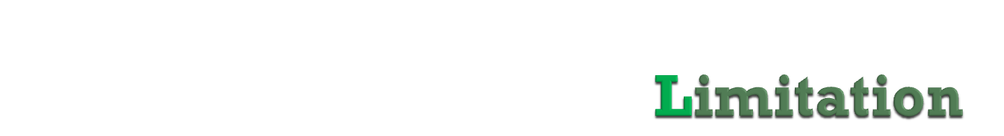
1. We cannot perform our work in multi window.
2. We cannot send or receive sms. because of the error of the network
3. We cannot calculate scientific calculation.
4. Game has to play with two users. One cannot play with the OS.

Slide 18

1. We want to make it more users friendly.
2. We want to add more application.
3. We will reduce time complexity.
4. We want to enrich the design of our project.
5. We want to implement it into a mobile hardware.

Slide 19

We tried our level best to make an efficient, less error, reliable, user friendly and dynamic operating SYSTEM. We don’t know whether we success or not in this system cause we are not yet a good system analyst. We will try to develop this system in future and wish to developed it based on online.

Slide 20

Thank You

Slide 21
