Slide 1

Epileptic Seizure Detection From EEG Data Using Machine Learning
Group 4
1806180 Md. Rokonuzzaman Rokon
1806184 Arnob Ghosh
1806185 Adib Md. Tawsif
1806186 Md. Alamgir Hossain

Slide 2
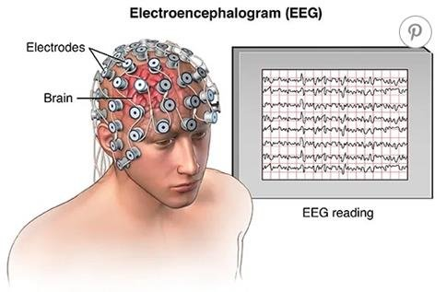
All About EEG
An electroencephalogram (EEG) is a recording of brain activity in terms of electrical signal.
During this test, small sensors are attached to the scalp to pick up the electrical signals produced by the brain.
From EEG data, we can know about different abnormalities in brain.

Slide 3
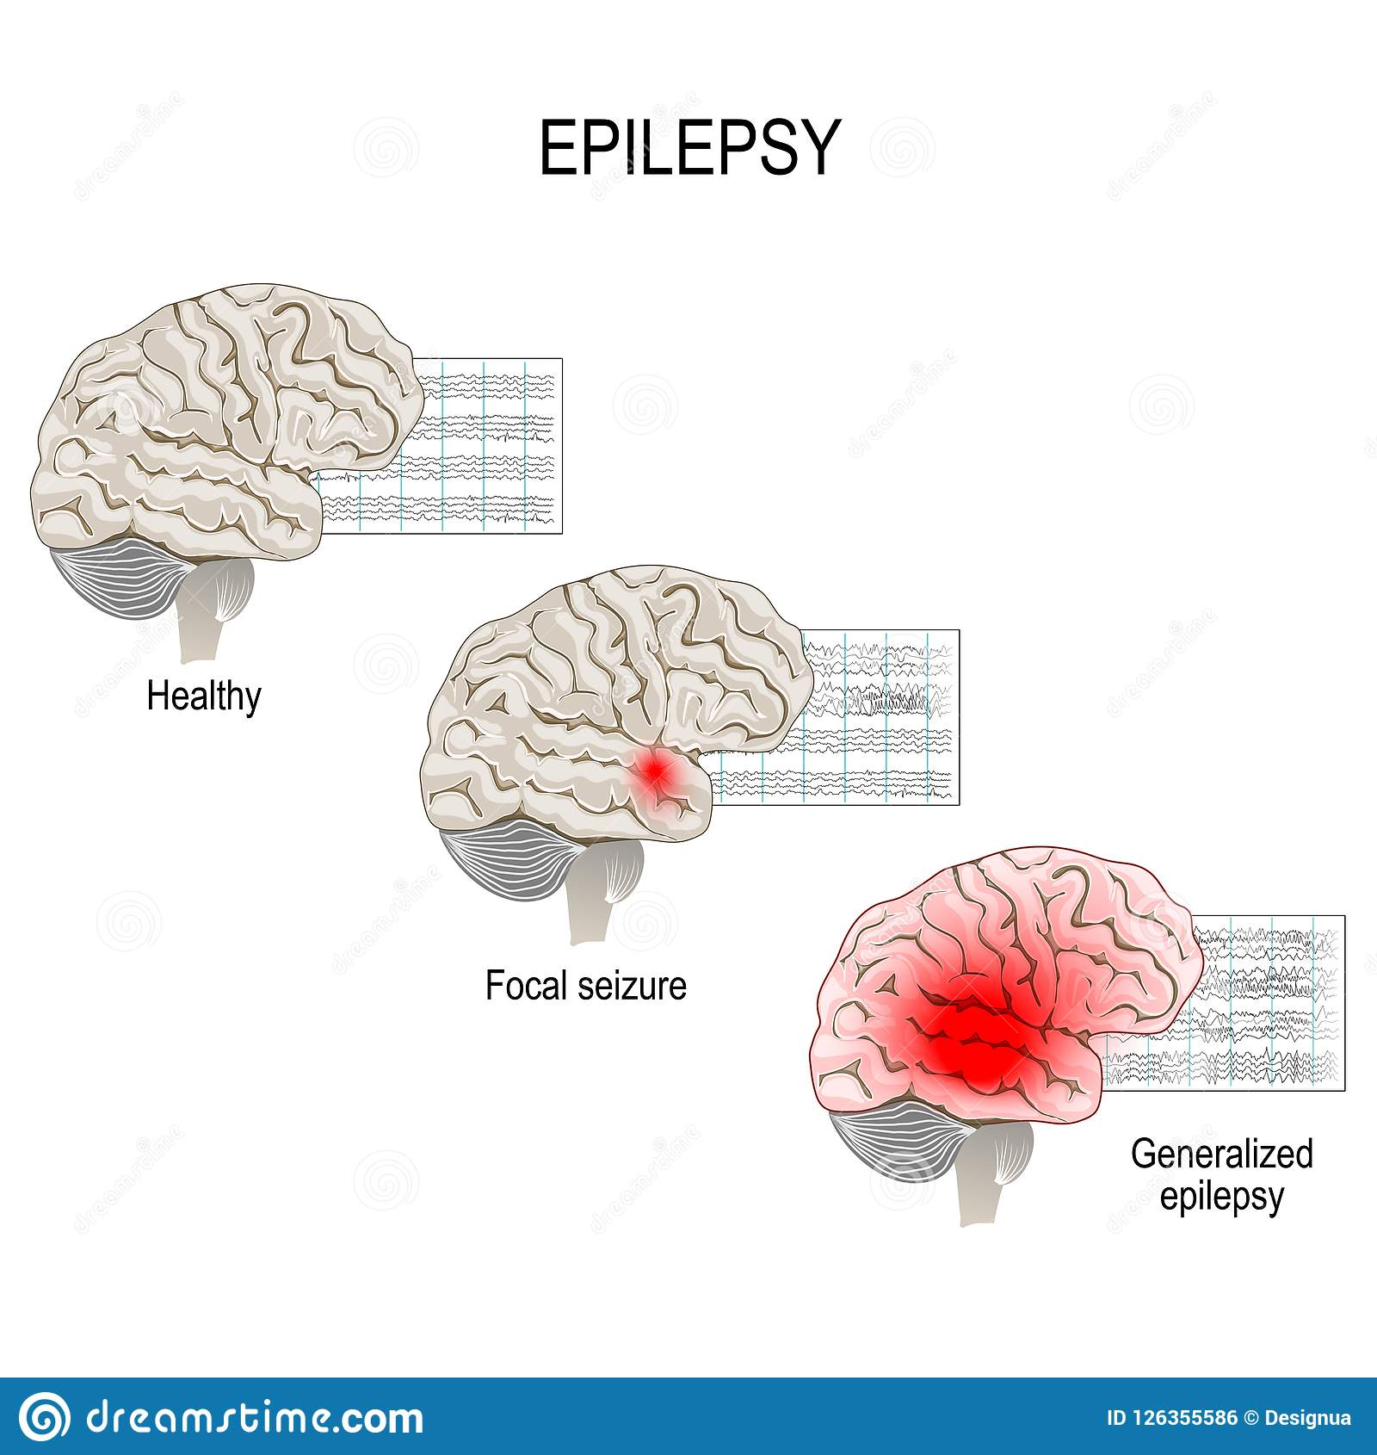
Epileptic Seizure
Neurological disorder that results abnormal brain activity, causing seizures and sometimes loss of awareness.
The mechanism is excessive and abnormal neuronal activity in the cortex of the brain which can be observed in the EEG of an individual.

Slide 4
Work Flow of Our Project
Data Collection
Signal Processing
Data Pre processing
Partitioning
Model Training
Analysis of results
Testing

Slide 5
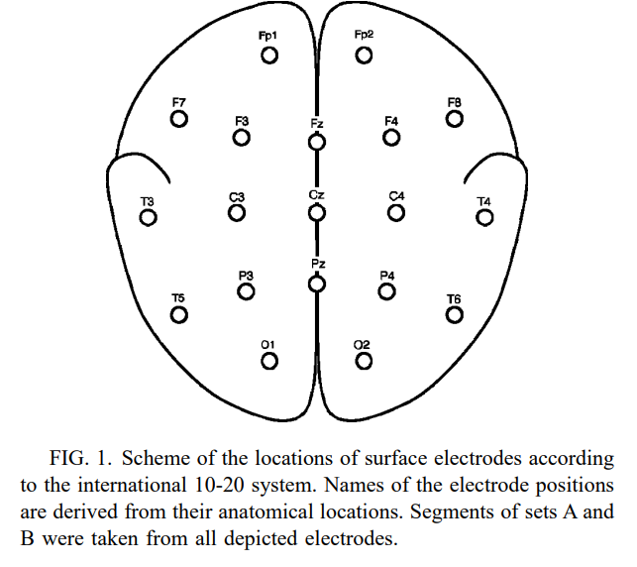
Data Collection
Data Set consists of Five patients and Five healthy volunteers in five folders.
Each folder has 100 single channel EEG signals.
First two folders are from healthy subjects, next two are from patients, but during normal condition. Fifth folder is patient data in seizure condition.
Data of subjects are collected from a database which is publicly made available by Dr. Ralph Andrzejak.^{[1]}
[1]Andrzejak RG, Lehnertz K, Rieke C, Mormann F, David P, Elger CE. Indications of nonlinear deterministic and finite dimensional structures in time series of brain electrical activity: Dependence on recording region and brain state [dataset]. Repositori Digital de la UPF: Barcelona; 2001. Available from: http://hdl.handle.net/10230/42894
Sampling Frequency=173.61 Hz
Duration = 23.6 sec
Samples per data = 4097
Total Data = 5*100 = 500

Slide 6
Signal Processing
The signal processing is done in two steps[1]. At first, the raw data is filtered using a FIR Low Pass Filter to remove artefacts like EOG,EMG etc. Then the filtered data is again denoised using Continuous Wavelet Transform.
[1] R. Mukherjee, S. S. Dhar and K. Tara, "Prediction of Disorder of Brain using EEG Signal Processing in MATLAB GUI Platform," 2017 2nd International Conference on Electrical & Electronic Engineering (ICEEE), 2017, pp. 1-4, doi: 10.1109/CEEE.2017.8412847.
Raw EEG Data
Low Pass Filtering
Continuous Wavelet Transform(CWT) denoising

Slide 7
Low Pass Filtering
Finite Impulse Response(FIR) Low Pass Filter is used.
The noise to be removed lies in the frequency range of 0.1 to 50 Hz
So a filter of cutoff 0.1 Hz is used.
The output spectra for various orders of filters are compared.

Slide 8
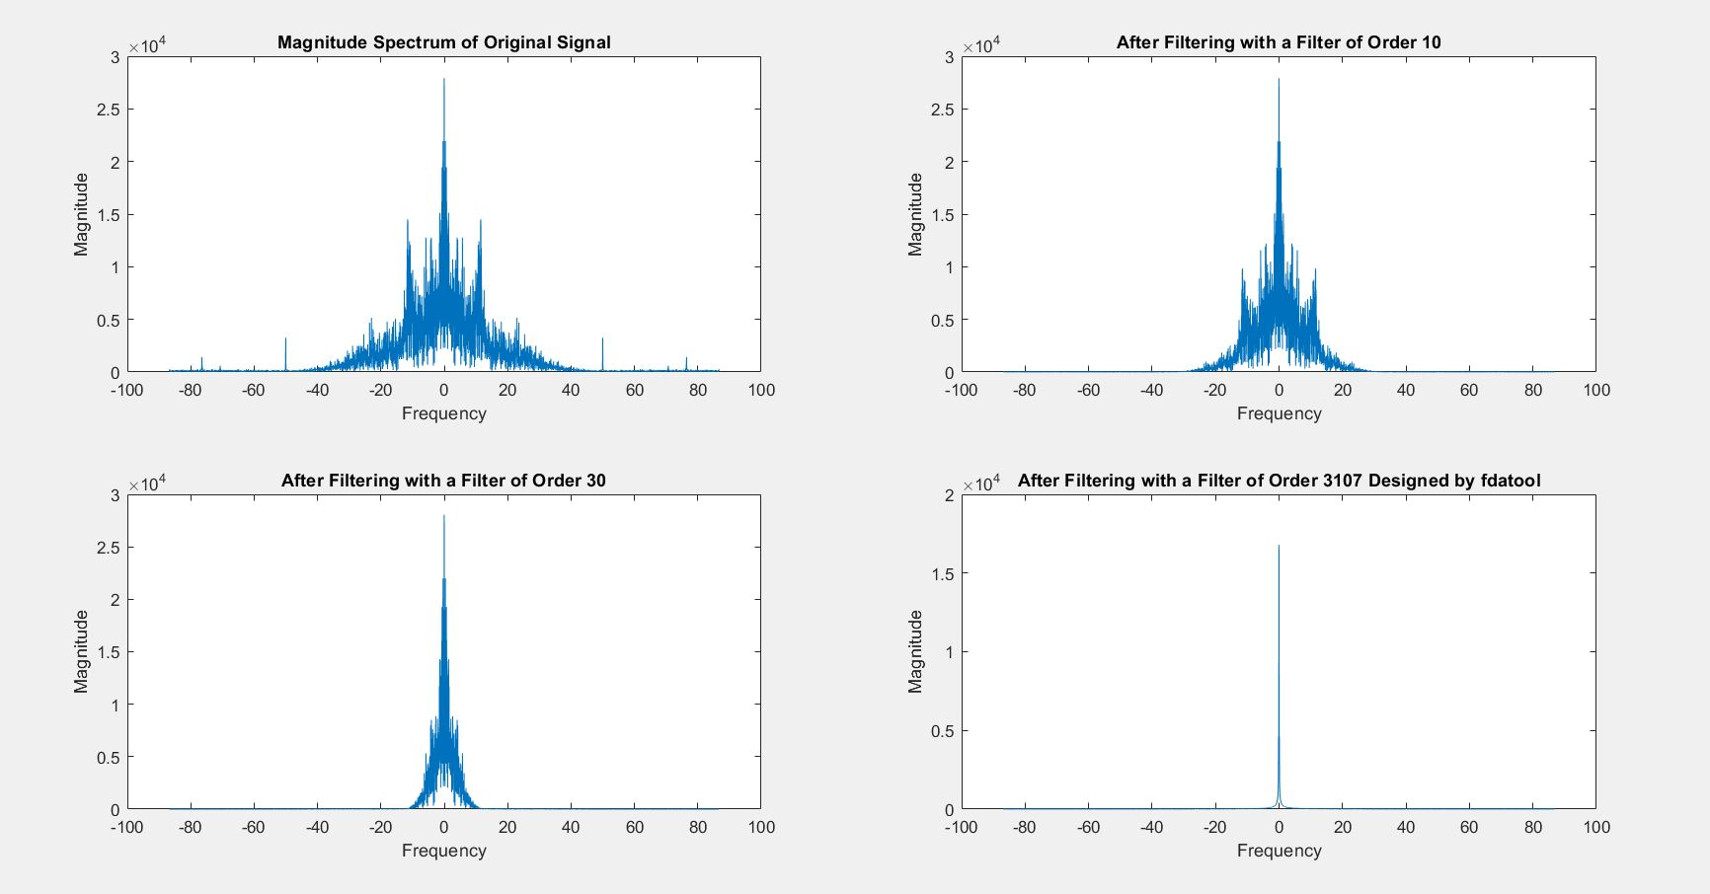
Comparison of Various Order Filters
Main Signal
Order 10 Filter
Order 30 Filter
Order 3107 Filter

Slide 9
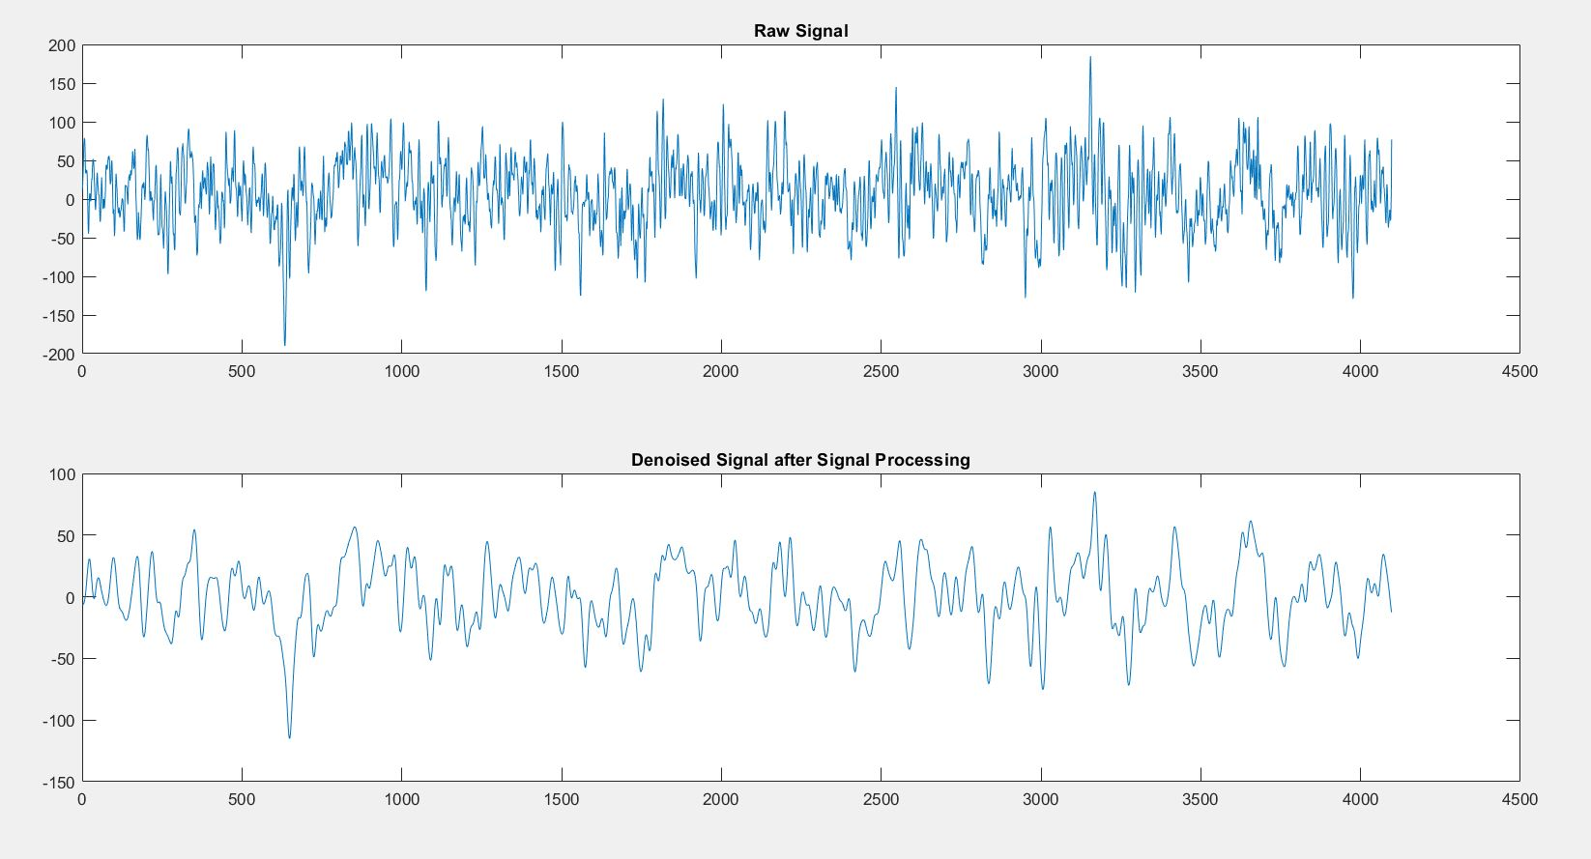
Continuous Wavelet Transform(CWT) Denoising
CWT is done for further noise reduction.
At first, the CWT co-efficients, C are found (Morse wavelet)
Then the denoised signal is reconstructed using C.
Raw Signal
Processed Signal

Slide 10
Filtered Signal Data Pre-Processing
Calling 5 dataset folders for processing
Merging 100 files of each folder
Splitting sample points
Adding an extra column for leveling
Merging all 500 files in one table
Partitioning Data for modelling.

Slide 11
Data Splitting
To enlarge the data set, we are interested in samples/sec.
4098 samples of each file are split into 23 rows and 178 columns.
Each row represents a second span of data having 178 columns.
For each folder, there will be 2300 rows and 178 columns.
Finally, 179th column is introduced for the purpose of labelling seizure or non-seizure.
Original Data of
1 file:
After splitting:
Column for labelling
1st sample | 2nd Sample | . | . | . | . | 4098 ^{th sample}
 | X1 | X2 | X3 | . | . | . | X178 | X179
1st Sec
2nd Sec
.
.
23rd Sec

Slide 12
Merging and Partitioning
After splitting all the 500 files of 5 folders, all the tables are merged to get a single table.
The table has 11500 rows and 179 columns.
The merged data set is then partitioned to training set and testing set.
 | X1 | X2 | X3 | . | . | . | X178 | X179
1st Row
2nd Row
.
.
.
11500th Row

Slide 13
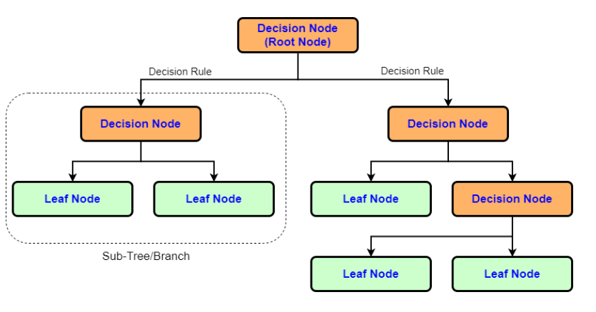
Modelling Decision Tree
1. Root node chooses feature to divide the
data into two main categories.
2. Two decision rules and two sub trees
at the end of the root node. Each sub tree
will once more divide the data into two
categories.
3. Up till every training sample is gathered
together, this process will be repeated.

Slide 14
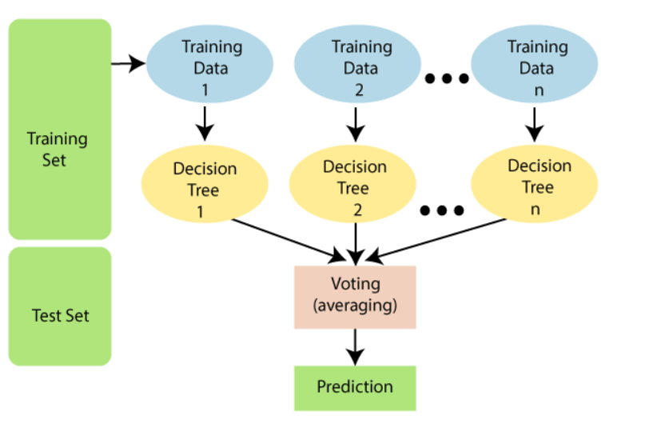
Random Forest
Builds multiple decision trees and Merges them together
More accurate and Stable results
Random decision forests correct for decision tree’s habit of overfitting to their training set

Slide 15
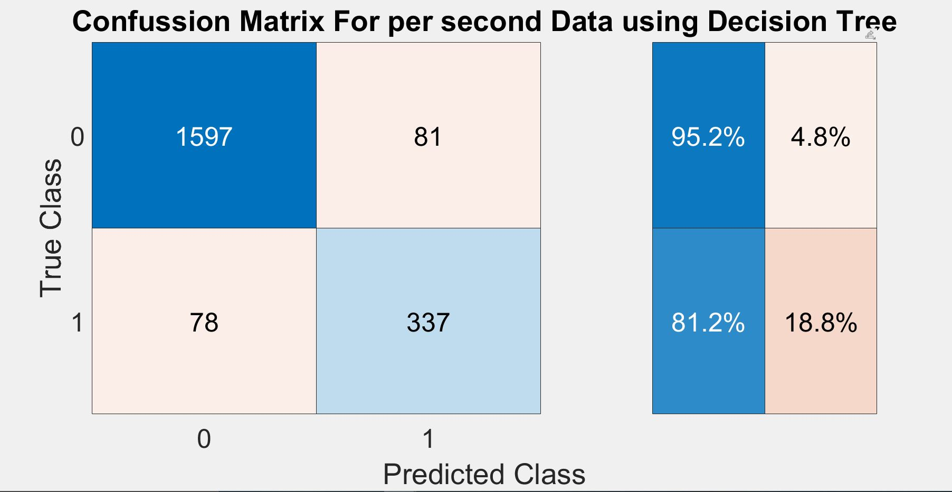
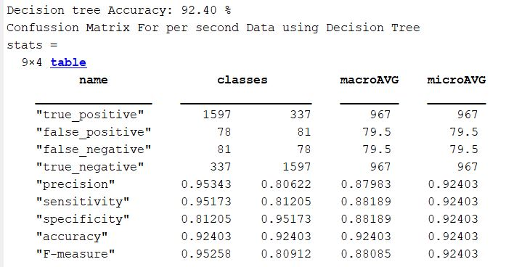
Trained Decision Tree Model on Testing Set (per second)
Confusion Matrix
Accuracy Scores

Slide 16
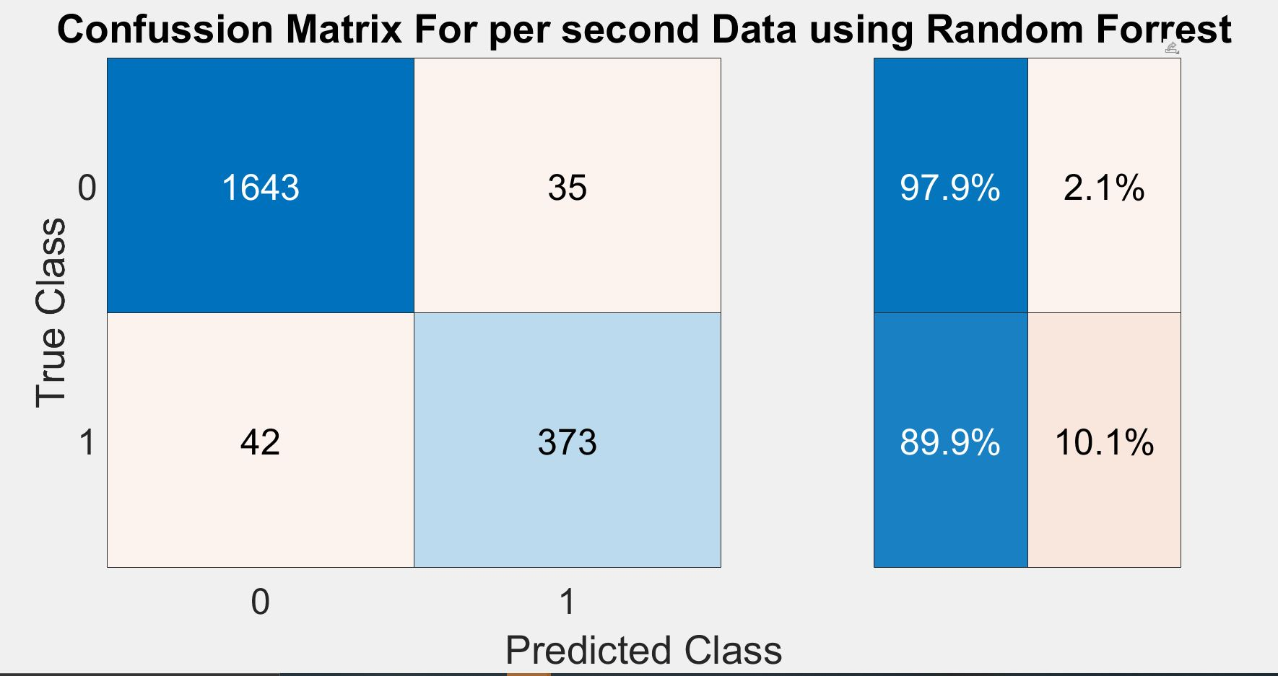
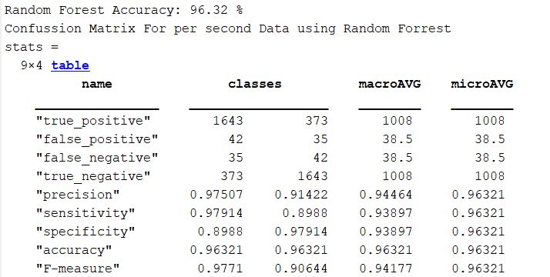
Trained Random Forest Model on Testing Set (per second)

Slide 17
Testing Per Sample
Sample 1 | Sample 2 | . | . | . | Sample 4097
Now we will test the full sample of 23.6 seconds and give output of 0 or 1s for per second data (an array of 23 data).
Then we will take the decision after counting the success rate (1s) and comparing to the threshold level (68%).
1st sec
2nd Sec
23rd sec
. . . ….. . . . . . . . . .
Model
1000111100000111…. (23 elements )

Slide 18
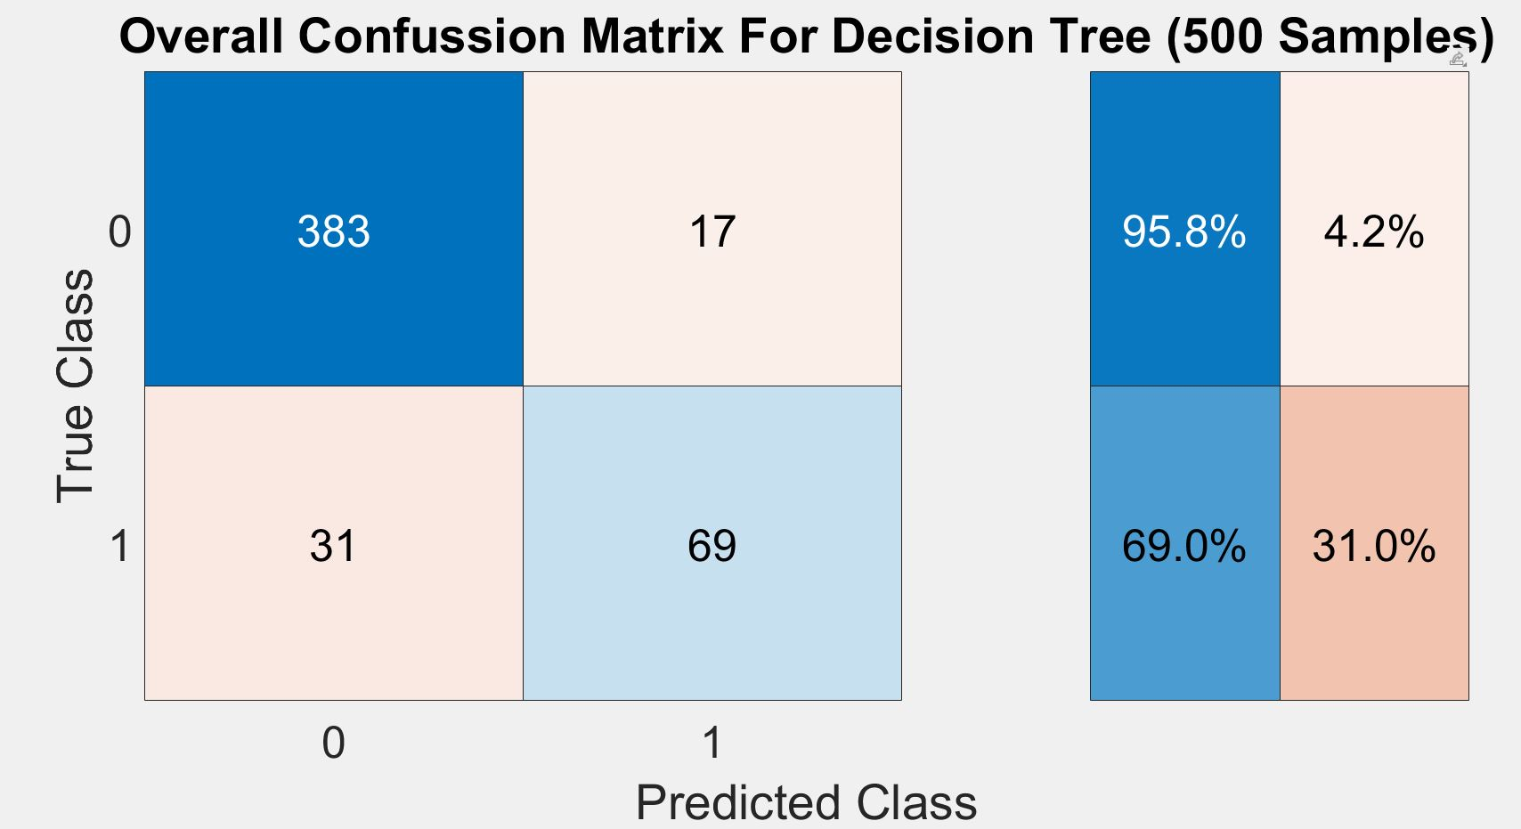
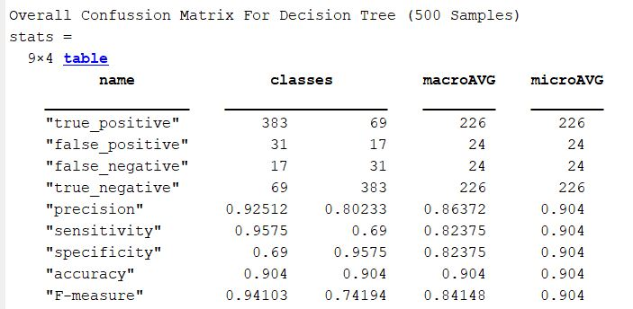
Results on Overall Dataset (Decision Tree)

Slide 19
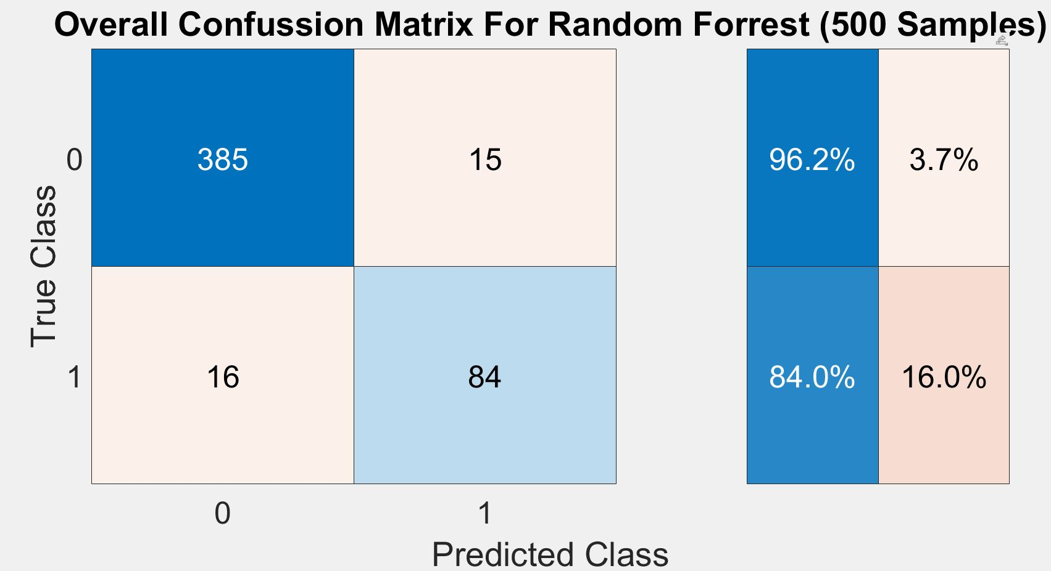
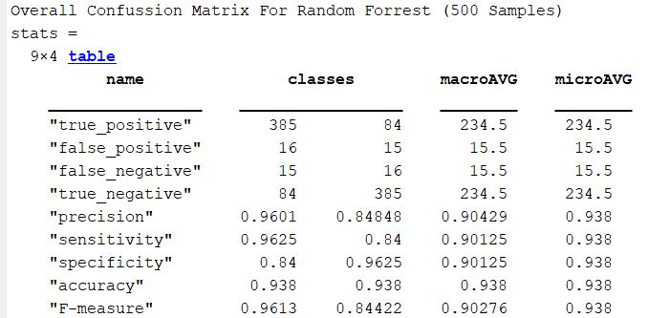
Results on Overall Dataset (Random Forest)

Slide 20
Conclusion
Random Forrest Model has better accuracy than Decision Tree Model.
The accuracy is more for Non-seizure data because the model was trained by datasets using mostly non-seizure data.
The model can be developed if it is trained using more data.

Slide 21

Thank You
Any Question?

