Slide 1

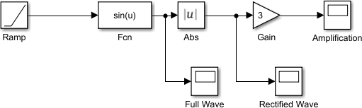
Computer Aided Engineering MEE20007 (SIMULINK) Lab 3, Part 2
Simulink Practice Exercises
Exercise 1:
(a) We are now going to construct our own function through Fcn block. We can access Fcn from Simulink->User defined Functions. Put it together with a Scope for output and use Ramp as the input signal. You can refer to the block arrangement in figure 1 below:
Figure 1 Click on Ramp and in this symbol, you can find three arguments: slope, start time and initial output. Use the following settings, slope = 1, start time = 2 and initial output = 2.
Afterwards set the value of Fcn to a sine function. Do this by typing sin (u) in the expression box. Set the simulation stop time to 10 seconds.
Now ‘Run’ the model! What is the output in Scope? Should be a sine wave with a delay of 2 seconds.
(b) Add more functions to the model above. From Math Operations block set drag the blocks Abs and Gain into the current model window. Double click the Gain and change the value to 3. Also add some extra Scopes in order to observe precisely what happens in every step. Select Scope and press the right mouse button and drag how many scopes you desire.
Figure 2
What we have here is a full wave rectifier with an amplifier.
Run the model! Does it work as expected?
Method: In Full Wave scope we can see a sine wave though with a time delay of 2 seconds. Thereafter we take the absolute value of the sine and get a rectified signal as can be seen in Rectified Wave scope. Finally, we amplify the amplitude with gain 3 and get the output signal in scope. You must note the amplitude to attain an idea of amplification.

Slide 2
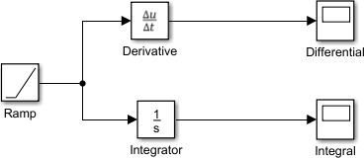
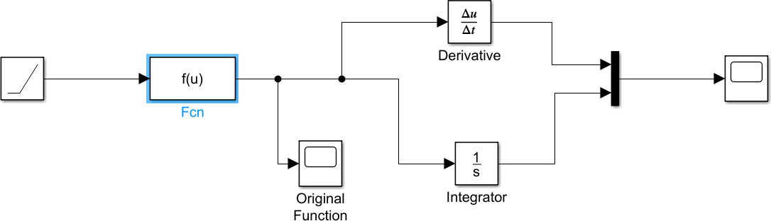
Computer Aided Engineering MEE20002 (SIMULINK) Lab 3, Part 2
Exercise 2:
Remove all blocks except Ramp and Scope.
Now we are going to take the time derivative of an input signal and to integrate the same signal. Get an integrator from Simulink->Continuous and in the same library we also find Derivative. If you double click on the Integrator you can set a parameter initial condition. From the start it has a default value 0, but it can be altered to whatever you want. Integrate and take the time derivate for 10 seconds.
Figure 3
Run the model file and observe the results in scopes. Why differential is a step and integral is a curve. Can you find out what type of curve it is and why the end value is 52 after 10 seconds?
Also check the output of two functions while changing the input signal to a Step. Can be found under Simulink->Sources. You are surely familiar with the step function. There are three parameters in the block: Initial value, Step time and Final value. Set the Step time=2 and the rest should be as it is.
What value does the integration and the time derivative give if we simulate for 10 seconds?
Sometimes you want the signals to appear in the same Scope. This can be arranged by choosing a multiplexer. Get a Mux from the Signal Routing block set. Delete one of the scopes. See figure
4. Create the function: sin(u)+exp(-u) in the Fcn block. Run simulation for 10 seconds.
Figure 4

Slide 3
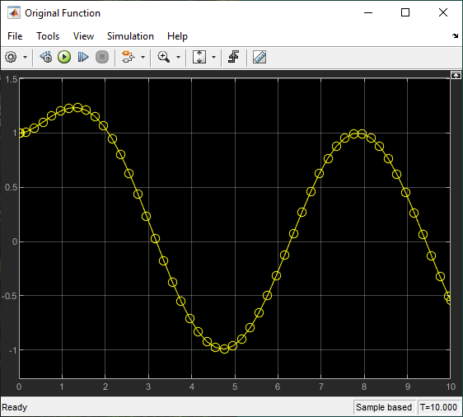
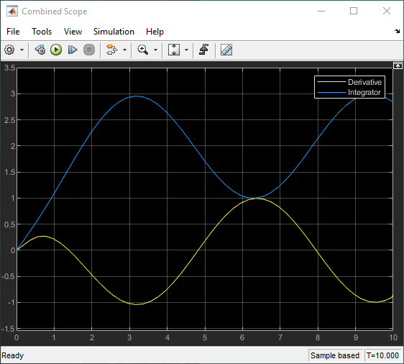
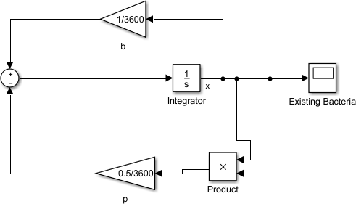
Computer Aided Engineering MEE20002 (SIMULINK) Lab 3, Part 2
Figure 5: Original function with the derivative and integral plots in the Combined scope
Exercise 3:
In this example we are going to investigate a differential equation and determining its solution. The problem consists of finding out the rate of bacteria growth in a jam pot. Assume that the number of “newly born bacteria” is directly proportional to the existing number (x) of bacteria and the number of dying bacteria is proportional to the square of existing number.
The differential equation may be written as: ((dx)/(dt)) = bx-px² Birth growth= bx; death growth= px²
The constants b =1/(hour) and p=0.5/(hour). We have a population of 100 bacteria from the start.
Figure 6

Slide 4
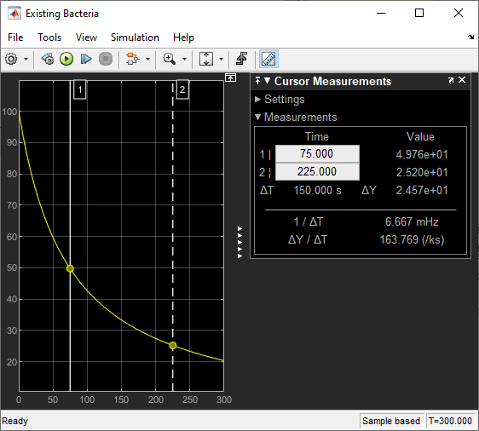
Computer Aided Engineering MEE20002 (SIMULINK) Lab 3, Part 2
The blocks Gain, Product and Sum can all be found in Simulink Library -> Math Operations.
Use the blocks above to formulate the solution to the given differential equation which should look like the model in Fig 6. The initial number of bacteria is defined in the initial conditions of integrator. The constants b and p can be assigned in the MATLAB command window or by just replacing the existing values of GAIN parameters. Be careful that ‘b’ and ‘p’ are given per hour. For changing the values double click on the Gains and summing junction.
Run the simulation for 5 minutes and note from the Scope that after how much time the bacteria population will be reduced to (a) half, and (b) 25 % of the initial bacteria count? You can take help from the “Cursor Measurements” tool in the scope window.

Slide 5
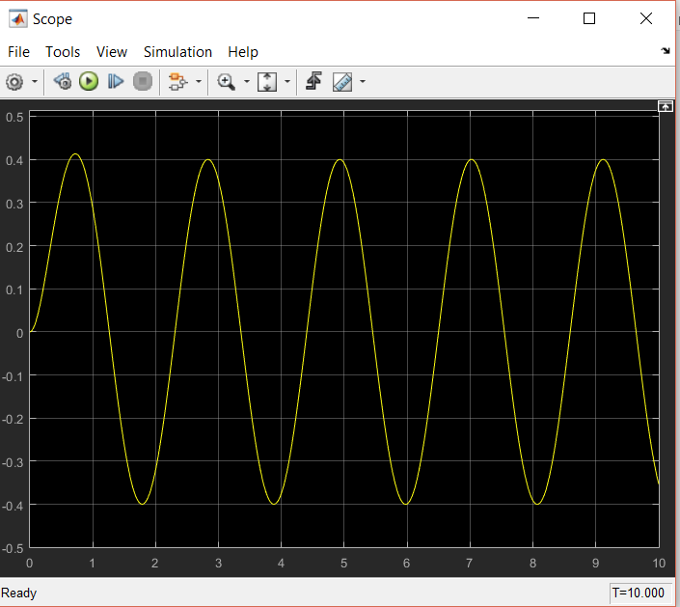
Computer Aided Engineering MEE20002 (SIMULINK) Lab 3, Part 2
Exercise problems to submitted on Canvas:
Use Simulink to model an equation, given as: 𝑥(𝑡)=𝐴. cos (𝜔𝑡+ 𝜑) ; where the displacement x is a function of time ‘t’. frequency ω, phase angle φ and amplitude A. For this exercise take: frequency = 5.5 rad/s, phase angle = 120º and amplitude = 2 cm.
Find out the solution of the differential equation:
𝑑𝑥
= 2 sin(3𝑡) − 4𝑥 . Set all initial conditions to zero. Please note that ‘2’ is the amplitude of
𝑑𝑡
the sine wave and ‘3’ is its frequency. You must adjust these values in the parameters of ‘sine’
block. Your output in the scope should look like the figure below:
You can refine the graphical output by going to ‘Data Import/Export’ in ‘Model Configuration Parameters’ and then from ‘Additional Parameters’ change the ‘Refine factor’ from 1 to 10.
END OF DOCUMENT

