Slide 1
Swinburne University of Technology MEE20007 – Lab 3 Part 1
Introduction to Simulink
Topics Covered:
(i) Introduction to Simulink Modelling Environment and Blocks Library
(ii)
Building simple models Block parameters
Modelling configuration parameters Running and Analysing simulations

Slide 2
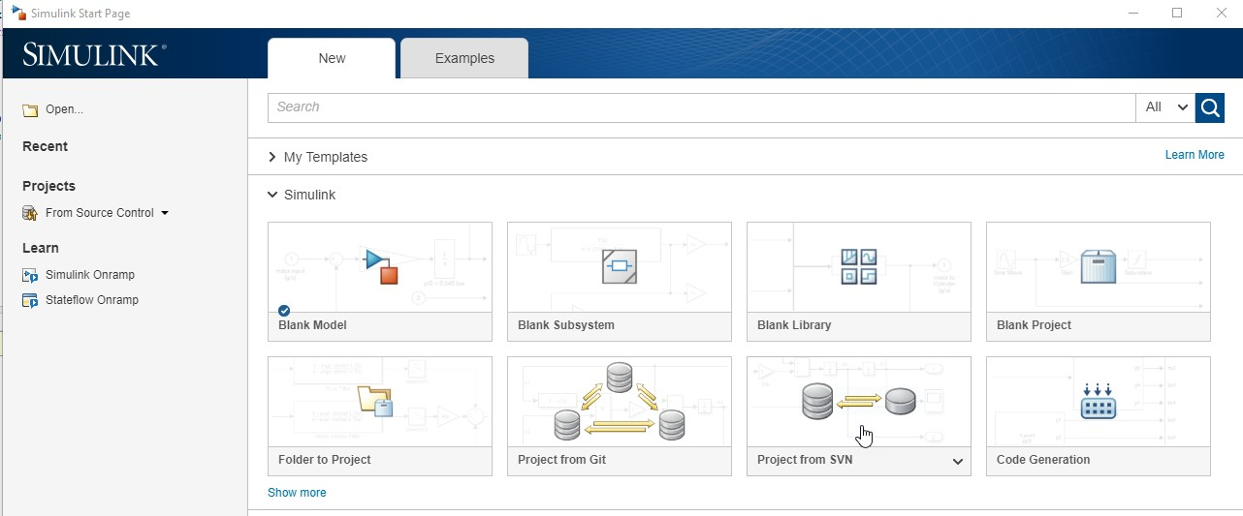
Simulink Basics Tutorial
Simulink ® is a block diagram environment for multi-domain simulation and Model- Based Design. It supports system- level design, simulation, automatic code generation, and continuous test and verification of embedded systems. Simulink provides a graphical editor, customizable block libraries, and solvers for modelling and simulating dynamic systems. It is integrated with MATLAB®, enabling you to incorporate MATLAB algorithms into models and export simulation results to MATLAB for further analysis.
Starting Simulink
Simulink is started from the MATLAB command prompt by entering the following command: Simulink. Alternatively, you can hit the Simulink Library button in MATLAB ribbon. When it starts, Simulink brings up the main Simulink window (Simulink Start Page) offering several options.
From there you can create a new model or open a previously saved model.
Click on the “Blank Model” to open a new Model Browser. But you need Blocks or pre- designed modules to build your model in the Simulink Environment.
Click on the “Library Browser” button to open the Blocks library.
Figure 4.1. Simulink start page

Slide 3
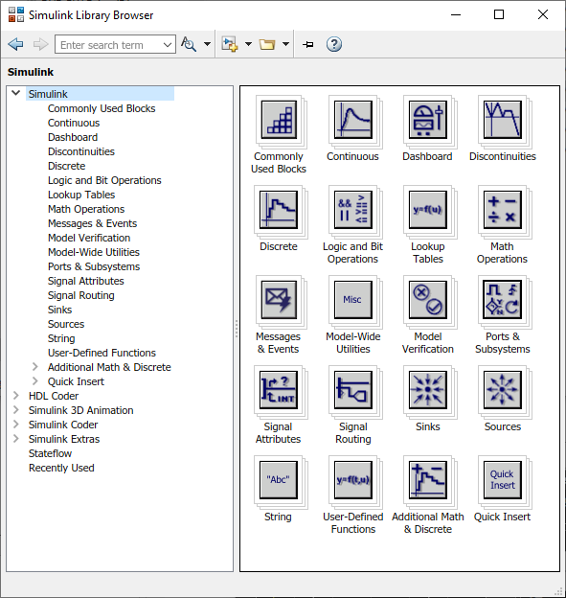



**Simulink add-on products let you incorporate specialized components for aerospace, communications, PID control, control logic, signal processing, video and image processing, and other applications. Add-on products are also available for modelling physical systems with mechanical, electrical, and hydraulic components in the Library Browser.
The Simulink library Browser displays the block libraries installed on your computer. The model is always built-up by copying (drag and drop) blocks from a specific library into the modelling or editor window. When you double click on any block a separate window is opened showing the description of that particular block and the set of appropriate input parameters. You can always find the detailed description about any block from the Help menu.
The power of block based modelling in Simulink provides the tools for hierarchical modelling, data management and
subsystem represent accurately.
customization which enables the engineer to
Figure 4.2: Simulink
Library Browser
even the most complex system concisely and

Slide 4
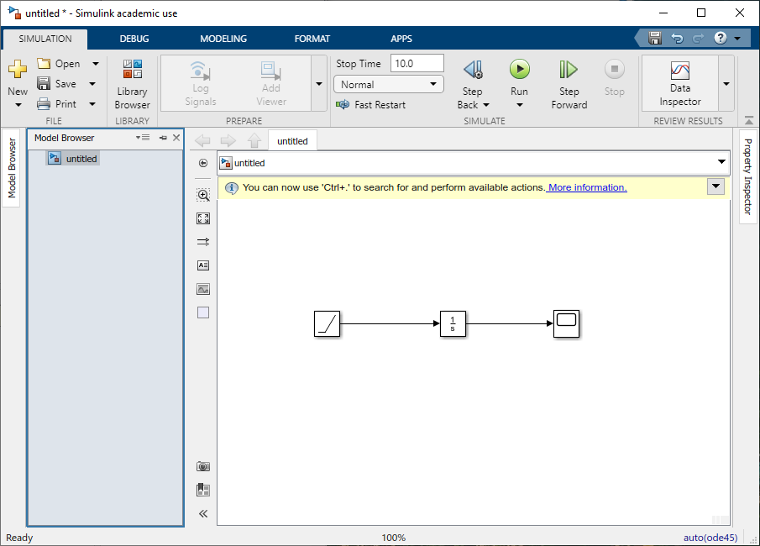

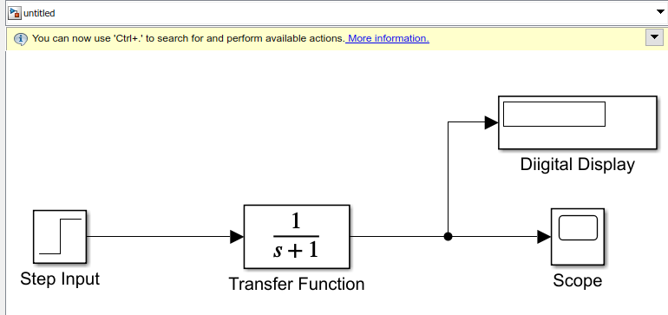


The models are built using two major classes of items in Simulink: blocks and lines. Blocks are used to generate, modify, combine, output, and display signals. Lines are used to transfer signals from one block to another.
(a) (b)
Figure 4.3: (a) Block with terminals (b) A simple model
Blocks have zero to several input and output terminals. Unused input terminals are indicated by a small open triangle. Unused output terminals are indicated by a small triangular point. The block in Fig 4.3(a) has an unused input terminal on the left and an unused output terminal on the right. Lines transmit signals in the direction indicated by the arrow as shown in Fig 4.3(b). Lines must always transmit signals from the output terminal of one block to the input terminal of another block. One exception to this is a line tapped off from another line, splitting the signal to two different destination blocks.
Lines can never inject a signal into another line; lines must be combined through the use of a block such as a
summing junction. A signal can be either a scalar signal or a vector signal. For "Single-Input, Single-Output"

Slide 5
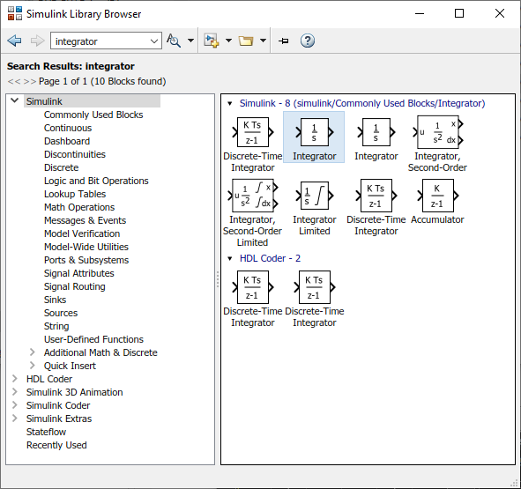
Building Blocks for the Model
** As already mentioned, Simulink® provides a set of predefined blocks that you can combine to create a detailed block diagram of your system. The Simulink Library Browser contains a library of blocks commonly used to model a system. These include:
Continuous and discrete dynamics blocks, such as
Integration and Unit Delay
Algorithmic blocks, such as Sum, Product, and Lookup
Table
Structural blocks, such as Mux, Switch, and Bus Selector
Arithmetic blocks providing all the Math functions.
** If you find it difficult to find the desired block from the huge library then you can conveniently use the Search Block option in the browser. Fig 4.4 illustrates searching for the Integrator block from the library. You should notice that when you click on a certain block its parent location is also displayed above the block.
Figure 4.4: Using the search option in the Simulink Blocks Library Browser.

Slide 6
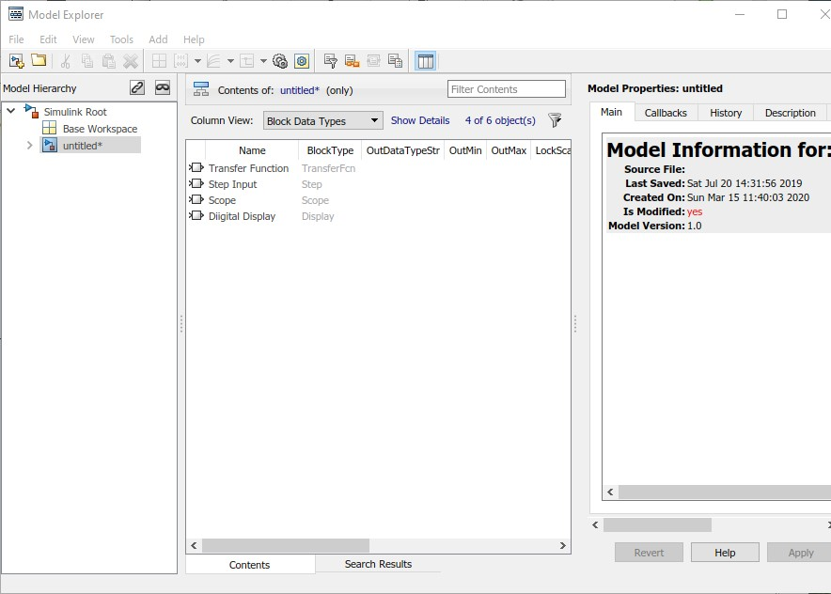
Managing Signals and Parameters
**These signal and parameter attributes can be specified either within the model or in a separate data dictionary. You can then use the Model Explorer shown in the figure below to organize, view, modify, and add data without navigating through the entire model.
**Simulink models contain both signals and parameters. Signals are time-varying data represented by the lines connecting blocks. Parameters are coefficients that define system dynamics and behaviour.
**Simulink helps you determine the following signal and parameter attributes:
Data type—single, double, signed, or unsigned 8-, 16- or
32-bit integers; Boolean; enumeration; or fixed point
Dimensions—scalar, vector, matrix, N-D, or variable- sized arrays
Complexity—real or complex values
Minimum and maximum range, initial value, and
engineering units
**If you choose not to specify data attributes, Simulink determines them automatically via propagation algorithms, and conducts consistency checking to ensure data integrity.
Figure 4.4: Options in the Model Explorer window.

Slide 7
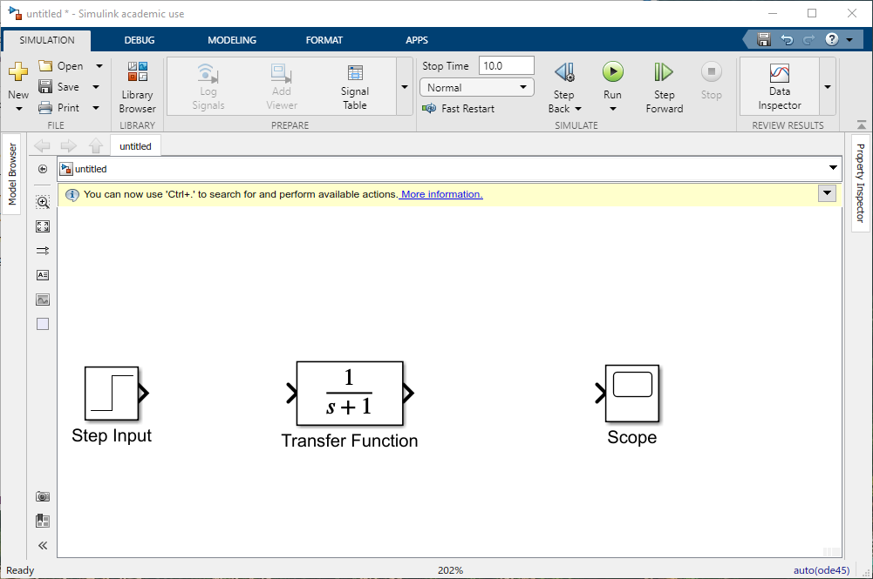
Simple Model Simulation Example:
**Here we present a very simple model built in Simulink which consists of only three blocks: Step, Transfer Fcn, and Scope. All these blocks can be dragged from the blocks library and dropped into the modelling window. The Step is a source block from which a step input signal originates. This signal is transferred through the signal line in the direction indicated by the arrow to the Transfer Function block. The Transfer Function (found in Continuous Block set) takes the input signal and outputs a new signal on another line to the Scope. The Scope is a sink or output block used to display a signal much like an oscilloscope. There are many more types of blocks available in Simulink, some of which will be discussed later. Right now, we will examine just the three we have used in the simple model, and displayed in the figure below. Note that step only has an output terminal while scope provides only the opportunity for inputs.
.

Slide 8
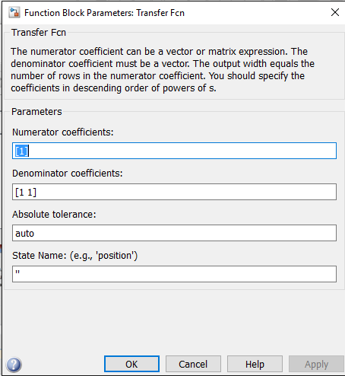
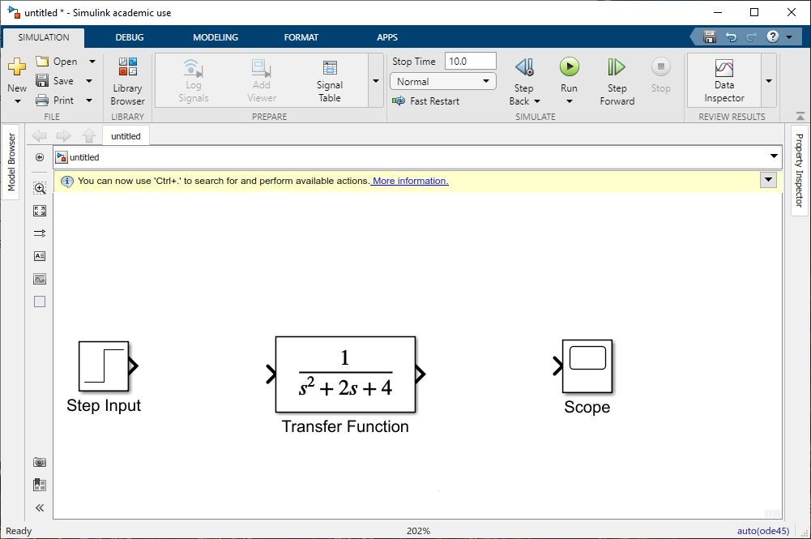
**Block parameters can be modified by double-clicking on it. For example, if you double-click on the "Transfer Fcn" block in the simple model, you will see the following dialog box. The block parameters that you can change for a Transfer Fcn block are shown in the figure below:
This dialog box contains fields for the numerator and the denominator of the block's transfer function. By entering a vector containing the coefficients of the appropriate numerator or denominator polynomial, the desired transfer function can be obtained. For example, to change the denominator to s^2+2s+4, enter the following into the denominator field: [1 2 4] and hit the close button, the model window will change to the following as shown in Fig
4.8 below:
Block reflects the change in the denominator of the transfer function.

Slide 9

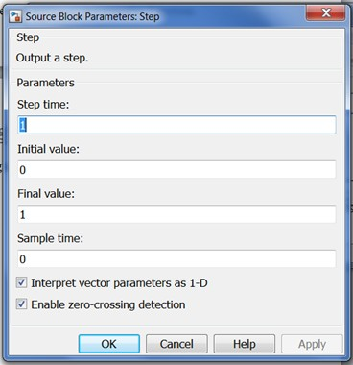
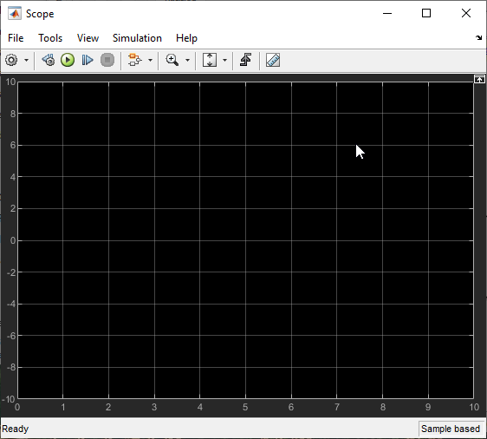

The "step" block can also be double-clicked, bringing up the
following dialog box
When a simulation is performed, the signal which is fed into the scope will be displayed in this window. Do not forget to make good use of "Autoscale“, “Cursor Measurements” and Zoom options to properly position your graph on the scope window.
The default parameters in this dialog box generate a step function occurring at time=1 sec, from an initial level of zero to a level of 1. (in other words, a unit step at t=1). Each of these parameters can be changed. Close this dialog before continuing. The most complicated of these three blocks is the "Scope" block. Double clicking on this brings up a blank oscilloscope screen.

Slide 10
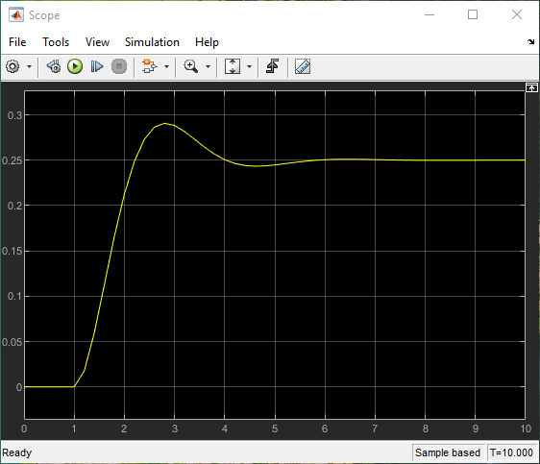

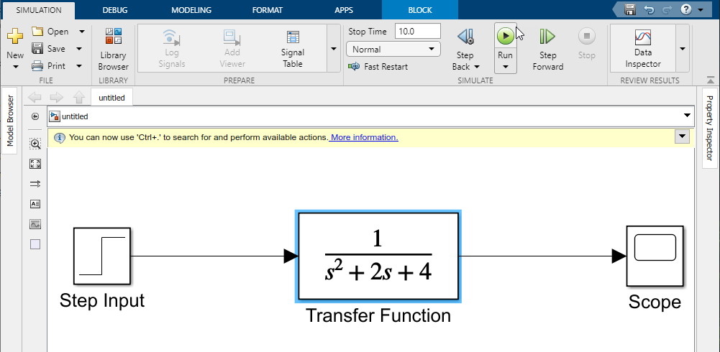

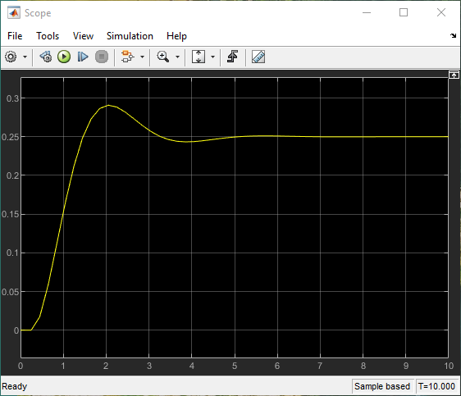

Running Simulations
If you find that the simulation output (shown in yellow) has a very low amplitude relative to the axes of the scope, then hit the Autoscale button. This will rescale the axes as shown in the side picture.
The finished model should like as shown above. Now you are ready to run the simulation.
Also note
that the step
response does not begin
until t=1. You can change the response time by changing the parameters of Step block. Double-click on the "step" block and change the step time to 0.25. You will now see the simulation result as shown in the adjacent scope image.
Before running a simulation of this system, first open the scope window by double-clicking on the scope block, so that the results of simulation can be displayed in the wave form.
Then, to start the from the Simulate
simulation, either select Run
group or hit Ctrl-T in the model window. The simulation should run very quickly and the scope window will appear as shown in the side pane.

Slide 11
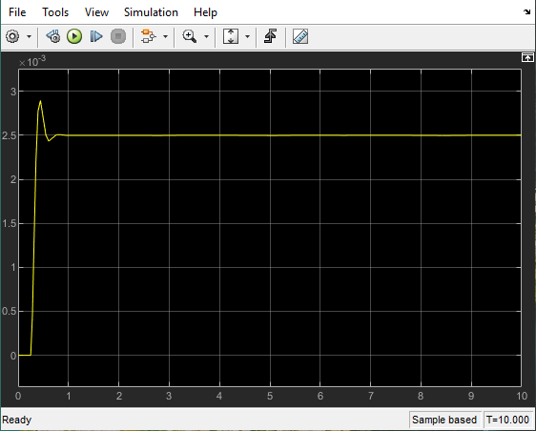
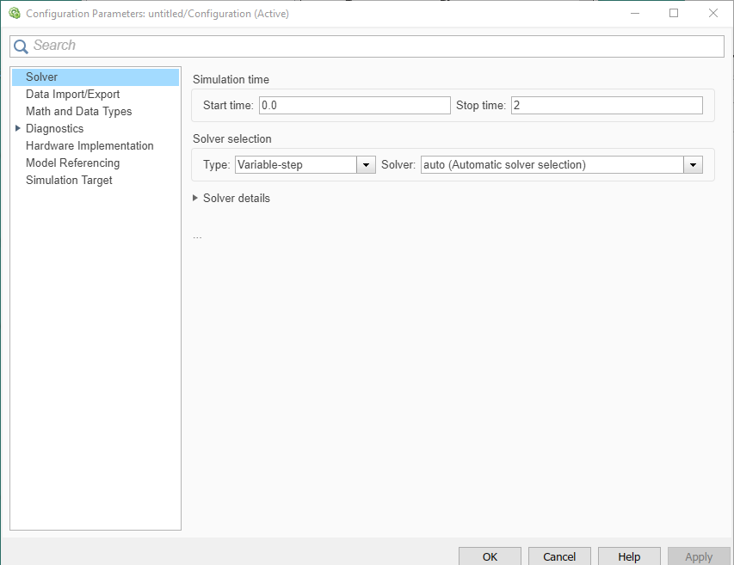
Now, we will change the parameters of the system and simulate the system again. Double-click on the "Transfer Fcn" block in the model window and change the denominator to [1 20 400]
Re-run the simulation and you will see the output as shown in scope on the right. Notice that the autoscale button only changes the vertical axis. Since the new transfer function has a very fast response, it is compressed into a very narrow part of the scope window. This is not really a problem with the scope, but with the simulation itself. Simulink simulated the system for a full ten seconds even though the system had reached steady state shortly after one second.
To correct this, you need to change the parameters of the simulation itself. In the Modeling tab, select “Model Settings”, Configuration Parameters dialog box will open. There are many simulation parameter options; we will only be concerned with the start and stop times, which tell Simulink over what time period to perform the simulation. Change Stop time from 10.0 to 2.0, which should be only shortly after the system settles.

Slide 12

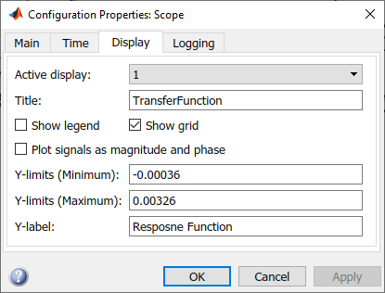
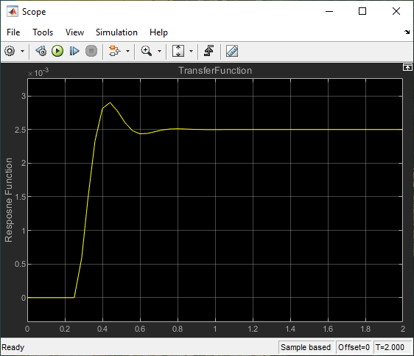
Close the dialog box and rerun the simulation. Now, the scope window should provide a much better display of the step response as shown below. Notice the number of oscillations after overshoot and the time required to achieve the stable state. You can improve the display by clicking on the Configuration Properties icon shown below. Click on the “Main” tab and set the Maximize axes and Axes scaling option to “Auto”. In the “Time” tab, set the Time Units to seconds. Then click on “Display” tab and change Title to “Transfer Function” and Y-label to “Response Function”. Scope will give display as shown below.

Slide 13
Simulink Practice Exercise
Problem: An object initially at origin moves vertically downwards into a fluid with a velocity given as:
Determine the variation of velocity, displacement and acceleration with time for first ten seconds of
motion. Note that this problem has been previously solved in Matlab.
Solution: In Simulink, the problem is solved by building a functional model comprising of building blocks from the very large library of functions provided within Simulink. Our methodology can be summarized in the following steps:
Develop a model to figure out velocity variation with time.
Differentiate the velocity function to evaluate acceleration.
Integrate the velocity function to estimate the displacement function.
Display the variation of velocity parameters with time on a scope in graphical form.
Compare the results with what obtained earlier in Matlab.
You should remember that in Simulink, the output variable is visualized in a "Scope". So in our finished model we should be having three scopes at output, one for each motion parameter.

Slide 14
Building the Model:
Step 1: Open a new Simulink model, and name it as "Motion Parameters".
Step 2: Have a good look at the formula of velocity given above and make a "list" of all the blocks you need to create the model which will give velocity as the output function.
Step 3: The multiplication of any value can be done using the "Gain" block and subsequently
adjusting its gain value. The blocks that you should import from the block library into the model window are:
Ramp from "Sources"
Scope from "Sink"
'Gain' and 'Sum' from 'Commonly used Blocks' set. 'sqrt' and 'Math Function' from "Math Operations" set.
'Derivative' and 'Integrator' from "Continuous" blocks library.
Step 4:Try to join the blocks using lines (signals) so that the function entering the scope is velocity function, according to the given equation. Do it without looking at the finished model. Step 5: Add the Integrator and Derivative blocks to either side of the velocity line and connect the output of every block to a separate scope.
Step 6: Label your model for clarity and elaborating all the operations.
Question: Why 'Ramp' function is used for 'time' input.

Slide 15
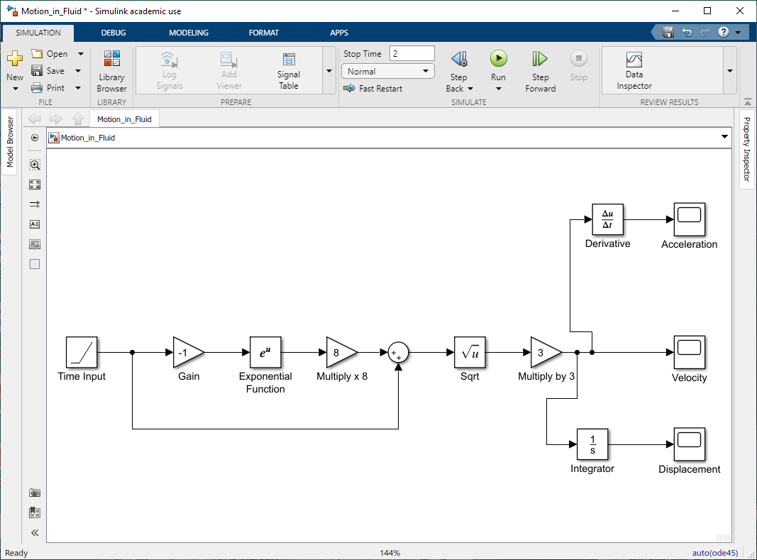
The finished model should look like the one shown in the picture below:

Slide 16
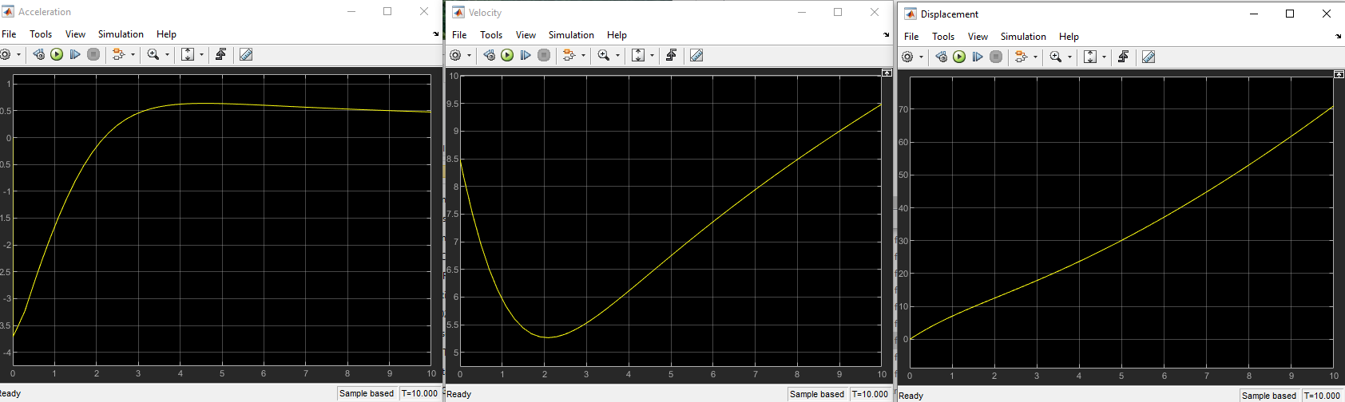
Open the scopes for displacement, velocity and acceleration, and run the simulation. You will
attain the graphs for three quantities like the ones shown below:
You can compare the result with the velocity graph you had drawn earlier with Matlab Plot command. Both the
curves are exactly same.
Upon the analysis of three curves, you can observe a steady increase in the displacement. But you must notice very carefully that acceleration starts from a negative value i.e. at time t=0, its value is nearly -3.7 (m/s^2). This negative acceleration explains the decrease of velocity from 0 to 2 seconds. You can use “Cursor Measurements” tool to find out the values of variables at particular instants.

Slide 17
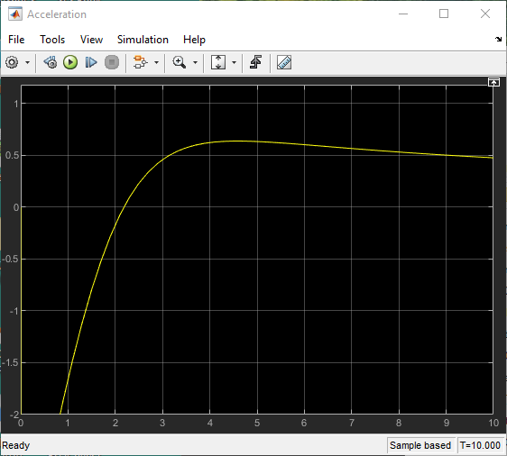
**Go to "Acceleration" scope and right click. Select the "Axes Properties" option and set the minimum value of Y- axis to -2. Now you should see the truncated acceleration curve. Thus, you should keep a keen eye on the range of axes range values corresponding to the regions of interest and make appropriate adjustments to your plots.
exactly compare the velocity curve with what you previously plotted in MATLAB.
**Although time cannot vary in a sinusoidal pattern, but consider the input as some other quantity and replace the Ramp input first by a "sine" input and then "step" input. Try to estimate what happened to the output values by changing the input type.
Which one is better to work with, Matlab or Simulink? And why?
Note: It is very important that you discuss
and understand every step with your Instructor during modelling and simulation phases.
**From Simulation tab, set the "Stop time" =2. Now run the simulation again. You will see all the curves from t=0 to t=2 sec. And now you can

