Slide 1
Swinburne University of Technology MATLAB and Simulink - Lecture Notes # 1 Course: MEE20007 Design and Product Visualisation Project Associate Professor Ambarish Kulkarni
Topics Covered:
Matlab Introduction
Matrices and Arrays in Matlab
Plotting in Matlab
Symbolic Maths in Matlab

Slide 2

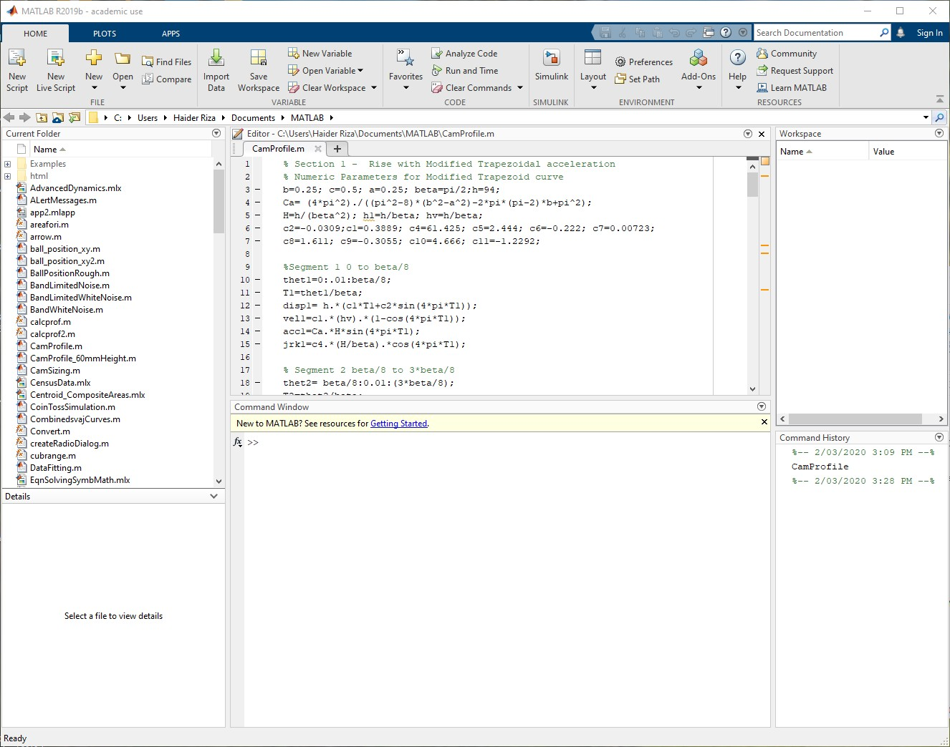
MATLAB Main window and Interface
The desktop includes these panels:
Current Folder allows you to access your files.
Command Window
where you
can enter at the prompt,
commands Matlab
indicated by the prompt
sign (>>).
Workspace — Saves the variables that you create in Matlab session or import from other files.
Command History —
View or
As you work in MATLAB, you issue commands that create variables and call functions in the Command Window. For example, create a variable named ‘a’ by typing this statement at the command line:
>> a = 1
re-run
you
commands that
have entered at the command line.

Slide 3
2. BASIC OPERATIONS ON ARRAYS : MATRICES AND VECTORS:
MATLAB is an abbreviation for "matrix laboratory." While other programming languages mostly work with numbers one at a time, MATLAB is designed to operate primarily on whole matrices and arrays. All MATLAB variables are multidimensional arrays, no matter what type of data. A Matrix is a two dimensional array often used in linear algebra. To create an array with four elements in a single row, separate the elements with either a comma (,) or a space. One dimensional array is called a Vector
>> a = [1 2 3 4] returns a = 1 2 3 4. This type of array is a row vector.
** To create a matrix that has multiple rows, separate the rows with semicolons.
>> a = [1 2 3; 4 5 6; 7 8 10], returns a = 1 2 3
4 5 6
7 8 10
**Another way to create a matrix is to use a function, such as ones, zeros, or rand. For example, create a 5-by-1 column vector of
zeros.
>> z = zeros(5,1) : Here 5 refers to number of rows and 1 is the number of columns z = 0
0
0
0
0

Slide 4
Matrix and Array Operations
(A) MATLAB allows you to process all of the values in a matrix using a single arithmetic operator or function.
>> a + 10
ans =
11 12 13
14 15 16
17 18 20
**Applying the sine function on matrix ‘a’
>> sin(a)
ans = | 0.8415 | 0.9093 | 0.1411
 | -0.7568 | -0.9589 | -0.2794
 | 0.6570 | 0.9894 | -0.5440
(B) To transpose a matrix, use a single quote ('):
>> a'
ans = 1 4 7
2 5 8
3 6 10

Slide 5
(C) You can perform standard matrix multiplication, which computes the inner products between rows and columns,
using the * operator. For example, confirm that a matrix times its inverse returns the identity matrix:
>> p = a*inv(a)
p = 1.0000
0
0
0
1.0000
0
-0.0000
0
1.0000
** Notice that p is not a matrix of integer values. MATLAB stores numbers as floating-point values, and arithmetic operations are sensitive to small differences between the actual value and its floating point representation. You can display more decimal digits using the format command:
>> format long % format affects only the display of numbers, not the way MATLAB computes or saves them.
>> p = a*inv(a)
p = 1.000000000000000
0
0
0
1.000000000000000
0
-0.000000000000000
0
0.999999999999998
Reset the display to the shorter format using >> format short

Slide 6
(D) To perform element-wise multiplication rather than matrix multiplication, use the .* operator:
>> p = a.*a will give the result as :
p = 1 4 9
16 25 36
49 64 100
**The matrix operators for multiplication, division, and power each have a corresponding array operator that operates element-wise. For example, try to compare the result of a^3 with that of a.^3 which does not perform any matrix multiplication but raise each element of ‘matrix a’ to the third power:
>> a.^3
ans =
1 8 27
64 125 216
343 512 1000

Slide 7
(E) Concatenation
**Concatenation is the process of joining arrays to make larger ones. In fact, you made your first array by concatenating its individual elements. The pair of square brackets [ ] is the concatenation operator.
>> A = [a,a] will join matrix a with itself, the answer will be:
A =
1 2 3 1 2 3
4 5 6 4 5 6
7 8 10 7 8 10
**Concatenating arrays next to one another using commas is called horizontal concatenation. Each array must have the same number of rows. Similarly, when the arrays have the same number of columns, you can concatenate vertically using semicolons.
>> A = [a; a] returns A = 1 2 3
4 5 6
7 8 10
1 2 3
4 5 6
7 8 10

Slide 8
(F) Array Indexing
**Every variable in MATLAB is an array that can hold many numbers. When you want to access
selected elements of an array, use indexing. For example, consider the 4-by-4 magic square A:
>> A = magic(4) *** What is magical about this matrix
A = 16 2 3 13
5 11 10 8
9 7 6 12
4 14 15 1
**There are two ways to refer to a particular element in an array. The most common way is to
specify row and column subscripts, such as
>> A(4,2)
ans = 14
**Less common, but sometimes useful, is to use a single subscript that traverses down each column
in order:
>> A(8)
ans = 14

Slide 9
**Using a single subscript to refer to a particular element in an array is called linear indexing. If you try to refer to elements outside an array on the right side of an assignment statement, MATLAB throws an error.
>> test = A(4,5) attempted to access A(4,5); index out of bounds because size(A)=[4,4].
However, on the left side of an assignment statement, you can specify elements outside the current dimensions. The size of the array increases to accommodate the newcomers.
>>A(4,5) = 17 A =
16 | 2 3 13 0
5 | 11 10 8 0
9 | 7 6 12 0
4 | 14 15 1 17
**To refer to multiple elements of an array, use the colon operator, which allows you to specify a range of the form start:end. For example, list the elements in the first three rows and the second column of A:
>> A(1:3,2)
ans = 2
11
7
**The colon alone, without start or end values, specifies all of the elements in that dimension. For example, select all the columns in the third row of A:
>> A(3,:)
ans = 9 7 6 12 0
**The colon operator also allows you to create an equally spaced vector of values using the more general form start:step:end.
>> B = 0:10:100
B = 0 10 20 30 40 50 60 70 80 90 100
If you omit the middle step, as in start:end, MATLAB uses the default step value of 1.

Slide 10
(G) Dealing with Strings and Characters
**A character string is a sequence of any number of characters enclosed in single quotes. You can assign a string to
a variable.
>> myText = 'Hello, world';
If the text includes a single quote, use two single quotes within the definition.
>> otherText = 'You''re right'
otherText = You're right
myText and otherText are arrays, like all MATLAB variables. Their class or data type is char, which is short for
character.
>> whos myText
Name Size Bytes Class Attributes myText 1x12 24 char
**You can concatenate strings with square brackets, just as you concatenate numeric arrays.
>> longText = [myText,' - ',otherText] longText = Hello, world - You're right
**To convert numeric values to strings, use functions, such as num2str or int2str.
>> f = 71;
>> c = (f-32)/1.8;
tempText = ['Temperature is ',num2str(c),'C'] tempText = Temperature is 21.6667C

Slide 11
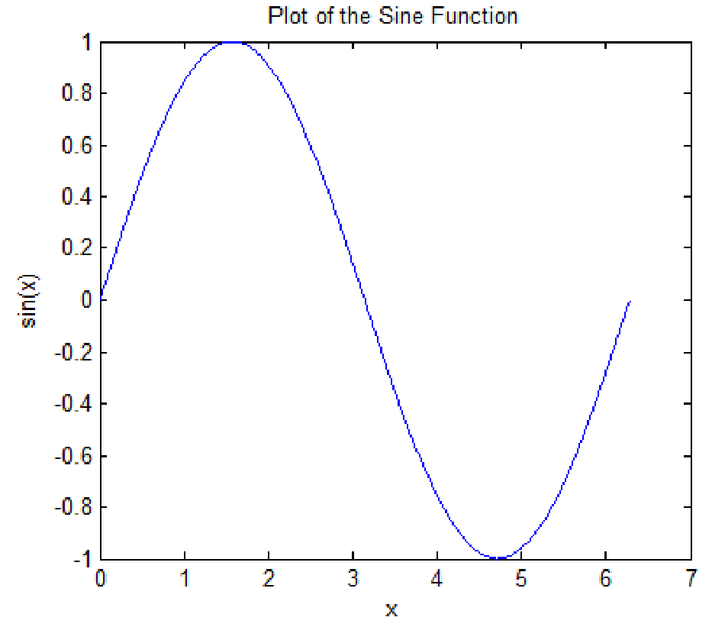
3. PLOTTING IN MATLAB
Line Plots
To create two-dimensional line plots, use the plot function. For example, plot the value of the sine function
from 0 to 2π:
>> x = 0:pi/100:2*pi %The interval 0 to 2*pi divided into 200steps
% for accurate and smooth curve plotting
>> y = sin(x);
>> plot(x,y)
**You can label the axes and add a title using following commands:
>> xlabel('x')
>> ylabel('sin(x)')
>> title('Plot of the Sine Function')
The graph should look like the figure shown in Fig 1.
Figure 1: A sine curve plotted from 0 to 2π

Slide 12
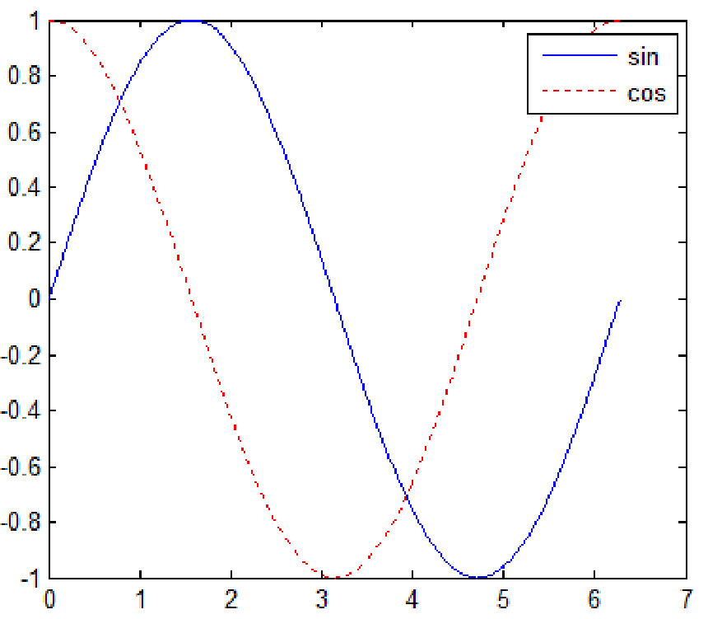
By adding a third input argument to the plot function, you can plot the same variables using a red
dashed line.
>> plot(x,y,'r--') Note how the curve is plotted with a red dashed line instead of solid one.
The 'r--' string is a line specification. Each specification can include characters for the line colour, style, and marker. A marker is a symbol that appears at each plotted data point, such as a +, o, or *. For example, 'g:*' requests a dotted green line with * markers.
Notice that the titles and labels that you defined for the first plot are no longer in the current figure window. By default, MATLAB clears the figure each time you call a plotting function, resetting the axes and other elements to prepare the new plot.
** To add plots to an existing figure, use ‘hold on’.
>> x = 0:pi/100:2*pi;
>> y = sin(x);
>> plot(x,y)
>> hold on
>> y2 = cos(x);
>> plot(x,y2,'r:')
>> legend('sin','cos')
Results shown in Fig 2.
Figure 2: Sine and Cosine curves plotted on same graph.

Slide 13
4. BASIC TUTOR ON SYMBOLIC MATHS:
Normal mode of MATLAB operation is "Numerical" i.e. the commands and functions operate on numeric data. But you can also apply MATLAB functions on variables and algebraic expressions; like in normal mathematics. Here is a tutorial to make you acquainted of the basic functionality of that amazing tool called SYMBOLIC MATH TOOL.
>> syms a b c d e f
>> A=[a b; c d] A = [ a, b]
[ c, d]
-- Defining symbolic variables, otherwise Matlab considers every value to be a vector or matrix.
>> det(A) -- Evaluating the determinant ans = a*d - b*c
>> syms x y % declaring x and y as symbolic variables
>> F= x^2+y^2 --- Defining a polynomial symbolic function F = x^2 + y^2
>> diff(F) ---- "diff" command performs differentiation on the given function. unless otherwise specified.
ans = 2*x
>> diff(F,y) – differentiating function 'F' w.r.t. variable 'y' only ans = 2*y
Default setting is to differentiate w.r.t. 'x'

Slide 14
>> int(F) --- Symbolic Integration w.r.t. 'x'
ans = x^3/3 + x*y^2
>> F1= (2*x-3)/(3*x^2+5)
F1 = (2*x - 3)/(3*x^2 + 5)
>> diff(F1)
ans = 2/(3*x^2 + 5) - (6*x*(2*x - 3))/(3*x^2 + 5)^2
>> F2=sin(3*x^2+2)
F2 = sin(3*x^2 + 2)
>> diff(F2)
ans = 6*x*cos(3*x^2 + 2)
>> F3=asin(5*x)
F3 = asin(5*x)
>> diff(F3)
ans = 5/(1 - 25*x^2)^(1/2)
>> pretty (ans) % This command will “print” the answer in a more readable manner on the screen

Slide 15
Symbolic Math Tutorial Continued:
>> syms x y z
>> symmatrix=[x 2*x x^2;y*x 1/(y+x) log(y); z*x z*y x*y]
>> symmatrix(1,2) --- Displays element at intersection of row 1 and column 2
>> symmatrix(2,:) --- Returns all elements of row 2
>> symmatrix(:,3) --- Displays all elements of column 3
>> y1=2*x+3*y+4*z y1 = 2*x + 3*y + 4*z
>> y2=(x+1)*(x*3) y2 = 3*x*(x + 1)
>> y1+y2 % Symbolic addition of polynomials
ans = 2*x + 3*y + 4*z + 3*x*(x + 1)
>> pretty(ans) gives 2 x + 3 y + 4 z + 3 x (x + 1)
>> simplify(ans)
ans = 3*x^2 + 5*x + 3*y + 4*z
>> u=x^2-x-2 u = x^2 - x - 2
>> factor(u)
ans = (x + 1)*(x - 2)

Slide 16
>> v=(x+y+z)^3
v = (x + y + z)^3
>> expv=expand(v)
expv = x^3 + 3*x^2*y + 3*x^2*z + 3*x*y^2 + 6*x*y*z + 3*x*z^2 + y^3 + 3*y^2*z + 3*y*z^2 + z^3
>> sympol= str2sym('5*x^4+4*x^3+3*x^2+2*x+1')
sympol = 5*x^4 + 4*x^3 + 3*x^2 + 2*x + 1 – A polynomial with symbolic values
>> numpol=sym2poly(sympol) – converts symbolic polynomial into numeric one
numpol = 5 4 3 2 1 --- Descending powers of ‘x’ from left to right
>> P= [1 2 3 4 5]
P = 1 2 3 4 5
>> S=poly2sym(P) – converts numeric polynomial into symbolic polynomial S = x^4 + 2*x^3 + 3*x^2 + 4*x + 5
Small Exercise: You are advised to note down the results in your note-books.
>> (x-y)*(x-y)^2 --- Note the result.
>> Write the difference between expand(ans) and factor(ans), where ‘ans’ is of previous statement.
>> simplify((xˆ3 - yˆ3)/(x - y)) ; ans = ?
>> sym(’1/2’) + sym(’1/3’) -- ans = ?
** Find the outputs and write the difference between: cos(pi/2) and cos(str2sym ('pi/2')) **

