Slide 1
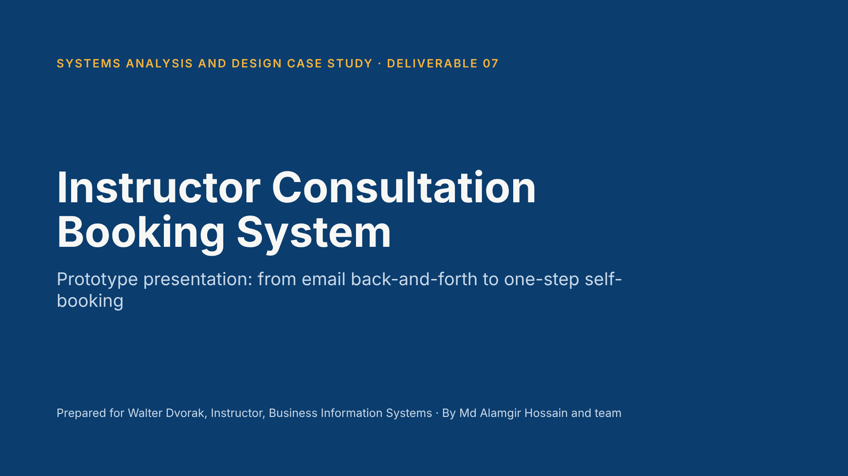
Notes:
Introduce the team and the purpose: we interviewed Walter about how students book consultations, and this prototype shows how an improved interface solves the problems we found. Note that the figures are from our practice scenario.

Slide 2
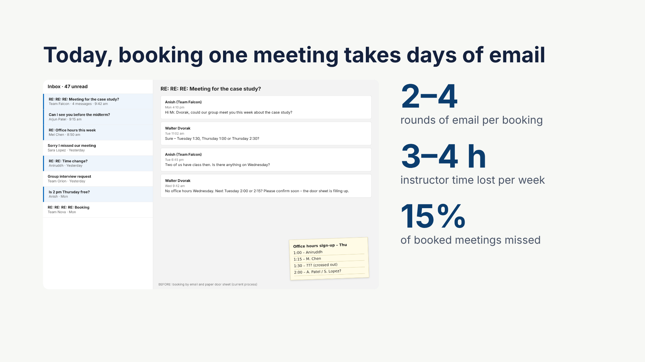
Notes:
This is the "before" picture. Students email Walter, he replies with times, and it goes back and forth two to four times. Walk-ins use a paper sheet on his door that is not linked to Outlook, so double-bookings happen. There are no reminders, so about 15% of meetings are missed. Figures are from our interview and questionnaire (practice scenario).

Slide 3
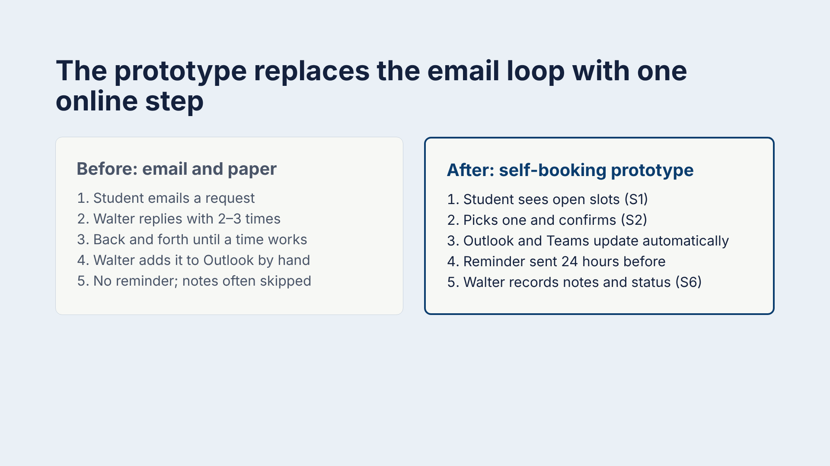
Notes:
Compare the two processes. The loop in step 3 disappears because students can see exactly which times are open. Scheduling, calendar updates and reminders are automatic. S1, S2 and S6 refer to the prototype screens we show next.

Slide 4
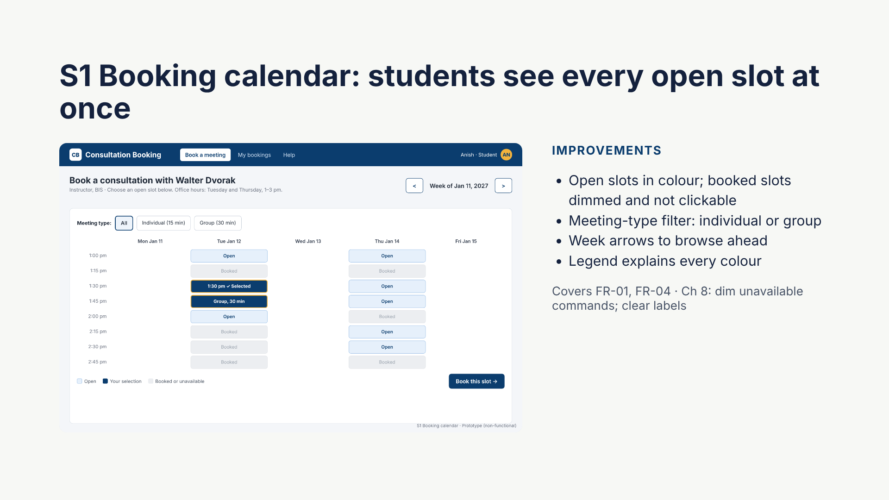
Notes:
This screen removes the email loop. Students can see exactly which times are free. Booked slots are greyed out, which follows the Chapter 8 guideline to dim commands that are not available. The selected slot uses a strong contrasting colour so the user knows what they picked.

Slide 5
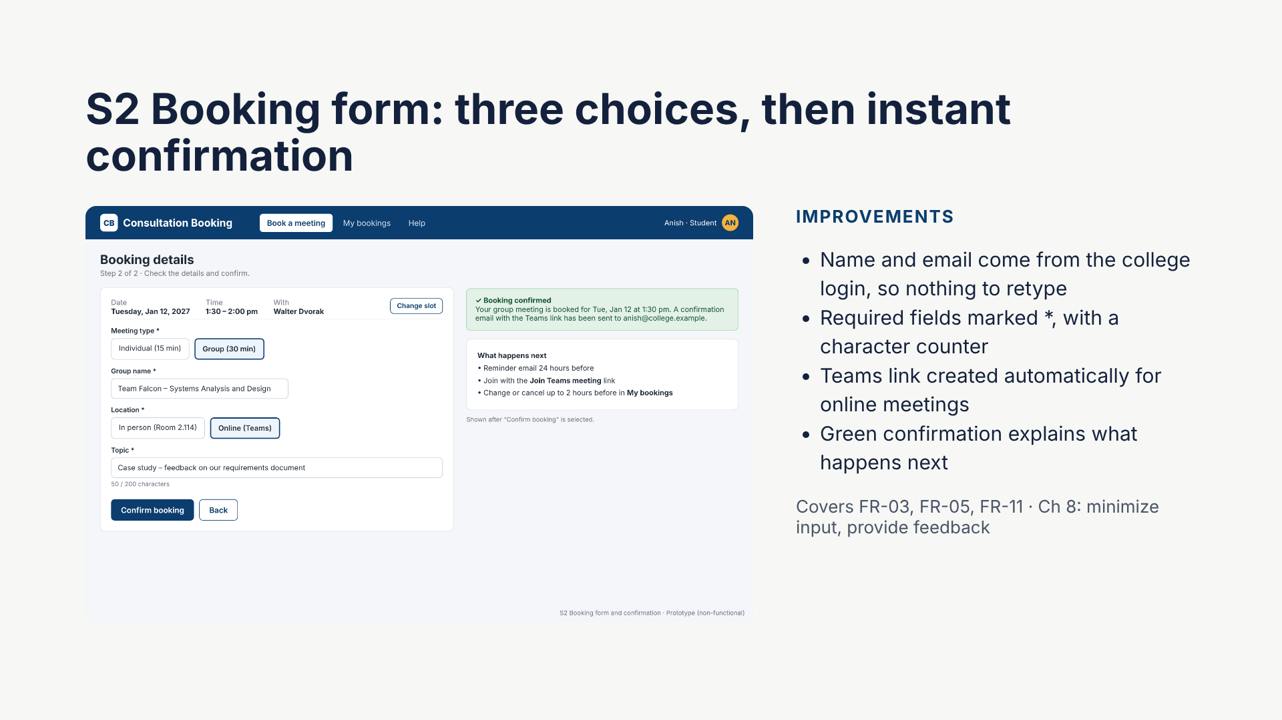
Notes:
The form asks only what the system cannot know: meeting type, group name, location and topic. Everything else comes from the college login. Clear feedback confirms the booking and tells the student what happens next, which follows the Chapter 8 guideline to provide feedback to users.

Slide 6
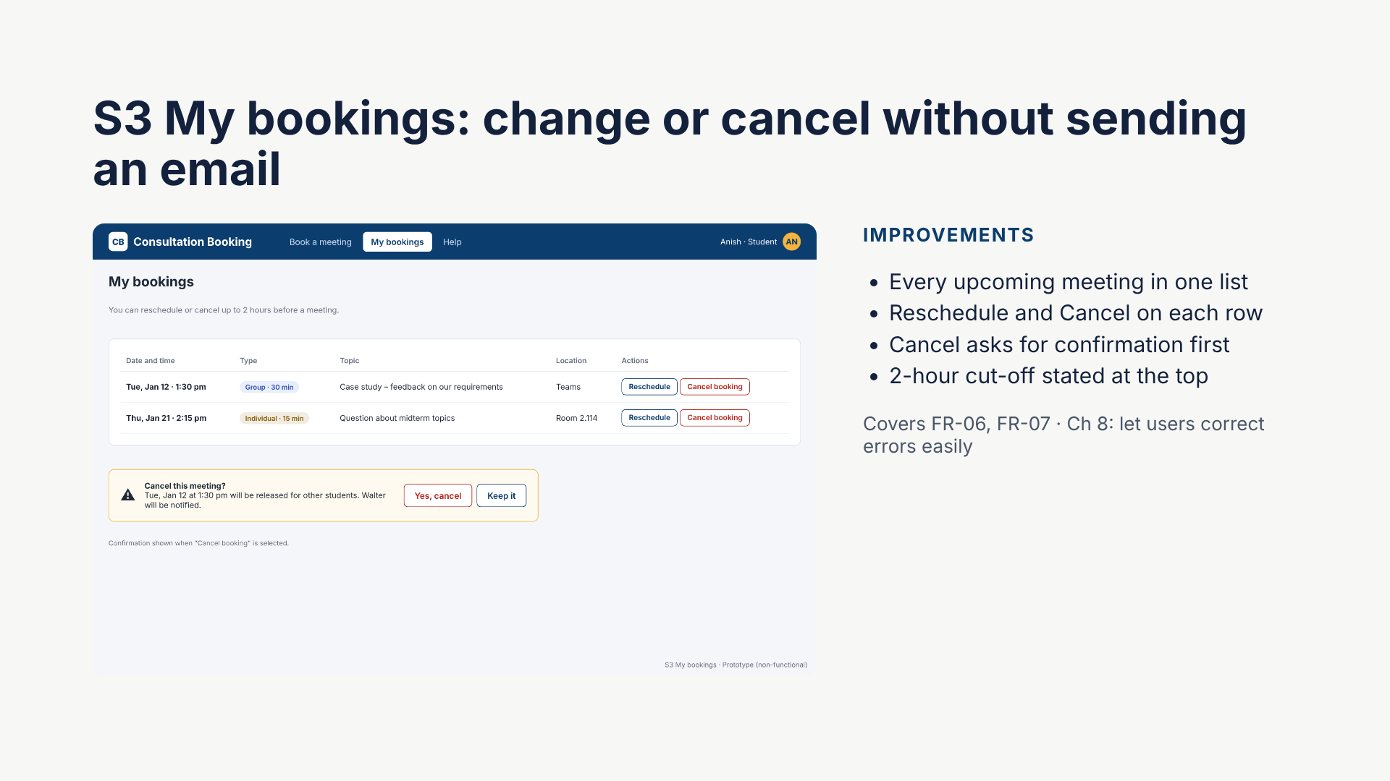
Notes:
Students can fix their own bookings. A confirmation step protects against accidental cancellation, and a freed slot goes straight back on the calendar for someone else. This follows the guideline to make it easy for users to correct errors.

Slide 7
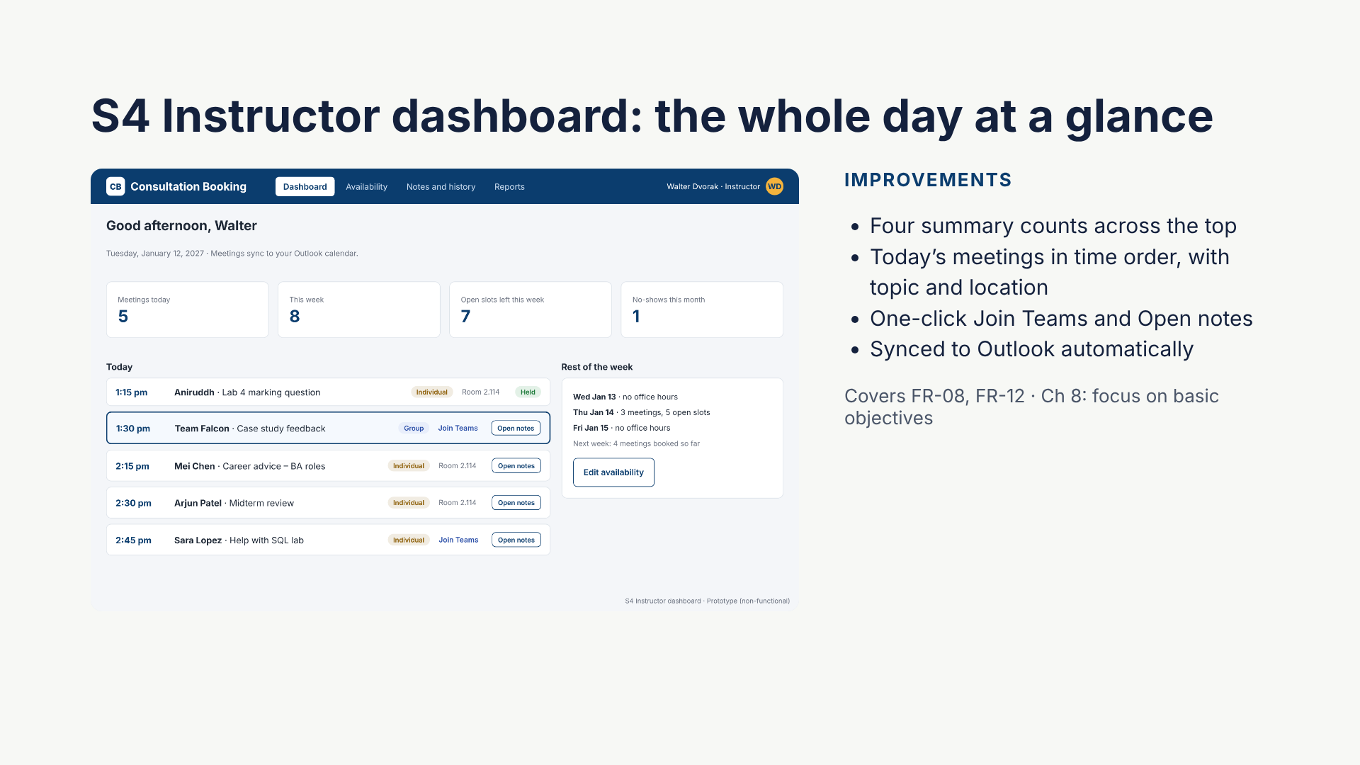
Notes:
Walter no longer searches his inbox to prepare for office hours. Everything he needs for today is on one screen, and the meetings already appear in his Outlook calendar.

Slide 8
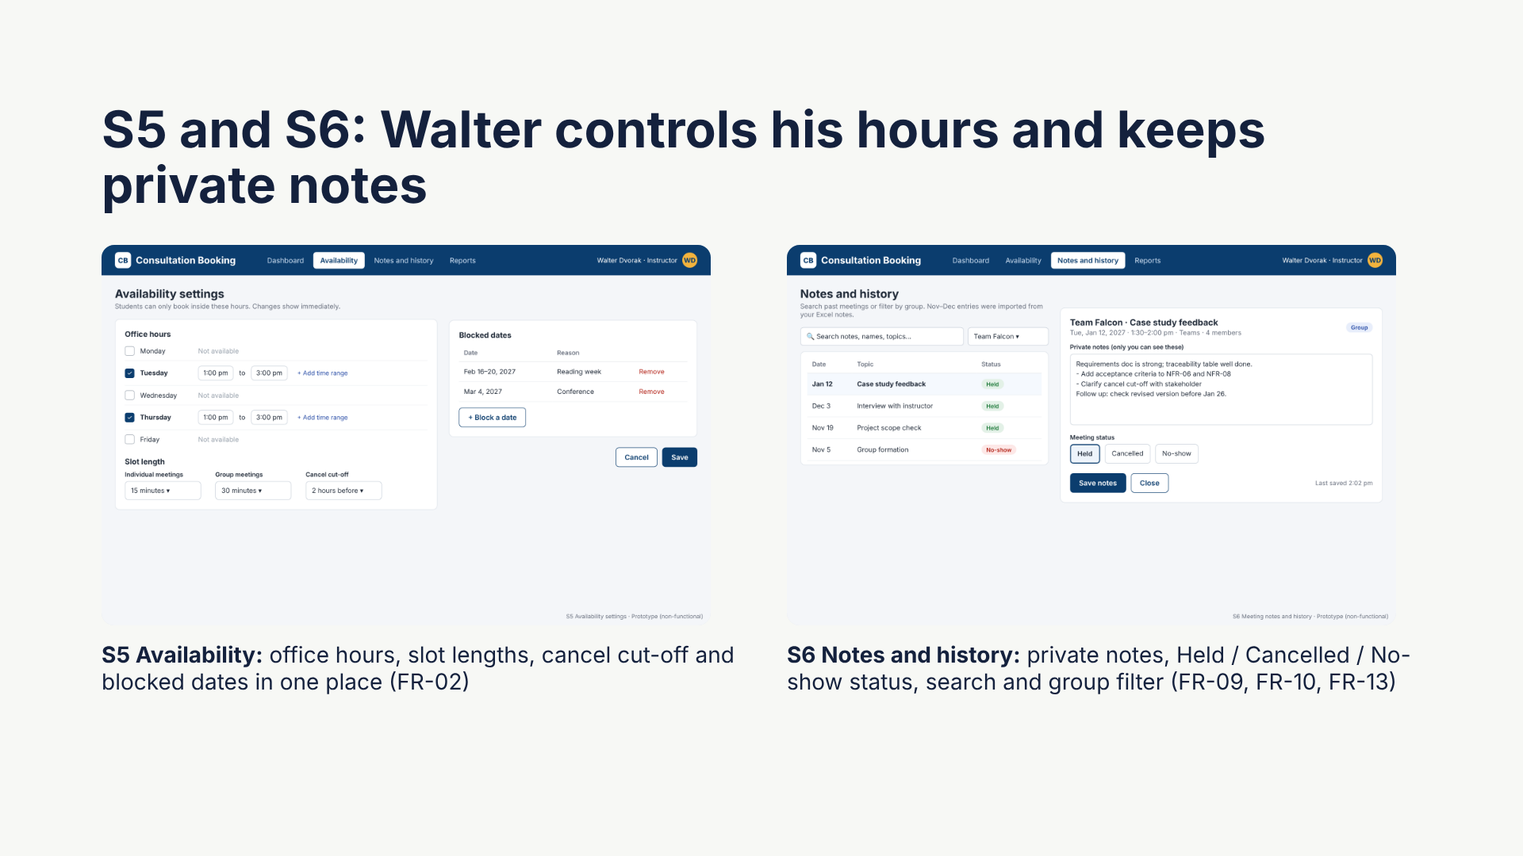
Notes:
S5 replaces the paper door sheet: changes show on the students’ calendar immediately. S6 replaces the personal Excel file, and notes are visible only to Walter, which meets the privacy requirement.

Slide 9
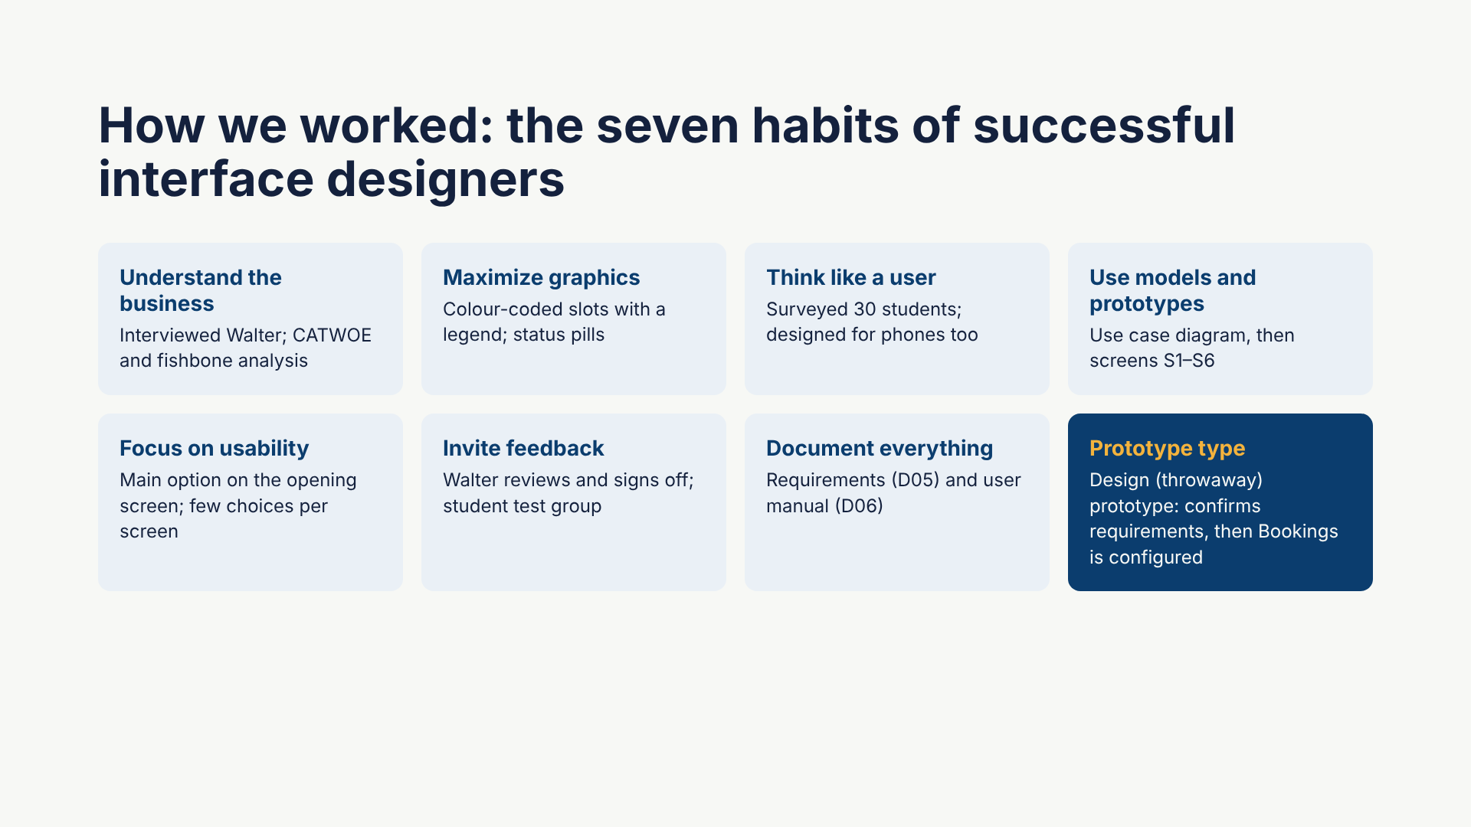
Notes:
These are the seven habits from the Chapter 8 lecture. The last card explains that ours is a design, or throwaway, prototype: it verifies the requirements with Walter and is then set aside while the real system is configured in Microsoft Bookings. This avoids the risk the lecture mentions of clients adopting an unfinished prototype.

Slide 10
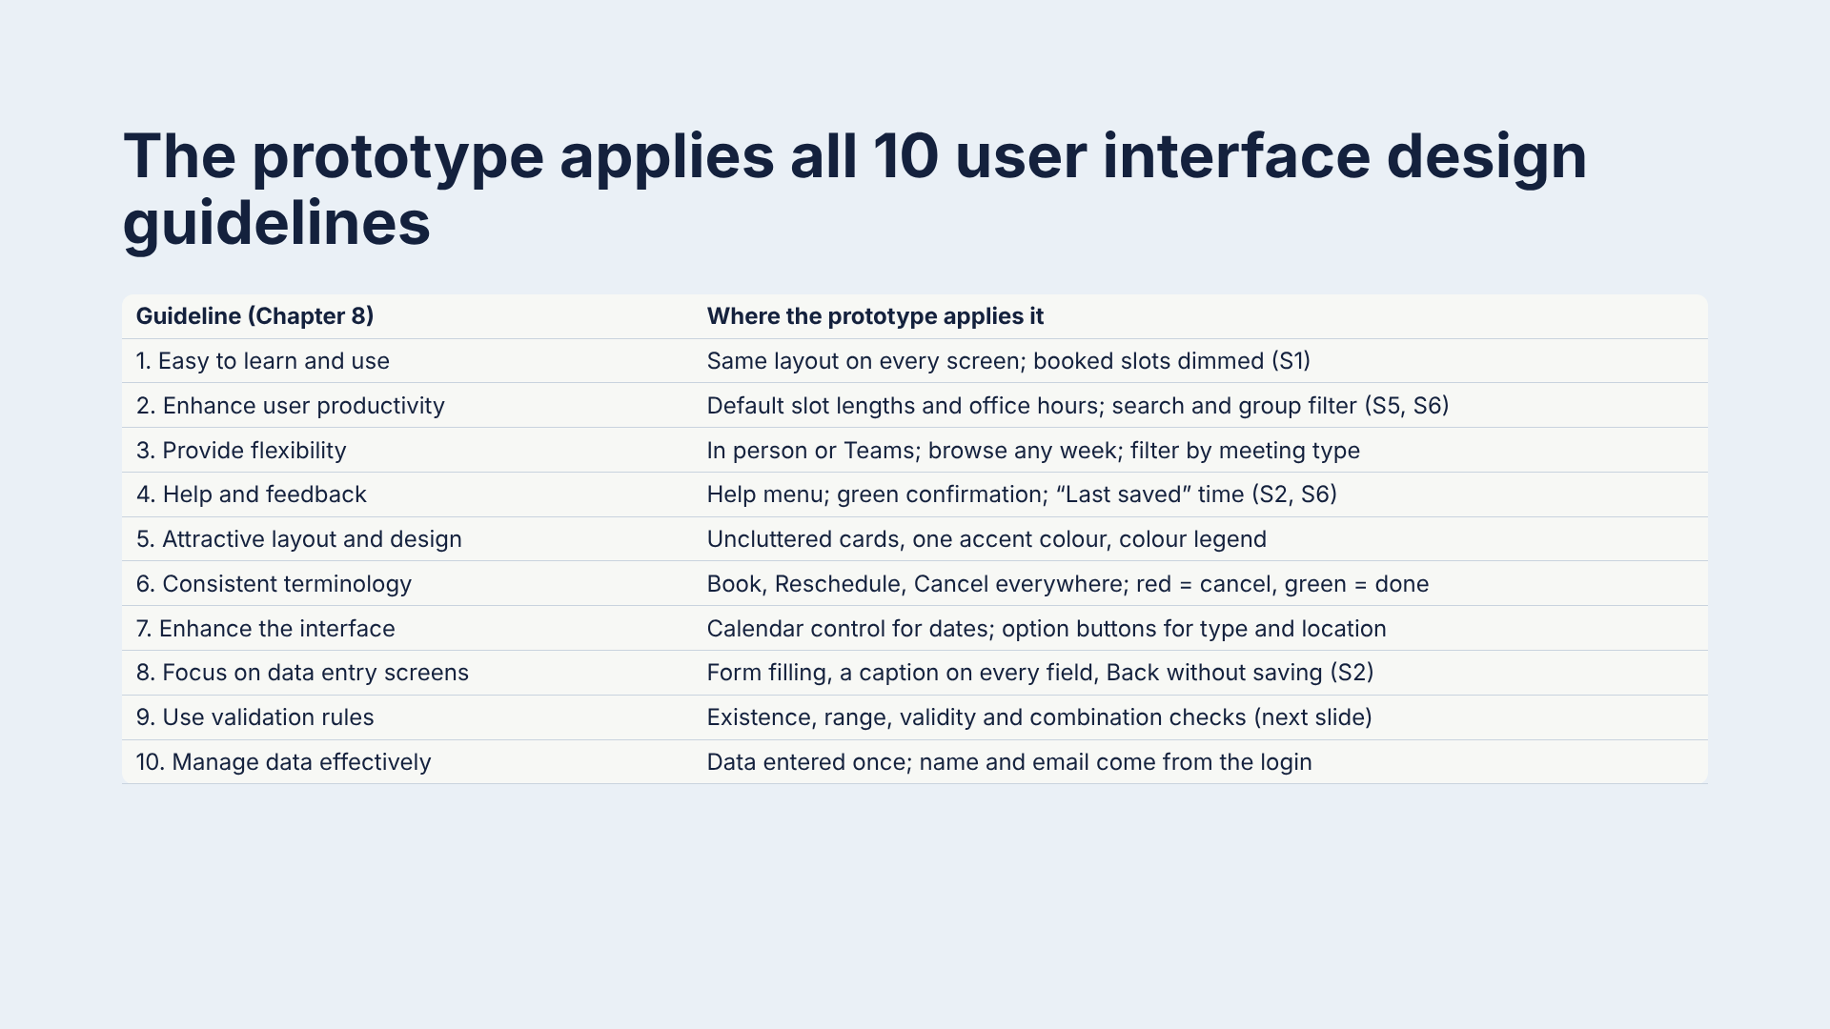
Notes:
These are the ten guidelines from the Chapter 8 lecture. Walk through them row by row and point to the screen where each appears. This is the core of the improvement argument.

Slide 11
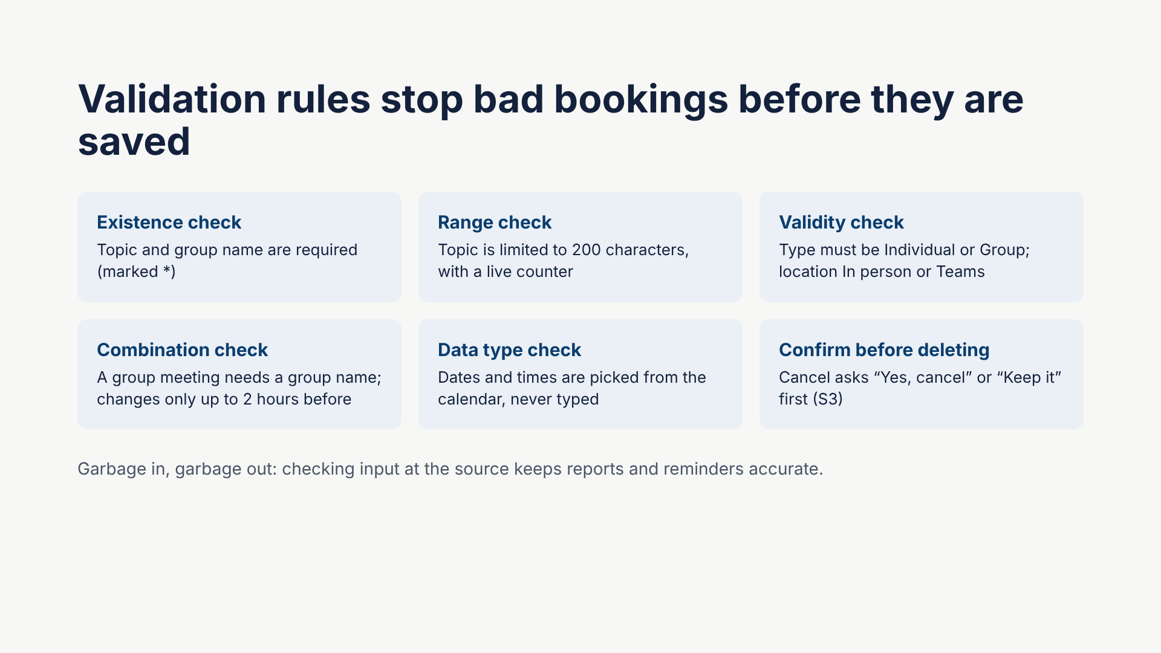
Notes:
These are the validation rules from the Chapter 8 lecture, applied to the booking form. Data is checked when it is entered, close to its source, so errors never reach the calendar or the reports.

Slide 12
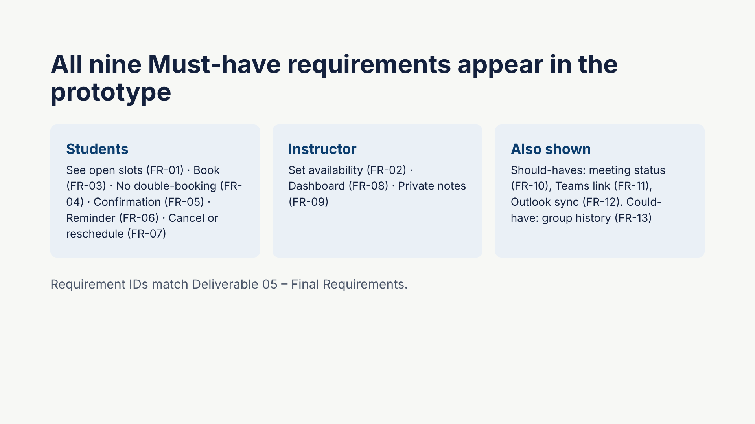
Notes:
Use this slide to show traceability: every Must-have requirement from Deliverable 05 maps to at least one screen. Reports (FR-14) are planned for a later screen, S7.

Slide 13
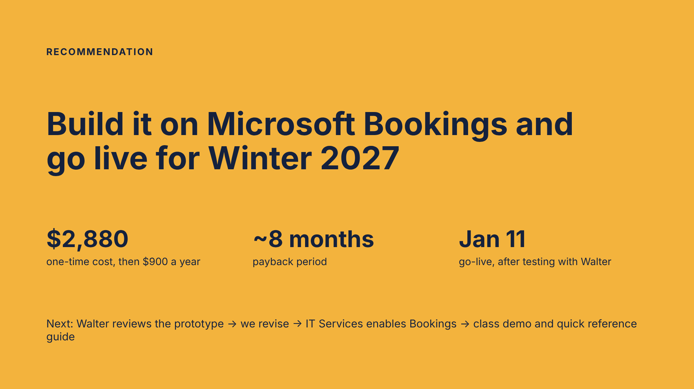
Notes:
Close with the recommendation from the Preliminary Investigation Report: approve Option B. Then ask Walter for feedback on the prototype screens, which counts toward the "feedback from personnel interviewed" criterion. Figures are illustrative estimates from Deliverable 02.

