Slide 1
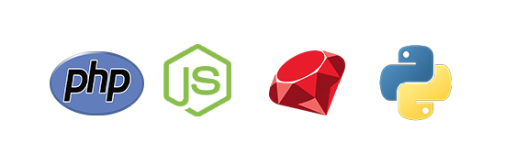
Leading Languages of non-Enterprise Web Applications
Zhou Liu
2016-11-29

Slide 2
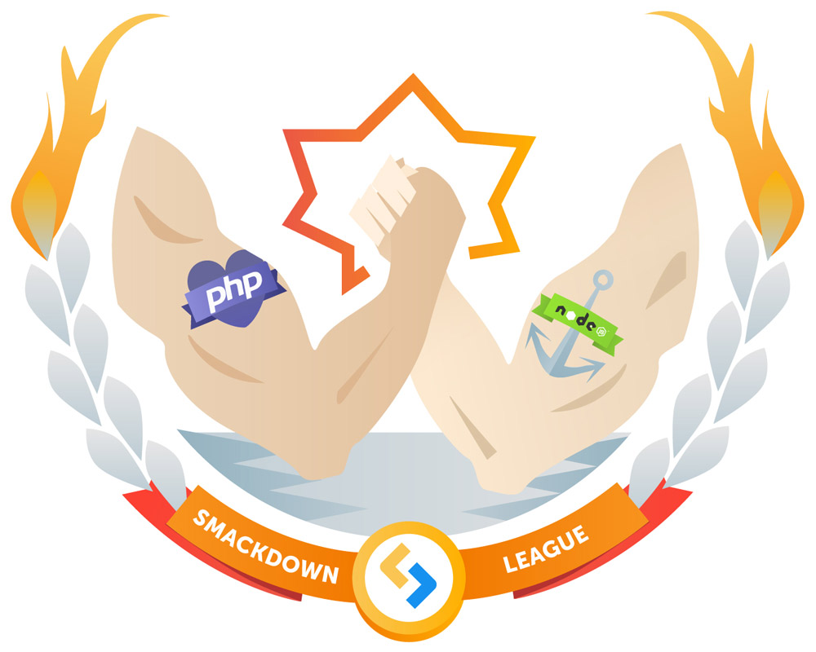
Partners become enemies
PHP
Speed of coding
JS
Speed of execution
Modern features
Complexity of closure and more
Separate concerns
Simplicity
Mixing code with content
Deep Code Base

Slide 3
Other players in web development
Neither Ruby nor Python are in any way restricted to web development
Pros: lots of libraries; convention-over-configuration: no config files, a predefined directory and following naming conventions. Delelopers only need to take care of unconventional aspects of the application.
Cons: Slow when compared to the runtime of Node.js
Pros: Explicit is better than implicit, code is very readable, project is organized around apps, each app has its own models, views, controllers and tests.
Cons: Django is released 1 year later than Rails, less popular means less libraries.

Slide 4
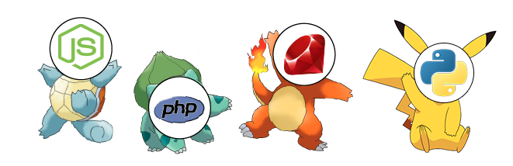
Summarizes: You only get to pick one (not really)

Slide 5
references for additional information
[1] http://www.infoworld.com/article/2866712/php/php-vs-node-js-an-epic-battle-for-developer-mind-share.html
[2] https://bernardopires.com/2014/03/rails-vs-django-an-in-depth-technical-comparison/
[3] https://www.madetech.com/blog/pros-and-cons-of-ruby-on-rails
[4] https://www.quora.com/Why-is-Django-not-as-popular-as-Ruby-on-Rails
[5]http://nando.oui.com.br/2014/04/04/why_i_sort_of_dislike_django.html

