Slide 1
Natural Language Processing (NLP)
with Deep NLP
from Zero to Hero
FAHAD HUSSAIN
MCS, MSCS, DAE(CIT)
Computer Science Instructor of well known international Center
Also, Machine Learning and Deep learning Practitioner
For further assistance, code and slide https://fahadhussaincs.blogspot.com/
YouTube Channel: https://www.youtube.com/channel/UCapJpINJKHzflWwCQ8Kse2g/playlists

Slide 2
Prerequisite
for
Natural language processing
Python
Basic Concept of Machine Learning and Deep Learning

Slide 3
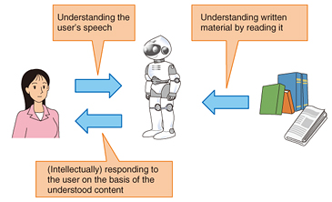
Natural language processing

Slide 4
Natural language processing
Natural language processing (NLP) is a subfield of linguistics, computer science, information engineering, and artificial intelligence concerned with the interactions between computers and human (natural) languages, in particular how to program computers to process and analyze large amounts of natural language data.
Challenges in natural language processing frequently involve speech recognition, natural language understanding, and natural language generation.
Fahad Hussain Tutorial
Fahad Hussain Tutorial
Fahad Hussain Tutorial
For further assistance, code and slide https://fahadhussaincs.blogspot.com/
YouTube Channel: https://www.youtube.com/channel/UCapJpINJKHzflWwCQ8Kse2g/playlists

Slide 5
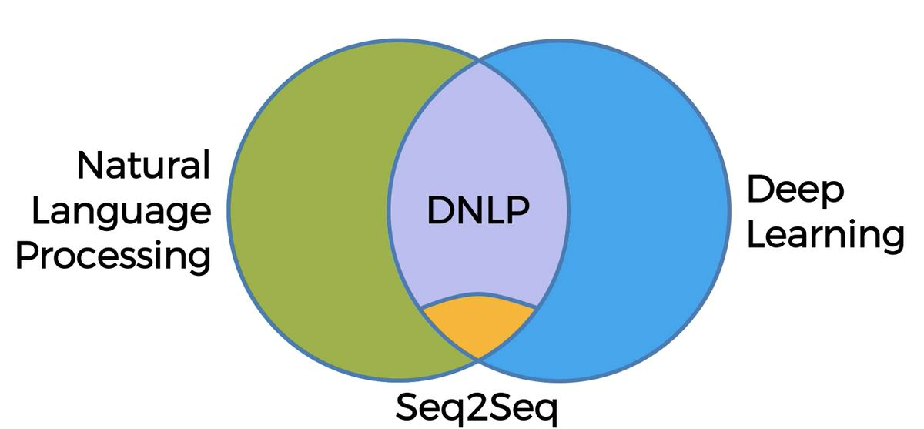
Types of NLP
Fahad Hussain Tutorial
Fahad Hussain Tutorial
Fahad Hussain Tutorial
For further assistance, code and slide https://fahadhussaincs.blogspot.com/
YouTube Channel: https://www.youtube.com/channel/UCapJpINJKHzflWwCQ8Kse2g/playlists

Slide 6
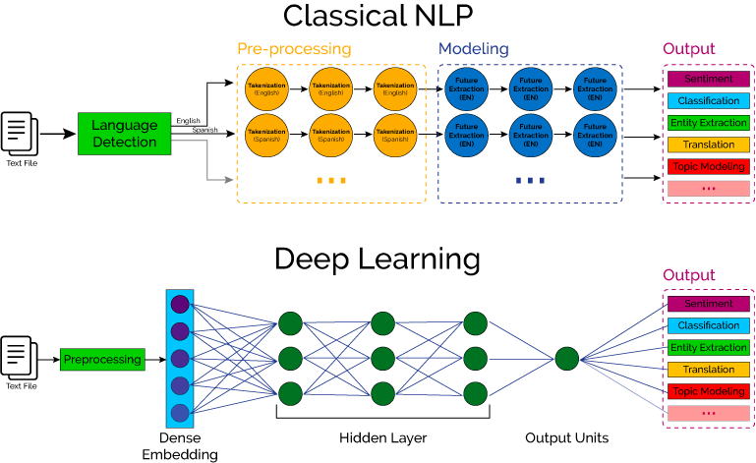

Slide 7
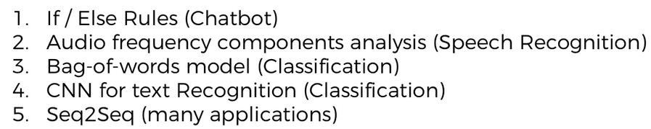
How NLP, DNLP and DL involves in!!!
Fahad Hussain Tutorial
Fahad Hussain Tutorial
Fahad Hussain Tutorial
For further assistance, code and slide https://fahadhussaincs.blogspot.com/
YouTube Channel: https://www.youtube.com/channel/UCapJpINJKHzflWwCQ8Kse2g/playlists

Slide 8
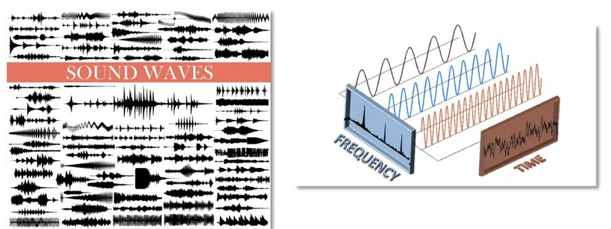
How NLP, DNLP and DL involves in!!!
Fahad Hussain Tutorial
Fahad Hussain Tutorial
Fahad Hussain Tutorial
For further assistance, code and slide https://fahadhussaincs.blogspot.com/
YouTube Channel: https://www.youtube.com/channel/UCapJpINJKHzflWwCQ8Kse2g/playlists

Slide 9
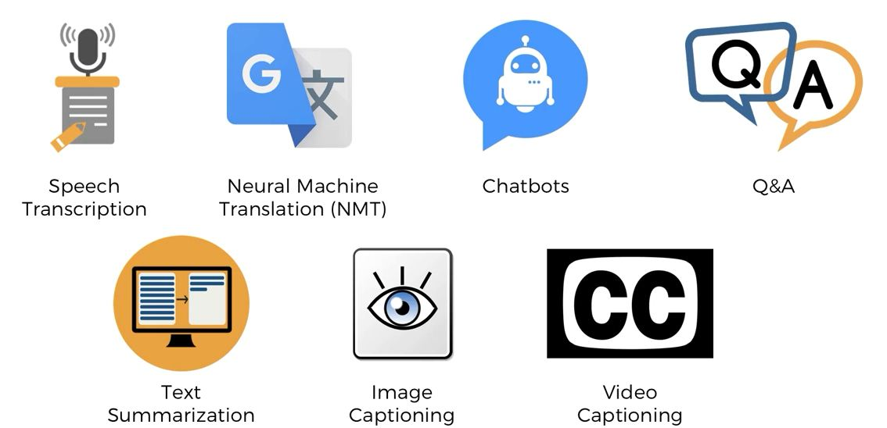
Applications
Fahad Hussain Tutorial
Fahad Hussain Tutorial
Fahad Hussain Tutorial
For further assistance, code and slide https://fahadhussaincs.blogspot.com/
YouTube Channel: https://www.youtube.com/channel/UCapJpINJKHzflWwCQ8Kse2g/playlists

Slide 10
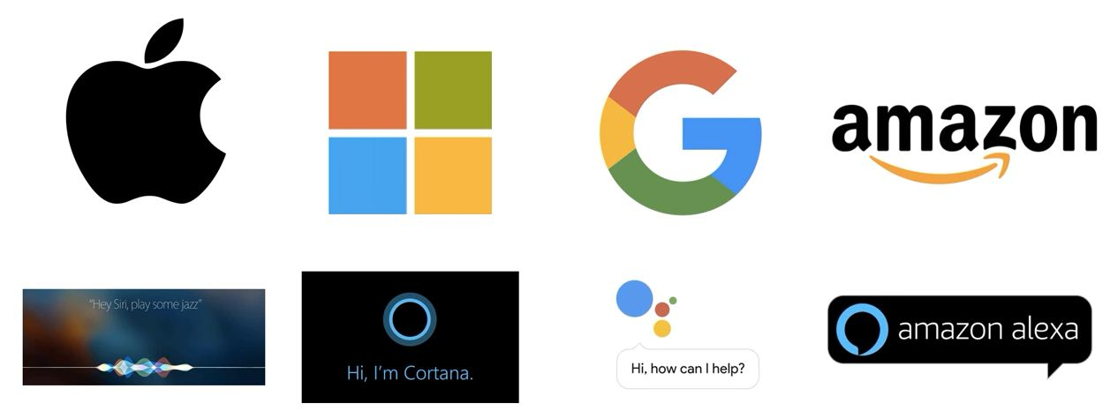
Used by
Fahad Hussain Tutorial
Fahad Hussain Tutorial
Fahad Hussain Tutorial
For further assistance, code and slide https://fahadhussaincs.blogspot.com/
YouTube Channel: https://www.youtube.com/channel/UCapJpINJKHzflWwCQ8Kse2g/playlists

Slide 11
Thanks
Do Subscribe, like and share
next we will discuss about
How NLP work?
For further assistance, code and slide https://fahadhussaincs.blogspot.com/
YouTube Channel: https://www.youtube.com/channel/UCapJpINJKHzflWwCQ8Kse2g/playlists

Slide 12
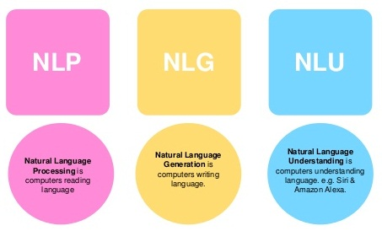
NLP Working
Fahad Hussain Tutorial
Fahad Hussain Tutorial
For further assistance, code and slide https://fahadhussaincs.blogspot.com/
YouTube Channel: https://www.youtube.com/channel/UCapJpINJKHzflWwCQ8Kse2g/playlists

Slide 13
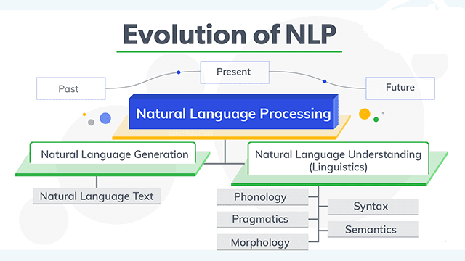
NLP Working
Fahad Hussain Tutorial
Fahad Hussain Tutorial
Fahad Hussain Tutorial
For further assistance, code and slide https://fahadhussaincs.blogspot.com/
YouTube Channel: https://www.youtube.com/channel/UCapJpINJKHzflWwCQ8Kse2g/playlists

Slide 14
Natural Language Understanding
Ambiguity:
Lexical Ambiguity : The Tank is full of water.
Syntactic Ambiguity : ill men and women get to hospital.
Semantic Ambiguity : The Bike hit the pole while it was running.
Pragmatic Ambiguity : The Army is coming.
Phonology – This science helps to deal with patterns present in the sound and speeches related to the sound as a physical entity.
Pragmatics – This science studies the different uses of language.
Morphology – This science deals with the structure of the words and the systematic relations between them.
Syntax – This science deal with the structure of the sentences.
Semantics – This science deals with the literal meaning of the words, phrases as well as sentences.
For further assistance, code and slide https://fahadhussaincs.blogspot.com/
YouTube Channel: https://www.youtube.com/channel/UCapJpINJKHzflWwCQ8Kse2g/playlists

Slide 15
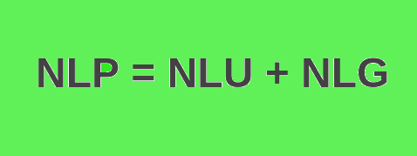
Natural Language Generation
Based on NL-Understanding, it will suggest about:
What should say to user.
Should be Intelligent and Covervational as like human
Usage of Structured data.
With text and Sentence like planning.
Fahad Hussain Tutorial
Fahad Hussain Tutorial
Fahad Hussain Tutorial
For further assistance, code and slide https://fahadhussaincs.blogspot.com/
YouTube Channel: https://www.youtube.com/channel/UCapJpINJKHzflWwCQ8Kse2g/playlists

Slide 16
Thanks
Do Subscribe, like and share
next we will discuss about
Data Processes,
Tokenization?
For further assistance, code and slide https://fahadhussaincs.blogspot.com/
YouTube Channel: https://www.youtube.com/channel/UCapJpINJKHzflWwCQ8Kse2g/playlists

Slide 18
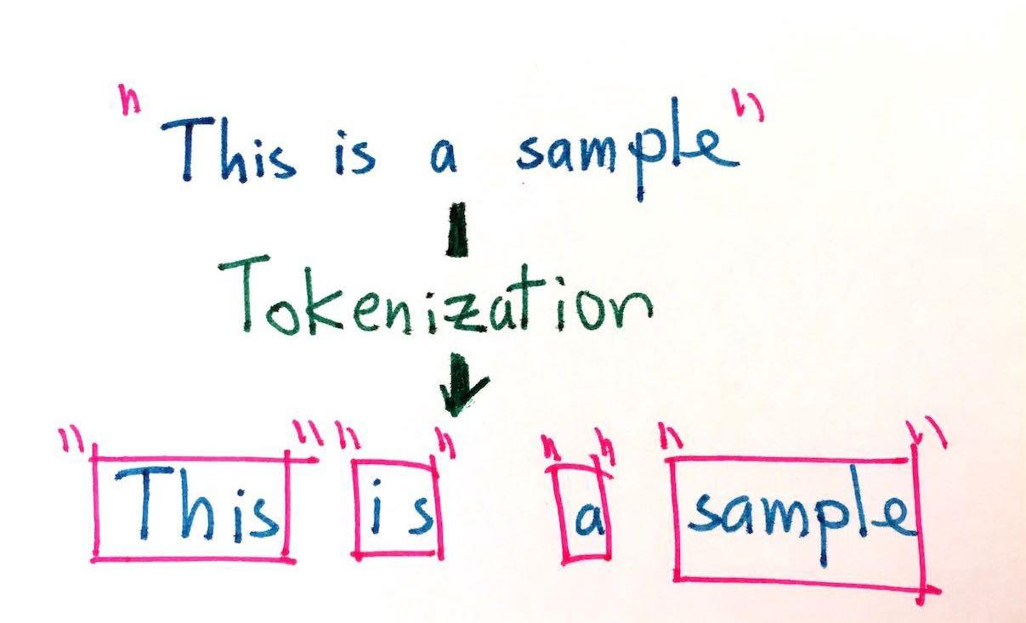
Tokenization
Tokenization is the process of replacing sensitive data with unique identification symbols that retain all the essential information about the data without compromising its security.
Fahad Hussain Tutorial
Fahad Hussain Tutorial
Fahad Hussain Tutorial
For further assistance, code and slide https://fahadhussaincs.blogspot.com/
YouTube Channel: https://www.youtube.com/channel/UCapJpINJKHzflWwCQ8Kse2g/playlists

Slide 19
Tokenization
There are many library / framework for NLP problem solution
1. Natural Language Toolkit (NLTK)
2. TextBlob
3. CoreNLP
4. Gensim
5. spaCy
6. polyglot
7. scikit–learn
8. Pattern
So lets' move to COLAB for practical work...
For further assistance, code and slide https://fahadhussaincs.blogspot.com/
YouTube Channel: https://www.youtube.com/channel/UCapJpINJKHzflWwCQ8Kse2g/playlists

Slide 20
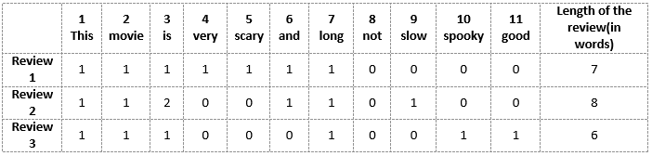
Bag of words
The bag-of-words model is a simplifying representation used in natural language processing and information retrieval (IR). In this, a text (such as a sentence or a document) is represented as the bag (multiset) of its words, disregarding grammar and even word order but keeping multiplicity.
Fahad Hussain Tutorial
For further assistance, code and slide https://fahadhussaincs.blogspot.com/
YouTube Channel: https://www.youtube.com/channel/UCapJpINJKHzflWwCQ8Kse2g/playlists

Slide 21
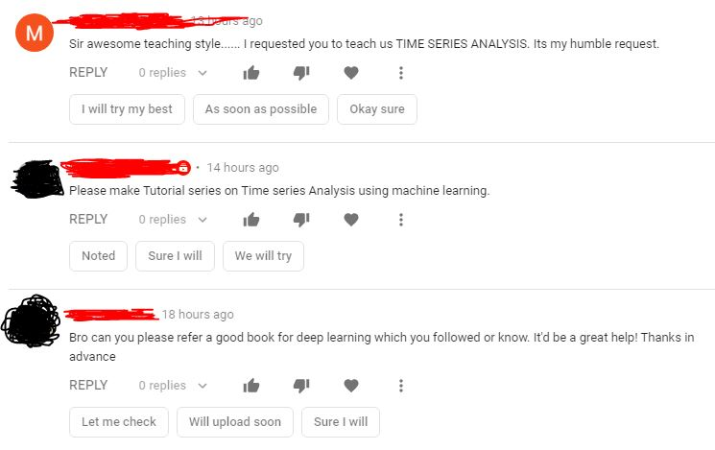
Bag of words
Fahad Hussain Tutorial
For further assistance, code and slide https://fahadhussaincs.blogspot.com/
YouTube Channel: https://www.youtube.com/channel/UCapJpINJKHzflWwCQ8Kse2g/playlists

Slide 22
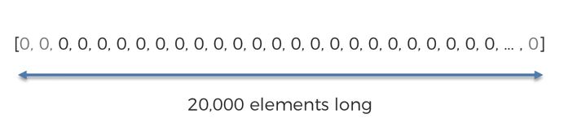
Comments
Are you ready, to start this course to?
Yes No None Don't No
Fahad Hussain Tutorial
For further assistance, code and slide https://fahadhussaincs.blogspot.com/
YouTube Channel: https://www.youtube.com/channel/UCapJpINJKHzflWwCQ8Kse2g/playlists

Slide 23
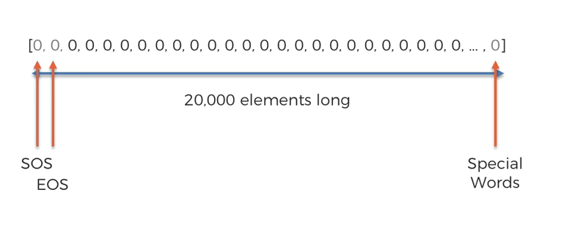
Comments
Are you ready, to start this course to?
For further assistance, code and slide https://fahadhussaincs.blogspot.com/
YouTube Channel: https://www.youtube.com/channel/UCapJpINJKHzflWwCQ8Kse2g/playlists

Slide 24
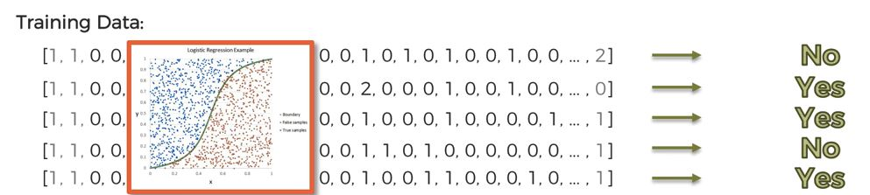
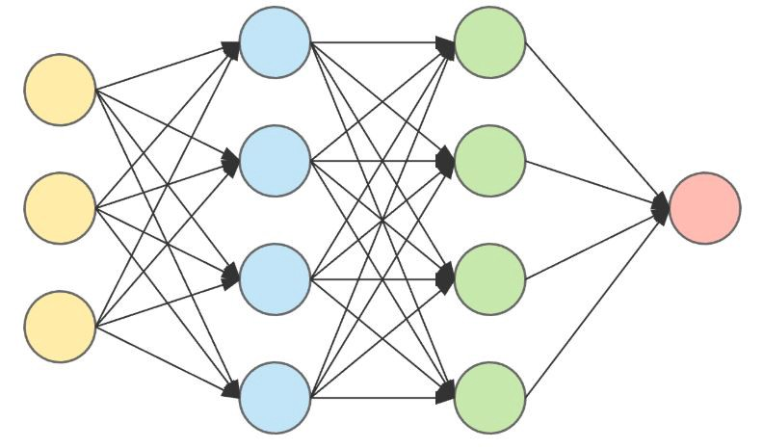
Training and Testing
NLP
Deep NLP
For further assistance, code and slide https://fahadhussaincs.blogspot.com/
YouTube Channel: https://www.youtube.com/channel/UCapJpINJKHzflWwCQ8Kse2g/playlists

Slide 25
Features Extraction in NLP
Frequency: This summarizes how often a given word appears within a document.
Document Frequency: This downscales words that appear a lot across documents.
Inverse Document Frequency (IDF): is a weight indicating how commonly a word is used. The more frequent its usage across documents, the lower its score. The lower the score, the less important the word becomes.
For example, the word the appears in almost all English texts and would thus have a very low IDF score as it carries very little “topic” information. In contrast, if you take the word coffee, while it is common, it’s not used as widely as the word the. Thus, coffee would have a higher IDF score than the.
TF-IDF: is a numerical statistic that is intended to reflect how important a word is to a document in a collection or corpus.
For further assistance, code and slide https://fahadhussaincs.blogspot.com/
YouTube Channel: https://www.youtube.com/channel/UCapJpINJKHzflWwCQ8Kse2g/playlists

Slide 26
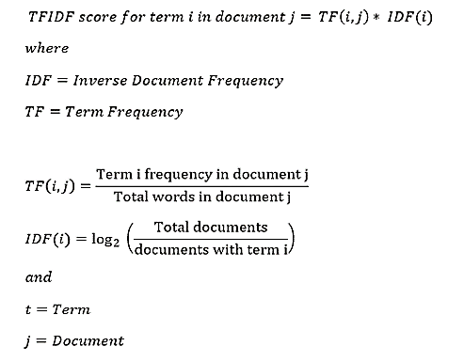
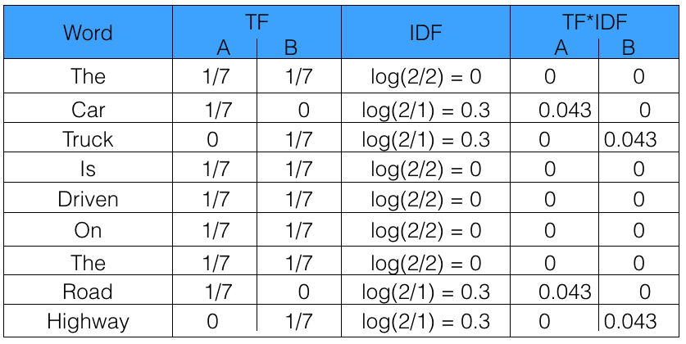
Sentence 1 : The car is driven on the road.
Sentence 2: The truck is driven on the highway.
For further assistance, code and slide https://fahadhussaincs.blogspot.com/
YouTube Channel: https://www.youtube.com/channel/UCapJpINJKHzflWwCQ8Kse2g/playlists

Slide 27
Fair men
Fair women
men women Fair
 | Sent. 1 | Sent. 2 | Sent.3
fair
men
women
words | IDF
men
women
fair
 | f1 | f2 | f3
 | men | women | fair
Sentence 1
Sentence 2
Sentence 3
For further assistance, code and slide https://fahadhussaincs.blogspot.com/
YouTube Channel: https://www.youtube.com/channel/UCapJpINJKHzflWwCQ8Kse2g/playlists

Slide 28
Hashing with HashingVectorizer in NLP
Count Vectorizer: The most straightforward one, it counts the number of times a token shows up in the document and uses this value as its weight.
Hash Vectorizer: This one is designed to be as memory efficient as possible. Instead of storing the tokens as strings, the vectorizer applies the hashing trick to encode them as numerical indexes. The downside of this method is that once vectorized, the features’ names can no longer be retrieved.
TF-IDF Vectorizer: TF-IDF stands for “term frequency-inverse document frequency”, meaning the weight assigned to each token not only depends on its frequency in a document but also how recurrent that term is in the entire corpora. More on that here.
For further assistance, code and slide https://fahadhussaincs.blogspot.com/
YouTube Channel: https://www.youtube.com/channel/UCapJpINJKHzflWwCQ8Kse2g/playlists

Slide 29
Hashing with HashingVectorizer in NLP
Counts and frequencies can be very useful, but one limitation of these methods is that the vocabulary can become very large. This, in turn, will require large vectors for encoding documents and impose large requirements on memory and slow down algorithms. A clever work around is to use a one way hash of words to convert them to integers. The clever part is that no vocabulary is required and you can choose an arbitrary-long fixed length vector. A downside is that the hash is a one-way function so there is no way to convert the encoding back to a word
For further assistance, code and slide https://fahadhussaincs.blogspot.com/
YouTube Channel: https://www.youtube.com/channel/UCapJpINJKHzflWwCQ8Kse2g/playlists

Slide 30
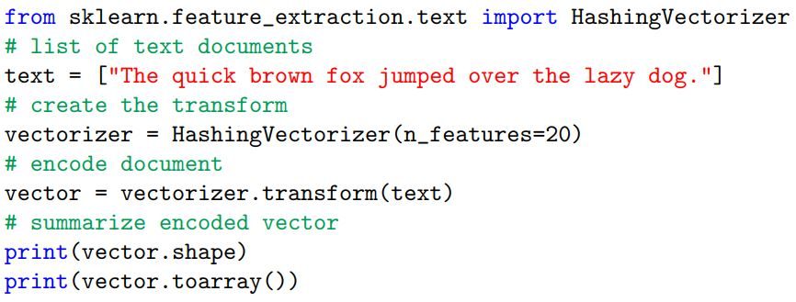
Hashing with HashingVectorizer in NLP
The HashingVectorizer class implements this approach that can be used to consistently hash words, then tokenize and encode documents as needed. The example below demonstrates the HashingVectorizer for encoding a single document. An arbitrary fixed-length vector size of 20 was chosen.
For further assistance, code and slide https://fahadhussaincs.blogspot.com/
YouTube Channel: https://www.youtube.com/channel/UCapJpINJKHzflWwCQ8Kse2g/playlists

Slide 31
How to Prepare Text Data With Keras
Keras is an open-source neural-network library written in Python. It is capable of running on top of TensorFlow, Microsoft Cognitive Toolkit, R, Theano, or PlaidML. Designed to enable fast experimentation with deep neural networks, it focuses on being user-friendly, modular, and extensible. It was developed as part of the research effort of project ONEIROS (Open-ended Neuro-Electronic Intelligent Robot Operating System).
https://keras.io/
For further assistance, code and slide https://fahadhussaincs.blogspot.com/
YouTube Channel: https://www.youtube.com/channel/UCapJpINJKHzflWwCQ8Kse2g/playlists

Slide 32
How to Prepare Text Data with scikit-learn
Lets understand the following topic using Keras;
Split Words with text to word sequence
Encoding with one hot
Hash Encoding with hashing trick
Tokenizer API
For further assistance, code and slide https://fahadhussaincs.blogspot.com/
YouTube Channel: https://www.youtube.com/channel/UCapJpINJKHzflWwCQ8Kse2g/playlists

Slide 33
N-grams in NLP
N-grams of texts are extensively used in text mining and natural language processing tasks. They are basically a set of co-occuring words within a given window and when computing the n-grams you typically move one word forward (although you can move X words forward in more advanced scenarios). For example, for the sentence "The quick brown fox jump over the lazy dog". If N=2 (known as bigrams), then the n-grams would be:
OR
Contiguous sequence of n item from a given sample text.
['The quick',
'quick brown',
'brown fox',
'fox jump',
'jump over',
'over the',
'the lazy',
'lazy dog']
['The quick brown',
'quick brown fox',
'brown fox jump',
'fox jump over',
'jump over the',
'over the lazy',
'the lazy dog']
['The', 'quick', 'brown', 'fox', 'jump', 'over', 'the', 'lazy', 'dog']
For further assistance, code and slide https://fahadhussaincs.blogspot.com/
YouTube Channel: https://www.youtube.com/channel/UCapJpINJKHzflWwCQ8Kse2g/playlists

Slide 34
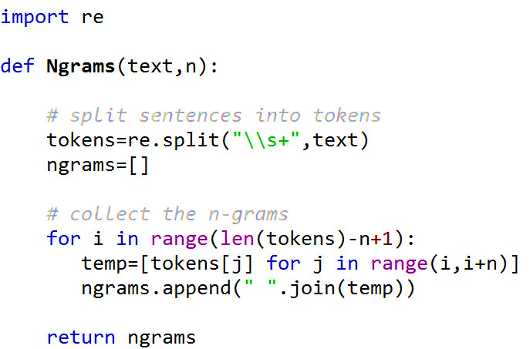
N-grams in NLP
How many N-grams in a sentence?
If X=Num of words in a given sentence K, the number of n-grams for sentence K would be:
For further assistance, code and slide https://fahadhussaincs.blogspot.com/
YouTube Channel: https://www.youtube.com/channel/UCapJpINJKHzflWwCQ8Kse2g/playlists

Slide 35
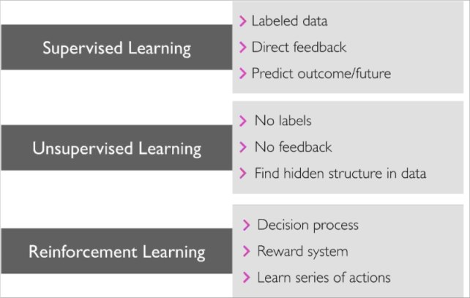
What is Machine Learning
Machine learning is an application of artificial intelligence (AI) that provides systems the ability to automatically learn and improve from experience without being explicitly programmed
For further assistance, code and slide https://fahadhussaincs.blogspot.com/
YouTube Channel: https://www.youtube.com/channel/UCapJpINJKHzflWwCQ8Kse2g/playlists

Slide 36
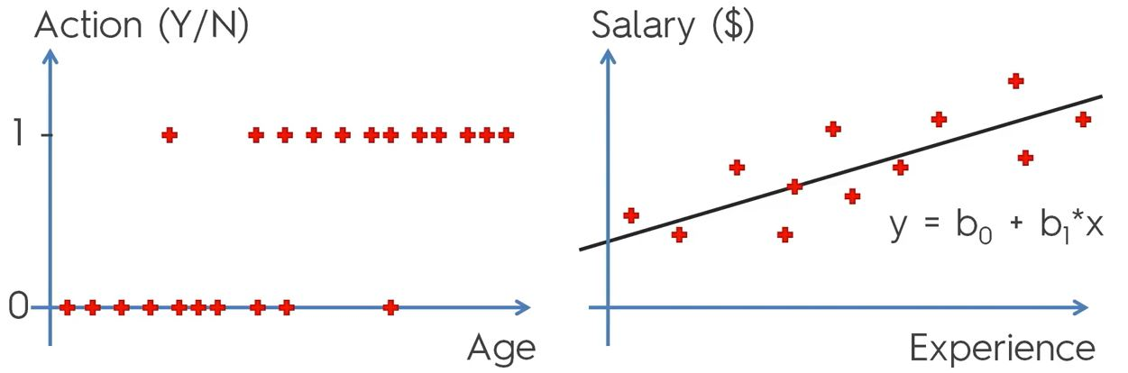
Machine Learning in NLP Logistic Regression
For further assistance, code and slide https://fahadhussaincs.blogspot.com/
YouTube Channel: https://www.youtube.com/channel/UCapJpINJKHzflWwCQ8Kse2g/playlists

Slide 37
Machine Learning in NLP
In linear regression, the outcome (dependent variable) is continuous. It can have any one of an infinite number of possible values.
In logistic regression, the outcome (dependent variable) has only a limited number of possible values.
The dependent variable:
Logistic regression is used when the response variable is categorical in nature. For instance, yes/no, true/false, red/green/blue, 1st/2nd/3rd/4th, etc.
Linear regression is used when your response variable is continuous. For instance, weight, height, number of hours, etc.
Y = mX + C
g(x) = 1 / (1 + e^-x)
For further assistance, code and slide https://fahadhussaincs.blogspot.com/
YouTube Channel: https://www.youtube.com/channel/UCapJpINJKHzflWwCQ8Kse2g/playlists

Slide 38
Machine Learning in NLP
In machine learning, support-vector machines (SVMs, also support-vector networks) are supervised learning models with associated learning algorithms that analyze data used for classification and regression analysis. The Support Vector Machine (SVM) algorithm is a popular machine learning tool that offers solutions for both classification and regression problems.
A Support Vector Machine (SVM) is a discriminative classifier formally defined by a separating hyperplane. In other words, given labeled training data (supervised learning), the algorithm outputs an optimal hyperplane which categorizes new examples. In two dimensional space this hyperplane is a line dividing a plane in two parts where in each class lay in either side.
For further assistance, code and slide https://fahadhussaincs.blogspot.com/
YouTube Channel: https://www.youtube.com/channel/UCapJpINJKHzflWwCQ8Kse2g/playlists

Slide 39
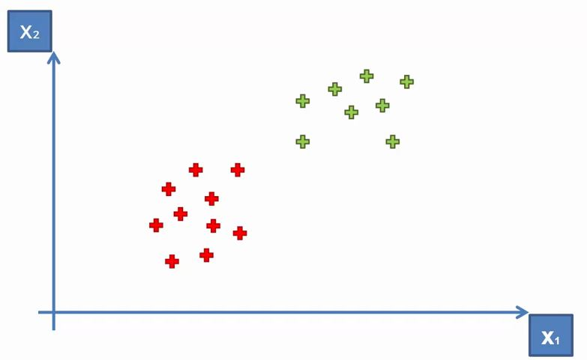
Machine Learning in NLP
For further assistance, code and slide https://fahadhussaincs.blogspot.com/
YouTube Channel: https://www.youtube.com/channel/UCapJpINJKHzflWwCQ8Kse2g/playlists

Slide 40
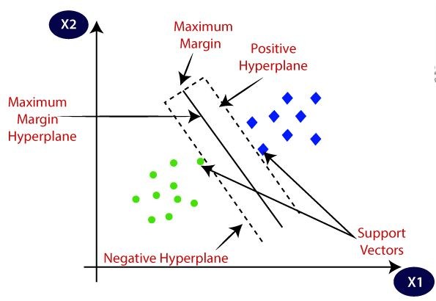
Machine Learning in NLP
For further assistance, code and slide https://fahadhussaincs.blogspot.com/
YouTube Channel: https://www.youtube.com/channel/UCapJpINJKHzflWwCQ8Kse2g/playlists

Slide 41
K-nearest neighbors algorithm
The k-nearest neighbors algorithm (k-NN) is a non-parametric method proposed by Thomas Cover used for classification and regression. In both cases, the input consists of the k closest training examples in the feature space. The output depends on whether k-NN is used for classification or regression:
In k-NN classification, the output is a class membership. An object is classified by a plurality vote of its neighbors, with the object being assigned to the class most common among its k nearest neighbors (k is a positive integer, typically small). If k = 1, then the object is simply assigned to the class of that single nearest neighbor.
In k-NN regression, the output is the property value for the object. This value is the average of the values of k nearest neighbors.
For further assistance, code and slide https://fahadhussaincs.blogspot.com/
YouTube Channel: https://www.youtube.com/channel/UCapJpINJKHzflWwCQ8Kse2g/playlists

Slide 42
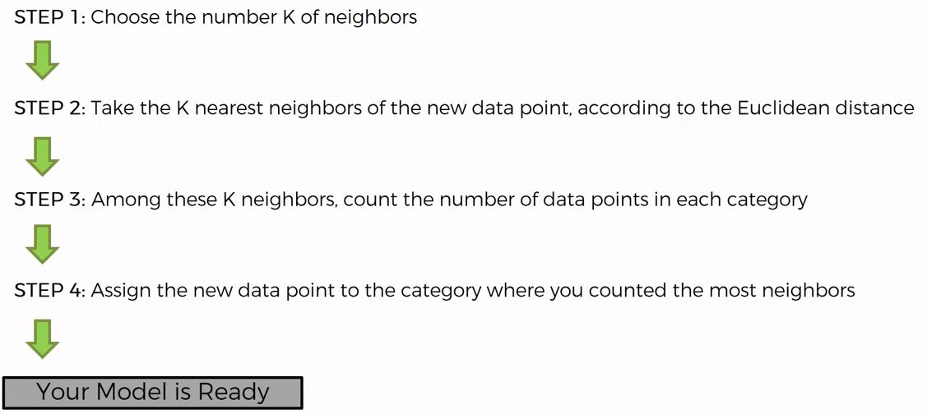
Steps of Working
For further assistance, code and slide https://fahadhussaincs.blogspot.com/
YouTube Channel: https://www.youtube.com/channel/UCapJpINJKHzflWwCQ8Kse2g/playlists

Slide 43
Example
For further assistance, code and slide https://fahadhussaincs.blogspot.com/
YouTube Channel: https://www.youtube.com/channel/UCapJpINJKHzflWwCQ8Kse2g/playlists

Slide 44
Naïve Bayes Classifier algorithm
Naive Bayes classifiers are a family of simple "probabilistic classifiers" based on applying Bayes' theorem with strong (naïve) independence assumptions between the features. They are among the simplest Bayesian network models. But they could be coupled with Kernel density estimation and achieve higher accuracy levels.
Naïve Bayes classifiers are highly scalable, requiring a number of parameters linear in the number of variables (features/predictors) in a learning problem. Maximum-likelihood training can be done by evaluating a closed-form expression,:718 which takes linear time, rather than by expensive iterative approximation as used for many other types of classifiers.
In the statistics and computer science literature, naive Bayes models are known under a variety of names, including simple Bayes and independence Bayes.[5] All these names reference the use of Bayes' theorem in the classifier's decision rule, but naïve Bayes is not (necessarily) a Bayesian method
For further assistance, code and slide https://fahadhussaincs.blogspot.com/
YouTube Channel: https://www.youtube.com/channel/UCapJpINJKHzflWwCQ8Kse2g/playlists

Slide 45
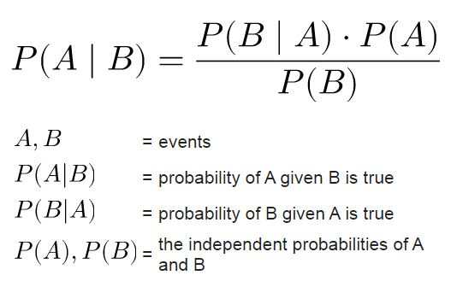
Naïve Bayes Classifier algorithm
For further assistance, code and slide https://fahadhussaincs.blogspot.com/
YouTube Channel: https://www.youtube.com/channel/UCapJpINJKHzflWwCQ8Kse2g/playlists

Slide 46
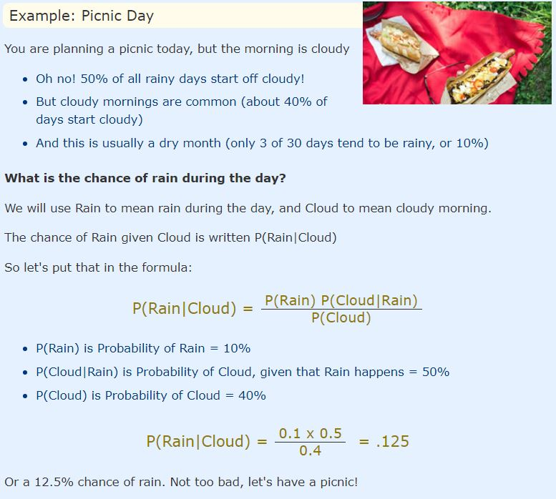
Naïve Bayes Example

Slide 47
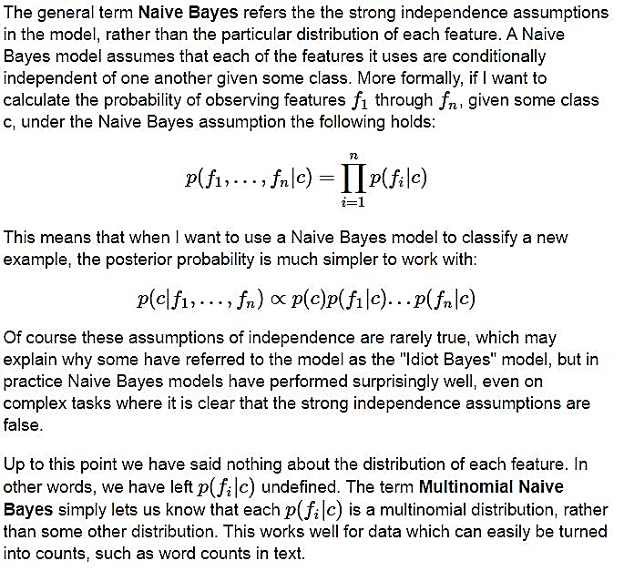
Naïve Bayes algorithm
For further assistance, code and slide https://fahadhussaincs.blogspot.com/
YouTube Channel: https://www.youtube.com/channel/UCapJpINJKHzflWwCQ8Kse2g/playlists

Slide 48
Word Embedding using Word2Vec
Word Embedding is a language modeling technique used for mapping words to vectors of real numbers. It represents words or phrases in vector space with several dimensions. Word embeddings can be generated using various methods like neural networks, co-occurrence matrix, probabilistic models, etc.
Word2Vec consists of models for generating word embedding. These models are shallow two layer neural networks having one input layer, one hidden layer and one output layer. Given enough data, usage and contexts, word2vec can make highly accurate guesses about a words’ meaning based on past appearances. Those guesses can be used to establish a word’s association with other words. Eg. Man is to boy what whome is to girl etc…
Word2Vec utilizes two architectures
CBOW (Continuous Bag of Words)
Skip Gram
For further assistance, code and slide https://fahadhussaincs.blogspot.com/
YouTube Channel: https://www.youtube.com/channel/UCapJpINJKHzflWwCQ8Kse2g/playlists

Slide 49
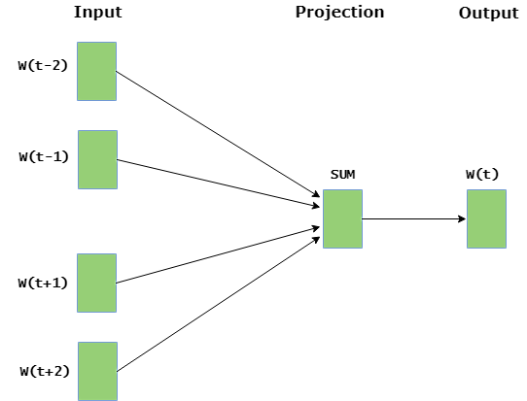
Word Embedding using Word2Vec
CBOW (Continuous Bag of Words)
CBOW model predicts the current word given context words within specific window. The input layer contains the context words and the output layer contains the current word. The hidden layer contains the number of dimensions in which we want to represent current word present at the output layer.
For further assistance, code and slide https://fahadhussaincs.blogspot.com/
YouTube Channel: https://www.youtube.com/channel/UCapJpINJKHzflWwCQ8Kse2g/playlists

Slide 50
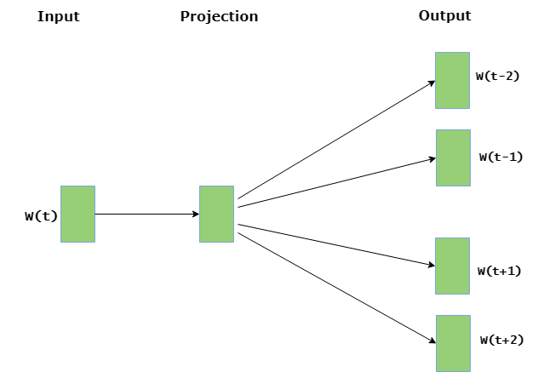
Word Embedding using Word2Vec
Skip Gram : Skip gram predicts the surrounding context words within specific window given current word. The input layer contains the current word and the output layer contains the context words. The hidden layer contains the number of dimensions in which we want to represent current word present at the input layer.
For further assistance, code and slide https://fahadhussaincs.blogspot.com/
YouTube Channel: https://www.youtube.com/channel/UCapJpINJKHzflWwCQ8Kse2g/playlists

Slide 51
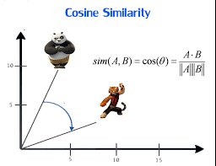
How does it work
In simple words Word2vec is just vector representation of words in n dimension(usually 300) space. It is also called embedding.
Now why we use cosine similarity - To get similarity between two words.
How does it work Cosine similarity = 1 - cosine distance.
Cosine distance is nothing but getting distance between two vectors in n dimension space. Distance represent how words are related to each other.
For further assistance, code and slide https://fahadhussaincs.blogspot.com/
YouTube Channel: https://www.youtube.com/channel/UCapJpINJKHzflWwCQ8Kse2g/playlists

Slide 52
Topic Modeling
In machine learning and natural language processing, a topic model is a type of statistical model for discovering the abstract "topics" that occur in a collection of documents. Topic modeling is a frequently used text-mining tool for discovery of hidden semantic structures in a text body. Intuitively, given that a document is about a particular topic, one would expect particular words to appear in the document more or less frequently: "dog" and "bone" will appear more often in documents about dogs, "cat" and "meow" will appear in documents about cats, and "the" and "is" will appear approximately equally in both. A document typically concerns multiple topics in different proportions; thus, in a document that is 10% about cats and 90% about dogs, there would probably be about 9 times more dog words than cat words. The "topics" produced by topic modeling techniques are clusters of similar words. A topic model captures this intuition in a mathematical framework, which allows examining a set of documents and discovering, based on the statistics of the words in each, what the topics might be and what each document's balance of topics is.
For further assistance, code and slide https://fahadhussaincs.blogspot.com/
YouTube Channel: https://www.youtube.com/channel/UCapJpINJKHzflWwCQ8Kse2g/playlists

Slide 53
Latent Dirichlet Allocation (LDA)
Johann Peter Gustav Lejeune Dirichlet was a German mathematician in the 1800s who contributed widely to the field of modern mathematics. There is a probability distribution named after him "Dirichlet Distribution"
In natural language processing, the latent Dirichlet allocation (LDA) is a generative statistical model that allows sets of observations to be explained by unobserved groups that explain why some parts of the data are similar. For example, if observations are words collected into documents, it posits that each document is a mixture of a small number of topics and that each word's presence is attributable to one of the document's topics. LDA is an example of a topic model and belongs to the machine learning toolbox and in wider sense to the artificial intelligence toolbox.
For further assistance, code and slide https://fahadhussaincs.blogspot.com/
YouTube Channel: https://www.youtube.com/channel/UCapJpINJKHzflWwCQ8Kse2g/playlists

Slide 54
Latent Dirichlet Allocation (LDA)
Later on 2003 paper published on Journal of machine learning
Latent Dirichlet Allocation
Graphic model for topic discovery
For further assistance, code and slide https://fahadhussaincs.blogspot.com/
YouTube Channel: https://www.youtube.com/channel/UCapJpINJKHzflWwCQ8Kse2g/playlists

Slide 55
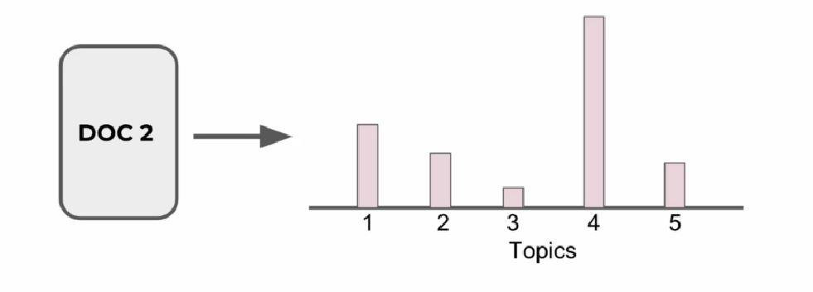
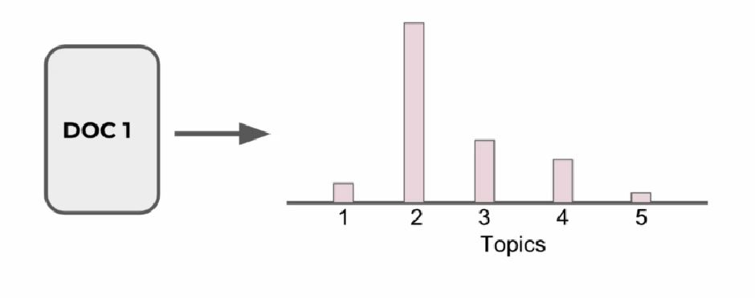
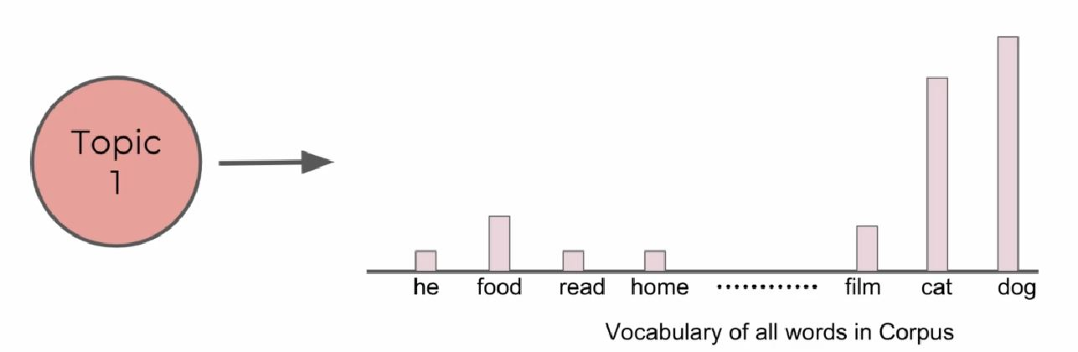
Latent Dirichlet Allocation (LDA)
For further assistance, code and slide https://fahadhussaincs.blogspot.com/
YouTube Channel: https://www.youtube.com/channel/UCapJpINJKHzflWwCQ8Kse2g/playlists

Slide 56
Latent Dirichlet Allocation (LDA)
It assumes that documents are produced in the following fashion: a Choose a topic mixture for the document (according to a Dirichlet distribution over a fixed set of K topics). a e.g. 60% Pet, 20% resident , 10% food
Using the topic to generate the word itself (according to the topic's multinomial distribution).
For further assistance, code and slide https://fahadhussaincs.blogspot.com/
YouTube Channel: https://www.youtube.com/channel/UCapJpINJKHzflWwCQ8Kse2g/playlists

Slide 57
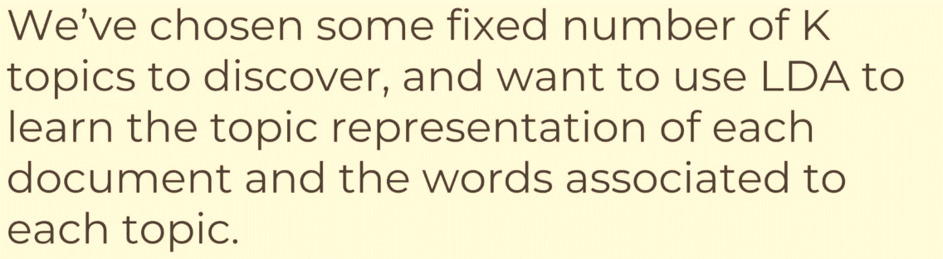
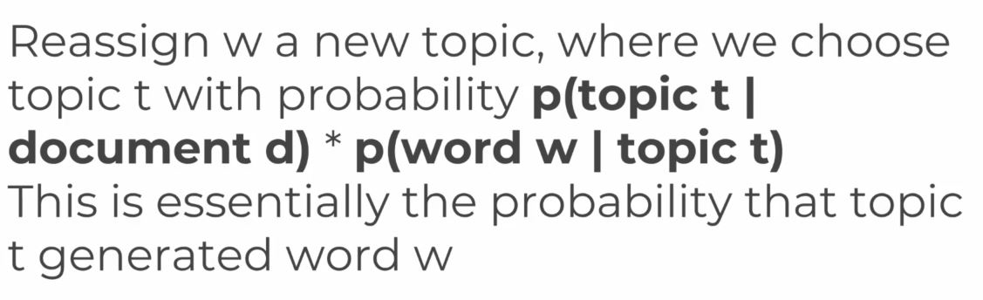
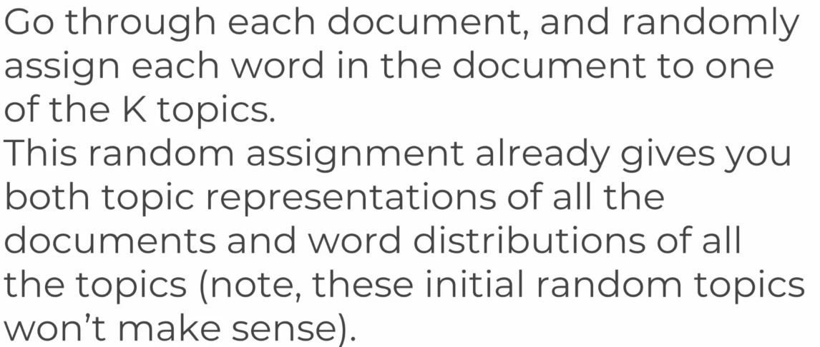
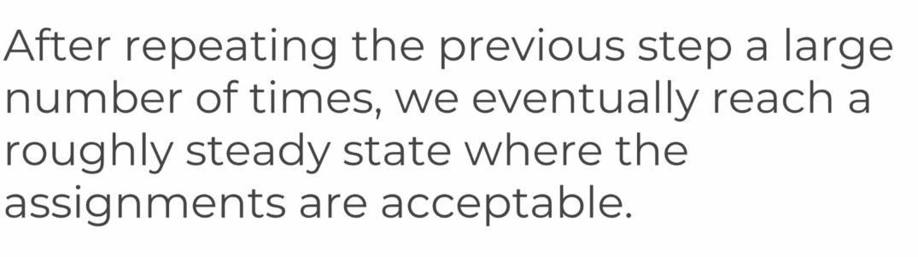
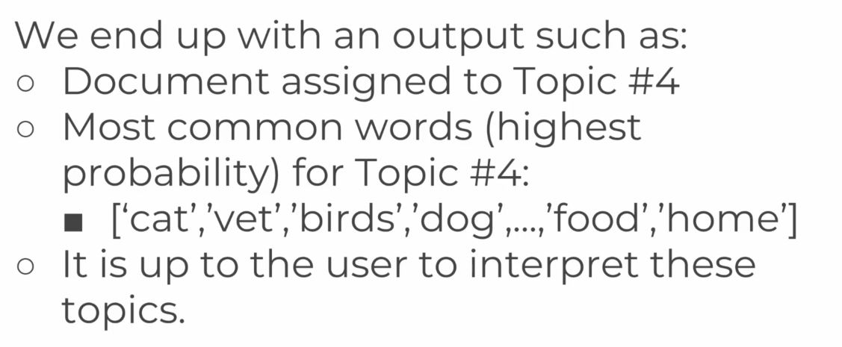
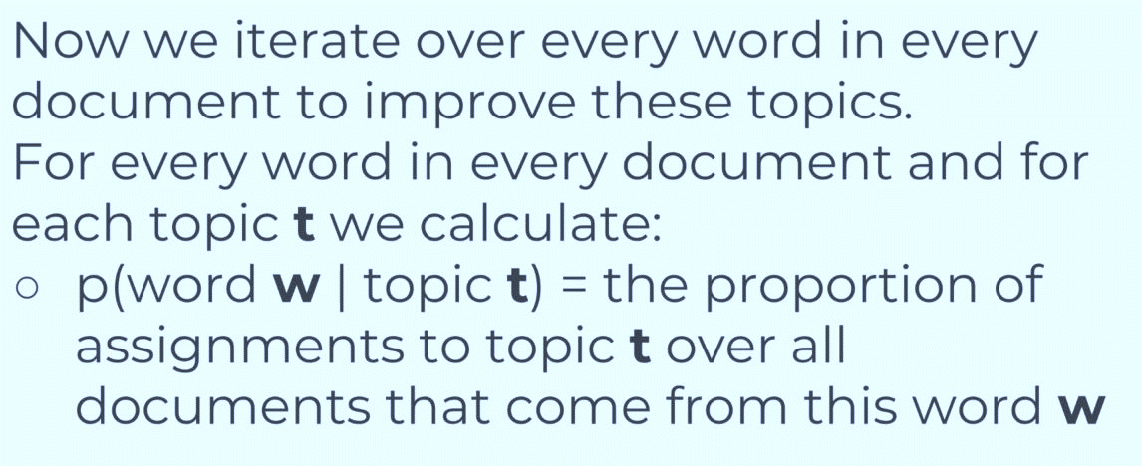
Step by Step work

Slide 58
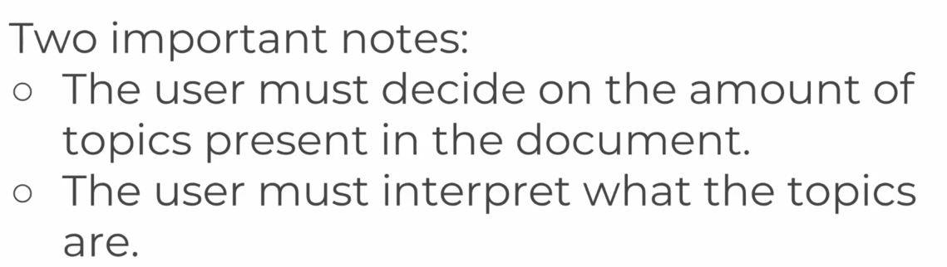
Step by Step work
Let’s move towards practical work to understand more…

Slide 59
Non-negative matrix factorization (NMF or NNMF)
Non-negative matrix factorization (NMF or NNMF), also non-negative matrix approximation is a group of algorithms in multivariate analysis and linear algebra where a matrix V is factorized into (usually) two matrices W and H, with the property that all three matrices have no negative elements.
Used for dimensionality reduction and clustering.
We can use it in conjunction with TF-IDF to model topics across documents.
For further assistance, code and slide https://fahadhussaincs.blogspot.com/
YouTube Channel: https://www.youtube.com/channel/UCapJpINJKHzflWwCQ8Kse2g/playlists

Slide 60
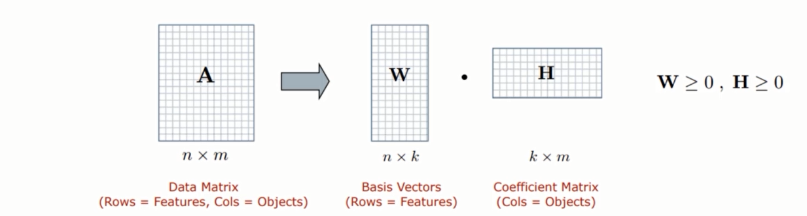
Non-negative matrix factorization (NMF or NNMF)
For further assistance, code and slide https://fahadhussaincs.blogspot.com/
YouTube Channel: https://www.youtube.com/channel/UCapJpINJKHzflWwCQ8Kse2g/playlists

Slide 61
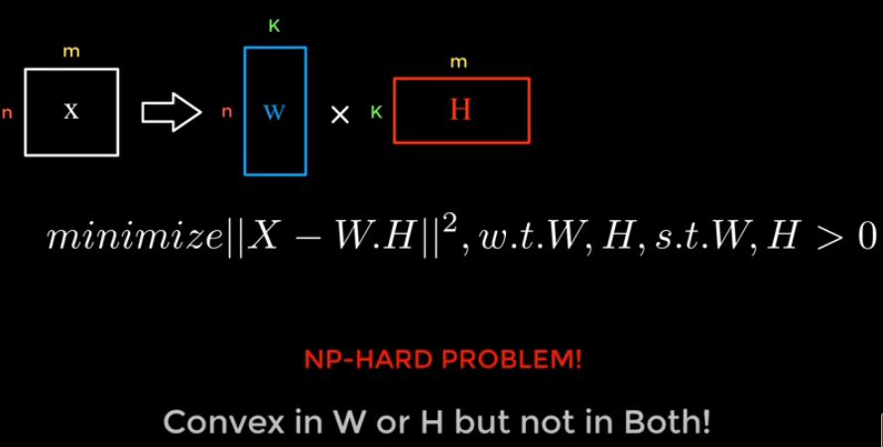
Non-negative matrix factorization (NMF or NNMF)
For further assistance, code and slide https://fahadhussaincs.blogspot.com/
YouTube Channel: https://www.youtube.com/channel/UCapJpINJKHzflWwCQ8Kse2g/playlists

Slide 62
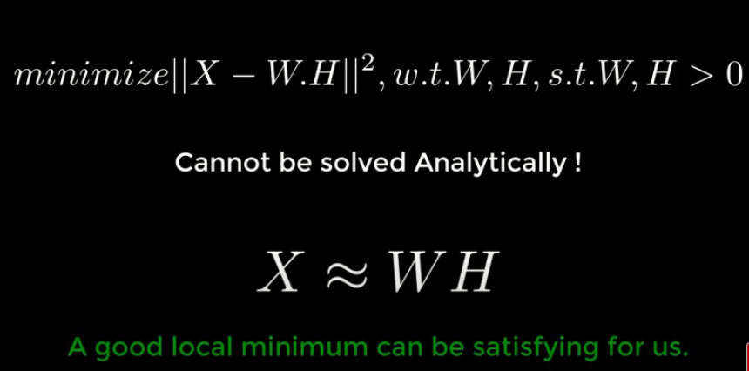
Non-negative matrix factorization (NMF or NNMF)
For further assistance, code and slide https://fahadhussaincs.blogspot.com/
YouTube Channel: https://www.youtube.com/channel/UCapJpINJKHzflWwCQ8Kse2g/playlists

Slide 63
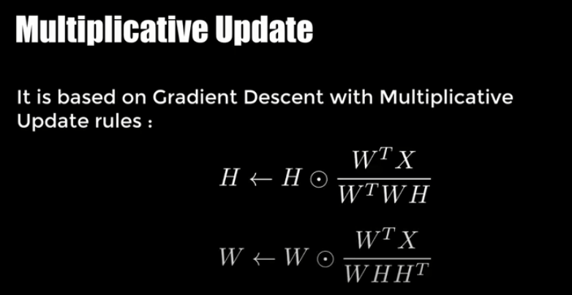
Non-negative matrix factorization (NMF or NNMF)
For further assistance, code and slide https://fahadhussaincs.blogspot.com/
YouTube Channel: https://www.youtube.com/channel/UCapJpINJKHzflWwCQ8Kse2g/playlists

Slide 64
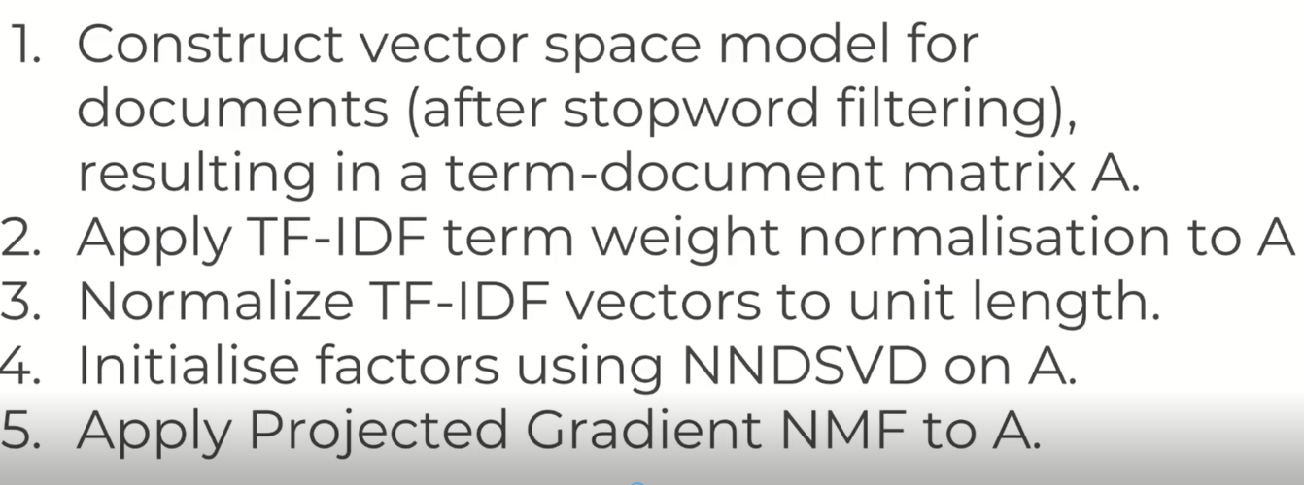
Non-negative matrix factorization (NMF or NNMF)
For further assistance, code and slide https://fahadhussaincs.blogspot.com/
YouTube Channel: https://www.youtube.com/channel/UCapJpINJKHzflWwCQ8Kse2g/playlists

