Slide 1
Modeling Time Series Data with Recurrent Neural Networks in Keras

Slide 2

DEEP LEARNING INSTITUTE
DLI Mission
Helping people solve challenging problems using AI and deep learning.
Developers, data scientists and engineers
Self-driving cars, healthcare and robotics
Training, optimizing, and deploying deep neural networks

Slide 3
Topics
Lab Perspective
RNNs / LSTMs
Keras
pandas / NumPy / Matplotlib
Lab
Discussion / Overview
Launching the Lab Environment
Lab Review

Slide 4
Lab Perspective

Slide 5
PURPOSE / GOAL
Build a deep neural network that can predict future outcomes based on time series, or sequential, data.
Explore and visualize a time series dataset: our real-life use case is electronic health records (EHRs) collected during hospital visits
Prepare the data for modeling
Create the neural network architecture using Keras and train it to predict mortality risk for the patients during treatment
Compare the quality of this neural network model to that of existing industry models

Slide 6
WHAT THIS LAB IS
Discussion of the tools, techniques and processes commonly used to build RNN / LSTM networks to evaluate time series data
Introduction to aspects of RNNs, LSTMs, Keras, pandas, NumPy, and Matplotlib
Guided, hands-on exercise using the tools noted above to build an LSTM network to evaluate time series data, using EHRs as our example

Slide 7
WHAT THIS LAB IS NOT
Introduction to machine learning from first principles
Rigorous mathematical formalism of neural networks
Survey of all the features and options of pandas, NumPy, Matplotlib, or Keras

Slide 8
ASSUMPTIONS
You are familiar with:
Basics of neural networks
Python programming
Helpful to have familiarity with:
pandas, NumPy and Matplotlib
recurrent neural network (RNNs)

Slide 9
TAKE AWAYS
Familiarity with the data preparation process using pandas, NumPy, and Keras
Ability to set up your own recurrent neural network workflow using Keras and adapt it to your use case
Know where to go for more info on RNNs and Keras

Slide 10
RNN / LSTM

Slide 11
RECURRENT NEURAL NETWORK
RNN = Recurrent Neural Network
Similar to a traditional feed-forward network
RNNs include previous output state
Limited to looking back only a few steps due to vanishing gradient
Errors are backpropagated through time
Inputs from previous time steps get exponentially down-weighted and are eventually driven to zero

Slide 12
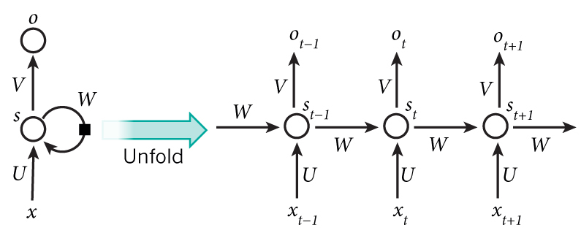
RNN

Slide 13
LONG SHORT-TERM MEMORY
LSTM = Long Short-Term Memory
Variant of RNN
No vanishing gradient problem
LSTMs can learn “very deep” tasks that require memories of events that happened or millions of discrete time steps ago
In our network, the sequence of measurements recorded from an encounter will be used as input to the network, and a probability of survival prediction will be generated.
Enables real-time monitoring of the patient’s probability of survival and insight into the patient’s trajectory

Slide 14
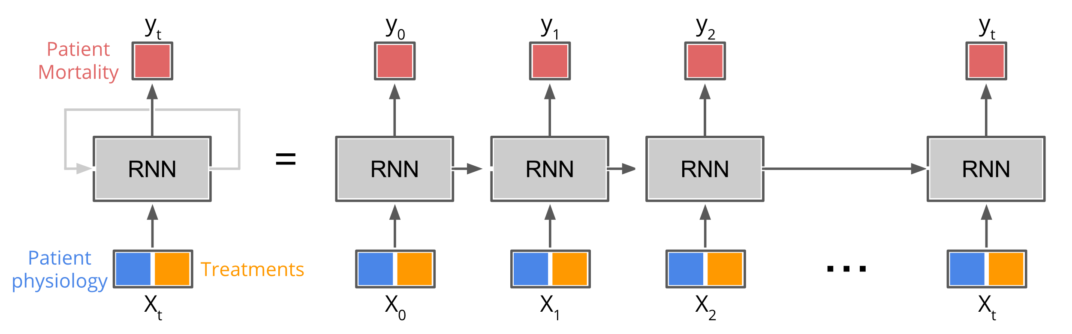
RNN ARCHITECTURE

Slide 15
KERAS

Slide 16
KERAS
Modular neural network written in Python
Now imports as part of TensorFlow
Keras API allows for easy and fast prototyping
Runs on GPUs and CPUs
Compatible with Python 2.7 – 3.6

Slide 17
Pandas / numpy / matplotlib

Slide 18
PANDAS
Used in academia and commercial domains
Open-source, BSD-licensed project
Fast and efficient DataFrame object for data manipulation with integrated indexing
Contains tools for reading and writing data between in-memory data structures and different formats such as:
CSV and text files, Microsoft Excel, SQL databases, HDF5

Slide 19
NUMPY
NumPy is a Python scientific computing package
Open-source software
Includes:
Support for large, N-dimensional arrays and matrices
Collection of high-level mathematical functions

Slide 20
MATPLOTLIB
Matplotlib is a Python 2D plotting library producing publication quality figures
Matplotlib can be used in:
Python scripts
Python and IPython shell
Jupyter notebook
Web application servers
Supports Python versions 2.7 – 3.6

Slide 21
LAB DISCUSSION / OVERVIEW

Slide 22

EXPLORE THE DATA
Electronic health records (EHRs)
Contains medical treatments and histories collected over time
Data provided by PICU at Children’s Hospital Los Angeles
5,000 unique patient encounters in the training set
Each encounter includes multiple observations during the hospital stay
Each observation includes values in some of the 265 measurement variable categories
Data is an irregular time series of measurements taken over the course of a patient’s stay in the PICU

Slide 23
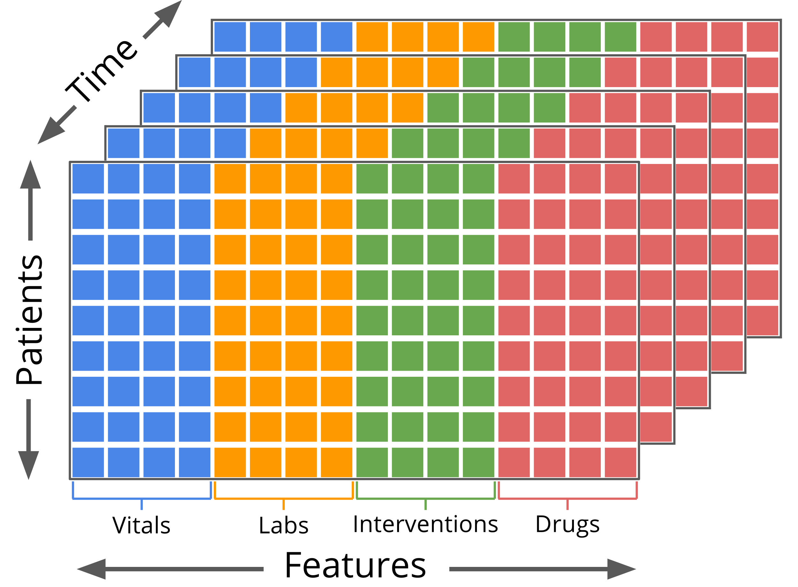
EXPLORE THE DATA
Measurements include:
Statistics - gender, age, weight
Vitals - heart rate, respiratory rate
Labs – glucose, creatinine
Interventions – intubation, O2
Drugs – dopamine, epinephrine

Slide 24
EXPLORE THE DATA
Not all measurements were taken for all patients
Dependent variable:
Alive – 1
Not alive – 0
1,113,529 observations (rows) containing 265 variables (columns) over the 5000 patients in the training data set
Mean observations per patient encounter = 223
Median observations per patient encounter = 94

Slide 25
EXPLORE THE DATA
Setup
Import pandas, Matplotlib (and NumPy later)
Define folders which contain training / testing datasets
Load data using pandas API

Slide 26
PREPARE THE DATA
Normalize data
Fill data gaps
Pad and truncate the data sequences

Slide 27
BUILD THE MODEL
Architect LSTM network using Keras
Train the model (feed data into network)
Evaluate model using validation (test) data
Visualize results
Compare baseline to PRISM3 and PIM2

Slide 28
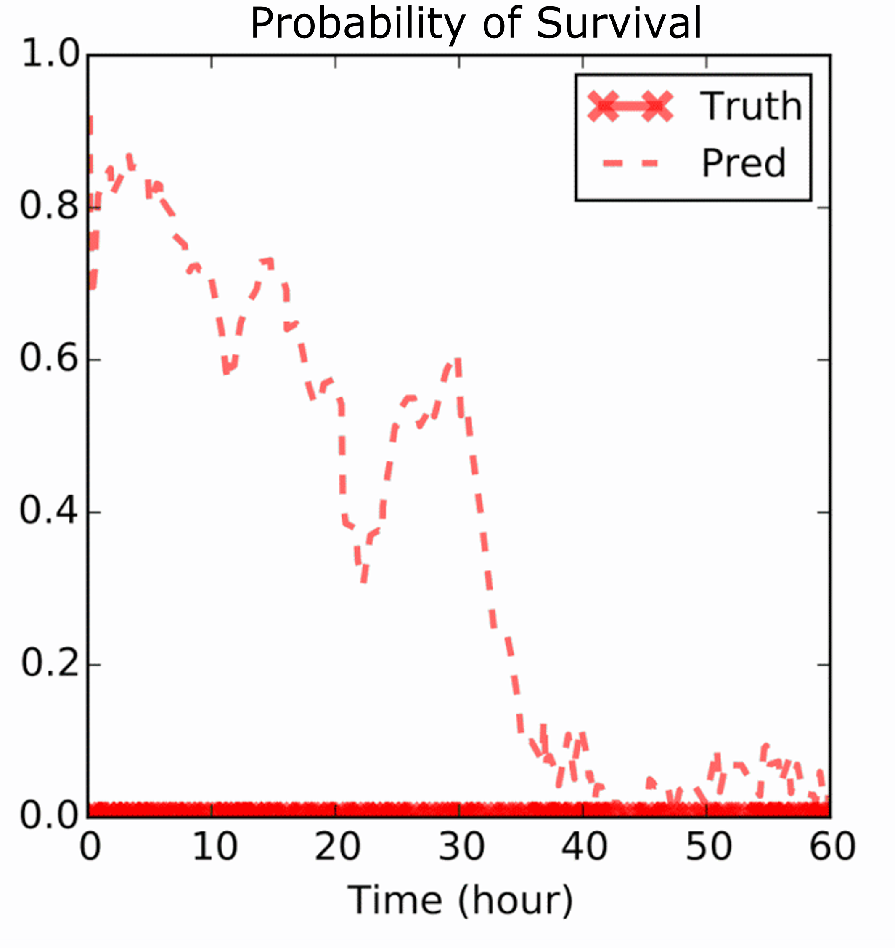
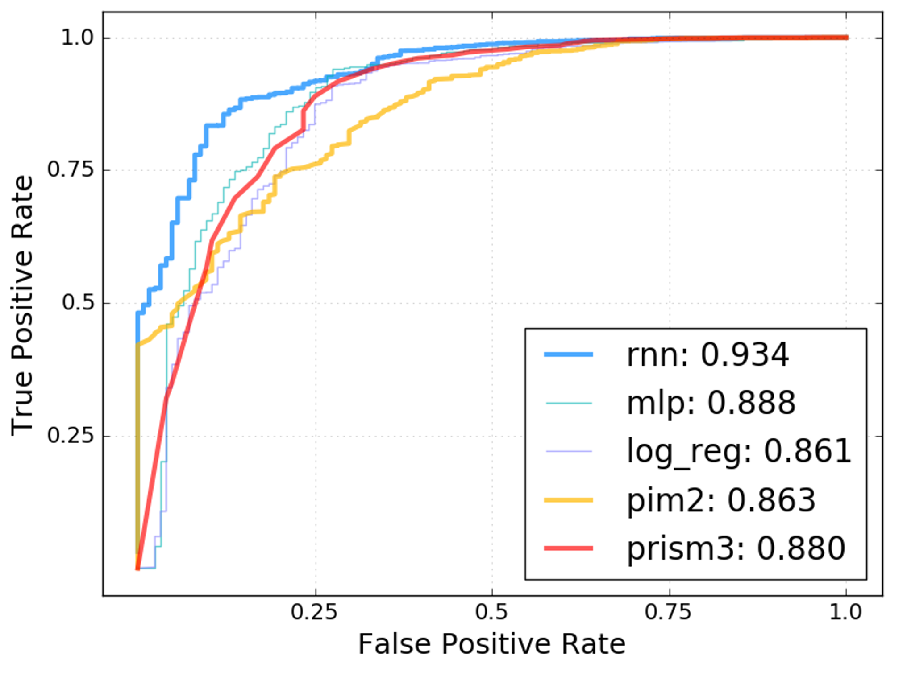
LAB REVIEW - COMPARE BASELINE

Slide 29
WHAT ELSE?
Many ways to explore and improve model:
Add a second and third LSTM layer to the network
Change the number of layers and the number of neurons in those layers
Change some of the meta parameters in the network configuration like dropout or learning rate, etc.
Try using a CNN? Does it outperform the RNN / LSTM model?

Slide 30
RECAP
Congratulations!
In this lab you learned to:
Load, explore, and visualize a time series dataset
Prepare the data for modeling
Normalize
Fill gaps
Pad and truncate sequences of data
Create the neural network architecture using Keras and train it, and to
Use the model to predict the probability of a binary outcome (patient mortality)
Evaluate the model and compare it to other baselines

