Slide 1
Bachelors Home
Search your dream room
Team Members:
17.02.04.058
17.02.04.070
17.02.04.084

Slide 2
ACTOR
NON REGISTERED USER
REGISTERED USER
ADMINISTRATOR

Slide 3
SUBSYSTEM
REGISTRATION
LOGIN
POST
COMMENT
USER PROFILE
FIX A MEETING

Slide 4
Use case diagram and narrative

Slide 5
Registration Subsystem
Use – case name | Primary Actors
Register | Non Registered User

Slide 6
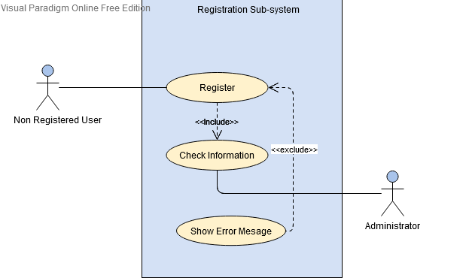
Use case diagram for Registration Subsystem

Slide 7
Use case narrative of ‘Registration’ use case
Name : Registration
Priority : High
Primary Actor : Non Registered User
Secondary Actor: Administrator
Precondition : Non Registered user should click on the Sign Up button

Slide 8
Log In Subsystem
Use – case name | Primary Actors
Log In | Registered User, Admin

Slide 9
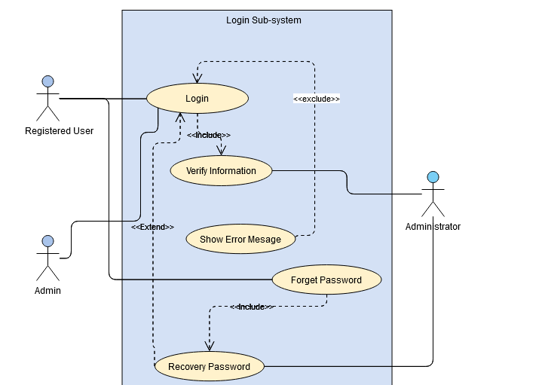
Use case diagram for Log In Subsystem

Slide 10
Use case narrative of ‘Login’ use case
Name : Login
Priority : High
Primary Actor : Registered User, Admin
Secondary Actor: Administrator
Precondition: Visitor should be a registered member
or Admin and must click on the log in button

Slide 11
Post subsystem
Use – case name | Actors
Post | Registered User, Admin, Non-Registered User

Slide 12
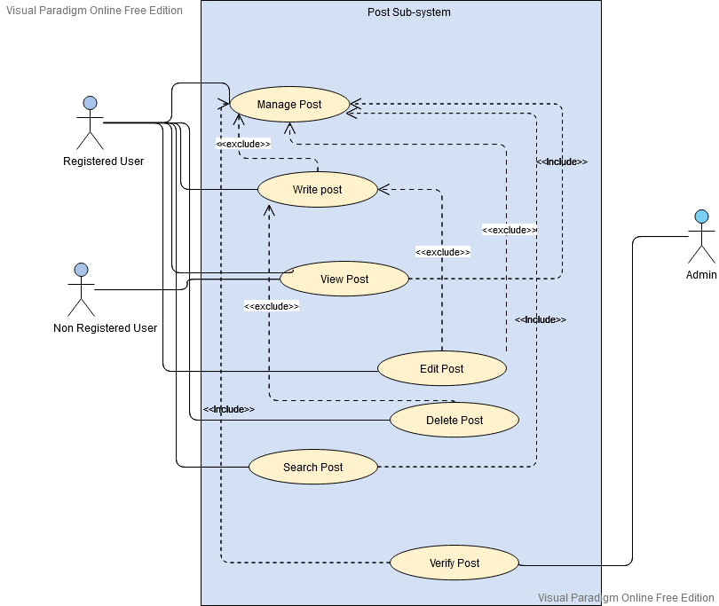
Use case diagram for Post Subsystem

Slide 13
Use case narrative of ‘post’ use case
Name : Post
Priority : High
Primary Actor : Registered User, Non-Registered User
Secondary Actor : Admin

Slide 14
comment Subsystem
Use – case name | Actors
Comment | Registered User

Slide 15
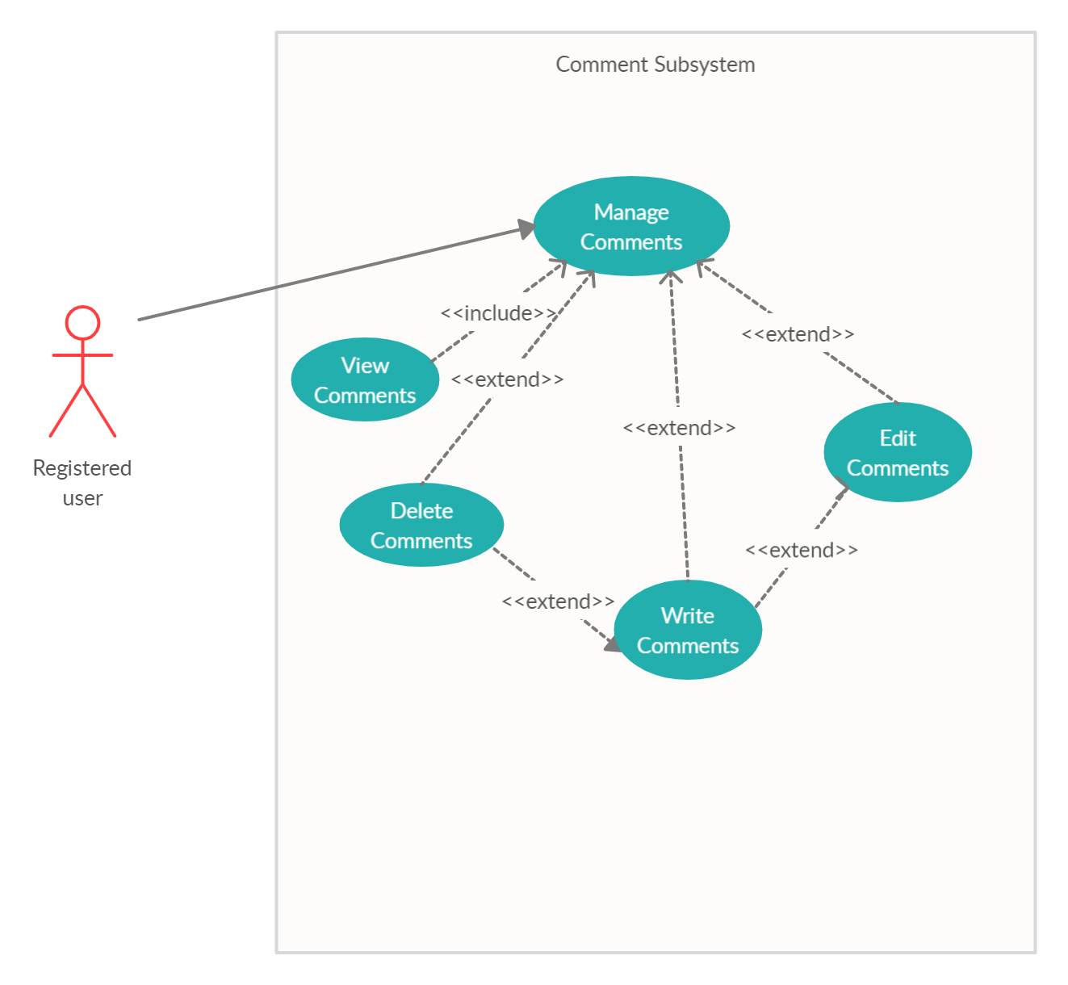
Use case diagram for Comment Subsystem

Slide 16
Use case narrative of ‘comment’ use case
Name : Comment
Priority : Low
Primary Actor : Registered User

Slide 17
User Profile Subsystem
Use – case name | Actors
User Profile | Registered User

Slide 18
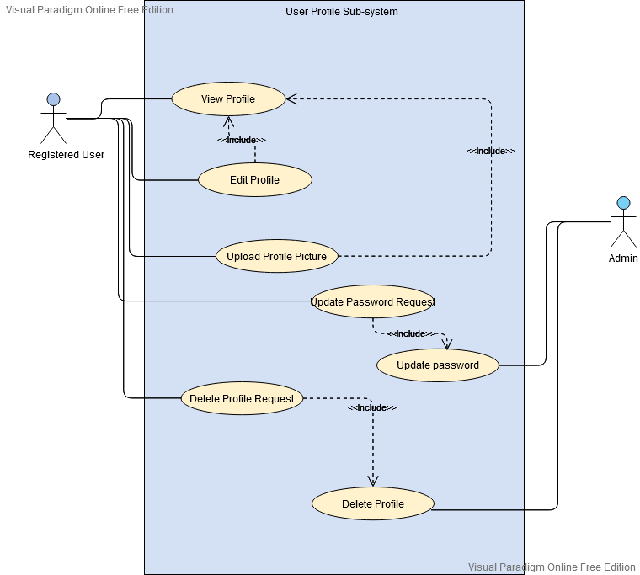
Use case diagram for User Profile Subsystem

Slide 19
Use case narrative of ‘User Profile’ use case
Name : User Profile
Priority : low
Primary Actor : Registered User
Secondary Actor: Admin

Slide 20
Fix a meeting Subsystem
Use – case name | Actors
Fix meeting | Registered User A, Registered User B

Slide 21
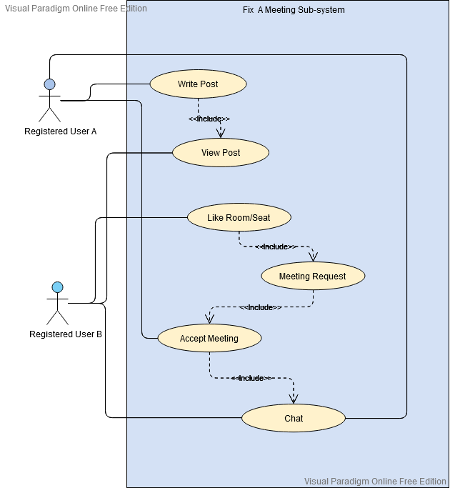
Use case diagram for Fix A Meeting Subsystem

Slide 22
Use case narrative of ‘Fix a meeting’ use case
Name : Fix a Meeting
Priority : High
Primary Actor : Registered User A, Registered User B

Slide 23

Ask if you have any Queries

Slide 24


