Slide 1
GLOBAL AUTO ECOSYSTEM
APPLICATION DESIGN · USE-CASE TEST MODEL
A cross-enterprise, cross-border network where a manufacturer, a dealer network, and a parts & service supplier operate as separate legal entities.
1 NETWORK 3 ENTERPRISES 6 ORGANIZATIONS 8 ROLES
UNIQUE ID: VIN · FULL-LIFECYCLE PLATFORM · DE / US / MX·KR

Slide 2
One vehicle, three enterprises, no shared record
PROBLEM DEFINITION
01
02
03
THE
PROBLEM
THE
GAP
TOTAL
VALUE
A vehicle's life spans a manufacturer, a dealer network, and a parts & service supplier — three separate legal entities on separate systems across borders, with no shared record.
Sales, service history, and parts usage, sit in silos. With no common key, records can't be joined and status is lost at every cross-enterprise handoff.
Give the vehicle one identity — the VIN — and one shared, auditable record every enterprise reads and writes end to end, so the whole is worth more than the parts.

Slide 3
Three properties make this the ideal test domain
WHY AN AUTOMOTIVE VALUE CHAIN
01
02
03
CROSS-ENTERPRISE,
CROSS-BORDER
VIN — UNIVERSAL
UNIQUE ID
STATUS
MANAGEMENT
A manufacturer, a dealer network, and a parts/service supplier are genuinely separate legal entities with separate systems — spanning national boundaries: Germany, the US, and Mexico / South Korea.
The Vehicle Identification Number satisfies the unique-ID criterion directly and forms a natural join key across every module: sales record, service history, parts and usage.
Vehicle and work-order flows run ordered → built → shipped → sold → in-service → serviced → traded-in

Slide 4
SYSTEM HIERARCHY
GLOBAL AUTO ECOSYSTEM
NETWORK
MANUFACTURER
DEALERSHIP GROUP
PARTS & LOGISTICS
Germany
United States
Mexico / South Korea
ORG
ORG
ORG
ORG
ORG
ORG
Production
Quality
Assurance
Sales
Service
Center
Warehousing
Logistics /
Shipping
1 NETWORK
3 ENTERPRISES
6 ORGANIZATIONS
8 ROLES

Slide 5
Separate legal entities across national boundaries
THE NETWORK · 3 ENTERPRISES
DE
US
MX / KR
MANUFACTURER
DEALERSHIP GROUP
PARTS & LOGISTICS SUPPLIER
Germany · HQ
United States
Mexico / South Korea
Designs and builds vehicles, issues the VIN
Sells and services vehicles and owns the end-customer relationship.
Supplies parts and runs cross-border warehousing and shipping.
ORGANIZATIONS Production · Quality Assurance
ORGANIZATIONS Sales · Service Center
ORGANIZATIONS Warehousing · Logistics / Shipping

Slide 6
Where the work — and the data — actually happens
MANUFACTURER
MANUFACTURER
DEALERSHIP GROUP
Production
Quality Assurance
Sales
Builds vehicles and records the build event and VIN issuance.
Inspects, releases, and ships completed builds.
Creates sales records and handles registration and handover.
DEALERSHIP GROUP
PARTS SUPPLIER
PARTS SUPPLIER
Service Center
Warehousing
Logistics / Shipping
Opens work orders and maintains the service history.
Receives, stocks, and picks parts against the vehicle BOM.
Dispatches and tracks cross-border shipments.

Slide 7
The actors who drive every use case
01
02
03
04
Production Manager
Quality Inspector
Sales Rep
Service Technician
Production · Manufacturer
Quality Assurance · Manufacturer
Sales · Dealership
Service Center · Dealership
05
06
07
08
Service Manager
Warehouse Clerk
Logistics Coordinator
Customer Service Rep
Service Center · Dealership
Warehousing · Supplier
Logistics · Supplier
Service Center · Dealership

Slide 8
The VIN is the join key across every module
IMPLEMENTATION CRITERION · UNIQUE ID
SALES RECORD
SERVICE HISTORY
buyer, price, registration
work orders, repairs
VIN
UNIQUE ID
PARTS USAGE
BOM, replacements
Assigned at build → one identity for the vehicle's entire life across all three enterprises.

Slide 9
One lifecycle, from order to second life — tracked end to end
IMPLEMENTATION CRITERION · LIFECYCLE MANAGEMENT
STEP 1
STEP 2
STEP 3
STEP 4
STEP 5
STEP 6
STEP 7
STEP 8
›
›
›
›
›
›
›
ORDERED
BUILT
SHIPPED
SOLD
IN-SERVICE
SERVICED
TRADED-IN
SECOND LIFE
Sales Rep
Production
Logistics
Sales Rep
Service Tech
Service Mgr
Sales Rep
Warehouse
Every transition is auditable and role-owned — spanning the full vehicle lifecycle

Slide 10
How the design is built and enforced
IMPLEMENTATION TECHNIQUES
01
02
03
SHARED
KEY MODEL
STATUS
STATE MACHINE
INTERFACES
& ACCESS
The VIN is issued once at build as the primary key; every module — sales, service, parts, — foreign-keys to it, so records join without duplication.
An eight-stage lifecycle (ordered → second life) runs as guarded transitions; each change is role-owned, timestamped, and written to an audit trail.
Separate systems exchange VIN and status over defined interfaces; role-based permissions bind each transition to the one role allowed to advance it.

Slide 11
Beyond status tracking — the full build scope
IMPLEMENTATION SCOPE · FULL CRITERIA
01 Data & Design Model
02 Workflow & Access
03 Quality & Extras
Model · types · CRUD · IDs
Roles · status · auth · admin
Reporting · seed data · robustness
Class design — clean OO model per entity
Data types — VIN, dates, money, status enums
CRUD — create, read, update, delete on all entities
Unique ID — VIN as the system-wide key
Validations — email, name, age, field rules
Work areas — a tailored workspace per role
Status — 8-stage lifecycle , role-owned
Auth — role-based login, strong user & password
Admin CRUD — system & enterprise admin control
UI / UX — consistent, aligned interface
Reporting — summarized system & network view
Seed data — Java Faker for demo & analytics
Robustness — error handling & NULL checks, no errors
Advanced — mail, AI, maps, SMS, APIs (a plus)
Database — optional: any DB or structured store

Slide 12
Use cases that exercise the whole design
TEST SCOPE · 8 USE CASES
ID | USE CASE | PRIMARY ROLE | ENTERPRISE | STATUS →
UC01 | Order & production kickoff | Production Manager | Manufacturer | ordered → built
UC02 | Quality inspection & release | Quality Inspector | Manufacturer | built → released
UC03 | Inbound parts receipt | Warehouse Clerk | Parts Supplier | part linked to VIN
UC04 | Cross-border dispatch | Logistics Coordinator | Parts Supplier | → shipped
UC05 | Vehicle sale & registration | Sales Rep | Dealership | shipped → sold
UC06 | Service appointment & repair | Service Technician | Dealership | → in-service
UC07 | Work-order approval & warranty | Service Manager | Dealership | warranty claim

Slide 13
Two end-to-end use cases that move status across borders
USE CASE FLOWS · CROSS-ENTERPRISE HANDOFFS
UC1 Custom Order & Global Fulfillment
UC3 Lifecycle, Parts & Trade-In
Global Supply Chain · US → DE
Post-Warranty Service · Global
US customer configures a custom order including VIN
Build scheduled at the German plant
QA the manufacture build
Status tracking of workflows
Shipment sent once completed
Routine maintenance loop begins
Replacement parts flow across borders
Vehicle kept in service
Trade-in enables a second life

Slide 14
Remove any one enterprise and value collapses
WHY EACH ENTERPRISE IS ESSENTIAL
01
02
03
MANUFACTURER
GERMANY
DEALERSHIP
UNITED STATES
PARTS &
LOGISTICS
Creates the identity — issues the VIN at build. Without it there is no key to join on and no source of truth for defects.
Owns the customer and the in-service vehicle — sales records,and work orders, . Without it there is no sale, no service history, no way to reach owners.
Moves the right parts across borders against the VIN's bill of materials. Without it builds and repairs stall can't be fulfilled.

Slide 15
Every implementation criterion, satisfied
ASSIGNMENT COVERAGE
✓
Unique ID
✓
Status management
VIN assigned at build; join key across sales, service, parts,
8-stage lifecycle (order → second life) on vehicles & work orders, each transition role-owned.
✓
Network
✓
Enterprises
1 — the Global Auto Ecosystem.
3 separate legal entities: DE, US, MX / KR.
✓
Organizations
✓
Roles
6 — two per enterprise.
8 distinct roles, excluding administrators.

Slide 16
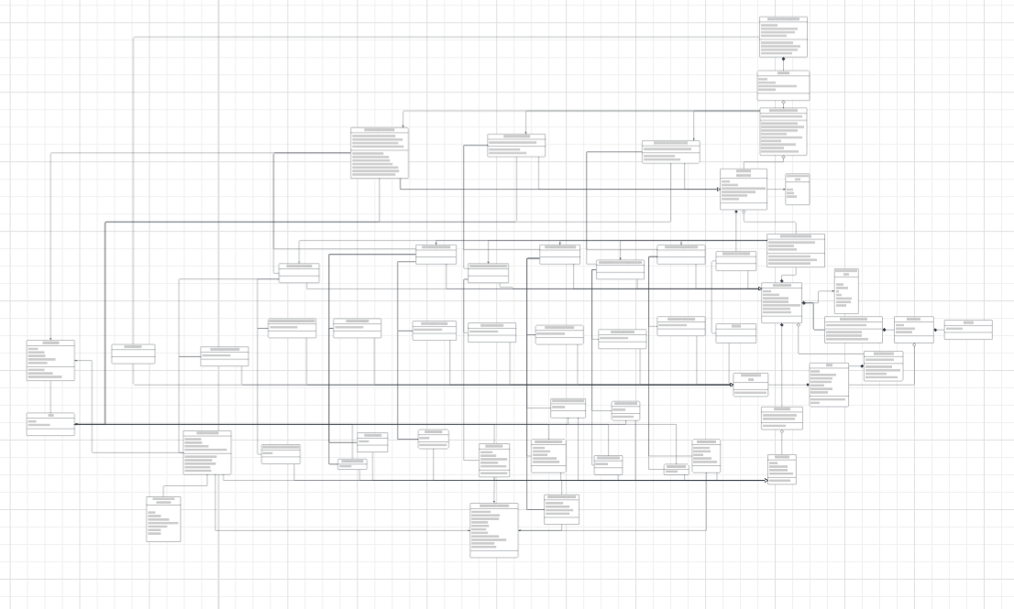
UML Diagram - Link
MODELING

Slide 17
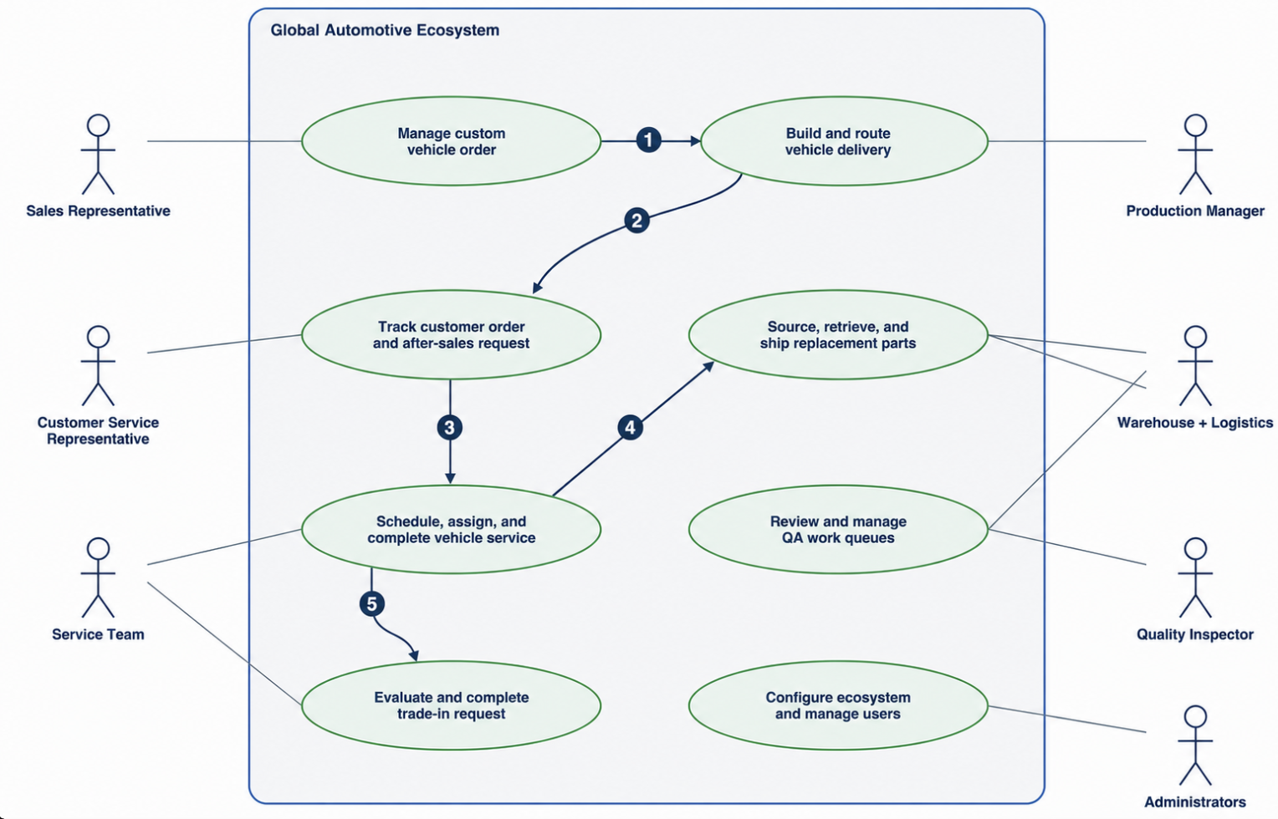
Ecosystem:
MODELING

Slide 18
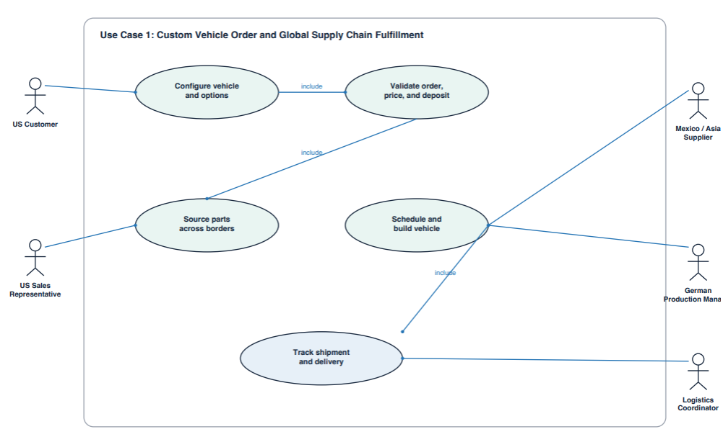
Use Case 1:
MODELING

Slide 19
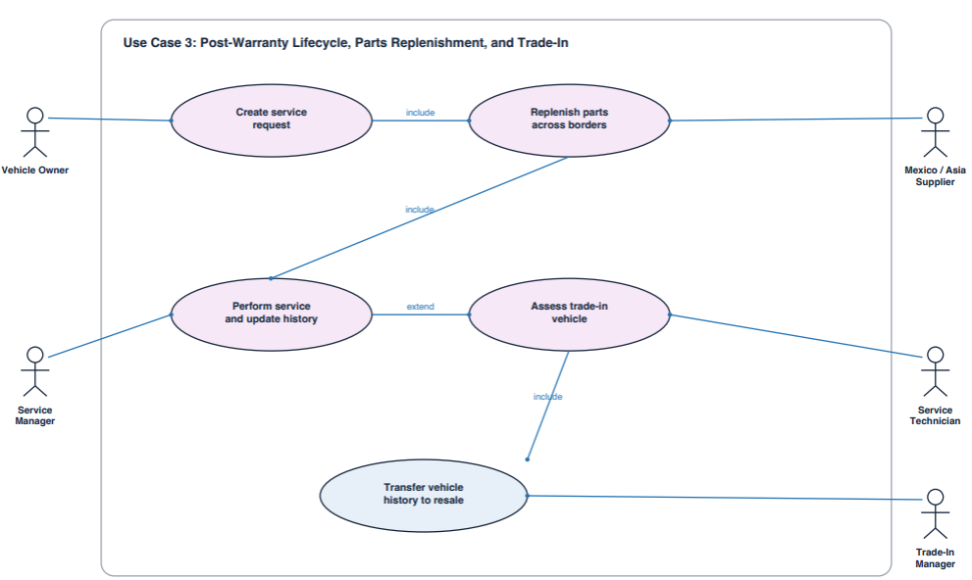
Use Case 3:
MODELING

Slide 20
Dealership Enterprise
ADVANCED FEATURES
01
02
03
Central State Management
Service Pre-check
Centralized Service Responsibilities
Sales portal displays current builds with their specific states, starting at DRAFT and moving right up through DELIVERED.
Customer Service portal verifies that vehicles were delivered before allowing them to be serviced, preventing false service appointment from being created.
Service Manager handles task delegation and completes Trade-In tasks, ensuring all connected technicians are being given work.

Slide 21
Supplier Enterprise
ADVANCED FEATURES
04
05
06
Parts Acquisition & Backordering
Smart Routing
Status View
When sending shipments, Logistics Coordinators dispatch Warehouse Clerks to gather the product before shipping out. Clerks can select from Manufacturer Production Organizations sharing the network to backorder from.
Users assign themselves a task and the current task button routes them to the correct page based on the task assigned, ensuring users handle only authorized duties.
The work queue updates task statuses as they are assigned and stores all completed orders in the organization's out queue, which can be viewed by it's employees.

Slide 22
Admin
ADVANCED FEATURES
10
11
12
Reports
Full CRUD
Template Security
Each admin area has a reports page that offers various high level insights on organization and user task performance.
Admin work area contains areas for creating, reading, updating, and deleting enterprise organizations, employees, and user accounts.
Although admins have the same portals, type checking is enforced, preventing admins from creating organizations for the wrong enterprise type.

Slide 23
Link to git hub

