Slide 1
ANGULAR7 FEATURES
Dhanusha Alamuri
ID:5067585

Slide 2
OBJECTIVE
Features of Angular7
Animation
Material
Guards

Slide 3
What is Angular7?
Angular 7 is an open source JavaScript framework for building web applications and apps in JavaScript, html, and Typescript which is a superset of JavaScript. Angular provides built-in features for animation, http service, and materials which in turn have features such as auto-complete, navigation, toolbar, menus, etc.

Slide 4
Prerequisites of Angular7
Angular2
TypeScript
HTML
CSS

Slide 5
Features of Angular7
CLI Prompts
Application Performance
Virtual Scrolling
Drag and Drop
Bundle Budget

Slide 6
CLI Prompts:
Angular CLI comes with commands that help us create and start on our project very fast.
Let us now go through the commands available to create a project, a component and services, change the port, etc..

Slide 7
Commads used in Angular7 Projects:
Component : ng g component new-component
Directive : ng g directive new-directive
Pipe : ng g pipe new-pipe
Service : ng g service new-service
Module : ng g module my-module
Test : ng test
Build : ng build --configuration=production // for production environment
ng build --configuration=staging // for stating environment

Slide 8
Application Performance
It does not only focus on making framework small but makes the app small too as much as possible.
In version 7 the reflect-metadata polyfill (includes in production) remove automatically.

Slide 9
Virtual Scrolling:
Virtual scrolling allows users to bind a list of elements even its too long in small packets.
As per the scroll movements, data will be supplied into packets at the user end.
But useful for web applications too as even in web applications if we scroll a long list of data, performance gets affected.

Slide 10
Drag and Drop
It comes with the feature of automatic rendering.
Bundle Budget
If the bundle size is more than 2MB, a warning message provided and for above 5MB, an error will be given.

Slide 11
Animation
Animations add a lot of interaction between the html elements. Animation was available with Angular 2, from Angular 4 onwards animation is no more a part of the @angular/core library, but is a separate package that needs to be imported in app.module.ts

Slide 12
To start with, we need to import the library with the below line of code −

Slide 13
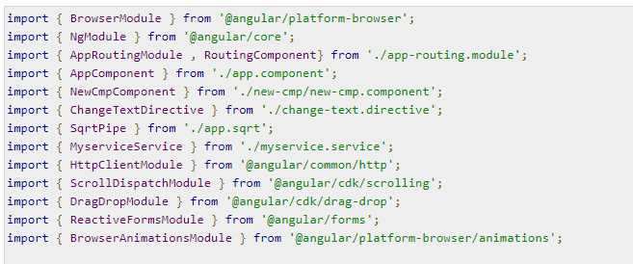
The BrowserAnimationsModule needs to be added to the import array in app.module.ts as shown below −

Slide 14
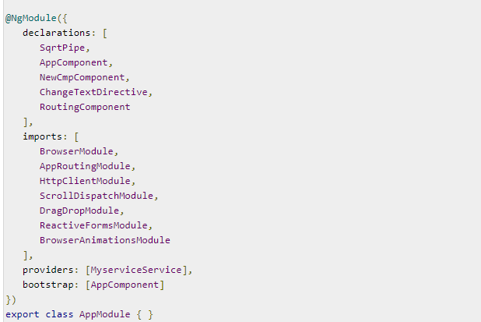

Slide 15
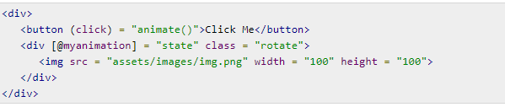
In app.component.html, we have added the html elements, which are to be animated.
Let us now see the app.component.ts where the animation is defined.

Slide 16
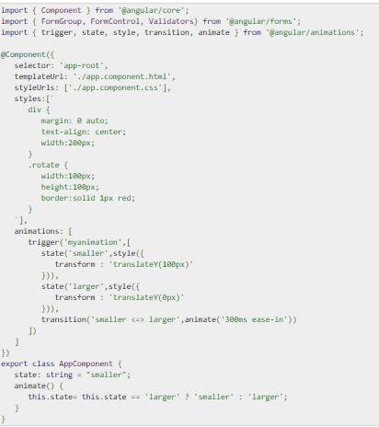

Slide 17
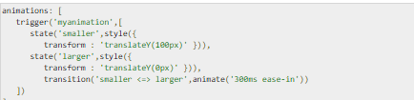
We have to import the animation function that is to be used in the .ts file as shown above
Here we have imported trigger, state, style, transition, and animate from @angular/animations.
Now, we will add the animations property to the @Component () decorator

Slide 18

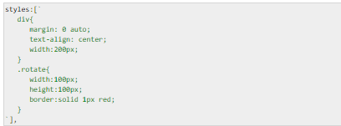
Let us now see the .html file to see how the transition function works
There is a style property added in the @component directive, which centrally aligns the div. Let us consider the following example to understand the same

Slide 19

Here, a special character [``] is used to add styles to the html element, if any. For the div, we have given the animation name defined in the app.component.ts file.
On the click of a button it calls the animate function, which is defined in the app.component.ts file as follows

Slide 20
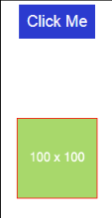
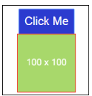
This is how the output in the browser (http://localhost:4200/) will look like −

Slide 21

Materials
Materials offer a lot of built-in modules for your project. Features such as autocomplete, datepicker, slider, menus, grids, and toolbar are available for use with materials in Angular 7.
To use materials, we need to import the package. Angular 2 also has all the above features but they are available as part of the @angular/core module. From Angular 4, Materials module has been made available with a separate module @angular/materials. This helps the user to import only the required materials in their project.
Following is the command to add materials to your project

Slide 22
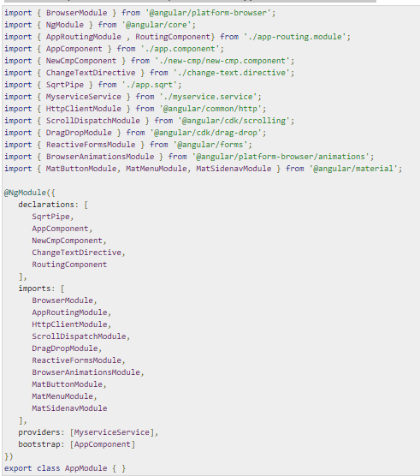
We will now import the modules in the parent module - app.module.ts as shown below

Slide 23
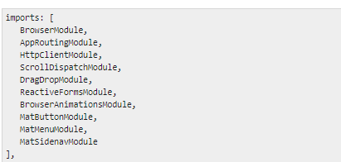
In the above file, we have imported the following modules from @angular/materials.
And the same is used in the imports array as shown below

Slide 24
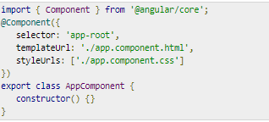
The app.component.ts is as shown below −
Let us now add the material-css support in styles.css.

Slide 25
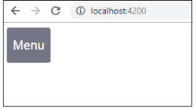
To add menu, <mat-menu></mat-menu> is used. The file and Save As items are added to the button under mat-menu. There is a main button added Menu. The reference of the same is given the <mat-menu> by using [matMenuTriggerFor]="menu" and using the menu with # in<mat-menu>.
The below image is displayed in the browser −

Slide 26
