Slide 1
More Pointers

Slide 2
Parsing (tokenizing) a string
Break up a string into smaller pieces (tokens) using separator characters (delimiters) in the string
char text[]=“123,abc,def”;
char *token;
token=strtok(text,”,”);
while (token != NULL){
printf(“%s\n”,token);
token=strtok(NULL,”,”);
}
1 | 2 | 3 | , | a | b | c | , | d | e | f | \0
Notes:
“text” will get changed

Slide 3
Array of Pointers
int main ()
{
int var[] = {10, 100, 200};
int i, *ptr[3];
for ( i = 0; i < MAX; i++){
// assign the address of integer
ptr[i] = &var[i];
}
}

Slide 4
memory layout
0xFFFFFFFF
when a program runs, its instructions/globals load into memory
address space is like a huge array of bytes
as functions are called, data goes on a stack
dynamic data is created on a heap
stack (function calls)
available memory
heap (dynamically allocated data)
global/static variables ("data segment")
code instructions ("text segment")
address
space
0x00000000

Slide 5
Stack frames
stack frame or activation record: memory for a function call
stores parameters, local variables, and return address to go back to
int f(int p1, int p2) {
int x;
int a[3];
...
return x + y;
}
stack
available
heap
global data
code

Slide 6
Stack frames
stack frame or activation record: memory for a function call
stores parameters, local variables, and return address to go back to
int f(int p1, int p2) {
int x;
int a[3];
...
return x + y;
}
stack
available
heap
global data
code
 | contents
 | p2
 | p1
 | return address
 | a[2]
 | a[1]
 | a[0]
 | x

Slide 7
Tracing function calls
int main(void) {
int n1 = f(3, -5);
n1 = g(n1);
}
int f(int p1, int p2) {
int x;
int a[3];
...
x = g(a[2]);
return x + y;
}
int g(int param) {
return param * 2;
}
stack
available
heap
global data
code main f g

Slide 8
Tracing function calls
int main(void) {
int n1 = f(3, -5);
n1 = g(n1);
}
int f(int p1, int p2) {
int x;
int a[3];
...
x = g(a[2]);
return x + y;
}
int g(int param) {
return param * 2;
}
stack
available
heap
global data
code main f g
main
n1

Slide 9
Tracing function calls
int main(void) {
int n1 = f(3, -5);
n1 = g(n1);
}
int f(int p1, int p2) {
int x;
int a[3];
...
x = g(a[2]);
return x + y;
}
int g(int param) {
return param * 2;
}
stack
available
heap
global data
code main f g
main
n1

Slide 10
Tracing function calls
int main(void) {
int n1 = f(3, -5);
n1 = g(n1);
}
int f(int p1, int p2) {
int x;
int a[3];
...
x = g(a[2]);
return x + y;
}
int g(int param) {
return param * 2;
}
stack
available
heap
global data
code main f g
main
n1
f
p1, p2
x, a

Slide 11
Tracing function calls
int main(void) {
int n1 = f(3, -5);
n1 = g(n1);
}
int f(int p1, int p2) {
int x;
int a[3];
...
x = g(a[2]);
return x + y;
}
int g(int param) {
return param * 2;
}
stack
available
heap
global data
code main f g
main
n1
f
p1, p2
x, a

Slide 12
Tracing function calls
int main(void) {
int n1 = f(3, -5);
n1 = g(n1);
}
int f(int p1, int p2) {
int x;
int a[3];
...
x = g(a[2]);
return x + y;
}
int g(int param) {
return param * 2;
}
stack
available
heap
global data
code main f g
main
n1
f
p1, p2
x, a
g
p

Slide 13
Tracing function calls
int main(void) {
int n1 = f(3, -5);
n1 = g(n1);
}
int f(int p1, int p2) {
int x;
int a[3];
...
x = g(a[2]);
return x + y;
}
int g(int param) {
return param * 2;
}
stack
available
heap
global data
code main f g
main
n1
f
p1, p2
x, a
g
p

Slide 14
Tracing function calls
int main(void) {
int n1 = f(3, -5);
n1 = g(n1);
}
int f(int p1, int p2) {
int x;
int a[3];
...
x = g(a[2]);
return x + y;
}
int g(int param) {
return param * 2;
}
stack
available
heap
global data
code main f g
main
n1
f
p1, p2
x, a

Slide 15
Tracing function calls
int main(void) {
int n1 = f(3, -5);
n1 = g(n1);
}
int f(int p1, int p2) {
int x;
int a[3];
...
x = g(a[2]);
return x + y;
}
int g(int param) {
return param * 2;
}
stack
available
heap
global data
code main f g
main
n1

Slide 16
Tracing function calls
int main(void) {
int n1 = f(3, -5);
n1 = g(n1);
}
int f(int p1, int p2) {
int x;
int a[3];
...
x = g(a[2]);
return x + y;
}
int g(int param) {
return param * 2;
}
stack
available
heap
global data
code main f g
main
n1
g
p

Slide 17
Tracing function calls
int main(void) {
int n1 = f(3, -5);
n1 = g(n1);
}
int f(int p1, int p2) {
int x;
int a[3];
...
x = g(a[2]);
return x + y;
}
int g(int param) {
return param * 2;
}
stack
available
heap
global data
code main f g
main
n1
g
p

Slide 18
Tracing function calls
int main(void) {
int n1 = f(3, -5);
n1 = g(n1);
}
int f(int p1, int p2) {
int x;
int a[3];
...
x = g(a[2]);
return x + y;
}
int g(int param) {
return param * 2;
}
stack
available
heap
global data
code main f g
main
n1

Slide 19
Tracing function calls
int main(void) {
int n1 = f(3, -5);
n1 = g(n1);
}
int f(int p1, int p2) {
int x;
int a[3];
...
x = g(a[2]);
return x + y;
}
int g(int param) {
return param * 2;
}
stack
available
heap
global data
code main f g

Slide 20
Tracing function calls
int main(void) {
int n1 = f(3, -5);
n1 = g(n1);
}
int f(int p1, int p2) {
int x;
int a[3];
...
x = g(a[2]);
return x + y;
}
int g(int param) {
return param * 2;
}
stack
available
heap
global data
code main f g

Slide 21
Arrays and pointers
A pointer can point to an array element
An array's name can be used as a pointer to its first element
The[] notation treats a pointer like an array
pointer[i] is i elements' worth of bytes forward from pointer
int a[5] = {10, 20, 30, 40, 50};
int* p1 = &a[3]; // a's 4th element
int* p2 = &a[0]; // a's 1st element
int* p3 = a; // a's 1st element
*p1 = 100;
*p2 = 200;
p1[1] = 300;
p2[1] = 400;
p3[2] = 500;
Final array contents:
{200, 400, 500, 100, 300}

Slide 22
“pointer[i] is i elements' worth of bytes” – what is an “elements’ worth”?
int x;
int a[5];
printf("int=%d,double=%d\n", (int)sizeof(int), (int)sizeof(double));
printf("x uses %d bytes\n", (int)sizeof(x));
printf("a uses %d bytes\n", (int)sizeof(a));
printf("a[0] uses %d bytes\n", (int)sizeof(a[0]));
int=4, double=8
x uses 4 bytes
a uses 20 bytes
a[0] uses 4 bytes
sizeof(type) or sizeof(variable) returns memory size in bytes
Arrays passed as parameters do not remember their size
int a[5];
printf("a uses %d bytes\n",
(int)sizeof(a));
f(a);
void f(int a[]) {
printf("a uses %2d bytes in f\n", (int)sizeof(a));
}
a uses 20 bytes
a uses 4 bytes in f

Slide 23
Arrays as parameters
Array parameters are passed as pointers to the first element; the [] syntax on parameters is only a convenience – the two programs below are equivalent
void f(int a[]);
int main(void) {
int a[5];
...
f(a);
return 0;
}
void f(int a[]) {
...
}
void f(int* a);
int main(void) {
int a[5];
...
f(&a[0]);
return 0;
}
void f(int* a) {
...
}

Slide 24
Returning an array
Stack-allocated variables disappear at the end of the function: this means an array cannot generally be safely returned from a method
int main() {
int nums[4] = {7, 4, 3, 5};
int nums2[4] = copy(nums, 4); // no
return 0;
}
int[] copy(int a[], int size) {
int i;
int a2[size];
for (i = 0; i < size; i++) {
a2[i] = a[i];
}
return a2; // no
}

Slide 25
Pointers (alone) don't help
A dangling pointer points to an invalid memory location
int main(void) {
int nums[4] = {7, 4, 3, 5};
int* nums2 = copy(nums, 4);
// nums2 dangling here
...
}
int* copy(int a[], int size) {
int i;
int a2[size];
for (i = 0; i < size; i++) {
a2[i] = a[i];
}
return a2;
}

Slide 26
Limitation of Stack
We'd like to have C programs with data that are
Dynamic (size of array changes based on user input, etc.)
Long-lived (doesn't disappear after the function is over)
Bigger (the stack can't hold all that much data)
Currently, our solutions include:
Declaring variables in main and passing as "output parameters"
Declaring global variables (do not want)

Slide 27
The heap
The heap is a large pool of unused memory that you can use for dynamically allocating data
It is allocated/deallocated explicitly, not (like the stack) on function calls/returns
Many languages (e.g. Java) place all arrays/ objects on the heap
// Java
int[] a = new int[5];
Point p = new Point(8, 2);

Slide 28
malloc: allocating heap memory
variable = (type*) malloc(size);
malloc function allocates a heap memory block of a given size
returns a pointer to the first byte of that memory
can/should cast the returned pointer to the appropriate type
initially the memory contains garbage data
often used with sizeof to allocate memory for a given data type
int* a = (int*) malloc(8 * sizeof(int));
a[0] = 10;
a[1] = 20;
...
Notes:
look at malloc man page; talk about how it returns void* ?

Slide 29
calloc: allocate and zero
variable = (type*) calloc(count, size);
calloc function is like malloc, but it zeros out the memory
also takes two parameters, number of elements and size of each
preferred over malloc for avoiding bugs (but slightly slower)
#include <stdlib.h>
// int a[8] = {0}; <-- stack equivalent
int* a = (int*) calloc(8, sizeof(int));

Slide 30
Returning a heap array
To return an array, malloc it and return a pointer
Array will live on after the function return
int main() {
int nums[4] = {7, 4, 3, 5};
int* nums2 = copy(nums, 4); ...
}
int* copy(int a[], int size) {
int i;
int* a2 = malloc(size * sizeof(int));
for (i = 0; i < size; i++) {
a2[i] = a[i];
}
return a2;
}

Slide 31
strdup()
Some C library function automatically calls malloc
E.g. strdup(s) returns a pointer to a new string which is a duplicate of the string s
char *strdup (const char *s) {
// Allocate memory
char *d = malloc (strlen (s) + 1);
// Copy string if ok
if (d != NULL) strcpy (d,s);
// Return new memory
return d;
}

Slide 32
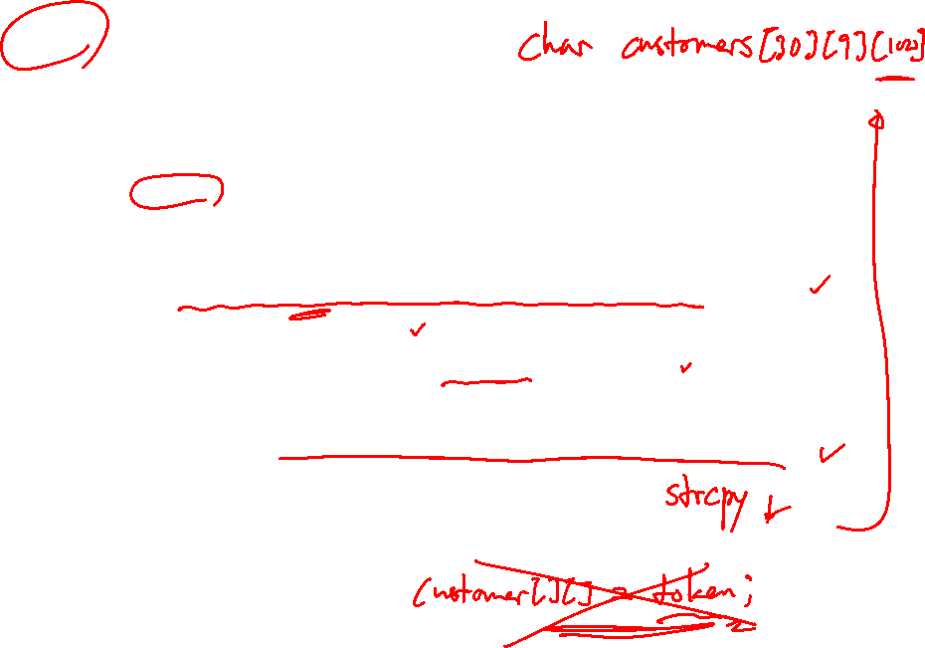
char *customers[30][9];
......
int read_customers()
{
char buffer[BUFSIZE];
FILE *infile = fopen(“data.txt”, “r”);
int num_cust = 0;
while ((fgets(buffer, BUFSIZE, infile)) != NULL){
int token_num = 0;
char *token = strtok(buffer, “|\n”);
while (token != NULL){
customers[num_cust][token_num] = strdup(token);
token_num++;
token = strtok(NULL, “|\n”);
}
num_cust++;
} }

Slide 33
NULL: an invalid memory location
In C, NULL is a global constant whose value is 0
If you malloc/calloc but have no memory free, it returns NULL
You can initialize a pointer to NULL if it has no meaningful value
Dereferencing a null pointer will crash your program
int* p = NULL;
*p = 42; // segfault

Slide 34
Null Pointers
If a memory allocation function can’t locate a memory block of the requested size, it returns a null pointer.
A null pointer is a special value that can be distinguished from all valid pointers.

Slide 35
Null Pointers
An example of testing malloc’s return value:
p = malloc(10000);
if (p == NULL) {
/* allocation failed; take appropriate action */
}
Some programmers combine the call of malloc with the NULL test:
if ((p = malloc(10000)) == NULL) {
/* allocation failed; take appropriate action */
}

Slide 36
Null Pointers
Pointers test true or false in the same way as numbers.
All non-null pointers test true; only null pointers are false.
Instead of writing
if (p == NULL) …
we could write
if (!p) …
Instead of writing
if (p != NULL) …
we could write
if (p) …

Slide 37
Deallocating memory
Heap memory stays allocated until the end of your program
A garbage collector is a process that automatically reclaims memory no longer in use
Keeps track of which variables point to which memory, etc.
Used in Java and many other modern languages; not in C
// Java
public static int[] f() {
int[] a = new int[1000];
int[] a2 = new int[1000];
return a2;
} // no variables refer to a here; can be freed

Slide 38
Memory leaks
A memory leak is a failure to release memory when no longer needed.
easy to do in C
can be a problem if your program will run for a long time
when your program exits, all of its memory is returned to the OS
void f() {
int* a = (int*) calloc(1000, sizeof(int));
...
} // oops; the memory for a is now lost

Slide 39
free: releases memory
free(pointer);
Releases the memory pointed to by the given pointer
precondition: pointer must refer to a heap-allocated memory block that has not already been freed
it is considered good practice to set a pointer to NULL after freeing
int* a = (int*) calloc(8, sizeof(int));
...
free(a);
a = NULL;

Slide 40
Memory corruption
If the pointer passed to free doesn't point to a heap-allocated block, or if that block has already been freed, bad things happen
you're lucky if it crashes, rather than silently corrupting something
int* a1 = (int*) calloc(1000, sizeof(int));
int a2[1000];
int* a3;
int* a4 = NULL;
free(a1); // ok
free(a1); // bad (already freed)
free(a2); // bad (not heap allocated)
free(a3); // bad (not heap allocated)
free(a4); // bad (not heap allocated)

Slide 41
Pointer and const modifier
We can use the const modifier to make the pointer constant, the data it points to constant, or both
int value;
int *ptr = &value;
int const *const_value1 = &value;
const int *const_value2 = &value;
int * const const_ptr = &value;

Slide 42
Pointer and const modifier
Use const to prevent data to be modified in a function
typedef struct Node NODE;
typedef NODE *Nodeptr;
struct Node{
int item;
Nodeptr link;
}
void traverse(Nodeptr const head){
// traverse the list
NODE const *curr = head;
while (curr != NULL){
printf(“%d\n”, curr->item);
// curr->item++; // not allowed
// head = head->link; // not allowed
curr = curr->link;
}
}

Slide 44
Dynamically Allocated Strings
Dynamic storage allocation is often useful for working with strings.
Strings are stored in character arrays, and it can be hard to anticipate how long these arrays need to be.
By allocating strings dynamically, we can postpone the decision until the program is running.

Slide 45
Using malloc to Allocate Memory for a String
Prototype for the malloc function:
void *malloc(size_t size);
malloc allocates a block of size bytes and returns a pointer to it.
size_t is an unsigned integer type defined in the library.

Slide 46
Using malloc to Allocate Memory for a String
A call of malloc that allocates memory for a string of n characters:
p=malloc(sizeof(char)*(n+1));
// or p=malloc(n+1)
p is a char * variable.
Each character requires one byte of memory; adding 1 to n leaves room for the null character.
Some programmers prefer to cast malloc’s return value, although the cast is not required:
p = (char *) malloc(n + 1);

Slide 47
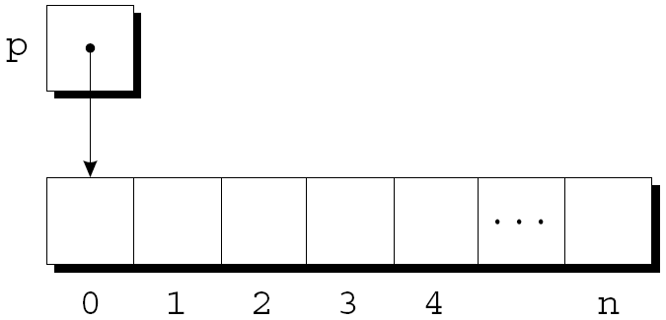
Using malloc to Allocate Memory for a String
Memory allocated using malloc isn’t cleared, so p will point to an uninitialized array of n + 1 characters:

Slide 48
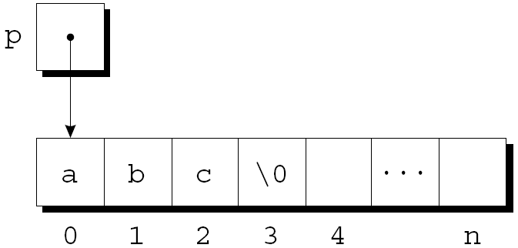
Using malloc to Allocate Memory for a String
Calling strcpy is one way to initialize this array:
strcpy(p, "abc");
The first four characters in the array will now be a, b, c, and \0:

Slide 49
Using Dynamic Storage Allocation in String Functions
Dynamic storage allocation makes it possible to write functions that return a pointer to a “new” string.
Consider the problem of writing a function that concatenates two strings without changing either one.
The function will measure the lengths of the two strings to be concatenated, then call malloc to allocate the right amount of space for the result.

Slide 50
Using Dynamic Storage Allocation in String Functions
char *concat(const char *s1, const char *s2)
{
char *result;
result = malloc(strlen(s1) + strlen(s2) + 1);
if (result == NULL) {
printf("Error: malloc failed in concat\n");
exit(EXIT_FAILURE);
}
strcpy(result, s1);
strcat(result, s2);
return result;
}

Slide 51
Using Dynamic Storage Allocation in String Functions
A call of the concat function:
p = concat("abc", "def");
After the call, p will point to the string "abcdef", which is stored in a dynamically allocated array.

Slide 52
Using Dynamic Storage Allocation in String Functions
Functions such as concat that dynamically allocate storage must be used with care.
When the string that concat returns is no longer needed, we’ll want to call the free function to release the space that the string occupies.
If we don’t, the program may eventually run out of memory.

Slide 53
Dynamically Allocated Arrays
Dynamically allocated arrays have the same advantages as dynamically allocated strings.
The close relationship between arrays and pointers makes a dynamically allocated array as easy to use as an ordinary array.
Although malloc can allocate space for an array, the calloc function is sometimes used instead, since it initializes the memory that it allocates.

Slide 54
Dynamically Allocated Arrays
Dynamically allocated arrays have the same advantages as dynamically allocated strings.
The close relationship between arrays and pointers makes a dynamically allocated array as easy to use as an ordinary array.
Although malloc can allocate space for an array, the calloc function is sometimes used instead, since it initializes the memory that it allocates.
The realloc function allows us to make an array “grow” or “shrink” as needed.

Slide 55
Using malloc to Allocate Storage for an Array
Suppose a program needs an array of n integers, where n is computed during program execution.
We’ll first declare a pointer variable:
int *a;
Once the value of n is known, the program can call malloc to allocate space for the array:
a = (int*) malloc(n * sizeof(int));
Always use the sizeof operator to calculate the amount of space required for each element.

Slide 56
Using malloc to Allocate Storage for an Array
We can now ignore the fact that a is a pointer and use it instead as an array name, thanks to the relationship between arrays and pointers in C.
For example, we could use the following loop to initialize the array that a points to:
for (i = 0; i < n; i++)
a[i] = 0;

Slide 57
The calloc Function
The calloc function is an alternative to malloc.
Prototype for calloc:
void *calloc(size_t nmemb, size_t size);
Properties of calloc:
Allocates space for an array with nmemb elements, each of which is size bytes long.
Returns a null pointer if the requested space isn’t available.
Initializes allocated memory by setting all bits to 0.

Slide 58
The calloc Function
A call of calloc that allocates space for an array of n integers:
a = calloc(n, sizeof(int));
By calling calloc with 1 as its first argument, we can allocate space for a data item of any type:
struct point { int x, y; } *p;
p = calloc(1, sizeof(struct point));

Slide 59
The realloc Function
The realloc function can resize a dynamically allocated array.
Prototype for realloc:
void *realloc(void *ptr, size_t size);
ptr must point to a memory block obtained by a previous call of malloc, calloc, or realloc.
size represents the new size of the block, which may be larger or smaller than the original size.

Slide 60
The realloc Function
Properties of realloc:
When it expands a memory block, realloc doesn’t initialize the bytes that are added to the block.
If realloc can’t enlarge the memory block as requested, it returns a null pointer; the data in the old memory block is unchanged.
If realloc is called with a null pointer as its first argument, it behaves like malloc.
If realloc is called with 0 as its second argument, it frees the memory block.

Slide 61
The realloc Function
We expect realloc to be reasonably efficient:
When asked to reduce the size of a memory block, realloc should shrink the block “in place.”
realloc should always attempt to expand a memory block without moving it.
If it can’t enlarge a block, realloc will allocate a new block elsewhere, then copy the contents of the old block into the new one.
Once realloc has returned, be sure to update all pointers to the memory block in case it has been moved.

Slide 62
Deallocating Storage
malloc and the other memory allocation functions obtain memory blocks from a storage pool known as the heap.
Calling these functions too often—or asking them for large blocks of memory—can exhaust the heap, causing the functions to return a null pointer.
To make matters worse, a program may allocate blocks of memory and then lose track of them, thereby wasting space.

Slide 63
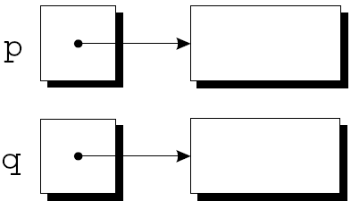
Deallocating Storage
Example:
p = malloc(…);
q = malloc(…);
p = q;
A snapshot after the first two statements have been executed:

Slide 64
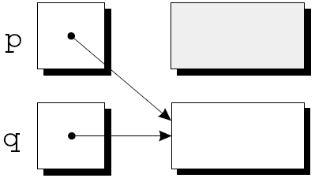
Deallocating Storage
After q is assigned to p, both variables now point to the second memory block:
There are no pointers to the first block, so we’ll never be able to use it again.

Slide 65
Deallocating Storage
A block of memory that’s no longer accessible to a program is said to be garbage.
A program that leaves garbage behind has a memory leak.
Some languages provide a garbage collector that automatically locates and recycles garbage, but C doesn’t.
Instead, each C program is responsible for recycling its own garbage by calling the free function to release unneeded memory.

Slide 66
The free Function
Prototype for free:
void free(void *ptr);
free will be passed a pointer to an unneeded memory block:
p = malloc(…);
q = malloc(…);
free(p);
p = q;
Calling free releases the block of memory that p points to.

Slide 67
Memory corruption
If the pointer passed to free doesn't point to a heap-allocated block, or if that block has already been freed, bad things happen
you're lucky if it crashes, rather than silently corrupting something
int* a1 = (int*) calloc(1000, sizeof(int));
int a2[1000];
int* a3;
int* a4 = NULL;
free(a1); // ok
free(a1); // bad (already freed)
free(a2); // bad (not heap allocated)
free(a3); // bad (not heap allocated)
free(a4); // bad (not heap allocated)

Slide 68
The “Dangling Pointer” Problem
Using free leads to a new problem: dangling pointers.
free(p) deallocates the memory block that p points to, but doesn’t change p itself.
If we forget that p no longer points to a valid memory block, chaos may ensue:
char *p = malloc(4);
…
free(p);
…
strcpy(p, "abc"); /*** WRONG ***/
Modifying the memory that p points to is a serious error.

Slide 69
The “Dangling Pointer” Problem
Dangling pointers can be hard to spot, since several pointers may point to the same block of memory.
When the block is freed, all the pointers are left dangling.

Slide 71
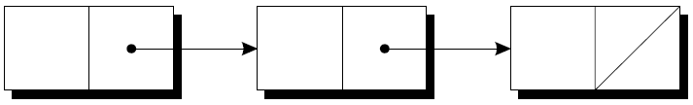
Linked Lists
Dynamic storage allocation is especially useful for building lists, trees, graphs, and other linked data structures.
A linked list consists of a chain of structures (called nodes), with each node containing a pointer to the next node in the chain:
The last node in the list contains a null pointer.

Slide 72
Linked Lists
A linked list is more flexible than an array: we can easily insert and delete nodes in a linked list, allowing the list to grow and shrink as needed.
On the other hand, we lose the “random access” capability of an array:
Any element of an array can be accessed in the same amount of time.
Accessing a node in a linked list is fast if the node is close to the beginning of the list, slow if it’s near the end.

Slide 73
Declaring a Node Type
To set up a linked list, we’ll need a structure that represents a single node.
A node structure will contain data (an integer in this example) plus a pointer to the next node in the list:
struct node {
int value; /* data stored in the node */
struct node *next; /* pointer to the next node */
};

Slide 74
Declaring a Node Type
To set up a linked list, we’ll need a structure that represents a single node.
A node structure will contain data (an integer in this example) plus a pointer to the next node in the list:
struct node {
int value; /* data stored in the node */
struct node *next; /* pointer to the next node */
};
node must be a tag, not a typedef name, or there would be no way to declare the type of next.

Slide 75
Declaring a Node Type
Next, we’ll need a variable that always points to the first node in the list:
struct node *first = NULL;
Setting first to NULL indicates that the list is initially empty.

Slide 76
Creating a Node
As we construct a linked list, we’ll create nodes one by one, adding each to the list.
Steps involved in creating a node:
Allocate memory for the node.
Store data in the node.
Insert the node into the list.
We’ll concentrate on the first two steps for now.

Slide 77
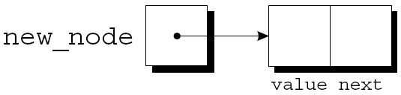
Creating a Node
When we create a node, we’ll need a variable that can point to the node temporarily:
struct node *new_node;
We’ll use malloc to allocate memory for the new node, saving the return value in new_node:
new_node = malloc(sizeof(struct node));
new_node now points to a block of memory just large enough to hold a node structure:

Slide 78
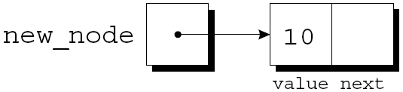
Creating a Node
Next, we’ll store data in the value member of the new node:
(*new_node).value = 10;
// equivalently: new_node->value = 10;
The resulting picture:

Slide 79
The -> Operator
Accessing a member of a structure using a pointer is so common that C provides a special operator for this purpose.
This operator, known as right arrow selection, is a minus sign followed by >.
Using the -> operator, we can write
new_node->value = 10;
instead of
(*new_node).value = 10;

Slide 80
The -> Operator
The -> operator produces an lvalue, so we can use it wherever an ordinary variable would be allowed.
A scanf example:
scanf("%d", &new_node->value);
The & operator is still required, even though new_node is a pointer.

Slide 81
Inserting a Node at the Beginning of a Linked List
One of the advantages of a linked list is that nodes can be added at any point in the list.
However, the beginning of a list is the easiest place to insert a node.
Suppose that new_node is pointing to the node to be inserted, and first is pointing to the first node in the linked list.

Slide 82
Inserting a Node at the Beginning of a Linked List
It takes two statements to insert the node into the list.
The first step is to modify the new node’s next member to point to the node that was previously at the beginning of the list:
new_node->next = first;
The second step is to make first point to the new node:
first = new_node;
These statements work even if the list is empty.

Slide 83
Inserting a Node at the Beginning of a Linked List
Let’s trace the process of inserting two nodes into an empty list.
We’ll insert a node containing the number 10 first, followed by a node containing 20.

Slide 84
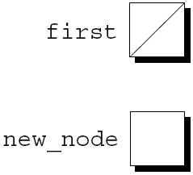
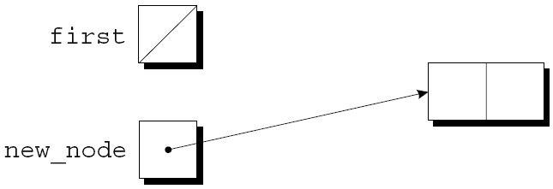
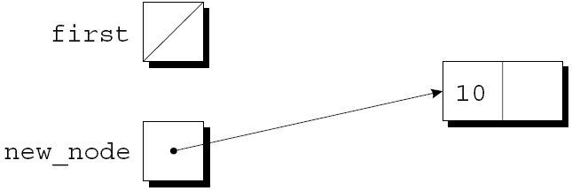
Inserting a Node at the Beginning of a Linked List
first = NULL;
new_node =
malloc(sizeof(struct node));
new_node->value = 10;

Slide 85
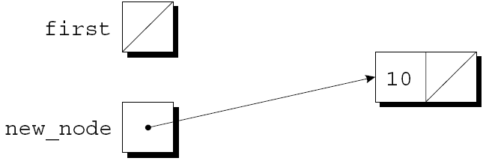
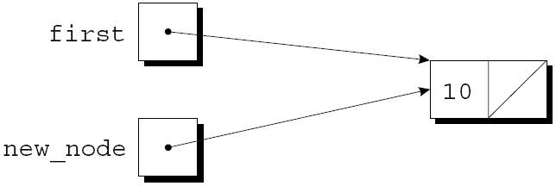
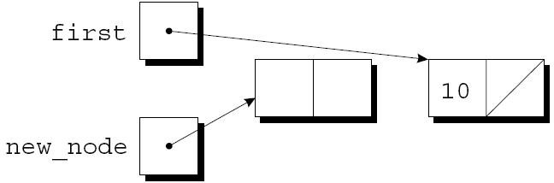
Inserting a Node at the Beginning of a Linked List
new_node->next = first;
first = new_node;
new_node =
malloc(sizeof(struct node));

Slide 86
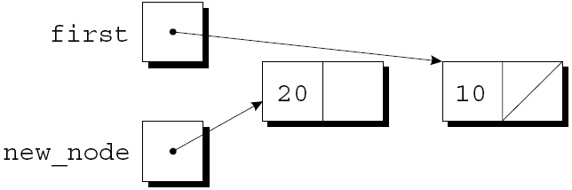
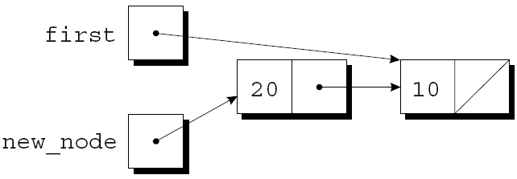
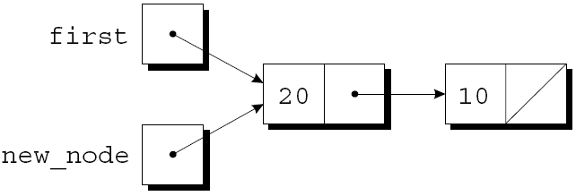
Inserting a Node at the Beginning of a Linked List
new_node->value = 20;
new_node->next = first;
first = new_node;

Slide 87
Inserting a Node at the Beginning of a Linked List
A function that inserts a node containing n into a linked list, which pointed to by list:
struct node *add_to_list(struct node *list, int n)
{
struct node *new_node;
new_node = malloc(sizeof(struct node));
if (new_node == NULL) {
printf("Error: malloc failed in add_to_list\n");
exit(EXIT_FAILURE);
}
new_node->value = n;
new_node->next = list;
return new_node;
}

Slide 88
Inserting a Node at the Beginning of a Linked List
Note that add_to_list returns a pointer to the newly created node (now at the beginning of the list).
When we call add_to_list, we’ll need to store its return value into first:
first = add_to_list(first, 10);
first = add_to_list(first, 20);

Slide 89
Inserting a Node at the Beginning of a Linked List
first = NULL;
new_node =
malloc(sizeof(struct node));
new_node->value = 10;

Slide 90
Inserting a Node at the Beginning of a Linked List
new_node->next = first;
first = new_node;
new_node =
malloc(sizeof(struct node));

Slide 91
Inserting a Node at the Beginning of a Linked List
new_node->value = 20;
new_node->next = first;
first = new_node;

Slide 92
Inserting a Node at the Beginning of a Linked List
A function that uses add_to_list to create a linked list containing numbers entered by the user:
struct node *read_numbers()
{
struct node *first = NULL;
int n;
printf("Enter a series of integers (0 to terminate): ");
for (;;) {
scanf("%d", &n);
if (n == 0)
return first;
first = add_to_list(first, n);
}
}

Slide 93
Searching a Linked List
Although a while loop can be used to search a list, the for statement is often superior.
A loop that visits the nodes in a linked list, using a pointer variable p to keep track of the “current” node:
for (p = first; p != NULL; p = p->next)
…
A loop of this form can be used in a function that searches a list for an integer n.

Slide 94
Searching a Linked List
If it finds n, the function will return a pointer to the node containing n; otherwise, it will return a null pointer.
An initial version of the function:
struct node *search_list(struct node *list, int n)
{
struct node *p;
for (p = list; p != NULL; p = p->next)
if (p->value == n)
return p;
return NULL;
}

Slide 95
Searching a Linked List
There are many other ways to write search_list.
One alternative is to eliminate the p variable, instead using list itself to keep track of the current node:
struct node *search_list(struct node *list, int n)
{
for (; list != NULL; list = list->next)
if (list->value == n)
return list;
return NULL;
}
Since list is a copy of the original list pointer, there’s no harm in changing it within the function.

Slide 96
Searching a Linked List
Another alternative:
struct node *search_list(struct node *list, int n)
{
for (; list != NULL && list->value != n;
list = list->next)
;
return list;
}
Since list is NULL if we reach the end of the list, returning list is correct even if we don’t find n.

Slide 97
Searching a Linked List
This version of search_list might be a bit clearer if we used a while statement:
struct node *search_list(struct node *list, int n)
{
while (list != NULL && list->value != n)
list = list->next;
return list;
}

Slide 98
Searching a Linked List
struct node *search_list(struct node *list, int n)
{
while (list != NULL && list->value != n)
list = list->next;
return list;
}

Slide 99
Deleting a Node from a Linked List
A big advantage of storing data in a linked list is that we can easily delete nodes.
Deleting a node involves three steps:
Locate the node to be deleted.
Alter the previous node so that it “bypasses” the deleted node.
Call free to reclaim the space occupied by the deleted node.
Step 1 is harder than it looks, because step 2 requires changing the previous node.

Slide 100
Deleting a Node from a Linked List
We can keep a pointer to the previous node (prev) as well as a pointer to the current node (cur).
Assume that list points to the list to be searched and n is the integer to be deleted.
A loop that implements step 1:
for (cur = list, prev = NULL;
cur != NULL && cur->value != n;
prev = cur, cur = cur->next)
;
When the loop terminates, cur points to the node to be deleted and prev points to the previous node.

Slide 101
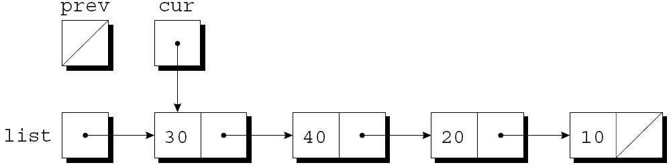
Deleting a Node from a Linked List
Assume that list has the following appearance and n is 20:
After cur = list, prev = NULL has been executed:

Slide 102
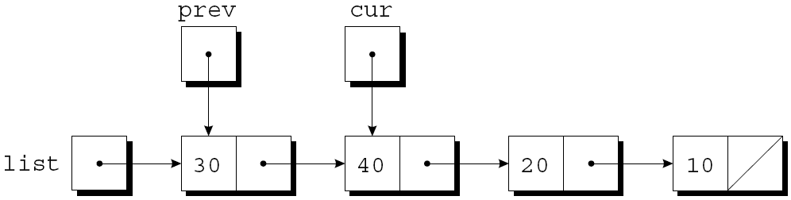
Deleting a Node from a Linked List
The test cur != NULL && cur->value != n is true, since cur is pointing to a node and the node doesn’t contain 20.
After prev = cur, cur = cur->next has been executed:

Slide 103
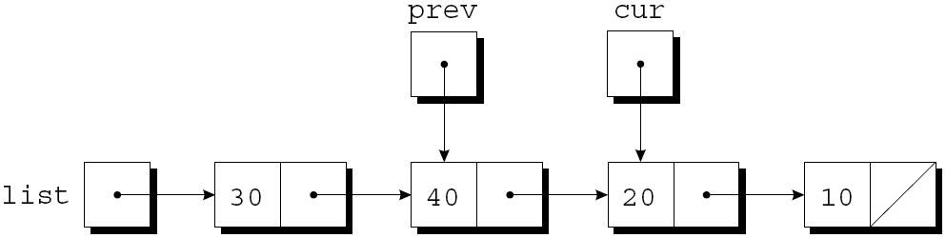
Deleting a Node from a Linked List
The test cur != NULL && cur->value != n is again true, so prev = cur, cur = cur->next is executed once more:
Since cur now points to the node containing 20, the condition cur->value != n is false and the loop terminates.

Slide 104
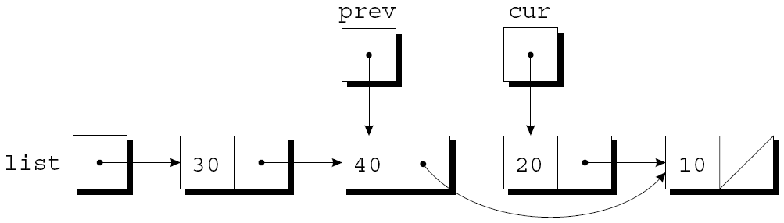
Deleting a Node from a Linked List
Next, we’ll perform the bypass required by step 2.
The statement
prev->next = cur->next;
makes the pointer in the previous node point to the node after the current node:

Slide 105
Deleting a Node from a Linked List
Step 3 is to release the memory occupied by the current node:
free(cur);

Slide 106
Deleting a Node from a Linked List
The delete_from_list function uses the strategy just outlined.
When given a list and an integer n, the function deletes the first node containing n.
If no node contains n, delete_from_list does nothing.
In either case, the function returns a pointer to the list.
Deleting the first node in the list is a special case that requires a different bypass step.

Slide 107
Deleting a Node from a Linked List
struct node *delete_from_list(struct node *list, int n)
{
struct node *cur, *prev;
for (cur = list, prev = NULL;
cur != NULL && cur->value != n;
prev = cur, cur = cur->next)
;
if (cur == NULL)
return list; /* n was not found */
if (prev == NULL)
list = list->next; /* n is in the first node */
else
prev->next = cur->next; /* n is in some other node */
free(cur);
return list;
}

Slide 108
Free the memory of the entire list
void *free_list(struct node *list)
{
struct node *next;
while (list != NULL){
next = list->next;
free(list);
list = next;
}
}

