Slide 1
Separate compilation
Modular design
makefile

Slide 2
Multi-file Programs

Slide 3
Motivation
Single-file programs do not work well when code gets large
compilation can be slow
hard to collaborate between multiple programmers
more cumbersome to edit
So, larger programs are split into multiple files
each file represents a partial program or module
modules can be compiled separately or together
a module can be shared between multiple programs

Slide 4
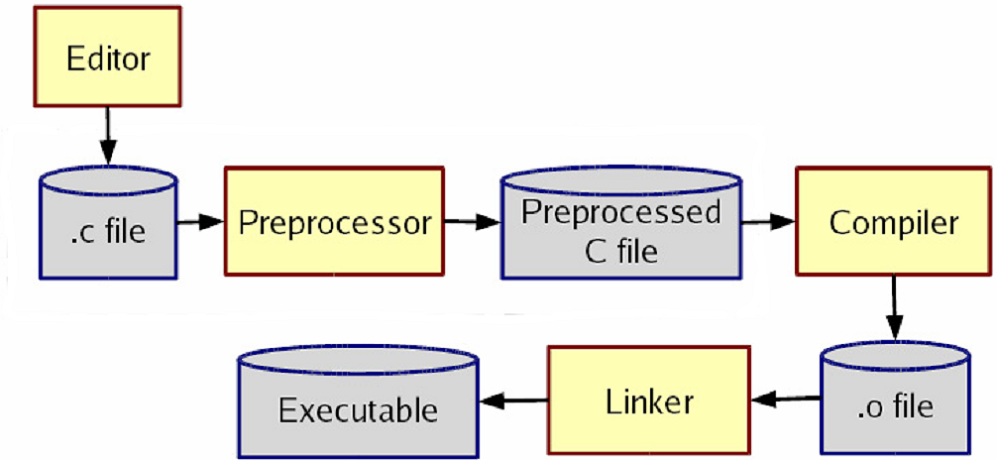
The compilation process
Each step's output can be dumped to a file, depending on arguments passed to clang

Slide 5
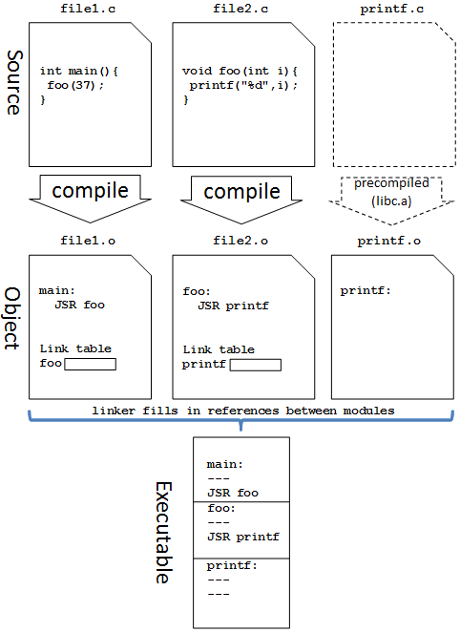

Slide 6
Partial programs
A .c file can contain a partial program:
#include <stdio.h>
void f1() { // part1.c
printf("this is f1\n");
}
Such a file cannot be compiled into an executable by itself:
$ clang part1.c
clang: error: linker command failed with exit code 1

Slide 7
But part2.c wants to use part1.c‘s code?
#include <stdio.h>
void f2(); // part2.c
int main() {
f1(); // not defined!
f2();
}
void f2() {
printf("this is f2\n");
}
The program will not compile
$ clang -o combined part2.c
In function `main':
part2.c:6: undefined reference to `f1'

Slide 8
Including .c files (bad)
One solution: #include part1.c in part2.c
#include <stdio.h>
#include "part1.c" // note "" not <>
void f2();
int main() {
f1(); // defined in part1.c
f2();
}
void f2() {
printf("this is f2\n");
}
The program will compile successfully:
$ clang –Wall -o combined part2.c

Slide 9
Multi-file compilation
#include <stdio.h>
void f2(); // part2.c
int main() {
f1(); // not defined?
f2();
}
void f2() {
printf("this is f2\n");
}
clang accepts multiple source files to combine
$ clang –Wall -o combined part1.c part2.c
$ ./combined
this is f1
this is f2

Slide 10
Object (.o) files
A partial program can be compiled into an object (.o) file with -c
$ clang -Wall -c part1.c
$ ls
part1.c part1.o part2.c
A .o file is a binary blob of compiled C code that cannot be directly executed, but can be directly inserted into a larger executable later
You can compile a mixture of .c and .o files
$ clang -Wall -o combined part1.o part2.o
Avoids recompilation of unchanged partial program files

Slide 11
Problem
With the previous code, we can't safely create part2.o
$ clang -Wall -c part2.c
warning: implicit declaration of function `f1‘
The compiler is complaining because f1 does not exist.
But it will exist once part1.c/o is added in later
We'd like a way to be able to declare to the compiler that certain things will be defined later in the compilation process...

Slide 12
Header files
Header : A file whose only purpose is to be included
By convention a filename with the .h extension
Holds shared variables, types, and function declarations
Key ideas:
every name.c intended to be a module has a name.h
name.h declares all global functions/data of the module
other .c files that want to use the module will #include name.h
Some conventions:
.c files never contain global function prototypes
.h files never contain definitions (only declarations)
never #include a .c file (only .h files)
any file with a .h file should be able to be built into a .o file

Slide 13
Multiple inclusion
If multiple modules include the same header, the variables/functions in it will be declared twice
Solution : use preprocessor to introduce conditional compilation
convention: #ifndef/#define with a variable named like the .h file
first time file is included, the variable won't be defined
on inclusions by other modules, will be defined and thus not included again
#ifndef _FOO_H
#define _FOO_H
... // contents of foo.h
#endif

Slide 14
Global visibility
// example.c
int passcode = 12345;
// example2.c
int main(void) { printf("Password is %d\n", passcode);
return 0;
}
By default, global variables and functions defined in one module can be seen and used by other modules it is compiled with
problem : clang compiles each file individually before linking them
if example2.c is compiled separately into a .o file, its reference to passcode will fail as being undeclared

Slide 15
extern
// example2.c
extern int passcode;
...
printf("Password is %d\n", passcode);
extern used on variables and functions
does not actually define a variable/function or allocate space for it – but promises the compiler that some other module will define it
allows your module to compile even with an undeclared variable/function reference, so long as eventually its .o object is linked to some other module that declares that variable/function
if example.c and example2.c are linked together, the above will work
In general, you are strongly discouraged to share variables between files in this way

Slide 16
static
// example.c
int passcode = 12345; // public
static int admin_passcode = 67890; // private
static used on global variables and functions
visible only to the current file/module (sort of like Java's private)
declare things static if you do not want them exposed
avoids potential conflicts with multiple modules that happen to declare global variables with the same names
admin_passcode will be visible through the rest of example.c, but not to any other modules/files compiled with example.c

Slide 17
Function static data
When used inside a function
static type name = value;
… declares a static local variable that will be remembered across calls
int nextSquare() {
static int n = 0;
static int increment = 1;
n += increment;
increment += 2;
return n;
}
nextSquare() returns 1, then 4, then 9, then 16, ...

