Slide 1
COMP 2160 Programming Practices Section A01
Stela H. Seo
Department of Computer Science
University of Manitoba
The class notes are a compilation and edition from many sources. The instructor does not claim intellectual property or ownership of the lecture notes. Please do not distribute the lecture notes.

Slide 2
Student Accessibility Services
Volunteer Note-takers Needed!
If you would like to volunteer, and receive a reference letter for your time, please login to JUMP and click on the Student Accessibility Services link.
Volunteering is now easier than ever, you can upload notes directly to JUMP in the Student Accessibility Services scheduler. Thank you!

Slide 4
Announcement
Your Unix account should be working now
Lab starts this week. Lab1 is available in UMLearn
If you cannot finish lab1 within the scheduled lab, you can do it at the BEGINNING of lab2
Due to limited seating, please attend the lab section that you are registered in

Slide 5
Unix Account
When you login on Mac lab for the 1st time, it might take a while (e.g. 1-2 minutes) for the system for set up. Please be patient. Subsequent logins should be faster.
See the “announcements” posted in UMLearn on how to change your password.

Slide 6
Disk Quota Issue
Some students have been having issues when working on the Mac computers (rodents) caused by exceeding their file quota limit.
The problem is apparently caused by Adobe updater writing a bunch of files to your cache.
Here is a fix to get your quota back under the limit:
Open a Terminal window
Use the command quota -v to display your current quota limit and how much you have exceeded it.
Use the command rm -Rf ~/Library/Caches/* to delete the cached files.
Repeat the command in step 2. You should now be under your quota limit.

Slide 7
UNIX and C
UNIX != C
C is a general purpose programming language
UNIX is an operating system
Notes:
in this course, we practice programming in C. C is permissive, that means you need to be more aware of your mistake, and how to detect and fix them.

Slide 8
Editor options
MAC: Xcode, vim, emacs, nano, pico, …
LINUX: sublime, vim, emacs, nano, pico, …
Windows:
Visual Studio
Sublime
SSH to use an editor on MAC or LINUX
…
Compile in Terminal using ‘clang’

Slide 9
SSH options for Windows
PuTTY (http://www.putty.org/)
WinScp (https://winscp.net/eng/download.php)
Cygwin (https://www.cygwin.com/)
Bash on Ubuntu on Windows (https://msdn.microsoft.com/en-us/commandline/wsl/about)
Virtual Machine
Dual boot (multi boot)

Slide 10
Compile and run on one of the lab machines!
We use clang in this course
clang -Wall SOURCE_CODE.c -o EXECUTABLE
gcc vs. clang
Marker will use clang

Slide 11
Introduction to C
Notes:
announce possible scam in class rooms. (Summer Opportunities 2018)

Slide 12
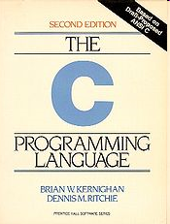
History of C
Created in 1972 by Dennis Ritchie of Bell Labs
Indirectly proceeded through the language B (created by Ken Thompson)
General-purpose programming language
Closely associated with the UNIX system
Notes:
“Many of the important ideas of C stem from the language BCPL”

Slide 13
History of C
System programming language
(programs close to the OS that talk directly to hardware)
One of the most widely used programming languages worldwide
Has influenced the designs of many languages
C++, Java, C#, Perl, Objective-C, Pascal, ...

Slide 14
Standardization of C
K&R C
Described in Kernighan and Ritchie, The C Programming Language (1978)
ANSI C (C89/C90)
most portable...
-ansi, -std=c89
C99
extends ANSI C, new data types, variable length arrays
Notes:
K&R C: the bible of C programmers (Kernighan and Ritchie - Brian Kernighan and Dennis Ritchie)
ANSI C: programmers writing compilers for C treat some features differently. C continue to evolve, standard is needed (American National Standards Institution)

Slide 15
C-Based Languages
C++ includes all the features of C, but adds classes and other features to support object-oriented programming.
Java is based on C++ and therefore inherits many C features.
C# is a more recent language derived from C++ and Java.
Perl has adopted many of the features of C.

Slide 16
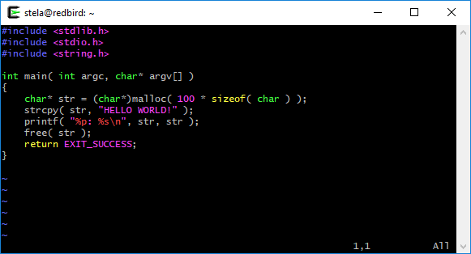
Properties of C
Low-level
Notes:
C provides machine-level concepts (byte, address) that other languages try to hide. C provide build-in operations that correspond closely to a computer’s built-in instructions. Good for system programming

Slide 17
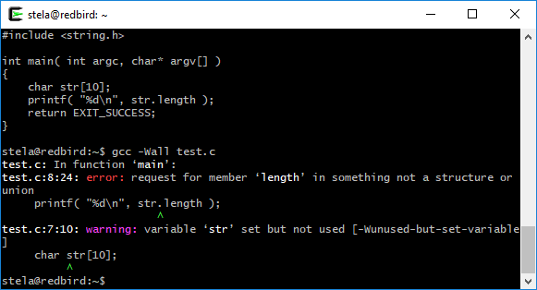
Properties of C
Low-level
Small
Notes:
a limited set of features compared with other languages. C rely on a “library” of standard functions

Slide 18
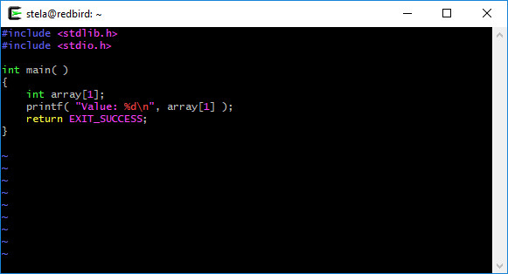
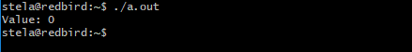
Properties of C
Low-level
Small
Permissive
Notes:
you know what you are doing, allow a wider degree of latitude than other languages. C does not mandate the detailed error-checking in other languages.

Slide 19
Strengths of C
Efficiency
Portability
Power
Flexibility
Standard library
Notes:
efficiency: one of C’s advantages from the beginning. C runs quickly in limited amount of memory. (system programming, embedded systems)
portable: portability is not the primary goal of C, but it turns out to be one of its advantage. there is C compiler for any platform (PC, supercomputer, embedding systems). Code is portable as long as you do not have platform-specific features
Power: can do a lot of thing that hard to do in other languages
flexible: used for all kinds of applications, from embedded systems to commercial data processing. C imposes very few restrictions on the use of its features; operations that would be illegal in other languages are often permitted in C.
library: rich libraries for input/output, string handling, and other useful operations

Slide 20
Weaknesses of C
Programs can be error-prone.
Programs can be difficult to understand.
Programs can be difficult to modify.
Notes:
error-prone: because C is flexible. Mistakes caught by other languages often cannot by C compiler.
hard to modify: other language might provide class, package, object-orientation. C does not have those.

Slide 21
Effective Use of C
Learn how to avoid pitfalls.
Use software tools (lint, debuggers) to make programs more reliable.
Take advantage of existing code libraries.
Adopt a sensible set of coding conventions.
Avoid “tricks” and overly complex code.
Stick to the standard.

Slide 22
C vs Java

Slide 23
Very much the same as Java
General syntax for statements, control structures, function calls
Types int, double, char, long
type-casting syntax
Expressions, operators, precedence
+ - * / % ++ --
= += -= *= /= %=
< <= == != > >= && || !
Scope (within set of { } braces)
Comments: /* ... */, // ( // not officially legal until C99)

Slide 24
Mostly the same as Java
Variables
can be used without being initialized (!)
if/else statements, while and do/while loops
there is no boolean type (nor bool)
any type of value can be used as a test
0 means false, every other number means true
Parameters / returns
C has certain features for values vs. references ("pointers")

Slide 25
Very different from Java
Strings
very clunky to use in C; arrays of characters
are not objects; do not contain methods (external string functions)
I/O to/from console and files
no Scanner; must use input functions such as scanf
Errors and exceptions
C has no try/catch and does not represent errors as objects
errors are usually returned as integer error codes from functions
crashes are mostly called "segmentation faults" and are not of much direct utility in figuring out what is wrong

Slide 26
Also very different
Arrays
are just bare contiguous blocks of memory
have no methods and do not know their own length (!)
Objects
C doesn't have them
closest similar feature: struct (a set of fields; no methods)
Memory management
most memory that you consume, you must explicitly free afterward

Slide 27
The C Development Cycle
Edit
Program
Source
Code
Compile
Object
Code
Library
Files
Executable
Link Object
Code

Slide 28
First C program – hello.c
#include <stdio.h>
int main() {
printf("Hello, world!\n");
return 0;
}

Slide 29
Dissecting Hello World
like import in Java; links the program to the standard I/O library (includes printf function)
#include <stdio.h>
int main() {
printf("Hello, world!\n");
return 0;
}
the main function header; you don't need to say public static because these are the default in C main returns an int error code to the OS (0 on success, > 0 on failure)
like println in Java (actually more like System.out.printf); prints output to console
Notes:
show some demo, explain line by line as I type

Slide 30
Second C program
/* Computes greatest common divisor (GCD) with Euclid's algorithm. */
#include <stdio.h>
int main() {
int a, b, temp, r;
printf("Please enter two positive integers: ");
scanf("%d %d", &a, &b);
if (b > a) {
temp = a;
a = b;
b = temp;
}
while ((r = a % b) != 0) {
a = b;
b = r;
}
printf("The GCD is %d.\n", b);
return 0;
}

Slide 31
Compilation
Compilation translates your source code (in the file hello.c) into object code (machine dependent instructions for the particular machine you are on).
Note the difference with Java:
The javac compiler creates Java byte code from your Java program.
The byte code is then executed by a Java virtual machine, so it’s machine independent.
Linking the object code will generate an executable file.
There are many compilers for C under Unix
gcc, clang
we will use clang in this course

Slide 32
Compilation
To compile a program:
Compile the program to object code.
clang -c hello.c
Link the object code to executable file.
clang hello.o -o hello
You can do the two steps together by running:
clang -Wall hello.c -o hello
To run your program:
./hello
Hello World!
If you leave off the
-o, executable goes into
the file a.out

Slide 33
Compiling and running
To compile the source code and generate the executable:
clang -Wall hello.c -o hello
To run your program:
./hello
Hello World!
If you leave off the
-o, executable goes into
the file a.out

Slide 34
Compilation error
Error messages are a little different than you may be used to but they can be quite descriptive.
Always try to fix problems starting with the first error the compiler gives you - the others may disappear too!

