Slide 1
C Basics

Slide 2
printf
function | description
printf | prints formatted output to stdout
printf("format string", parameters);
A format string contains placeholders to insert parameters into it:
%d an integer
%f a float
%s a string
%p a pointer (seen later)
int x = 3; int y = 2;
printf("(%d, %d)\n", x, y); // (3, 2)

Slide 3
Primitive data types
The size of data types is hardware dependent. Typical sizes are:
integer types: char (1B), short (2B), int (4B), long (8B)
real numbers: float (4B), double (8B)
modifiers: short, long, signed, unsigned (non-negative)
type | bytes | range of values | printf
char | 1 | 0 to 255 | %c
short int | 2 | -32,768 to 32,767 | %hi
unsigned short int | 2 | 0 to 65,535 | %hu
int | 4 | -2,147,483,648 to 2,147,483,647 | %d, %i
unsigned int | 4 | 0 to 4,294,967,295 | %u
long long int | 8 | -9e18 to 9e18 - 1 | %lli
float | 4 | approx. 10⁻⁴⁵ to 10³⁸ | %f
double | 8 | approx. 10⁻³²⁴ to 10³⁰⁸ | %lf
long double | 12 | A lot! | %Lf

Slide 4
sizeof()
The sizeof() function returns the number of bytes in a data type
Example
// sizeof() returns “unsigned long”
double i;
printf(“size of int=%d\n”, (int)sizeof(int));
printf(“size of i=%d\n”, (int)sizeof(i));

Slide 5
Basic Types: char
Characters (char)
’a’ ’z’ ’A’ ’Z’ ’?’ ’@’ ’0’ ’9’
- Special Characters: preceded by \
’\n’ ’\t’ ’\0’ ’\’’ ’\\’ etc.
Notes:
\n = end of line
\t = tab
\0 = end of string
\’ gives single quote
\\ gives backslash

Slide 6
Character Representation
Characters are stored as a small integer
Each character has a unique integer equivalent specified by its position in the ASCII table (pronounced “as-key”)
American Standard Code for Information Interchange

Slide 7
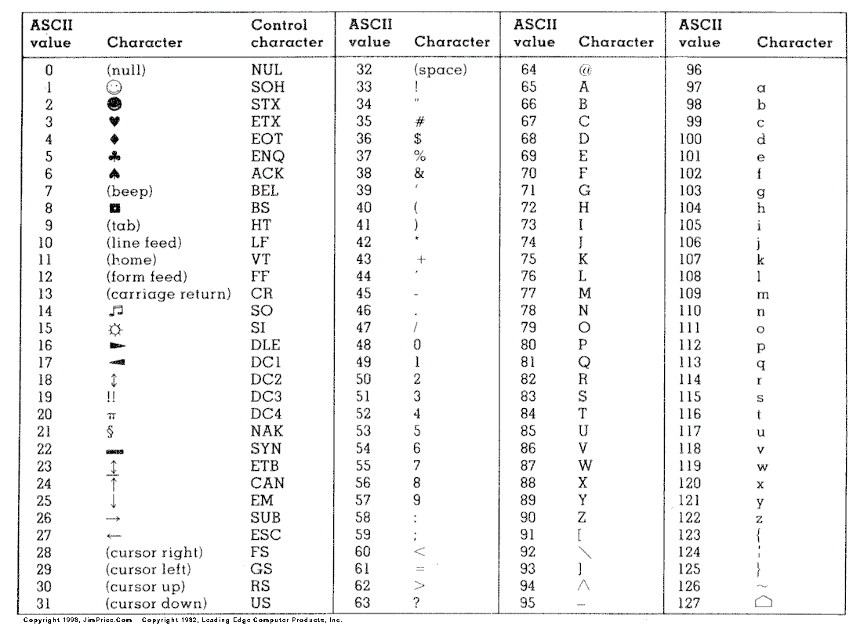

Slide 8
Basic Types: character string
No build-in String type in C
Character Strings (a string of char-s)
Examples:
”Hi there!”
”Line 1\nLine 2\nLine 3”
””
”\”\””

Slide 9
Variable Declaration
Examples
char a;
double i, j;
int x, y = 10; //only y is initialized
If a variable is not initialized, its value is undefined

Slide 10
Type int as Boolean
In C, integers are used as Booleans
Integer value 0 is false.
Any non-zero integer value is true.

Slide 11
Type int as Boolean
Any expression with an integer result can be used in comparison for decision and looping statements
int index = 10;
while (index){
index--;
}

Slide 12
Type int as Boolean
answer = swap(first, second);
while (answer > 0){
……
answer = swap(first, second);
}
First, the swap function is called, and its result is assigned to the variable answer
The value of answer is compared to zero. If it is greater, the loop body is executed.

Slide 13
Common Mistake
Using = (assignment) instead of ==(comparison)

Slide 14
Example:
#include <stdio.h>
/* Probably the most common C error. */
int main()
{
int score = 10;
if (score = 48 || score = 49)
{
printf("Almost!\n");
}
return 0;
}

Slide 15
Example:
#include <stdio.h>
/* Probably the most common C error. */
int main()
{
int score = 10;
if (score == 48 || score == 49)
{
printf("Almost!\n");
}
return 0;
}

Slide 16
One way of avoiding this mistake
Reverse the order of operands in the comparison
If an assignment operator is used by mistake, the compiler will catch the error
int code = 10;
if (1 == code)

Slide 17
The if statement
Determines whether a statement or block is executed.
If the expression is true (non-zero), the statement or block is executed.
if ( expression )
statement

Slide 18
What is a statement?
Statements are lines of instructions in our programs ending with a semicolon (;).
A compound statement or block is a series of statements surrounded by braces.
{
number = number + 1;
printf("%d\n", number);
}

Slide 19
Notes on if
Which of the following code fragments are equivalent?
A
if (number % 2 != 0)
{
printf("%d", number);
}
printf(” is odd\n");
B
if (number % 2 != 0)
printf("%d", number);
printf(” is odd\n");
C
if (number % 2 != 0)
{
printf("%d", number);
printf(” is odd\n");
}

Slide 20
Notes on if
Which of the following code fragments are equivalent?
A
if (number % 2 != 0)
{
printf("%d", number);
}
printf(” is odd\n");
B
if (number % 2 != 0)
printf("%d", number);
printf(” is odd\n");
C
if (number % 2 != 0)
{
printf("%d", number);
printf(” is odd\n");
}

Slide 21
Notes on if
Which of the following code fragments are equivalent?
A
if (number % 2 != 0)
{
printf("%d", number);
}
printf(” is odd\n");
A Compound Statement
B
if (number % 2 != 0)
printf("%d", number);
printf(” is odd\n");
A Statement
C
if (number % 2 != 0)
{
printf("%d", number);
printf(” is odd\n");
}

Slide 22
Notes on if
Common mistake
if (number % 2 != 0);
{
printf("%d is an odd ", number);
}
printf("number\n");

Slide 23
Notes on if
Common mistake
if (number % 2 != 0);
{
printf("%d is an odd ", number);
}
printf("number\n");
No semi-colon here!
The semicolon is an empty statement.

Slide 24
Notes on if
Common mistake
if (number = 0)
{
printf("%d\n", number);
}
printf("%d\n", number);

Slide 25
“Dangling else”
if (expr1)
if (expr2)
statement1;
else
statement2;
The compiler will match “else” with the 2nd “if”
Use braces to eliminate ambiguity like this

Slide 26
Common Mistakes in while – “one liners”
while (num < minimum)
scanf(“%d”, &num);
printf(“Number must be greater than %d.\n”, minimum);
printf(“Please try again.\n”);
while (num < minimum)
{
scanf(“%d”, &num);
}
printf(“Number must be greater than %d.\n”, minimum);
printf(“Please try again.\n”);

Slide 27
Common Mistakes in while -- “one liners” (cont)
while (num < minimum)
scanf(“%d”, &num);
printf(“Number must be greater than %d.\n”, minimum);
printf(“Please try again.\n”);
while (num < minimum)
{
scanf(“%d”, &num);
printf(“Number must be greater than %d.\n”, minimum);
printf(“Please try again.\n”);
}

Slide 28
Common Mistakes in while -- extra semi-colon;
while (num < minimum);
{
scanf(“%d”, &num);
printf(“Number must be greater than %d.\n”, minimum);
printf(“Please try again.\n”);
}
Marks the end of the while-block -- usual cause of infinite loops

Slide 29
The for Statement
Syntax:
for ( initialization; condition; update )
{
instruction block
}
Careful! A semi-colon here marks the end of the instruction block!

