Slide 1
Malignant Comments Classification Project
Submitted by: Alan Tresa Ananyase

Slide 2
Abstract
Now-a-days, derogatory comments are often made by one another, not only in offline environment but also immensely in online environments like social networking websites and online communities. So, an Identification combined with Prevention System in all social networking websites and applications, including all the communities, existing in the digital world is a necessity. In such a system, the Identification Block should identify any negative online behavior and should signal the Prevention Block to take action accordingly. This study aims to analyze any piece of text and detecting different types of malignant like rude, threats, insults and hatred.

Slide 3
Introduction
Over a decade, social media have been growing, and people are able to express their opinions and also discuss among others via these platforms. These debates may arise due to differences in opinion and may often result in fights over the social media during which offensive language termed as malignant comments may be used from one side. This clearly pose the threat of abuse and harassment online. As such, some people stop giving their opinions or give up seeking different opinions which result in unhealthy and biased discussion. As a result, different platforms and communities find it very difficult to facilitate fair conversation and are often forced to either limit user comments or get dissolved by shutting down user comments completely.

Slide 4
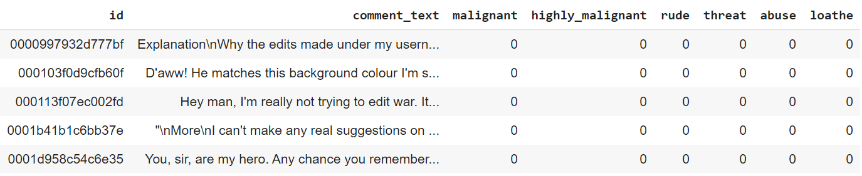
Dataset
Id: A unique id aligned with each comment text.
comment_text: It includes the comment text.
Malignant: It is a column with binary values depicting which comments are malignant in nature.
highly_malignant: Binary column with labels for highly malignant text.
Rude: Binary column with labels for comments that are rude in nature.
Threat: Binary column with labels for threatening context in the comments.
Abuse: Binary column with labels with abusive behaviour.
Loathe: Label to comments that are full of loathe and hatred.

Slide 5
Data Pre-processing
Convert text to lower case and replaced email addresses with ‘email’
Replaced URLs with 'webaddress'
Replaced money symbols with 'dollars'
Replaced 10 digit phone numbers (formats include paranthesis, spaces, no spaces, dashes) with 'phonenumber'
Replaced numbers with 'numbr'
Removed punctuation
Replaced whitespace between terms with a single space
Removed leading and trailing whitespace
Removed stopwords with nltk stopwords corpus. Additional stopwords removed are 'u', 'ü', 'â', 'ur', '4', '2', 'im', 'dont', 'doin' and 'ure'

Slide 6
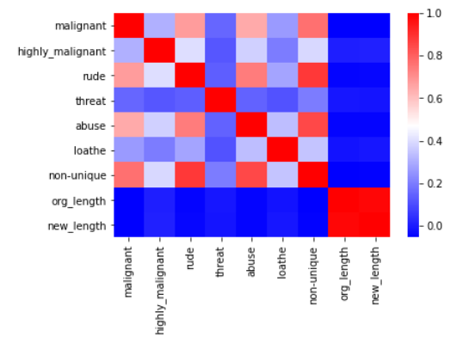
Correlation Heatmap

Slide 7
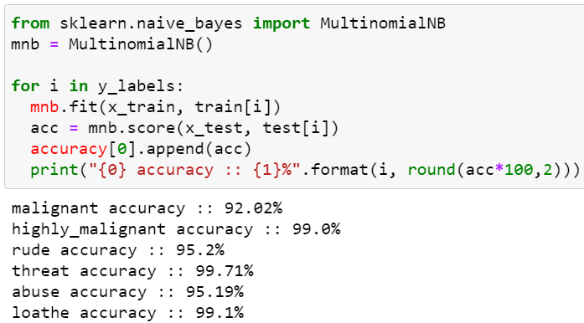
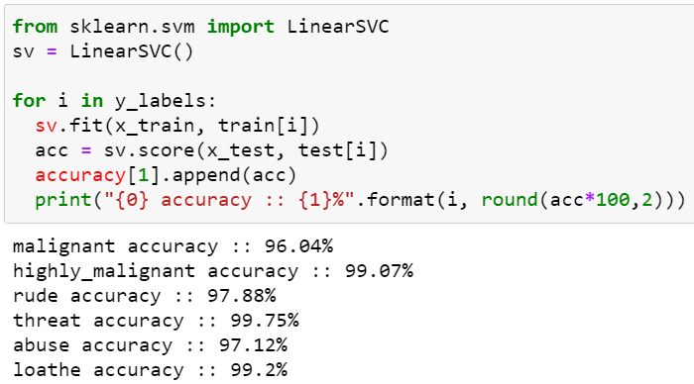
Machine Learning Models
Multinomial Naïve Bayes
Linear SVC
Logistic Regression
Decision Tree Classifier
K-Neighbors Classifier

Slide 8
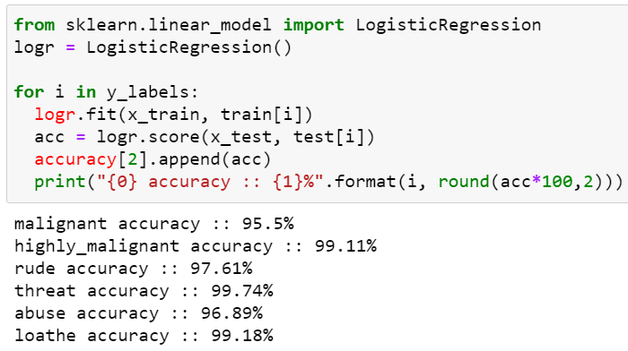
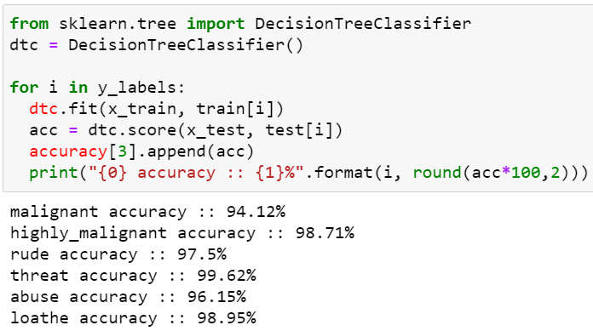
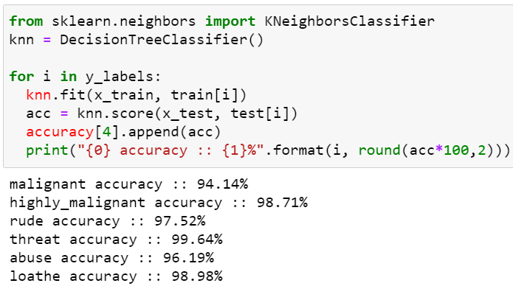
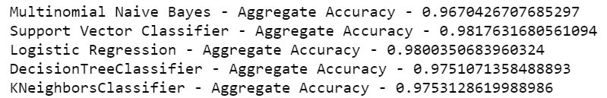
Machine Learning Models (cont.…)

Slide 9
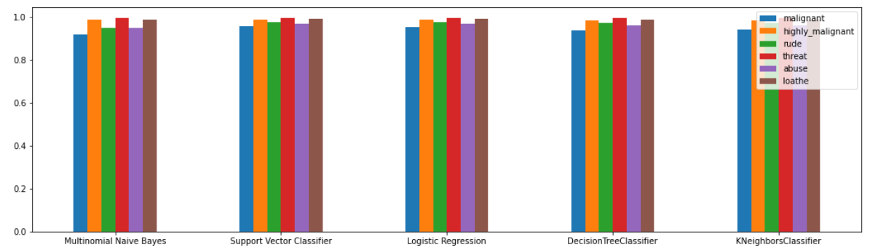
Machine Learning Models Accuracy

Slide 10
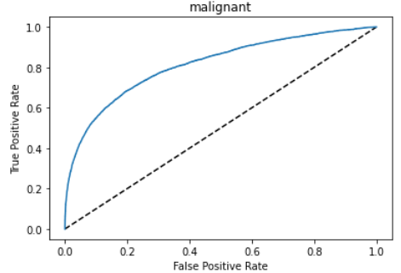
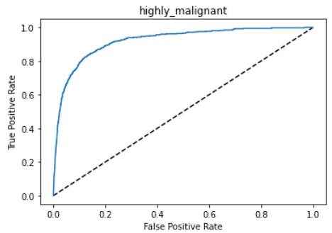
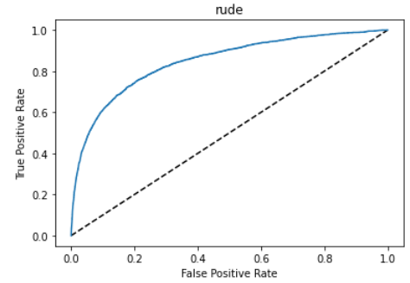
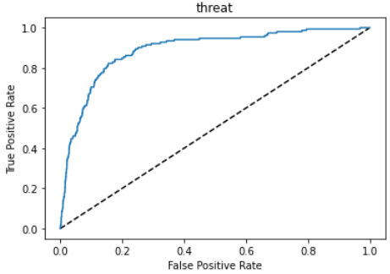
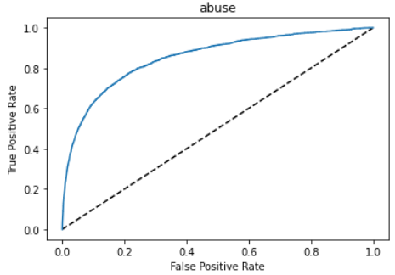
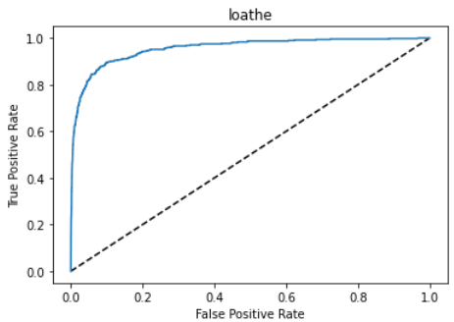
ROC Curve

Slide 11
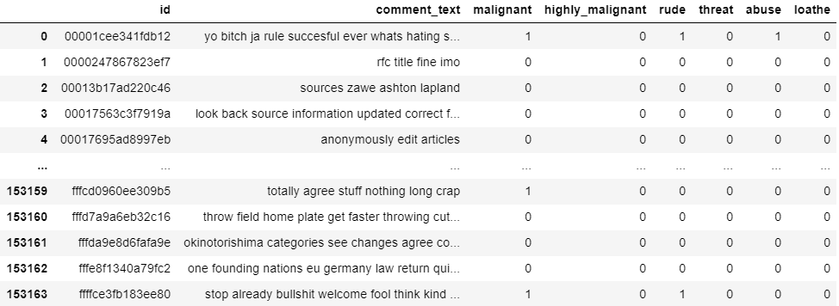
Final Submission

