Slide 1

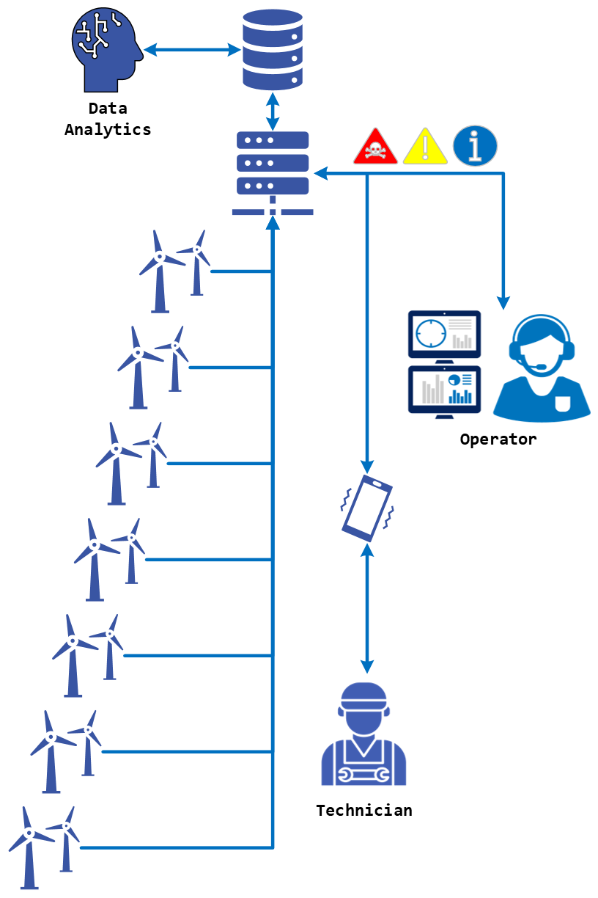



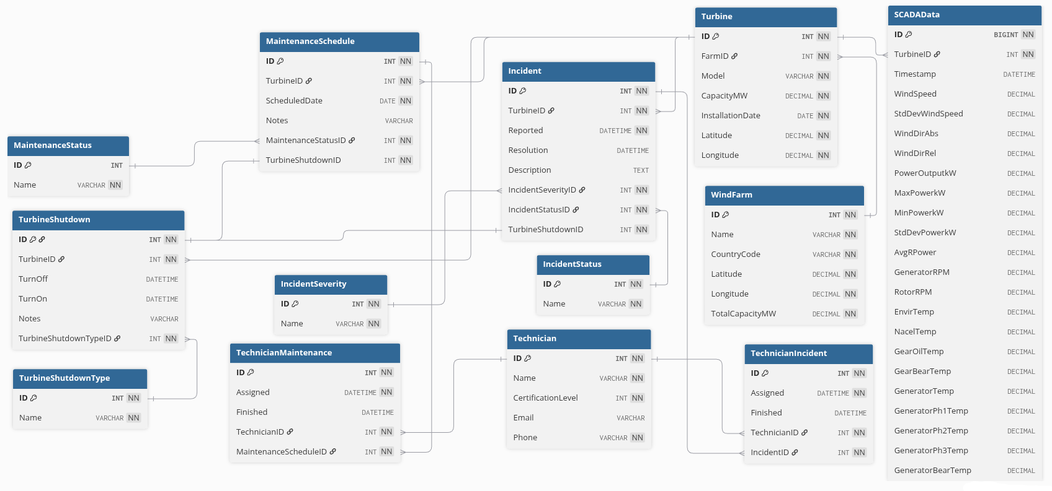

Wind Farm Management System
Department of
Electronic & Mechanical Engineering
Alan Cueva Mora
Supervisor: Adam Dunworth
L00196600@atu.ie
L00196600
Description
System Workflow
Business Intelligence applications
The Wind Farm Management System uses a data model that store data collected from SCADA and manage operations of wind turbines. It shows information, warning and alerts necessary to schedule maintenance and report incidents.
Constraints
Unique technician and maintenance schedule to avoid assigning a technician to a maintenance twice.
Unique technician and incident to avoid assigning a technician to a incident twice.
Unique turbine and reported timestamp to avoid duplicate SCADA data.
Unique turbine latitude and longitude to avoid register the same turbine twice.
Unique values for integrity of the status and types:
Maintenance status
Incident status
Incident severity
Turbine shutdown type
The Wind Farm Management System support business intelligence application by providing the necessary data for reporting and data analytics.
Applications
Performance Monitoring: SCADA data can show energy / power generated by a certain turbine or the entirely wind farm.
Predictive Maintenance: historical SCADA data and data from Incidents and Maintenance Scheduled tables is used by machine learning algorithms to predict the best date for schedule a new maintenance.
Operational Optimisation: storing turbine shutdowns allows calculation of idle time and, with SCADA data, enables planning for optimal turbine operation.
Energy Price: with the support of other systems, use production power report to predict the most profitable time to operate.
SCADA
Entity Relationship Diagram
Faculty of Engineering & Computing
Department Electronic & Mechanical Engineering
ATU Donegal
atu.ie

