Slide 1
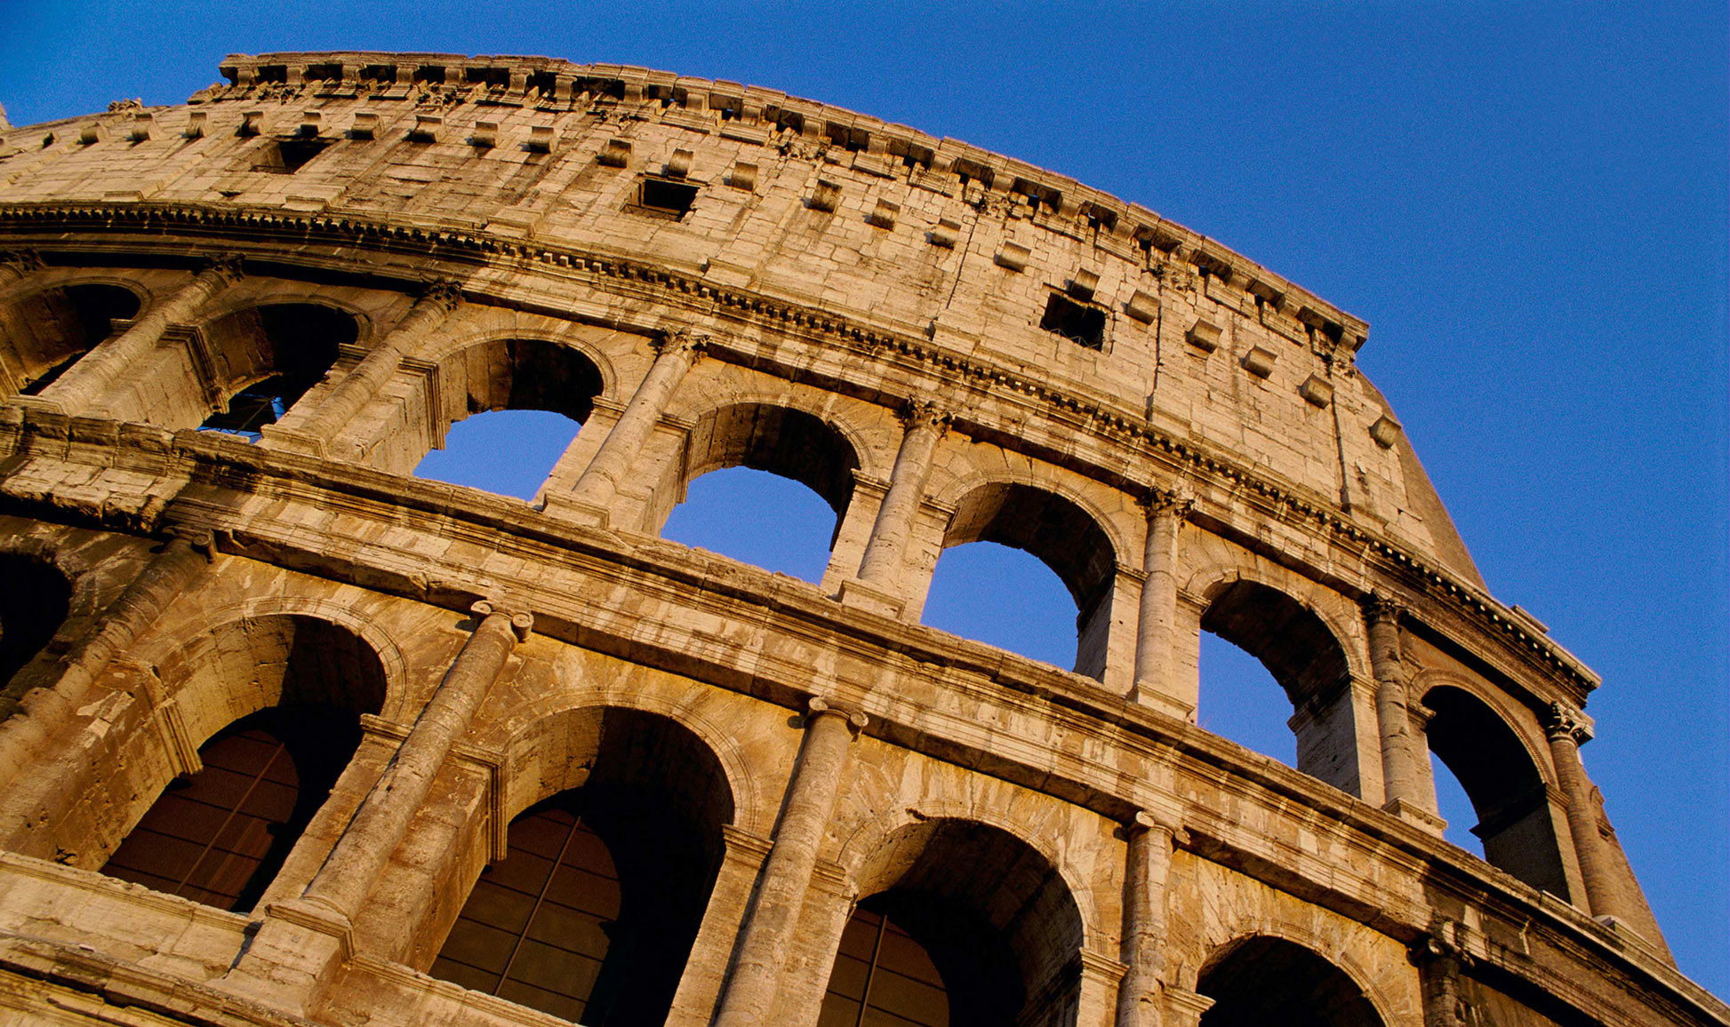
Algorithm Basics Series 1 - Loops
jackfrued

Slide 2
50m
Run a line between two rooms in buildings 50 m apart

Slide 3
Hundreds of students are sitting in a large classroom; how can you count them quickly?

Slide 4
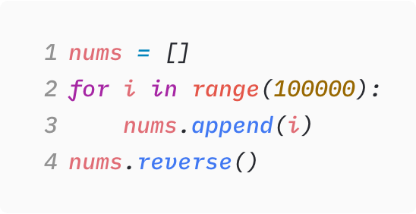
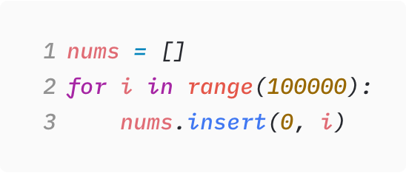
Into a list containerin reverseinsert 100,000 elements

Slide 5
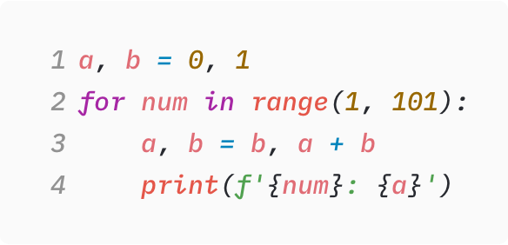
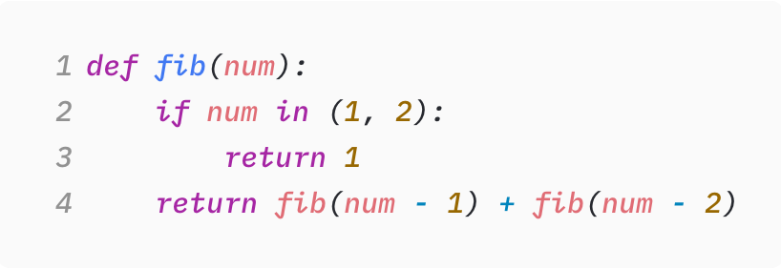
GenerateFibonaccisequence

Slide 6
Time Complexity
Space Complexity

Slide 7
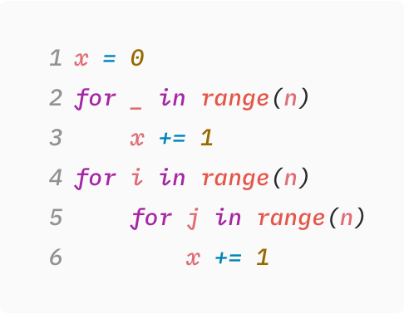
O(n²)

Slide 8
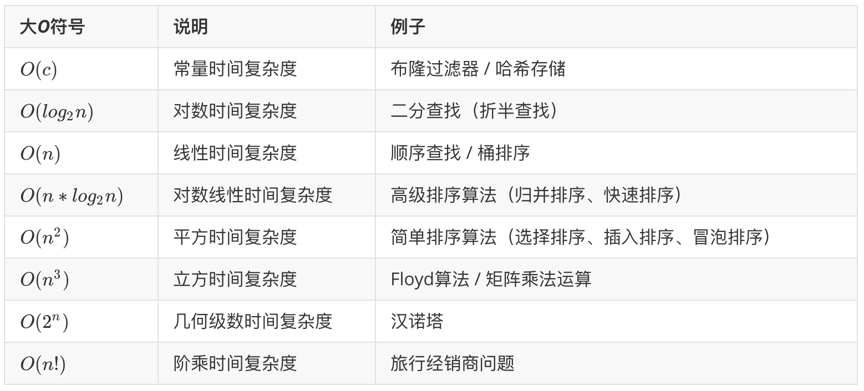

Slide 9

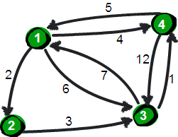

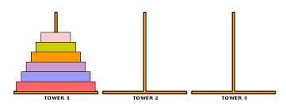

Slide 10
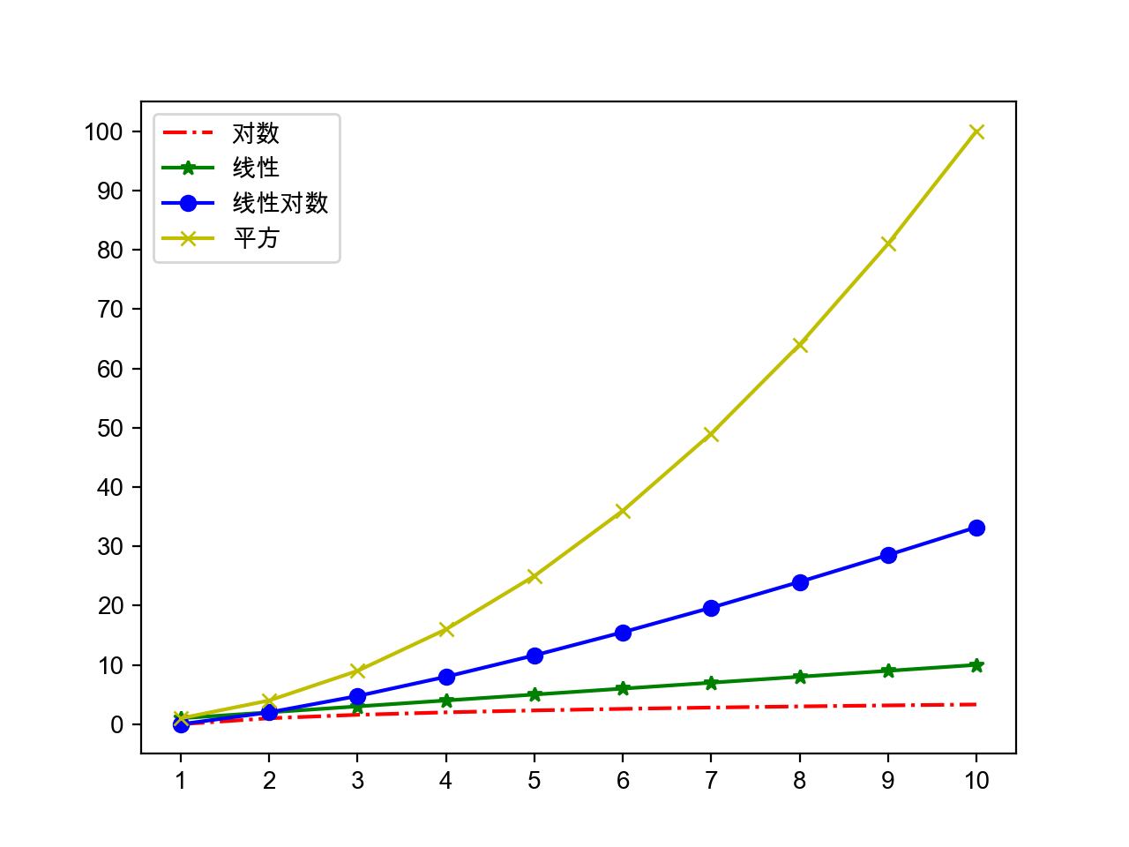

Slide 11
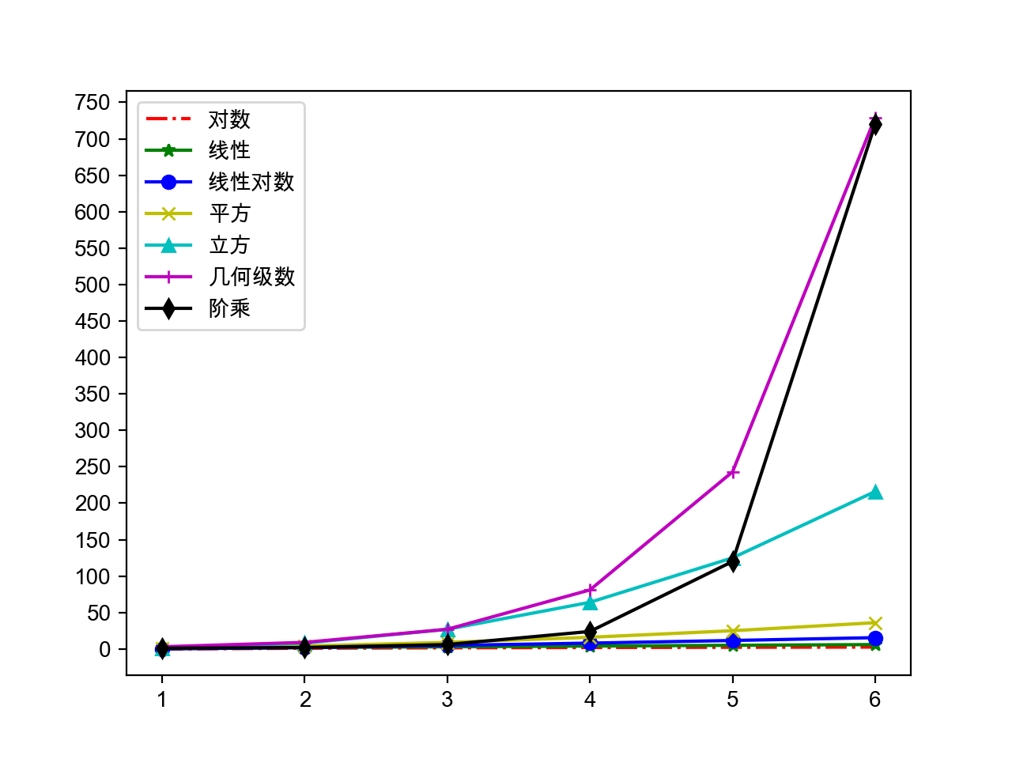

Slide 12
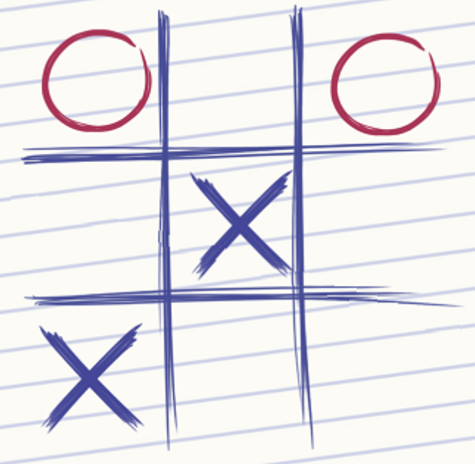
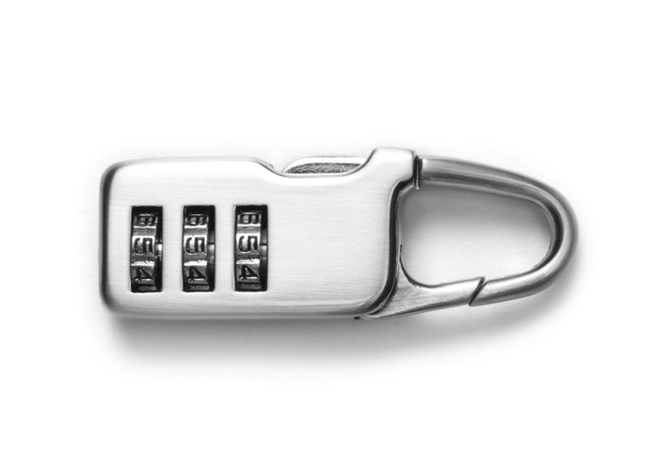
Brute Force
Try every possibility,
until the correct answer is found

