Slide 1
freeRTOS
http://elm-chan.org/fsw/ff/00index_e.html
Dr. Heinz Rongen
Forschungszentrum Jülich GmbH
Zentralinstitut Systeme der Elektronik (ZEA-2)
H.Rongen@fz-juelich.de

Slide 2
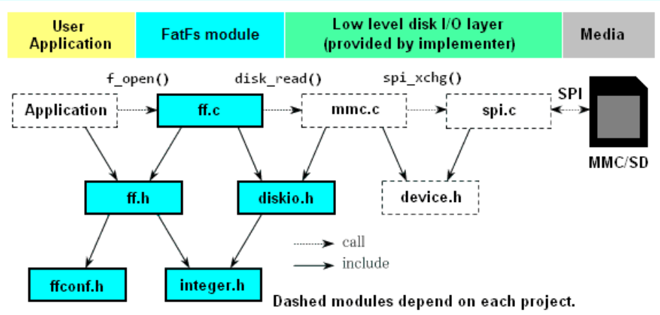
Porting of FatFF
General structure of SW layers:
Blue: FAT Filesystem library from elm-chan.org
Green: Hardware dependent modules
Xilinx ZYNQ modules for HW SDI interface:
Find examples:
C:\Xilinx\SDK\2014.2\data\embeddedsw\lib\sw_services\xilffs_v2_1

Slide 3
Xilinx ZYNQ Porting
in diskio.h
#define FILE_SYSTEM_INTERFACE_SD
In main.c
#include "xil_cache.h"
#include "sd_card/ff.h"
Xil_DCacheFlush();
Xil_DCacheDisable();
FfsSdPolledExample();
Xil_DCacheEnable();
static FIL fil;
static FATFS fatfs;
char hstr[32];
int FfsSdPolledExample(void)
{
FRESULT Res;
UINT NumBytesRead;
Res = f_mount(&fatfs, "", 1);
if (Res != FR_OK) { printf ("-- NO -- Mount \n"); return 0; }
Res = f_open (&fil, "xxx.txt", FA_READ);
if (Res != FR_OK) { printf ("-- NO -- Open \n"); return 0; }
Res = f_read (&fil, hstr, 8, &NumBytesRead);
printf ("Read = %d %d\n", Res,NumBytesRead);
printf (hstr); printf ("\n\n");
f_close (&fil);
return 1;
}

Slide 4
Xilinx File System Library:
C:\Xilinx\SDK\2014.2\data\embeddedsw\lib\sw_services\xilffs_v2_1
Right click the bsp project and choose settings. There you can choose additional librarys. The FatFs SDIO lib is xilffs.
In Vivado ZYNQ processing system; IO configuration:
For the speed of the sd 0 port one should choose "fast" and disable the pullups, otherwise strange things happend.
The data caches have to be disabled, otherwise it does not work propperly.

