Slide 1
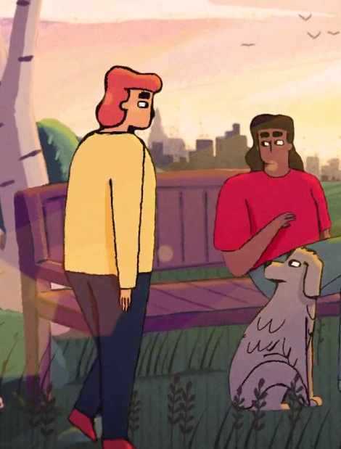
Moderating the citizen science platform (AutSPACE) Co-creating a code of conduct and a moderation process
Georgia Aitkenhead
Pronouns: she/her

Slide 2
Citizen Science Platform: Recap/Intro
We are building a citizen science platform with autistic people and their families to investigate the impact of sensory processing differences.
https://alan-turing-institute.github.io/AutisticaCitizenScience
https://github.com/alan-turing-institute/AutisticaCitizenScience

Slide 3
Citizen Science Platform: Recap/Intro
We are building a citizen science platform with autistic people and their families to investigate the impact of sensory processing differences.
The platform will let people share experiences with researchers and/or publish them on the platform.
https://alan-turing-institute.github.io/AutisticaCitizenScience
https://github.com/alan-turing-institute/AutisticaCitizenScience

Slide 4
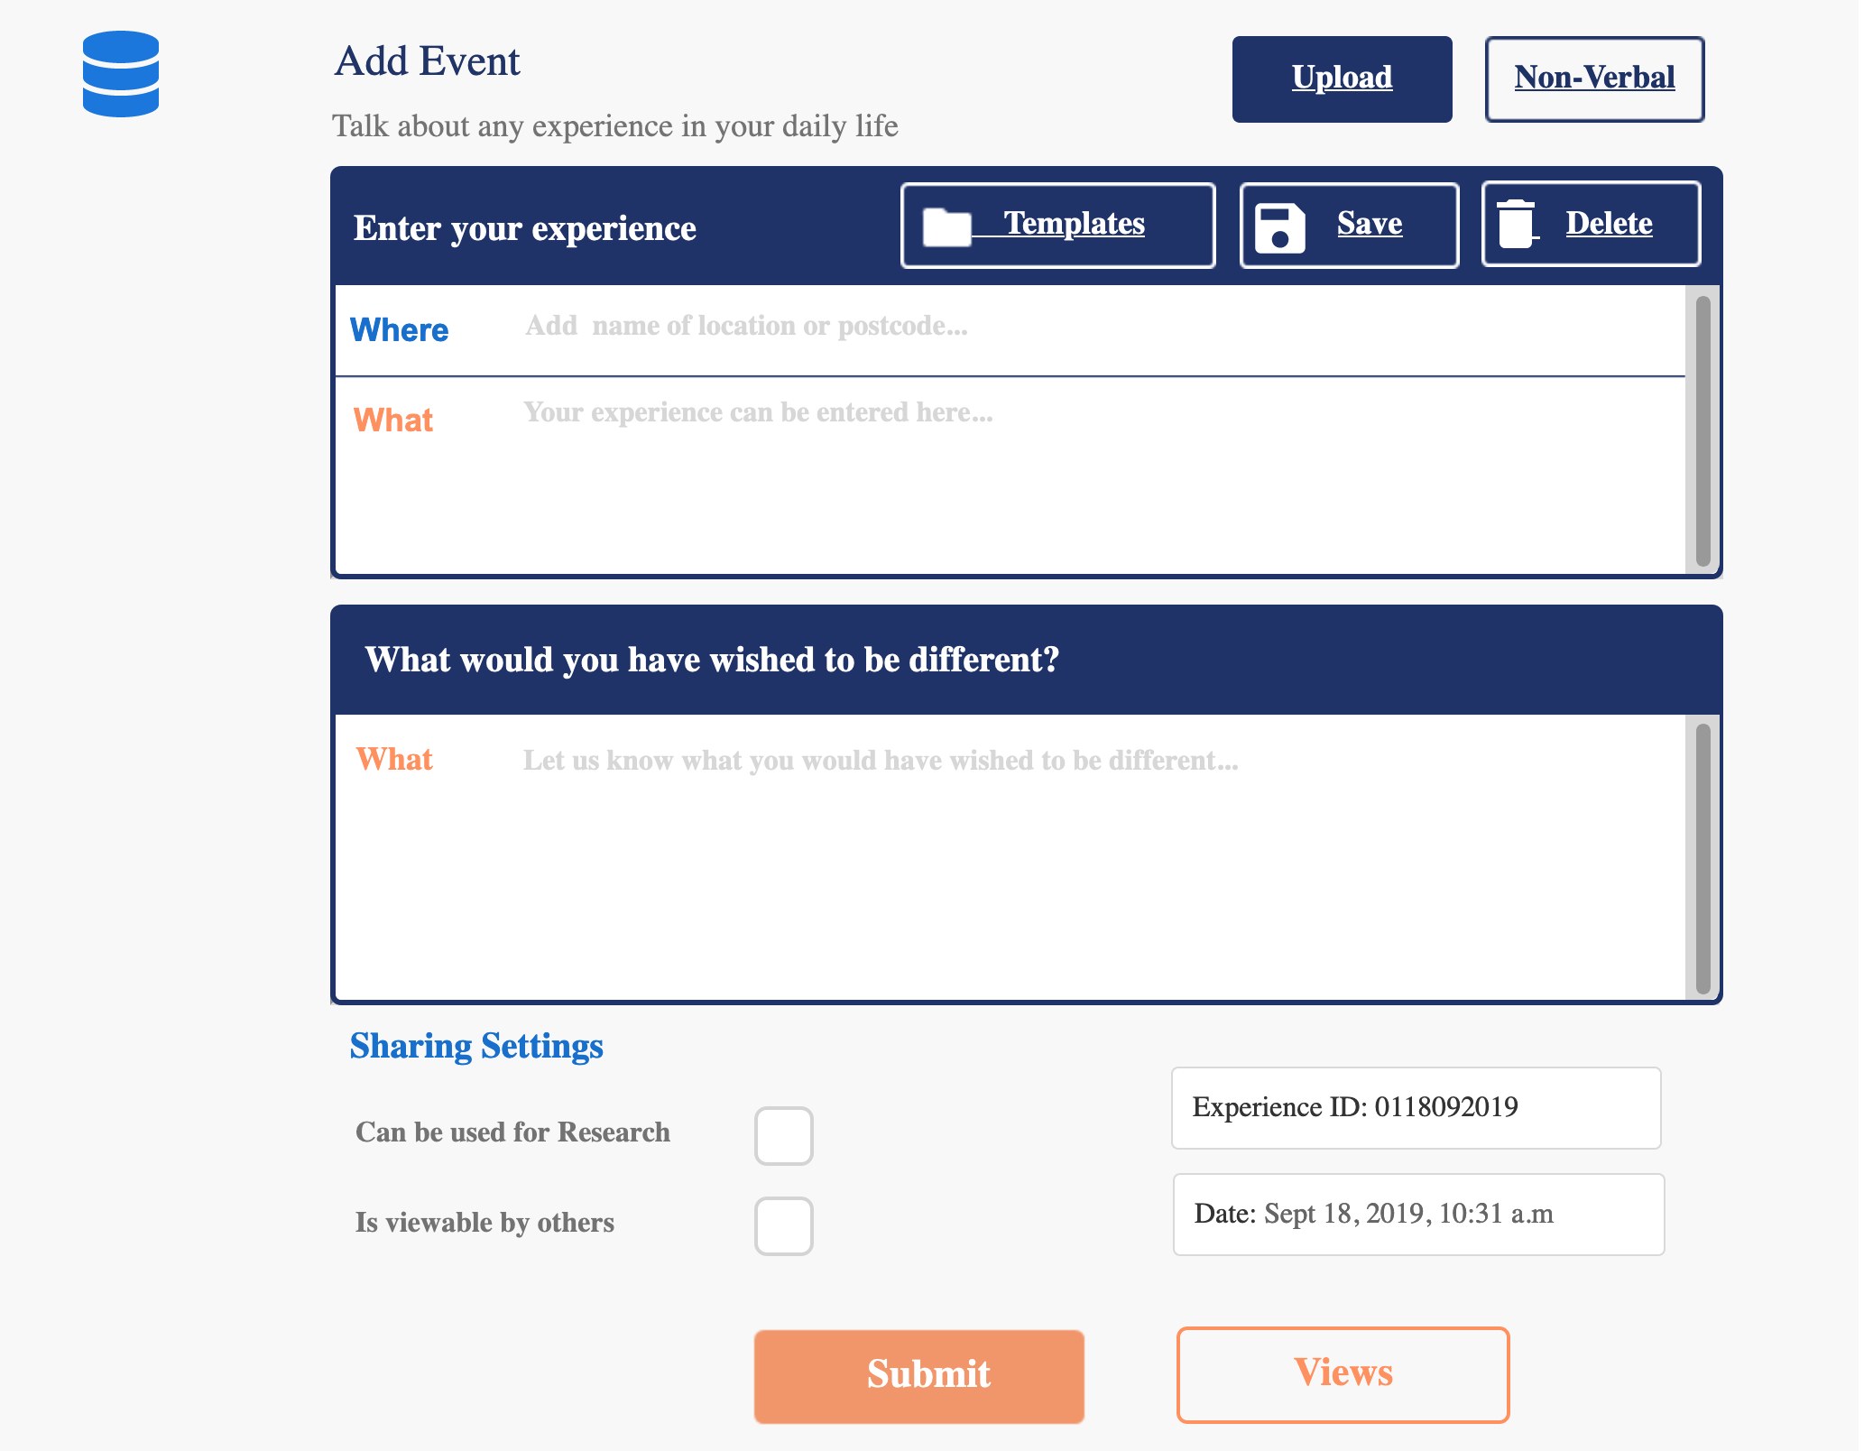

Slide 5
Citizen Science Platform: Recap/Intro
We are building a citizen science platform with autistic people and their families to investigate the impact of sensory processing differences.
The platform will let people share experiences with researchers and/or publish them on the platform.
Before an experience is published, it must be read and accepted by at least one moderator.
https://alan-turing-institute.github.io/AutisticaCitizenScience
https://github.com/alan-turing-institute/AutisticaCitizenScience

Slide 6
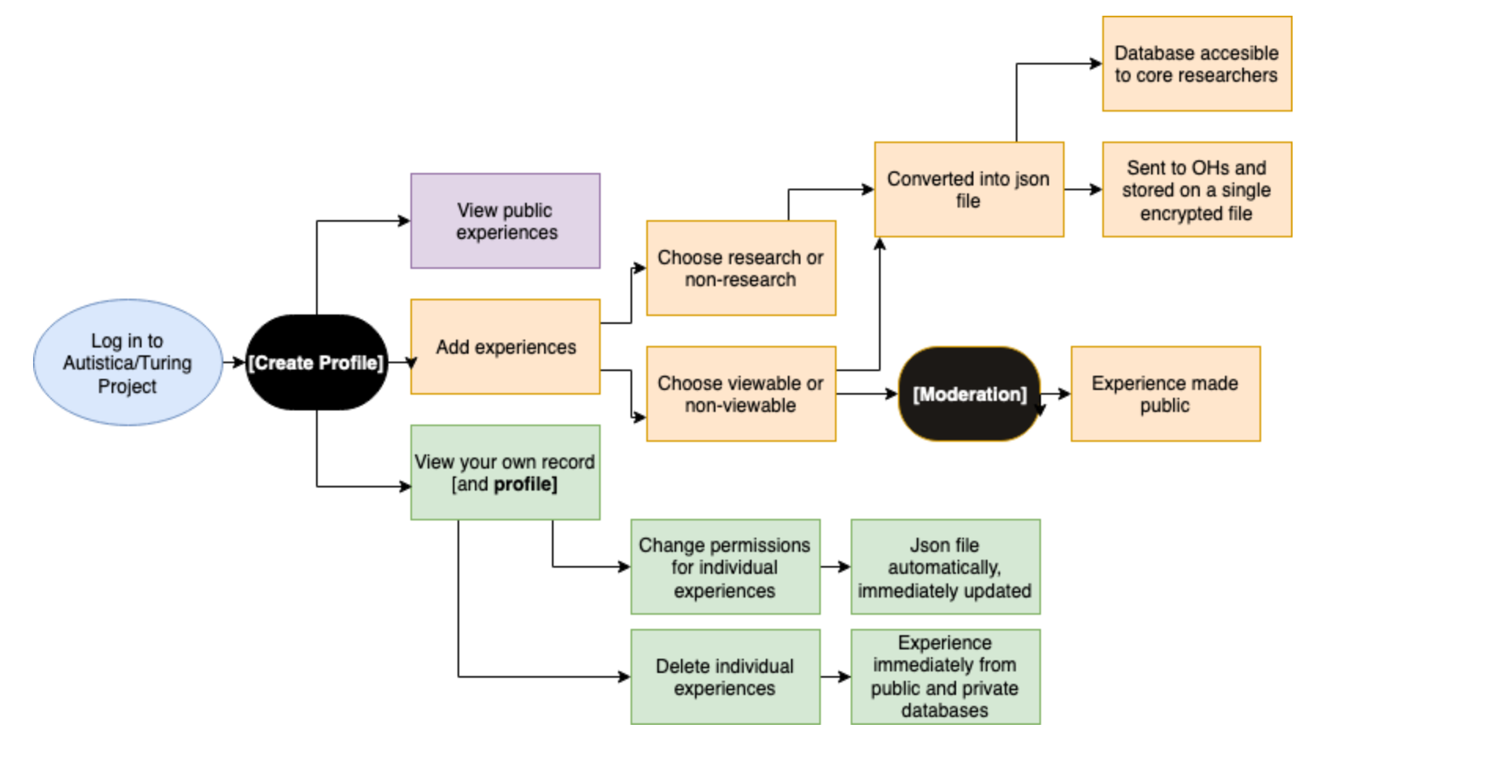
Notes:
2 “black boxes” – backend file management system, json etc. – adding experiences – fairly good understanding of the data flow – but moderation needs to be carefully sketched out – before experience is published, has to be looked at –designed multiple versions with Bastian from Open Humans when he visited the Turing –

Slide 7
Moderation happens when a story a user wants to share on AutSPACE is checked by a moderator before it is publicly published.
@kirstie_j
https://doi.org/10.5281/zenodo.3766922
https://www.autistica.org.uk/about-us/about-us

Slide 8

Goals
Co-create a code of conduct for sharing experiences publicly
@kirstie_j
https://doi.org/10.5281/zenodo.3766922

Slide 9
Goals
Co-create a code of conduct for sharing experiences publicly
Co-design a moderation process for the platform
@kirstie_j
https://doi.org/10.5281/zenodo.3766922

Slide 10
Goals
Co-create a code of conduct for sharing experiences publicly
Co-design a moderation process for the platform
Co-create guidelines for sharing experiences on behalf of others.
@kirstie_j
https://doi.org/10.5281/zenodo.3766922

Slide 11
Goals
Co-create a code of conduct for sharing experiences publicly
Co-design a moderation process for the platform
Co-create guidelines for sharing experiences on behalf of others.
Include lots of autistic people and their families
@kirstie_j
https://doi.org/10.5281/zenodo.3766922

Slide 12
So far
We had a series of focus groups, workshops, individual discussions and co-working/co-design sessions with autistic people and the parents of autistic people
We had lots of discussion about what rules and guidance we should have for people using the platform
We have done some design work already using the insights gained from the discussions,
This is a work in progress – we want it to reflect your needs
@kirstie_j
https://doi.org/10.5281/zenodo.3766922

Slide 13
Today
From broad discussions to more specific recommendations
Presentation of thoughts from the community (focus groups, volunteers, collaborators)
You may recognise some of your own comments!
Presentation of we have already created for moderating the platform
Discuss issues
@kirstie_j
https://doi.org/10.5281/zenodo.3766922

Slide 14
Next Steps
This meeting is anonymised and transcribed
Key themes are taken from the meeting to group comments
These will be circulated to everyone present today so you have the option to change your comments
The grouped comments are published on our GitHub repository
The moderation process, code of conduct, and guidelines will then be designed using this and previous discussions
They will be circulated to all project participants for feedback
They will then be modified again on that basis
They will be published on our GitHub repository
They will be used to make AutSPACE inclusive and welcoming for everyone
Always open to change and feedback
@kirstie_j
https://doi.org/10.5281/zenodo.3766922

Slide 15
Code of conduct
@kirstie_j
https://doi.org/10.5281/zenodo.3766922
https://www.autistica.org.uk/about-us/about-us

Slide 16
A code of conduct is a set of rules outlining the norms, rules, and responsibilities or proper practices of an individual party or an organisation.
@kirstie_j
https://doi.org/10.5281/zenodo.3766922
https://www.autistica.org.uk/about-us/about-us

Slide 17
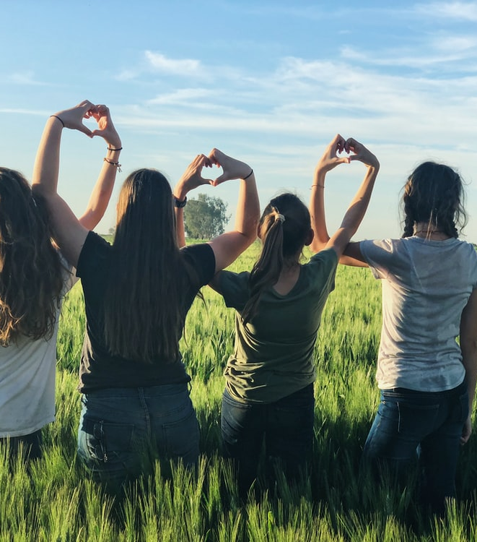
Why is it important?
Protects community
Clear rules to follow
Supports values/ethics
Facilitates growth and diversity
More effective participation
Transparent
Resolves ambiguity
Helps moderators
Holds moderators to account
Notes:
Thank you to the project team – especially our volunteers and focus group participants from the autistic community, and thank you to everyone from Autistica, The Alan Turing Institute, Open Humans and Fujitsu who are supporting the project.

Slide 18
(A d): “Use other codes of conduct as templates and adapt them.”
@kirstie_j
https://doi.org/10.5281/zenodo.3766922
https://www.autistica.org.uk/about-us/about-us

Slide 19
- We took a code of conduct written by autistic people to support an autistic community (AutAngels).
- We combined it with a code of conduct developed by The Carpentries for open source projects.
- We adapted the combined code of conduct for AutSPACE based on feedback from project participants.
@kirstie_j
https://doi.org/10.5281/zenodo.3766922
https://www.autistica.org.uk/about-us/about-us

Slide 20

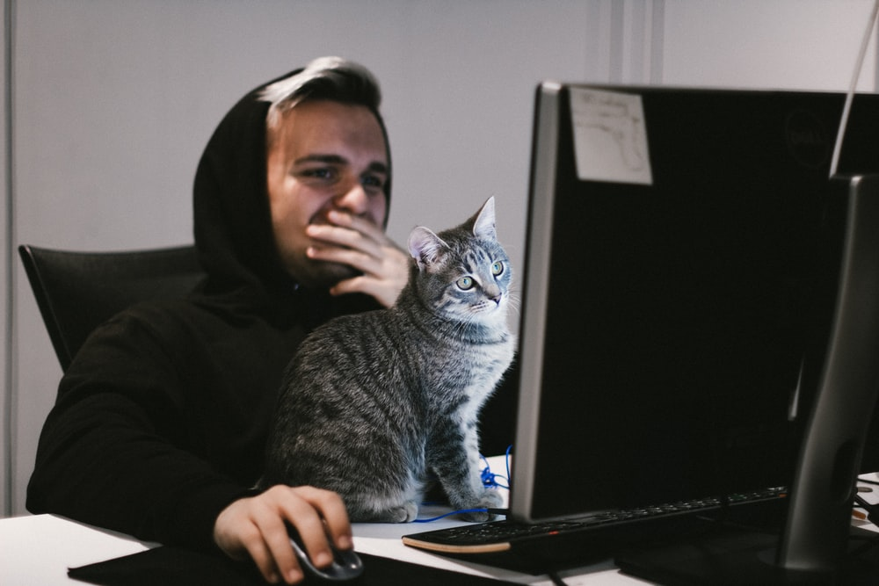
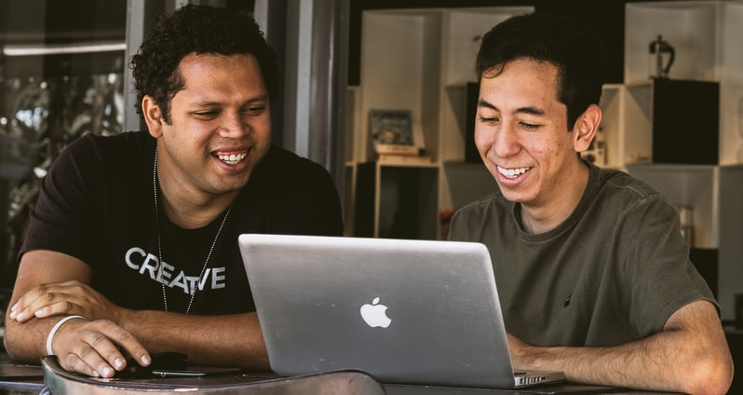
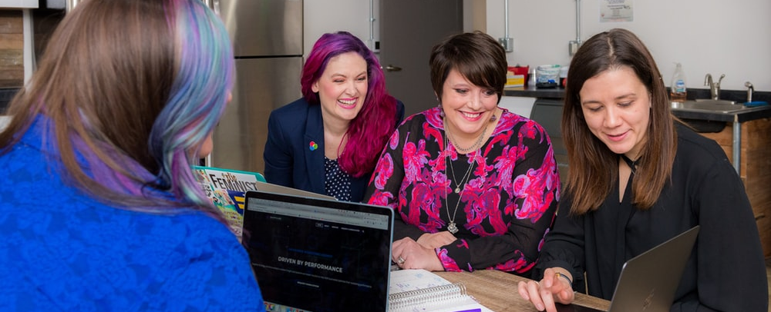
We created a draft code of conduct for people visiting and using AutSPACE. It is a WIP and we need your help!
We want the code of conduct to help make AutSPACE welcoming and inclusive for everyone.
You can view it online using this link:
https://hackmd.io/0mANOt-7TKOIt0ywogLrgw?view
Notes:
Thank you to the project team – especially our volunteers and focus group participants from the autistic community, and thank you to everyone from Autistica, The Alan Turing Institute, Open Humans and Fujitsu who are supporting the project.

Slide 21
What principles did we use?
autistic voice-first
but also welcoming of other voices
barring abusive, or threatening content
barring comments which are discriminatory or offensive towards identity markers
Barring personally identifying or compromising content
open to change: not set in stone
co-created
Notes:
Thank you to the project team – especially our volunteers and focus group participants from the autistic community, and thank you to everyone from Autistica, The Alan Turing Institute, Open Humans and Fujitsu who are supporting the project.

Slide 22
(A d): “From a user point of view, people have got to feel safe and comfortable while using the platform…if…you don’t feel comfortable with it, then [you] won’t use it!”
@kirstie_j
https://doi.org/10.5281/zenodo.3766922
https://www.autistica.org.uk/about-us/about-us

Slide 23
(A d): personal experience should not up for debate from others, “because it’s my experience, there’s nothing to debate about it - what does some other random know about it?”
@kirstie_j
https://doi.org/10.5281/zenodo.3766922
https://www.autistica.org.uk/about-us/about-us

Slide 24
(A d): “I think you need to have a very, very clear set of rules”
@kirstie_j
https://doi.org/10.5281/zenodo.3766922
https://www.autistica.org.uk/about-us/about-us

Slide 25
(A d): “you can’t just say, ‘this has been moderated out’, you’ve got to provide an explanation”
@kirstie_j
https://doi.org/10.5281/zenodo.3766922
https://www.autistica.org.uk/about-us/about-us

Slide 26
Please don’t: ”Make offensive comments related to neurology, gender, gender identity and expression, sexual orientation, disability, mental illness, physical appearance, body size, age, race, national origin, ethnic origin, nationality, immigration status, language, religion or lackthereof, or other identity markers”
AutAngels Code of Conduct
@kirstie_j
https://doi.org/10.5281/zenodo.3766922
https://www.autangel.org.uk/wp-content/uploads/2020/11/1904-autangel-code-of-conduct-1.pdf

Slide 27
Users can express frustration and anger
Users can use swearwords
Users can write about their own challenges and frustrations
Users cannot be offensive based on “identity markers”
Users cannot be disrespectful of autism, autistic traits, or other neurological differences
Users cannot write threatening comments
@kirstie_j
https://doi.org/10.5281/zenodo.3766922
https://www.autistica.org.uk/about-us/about-us

Slide 28
Self-moderation: filtering
Viewers would be able to apply filters which would stop them seeing content they didn’t want to see
This would allow people to adjust AutSPACE so it better meets their individual needs and preferences
Without blocking user’s stories from being published on AutSPACE
But sorting stories so they can be filtered takes time
And is not a guarantee
Notes:
Thank you to the project team – especially our volunteers and focus group participants from the autistic community, and thank you to everyone from Autistica, The Alan Turing Institute, Open Humans and Fujitsu who are supporting the project.

Slide 29
Examples
Filter stories in a “child-friendly” mode (no swear words or sexual or extreme content)
Filter in a “calm” mode (no stories which contain content that might be particularly distressing)
Filter stories in an “autism-only” mode (only comments by people who have signed in to the platform as autistic)
@kirstie_j
https://doi.org/10.5281/zenodo.3766922
https://www.autistica.org.uk/about-us/about-us

Slide 30
What rules should be in the code of conduct?
What should users be able to filter?
@kirstie_j
https://doi.org/10.5281/zenodo.3766922
https://www.autistica.org.uk/about-us/about-us

Slide 31
Process
@kirstie_j
https://doi.org/10.5281/zenodo.3766922
https://www.autistica.org.uk/about-us/about-us

Slide 32
3 people:
A user who uses shares a story on AutSPACE
A moderator who decides if a story can be published on AutSPACE
A viewer who comes to AutSPACE to view other people’s stories
@kirstie_j
https://doi.org/10.5281/zenodo.3766922
https://www.autistica.org.uk/about-us/about-us

Slide 33
Viewers can read other people’s stories
Viewers cannot comment on or reply to stories publicly
@kirstie_j
https://doi.org/10.5281/zenodo.3766922
https://www.autistica.org.uk/about-us/about-us

Slide 34
(A d): have clear feedback which is “sensitive, non-judgemental, and constructive, saying how they would alter things”
@kirstie_j
https://doi.org/10.5281/zenodo.3766922
https://www.autistica.org.uk/about-us/about-us

Slide 35
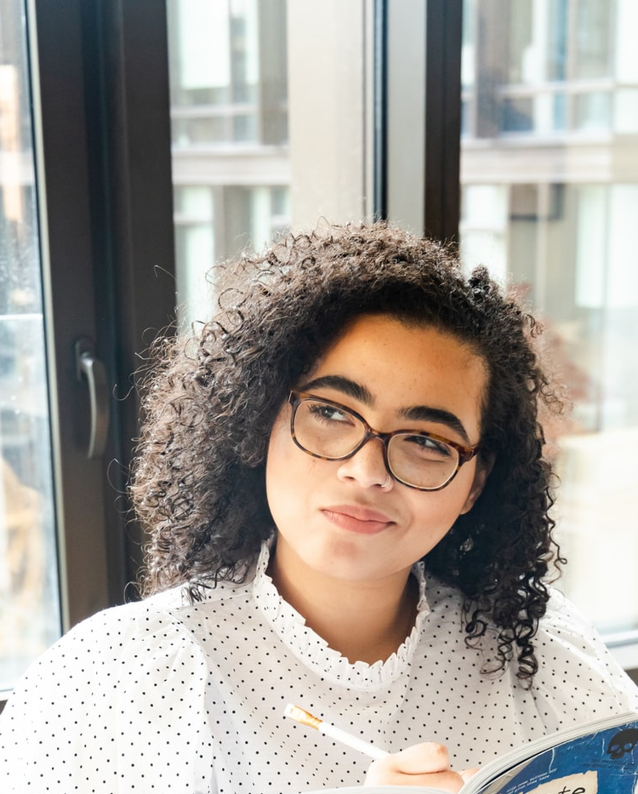
So far
Moderators, users and viewers follow a code of conduct
Reviewed by people not machines
Confirmation
Autistic people as moderators
All entries are anonymous
Notes:
Thank you to the project team – especially our volunteers and focus group participants from the autistic community, and thank you to everyone from Autistica, The Alan Turing Institute, Open Humans and Fujitsu who are supporting the project.

Slide 36
What’s Next? Priority setting
How long should moderators have to assess stories?
Do all stories need to be cross-checked by an additional moderator?
Who should moderate?
Should moderators be able to edit responses?
Should moderators/users be able to add tags for filtering? (e.g. “may be distressing”, “not child-friendly”)
How do we find and recruit moderators?
How do users get feedback on why their story was blocked?
How do users respond to decisions?
Should viewers be able to flag stories for moderation
Notes:
Thank you to the project team – especially our volunteers and focus group participants from the autistic community, and thank you to everyone from Autistica, The Alan Turing Institute, Open Humans and Fujitsu who are supporting the project.

Slide 37
Guidelines for entering experiences on behalf of others
@kirstie_j
https://doi.org/10.5281/zenodo.3766922
https://www.autistica.org.uk/about-us/about-us

Slide 38
Sharing stories on behalf of people who are autistic is a topic many people feel passionate about.
Many autistic people say they often feel talked about instead of heard. Many have had negative experiences of non-autistic people judging them, making assumptions, or misunderstanding them.
Many parents, carers and others who support autistic people are concerned that autistic people who may have challenges communicating are often left out of studies and do not get a chance to be heard at all. They want to be able to represent others so they are not excluded.
@kirstie_j
https://doi.org/10.5281/zenodo.3766922
https://www.autistica.org.uk/about-us/about-us

Slide 39
(A d): “it’s very difficult to make a place welcoming to autistic people when you also have a lot of neurotypical people explaining about autistic people”
@kirstie_j
https://doi.org/10.5281/zenodo.3766922
https://www.autistica.org.uk/about-us/about-us

Slide 40
(P d): “I feel quite strongly that we should be able to share a story, because…my son’s non-verbal, so his behaviour displays a lot of how he feels, and as his Mum I feel I understand him pretty well, and I would hate for people’s voices not to be heard because they can’t express it”
(P d): If you could not report publicly on behalf of others: “my son’s experiences would never be heard”
@kirstie_j
https://doi.org/10.5281/zenodo.3766922
https://www.autistica.org.uk/about-us/about-us

Slide 41
(P i): “be mindful that there are autistic people who will read it, and it’ll be their experience they’ll be thinking about, even though your experience is entirely valid.”
@kirstie_j
https://doi.org/10.5281/zenodo.3766922
https://www.autistica.org.uk/about-us/about-us

Slide 42
(A d): “maybe have a separate section for parents”
@kirstie_j
https://doi.org/10.5281/zenodo.3766922
https://www.autistica.org.uk/about-us/about-us

Slide 43
(A P i): “there’s no way [my son] is having the same experience I am, but he is experiencing some things which he can share with me”
@kirstie_j
https://doi.org/10.5281/zenodo.3766922
https://www.autistica.org.uk/about-us/about-us

Slide 44
(A d): “…sometimes…they’re complaining from a neurotypical point of view about how difficult the child is, or the adult is, and I kinda don’t want that…because I feel this is supposed to be a safe platform for autistic people to talk about their experiences”
@kirstie_j
https://doi.org/10.5281/zenodo.3766922
https://www.autistica.org.uk/about-us/about-us

Slide 45
(A d): create “a set kind of guidelines”
@kirstie_j
https://doi.org/10.5281/zenodo.3766922
https://www.autistica.org.uk/about-us/about-us

Slide 46

Suggested solution
We state clearly in the code of conduct that this is an autistic-voice-first space
We do allow users to share stories about, or on behalf of, autistic people
We co-create guidelines about representing others in a respectful and valid way
Users have the option to only share with signed-in autistic viewers
Viewers have the option to only view stories shared by autistic people
Notes:
Thank you to the project team – especially our volunteers and focus group participants from the autistic community, and thank you to everyone from Autistica, The Alan Turing Institute, Open Humans and Fujitsu who are supporting the project.

Slide 47
What’s next
Discuss
Share your point of view
Share ideas, suggestions and concerns.
Remember
Treat others with respect and kindness
If you need a break for any reason you can switch your camera and microphone off at any time
You can share your thoughts privately by using the chat to write a message with someone from the research team (Georgia, Bethan, or Kirstie)
You can raise a hand if you want to speak and a facilitator will try to bring you in
Notes:
Thank you to the project team – especially our volunteers and focus group participants from the autistic community, and thank you to everyone from Autistica, The Alan Turing Institute, Open Humans and Fujitsu who are supporting the project.

Slide 48
Trust the ouch: It’s likely that if someone says they’re hurt, they really are hurt; listen and trust them, even (and especially if) you don’t understand why or how.
AutAngels Code of Conduct
https://www.autangel.org.uk/wp-content/uploads/2020/11/1904-autangel-code-of-conduct-1.pdf

Slide 49
Suggested solution
We state clearly in the code of conduct that this is an autistic voice first space
We do allow users to share stories about, or on behalf of, autistic people
We co-create guidelines: sharing for others in a respectful and valid way
Users have the option to only share with signed-in autistic viewers
Viewers have the option to only view stories shared by autistic people
What do you think about this solution?
What would make it better?
Any concerns or thoughts you would like to share?
Notes:
Thank you to the project team – especially our volunteers and focus group participants from the autistic community, and thank you to everyone from Autistica, The Alan Turing Institute, Open Humans and Fujitsu who are supporting the project.

Slide 50
Guidelines
@kirstie_j
https://doi.org/10.5281/zenodo.3766922
https://www.autistica.org.uk/about-us/about-us

Slide 51
(P d): “I feel quite strongly that we should be able to share a story, because…my son’s non-verbal, so his behaviour displays a lot of how he feels, and as his Mum I feel I understand him pretty well, and I would hate for people’s voices not to be heard because they can’t express it”
@kirstie_j
https://doi.org/10.5281/zenodo.3766922
https://www.autistica.org.uk/about-us/about-us

Slide 52
(A d): “I would be absolutely fine with, ‘we went into a supermarket, Jack became upset because the lights were flickering again, this is something that has bothered him before’, whereas I would have a real problem with the parents saying something like, ‘We went into the supermarket, Jack had a bloody meltdown again, I hate it when he does this, it’s so difficult being me’, because we do see an awful lot of parents complaining how difficult we are to deal with – people like us – so I think there needs to be something in there about this group has to focus on the person’s experience not the caregiver’s experience.”
@kirstie_j
https://doi.org/10.5281/zenodo.3766922
https://www.autistica.org.uk/about-us/about-us

Slide 53
(P d): “unless we do include people who are non-verbal or not or minimally verbal, they’re going to continue to be a neglected group.”
@kirstie_j
https://doi.org/10.5281/zenodo.3766922
https://www.autistica.org.uk/about-us/about-us

Slide 54
(A P d): “…distortions are very important, because we want raw data…it needs to be given even to non-verbal people to deliver feedback through pictures, through other ways…the more opportunities [for] people to express them[selves] directly the better. We want…as unbiased, authentic information as possible”
@kirstie_j
https://doi.org/10.5281/zenodo.3766922
https://www.autistica.org.uk/about-us/about-us

Slide 55
(A d): “depends how close they [the person doing the reporting] are…as long as it’s…a close parent, or guardian, or sibling, someone…the person themselves could trust.”
@kirstie_j
https://doi.org/10.5281/zenodo.3766922
https://www.autistica.org.uk/about-us/about-us

Slide 56
What’s next
Discuss
Share your point of view
Share ideas, suggestions and concerns.
Remember
Treat others with respect and kindness
If you need a break for any reason you can switch your camera and microphone off at any time
You can share your thoughts privately by using the chat to write a message with someone from the research team (Georgia, Bethan, or Kirstie)
You can raise a hand if you want to speak and a facilitator will try to bring you in
Notes:
Thank you to the project team – especially our volunteers and focus group participants from the autistic community, and thank you to everyone from Autistica, The Alan Turing Institute, Open Humans and Fujitsu who are supporting the project.

Slide 57
What should the guidelines include?
@kirstie_j
https://doi.org/10.5281/zenodo.3766922
https://www.autistica.org.uk/about-us/about-us

Slide 58
Thank you!
More to say? Or want to volunteer? Email gaitkenhead@turing.ac.uk.
@kirstie_j
https://doi.org/10.5281/zenodo.3766922
https://www.autistica.org.uk/about-us/about-us

Slide 59





Thank you to the project team and you for listening
Kirstie Whitaker
Otis Smith
James Scott
Sarah Markham
James Cusack
Bethan Davies
Bastian Greshake Tzvoras
Andrew Harding
Craig Hall
Otis Smith
Tom Augur
Ekaterina Harrison
All our autistic community participants
Katharina Kloppenborg
https://alan-turing-institute.github.io/AutisticaCitizenScience
https://github.com/alan-turing-institute/AutisticaCitizenScience
Notes:
Thank you to the project team – especially our volunteers and focus group participants from the autistic community, and thank you to everyone from Autistica, The Alan Turing Institute, Open Humans and Fujitsu who are supporting the project.

Slide 60
Unsplash Images
Photo by Brooke Cagle on Unsplash
Photo by Ga on Unsplash
Photo by DISRUPTIVO on Unsplash
Photo by Kylie Haulk on Unsplash
Photo by Katherine Hanlon on Unsplash
Photo by Elena Mozhvilo on Unsplash
https://alan-turing-institute.github.io/AutisticaCitizenScience
https://github.com/alan-turing-institute/AutisticaCitizenScience
Notes:
Thank you to the project team – especially our volunteers and focus group participants from the autistic community, and thank you to everyone from Autistica, The Alan Turing Institute, Open Humans and Fujitsu who are supporting the project.

Slide 61
Please join us
Anonymously, publicly share suggestions via the "always open" google form: https://bit.ly/AutisticaTuringCitSciForm
Say hello in our Slack channel:
Subscribe to our mailing list for monthly project updates: https://tinyletter.com/AutisticaTuringCitizenScience
Join the discussion in our issues and pull requests on GitHub: https://github.com/alan-turing-institute/ AutisticaCitizenScience
@kirstie_j
https://doi.org/10.5281/zenodo.3766922
https://alan-turing-institute.github.io/AutisticaCitizenScience

