Slide 1
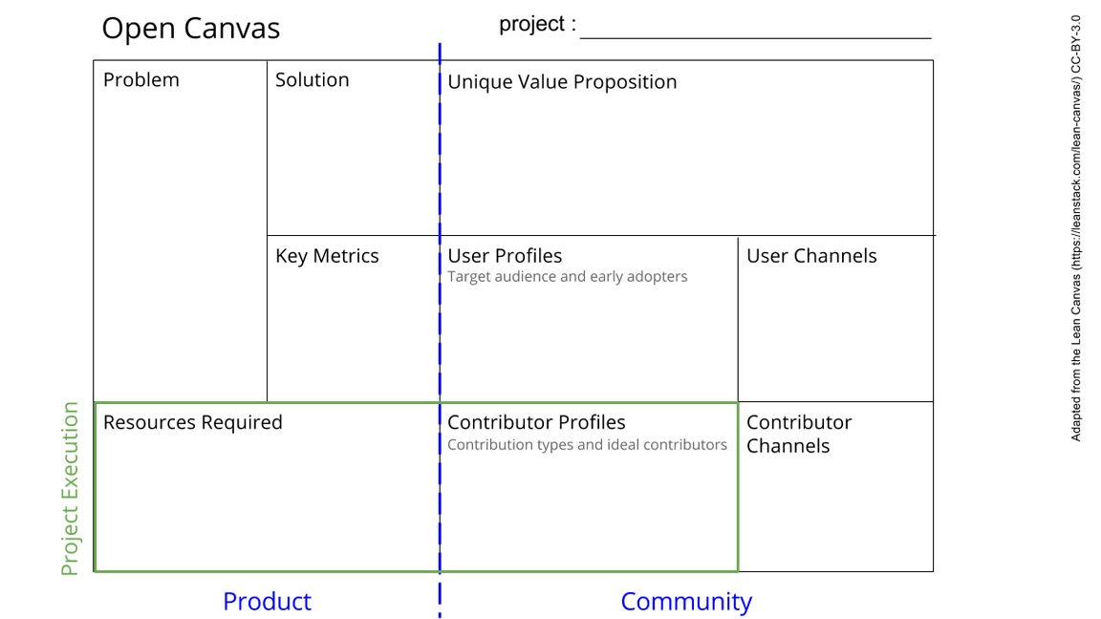
AutSPACEs
The experiences and priorities of the subjects of research are often not thoroughly integrated into health research. This can lead to a flattening of complexity, and power asymmetries between researchers and those researched. There is a need for greater inclusivity of diverse groups,
Develop participatory practices/resources and tools which allow them to be upscaled and inclusive.
An example of, and instrument for, a new best practice in science. A unique, co-created citizen science platform built using thoroughly participatory, open methods; and a framework for conducting open, participatory citizen science. A platform unlike any other: it has an inbuilt fine-grained, dynamic consent model which facilitates ethical data management and participant agency. All features are directly linked to community recommendations. It can be easily adapted for other research.
Social media,
Orgs such as Autistica
Networks of collaborators, conferences,
Through launch and advertised events/webinars
Community wellbeing
Diversity of group
Scale of dataset
Project reproducibility
First iteration, focusses on the autistic community - in future, the relevant population of research subjects for each study; researchers; people who can action research, e.g. policy-makers.
Protocols/methods/framework for participatory research
A citizen science platform which is accessible/usable for diverse groups
Open repositories which support onboarding and encourage collaboration
Dataset used for impactful research
Citizen scientists - especially those who are autistic or are close supporters; researchers (open source and autism specifically); open source community - Django knowledge, value-aligned orgs
Talks, presentations, webinars,
Twitter, slack, GFs
Via repos - PRs, issues.
Meet-up sessions and focus groups
See next slide for instructions!
Notes:
Go to File > Make a Copy… to make your own canvas
See next slide for instructions

Slide 2
