Slide 1
Transformer Models
Julia Ive

Slide 2
Session Outline
Attention
Self-Attention
Multi-Head Self-Attention
Positional Encoding
Key Takeaways
Learning Outcomes
Being familiar with concepts of attention and self-attention
Being familiar with the BERT model and its training procedure

Slide 3
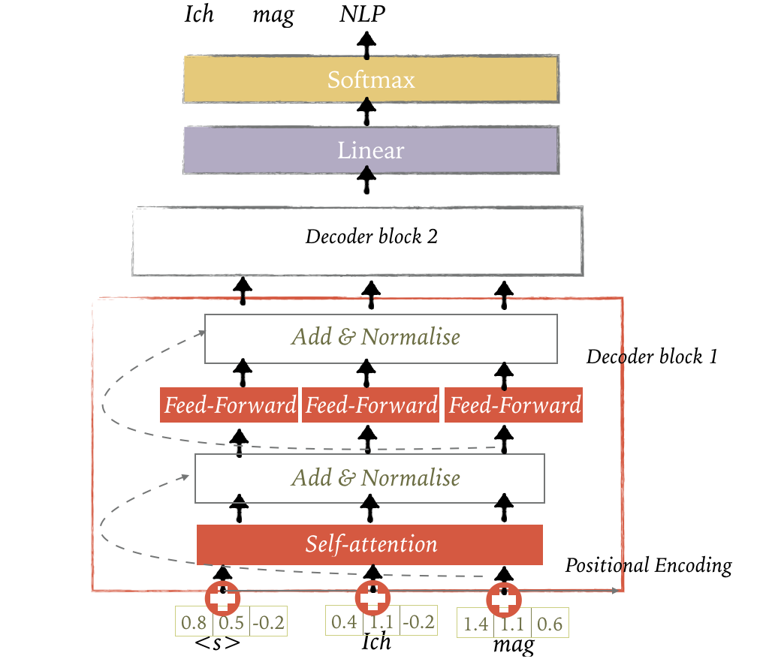
Transformer Language Model

Slide 4
Attention
Mechanism that at each time-step of decoding, focuses on a particular set of source units (tokens)
Alternative definition: given a query Q and a set of key-value pairs (K, V), attention computes a weighted sum of the values, where the weight is computed by the query-key compatibility function
Analogy: search engine maps a query against a set of keys (video title, description etc.) associated with candidate videos in the database (values)

Slide 5
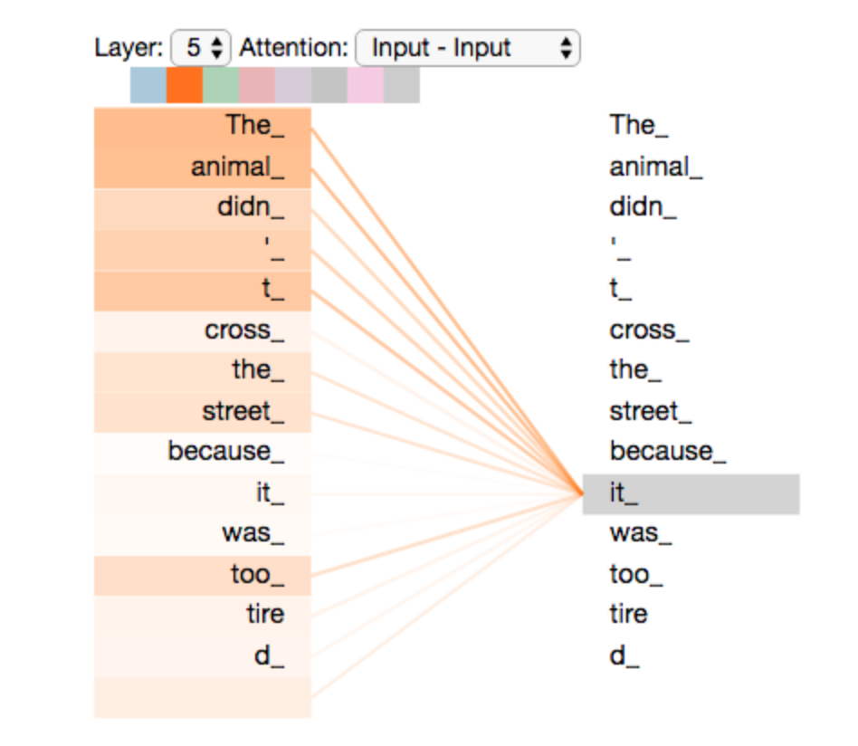
Self-Attention
Self-attention relates different positions of a single sequence in order to compute a representation of the same sequence
Find relationships between different words in a sentence to compute its representation
https://jalammar.github.io/illustrated-transformer

Slide 6
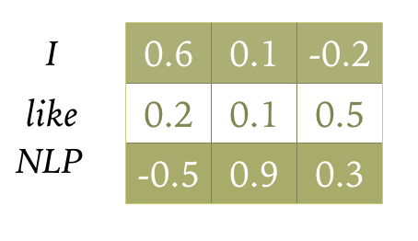
Self-Attention

Slide 7
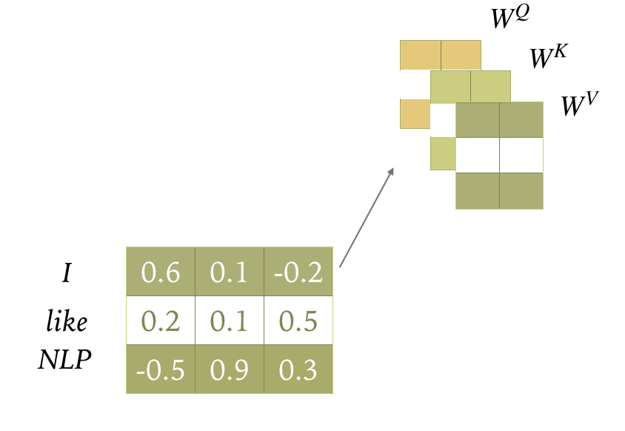
Self-Attention
Create query, key and value projections of encoder states

Slide 8
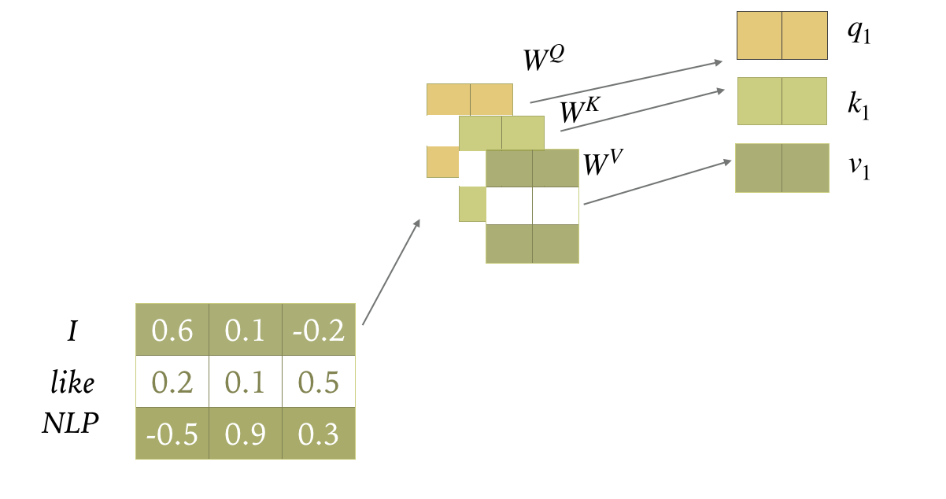
Self-Attention

Slide 9
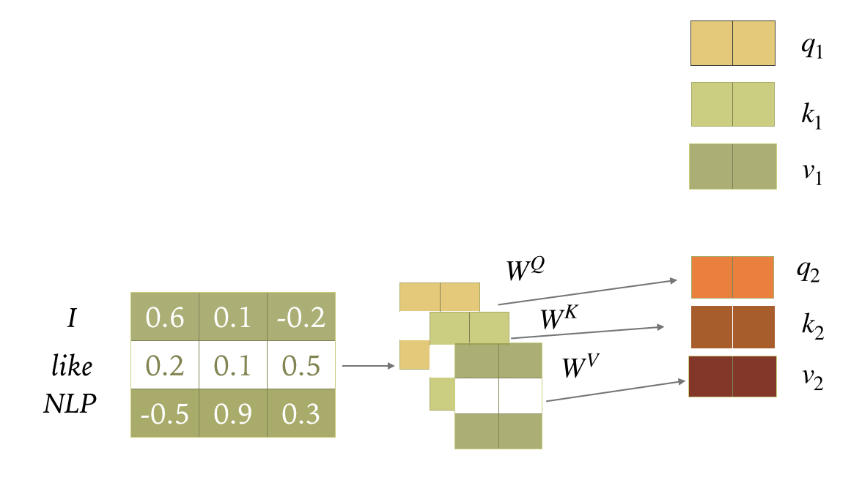
Self-Attention

Slide 10
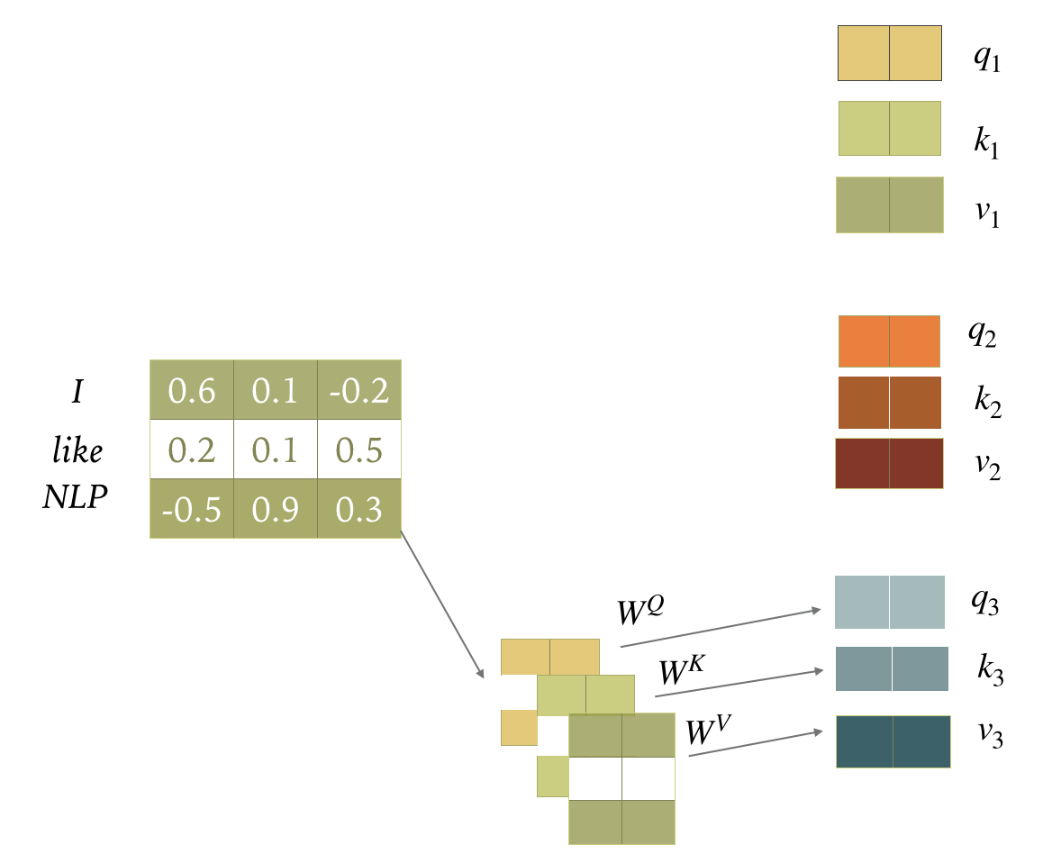
Self-Attention

Slide 11
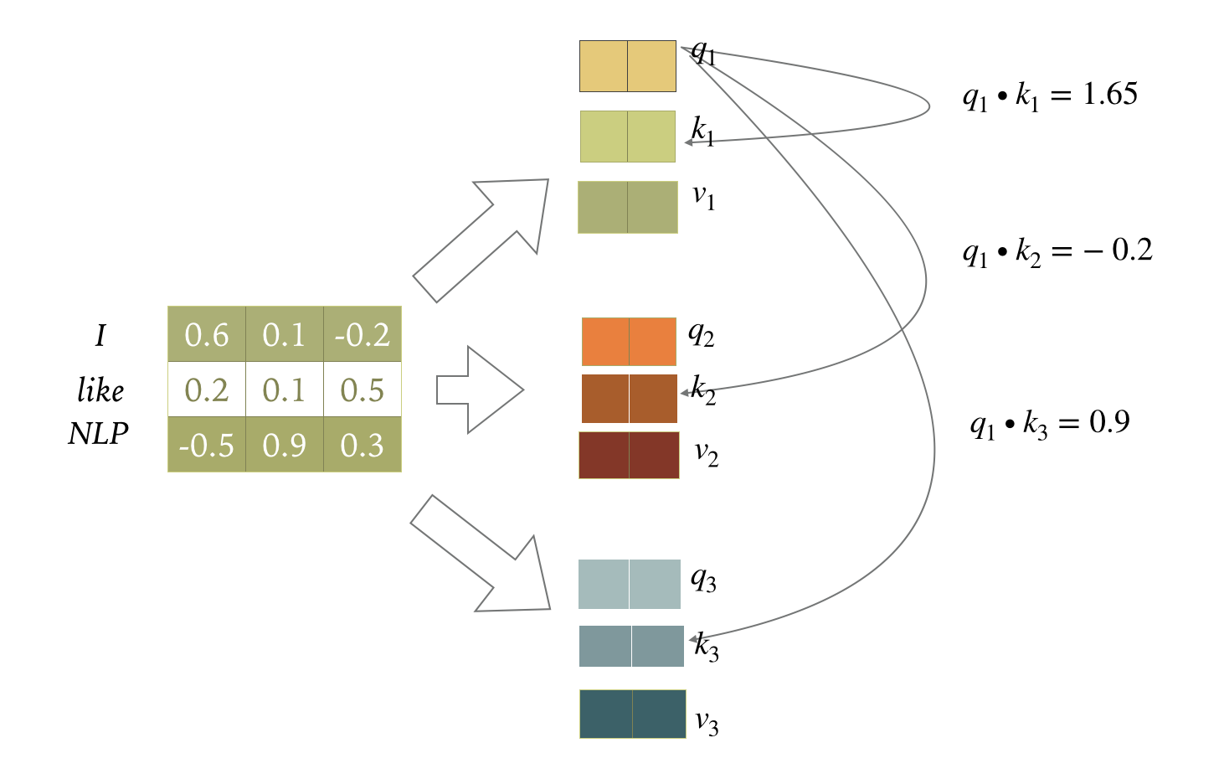
Self-Attention
Compute scores as dot product of q and k

Slide 12
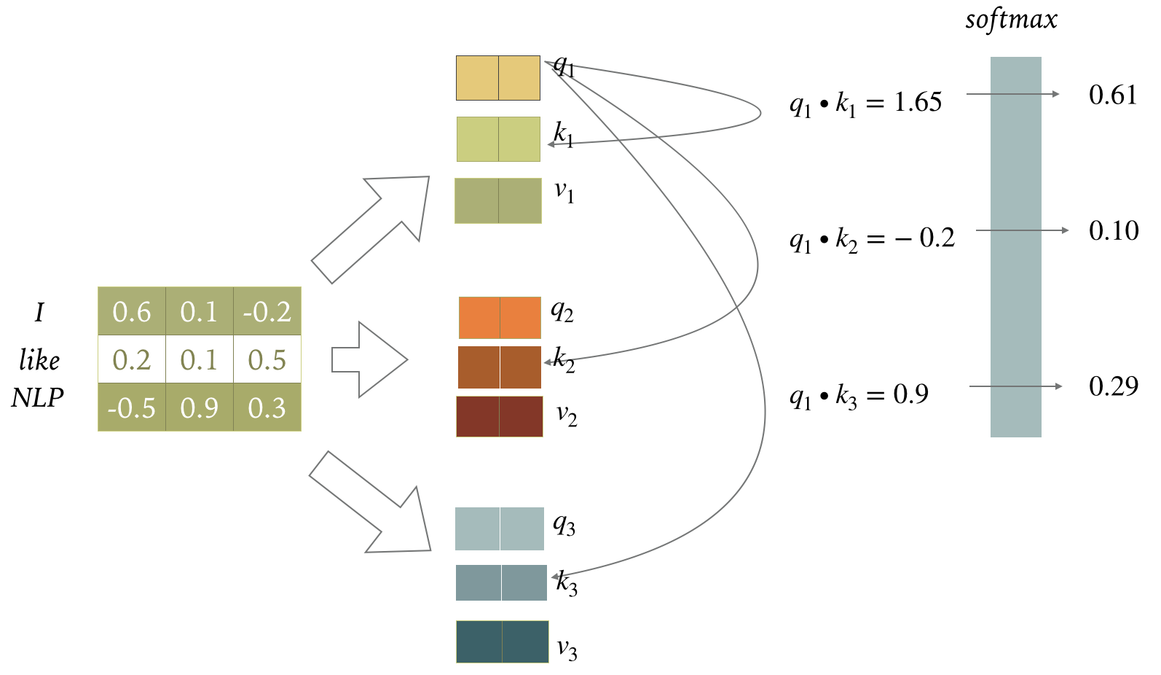
Self-Attention
Softmax score determines the importance of words in a sequence for a position

Slide 13
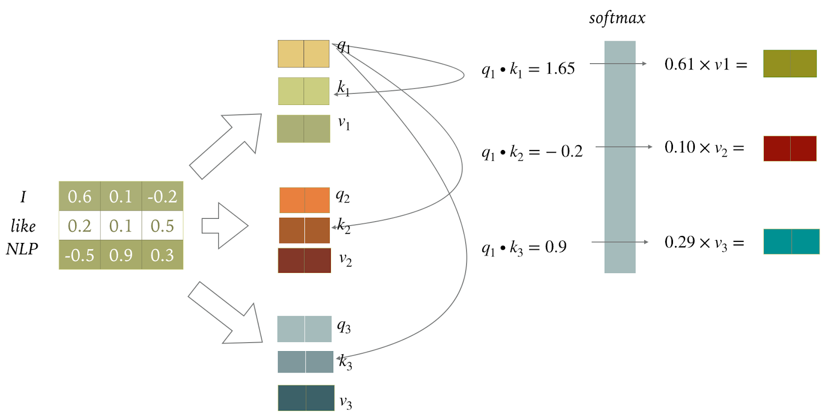
Self-Attention

Slide 14
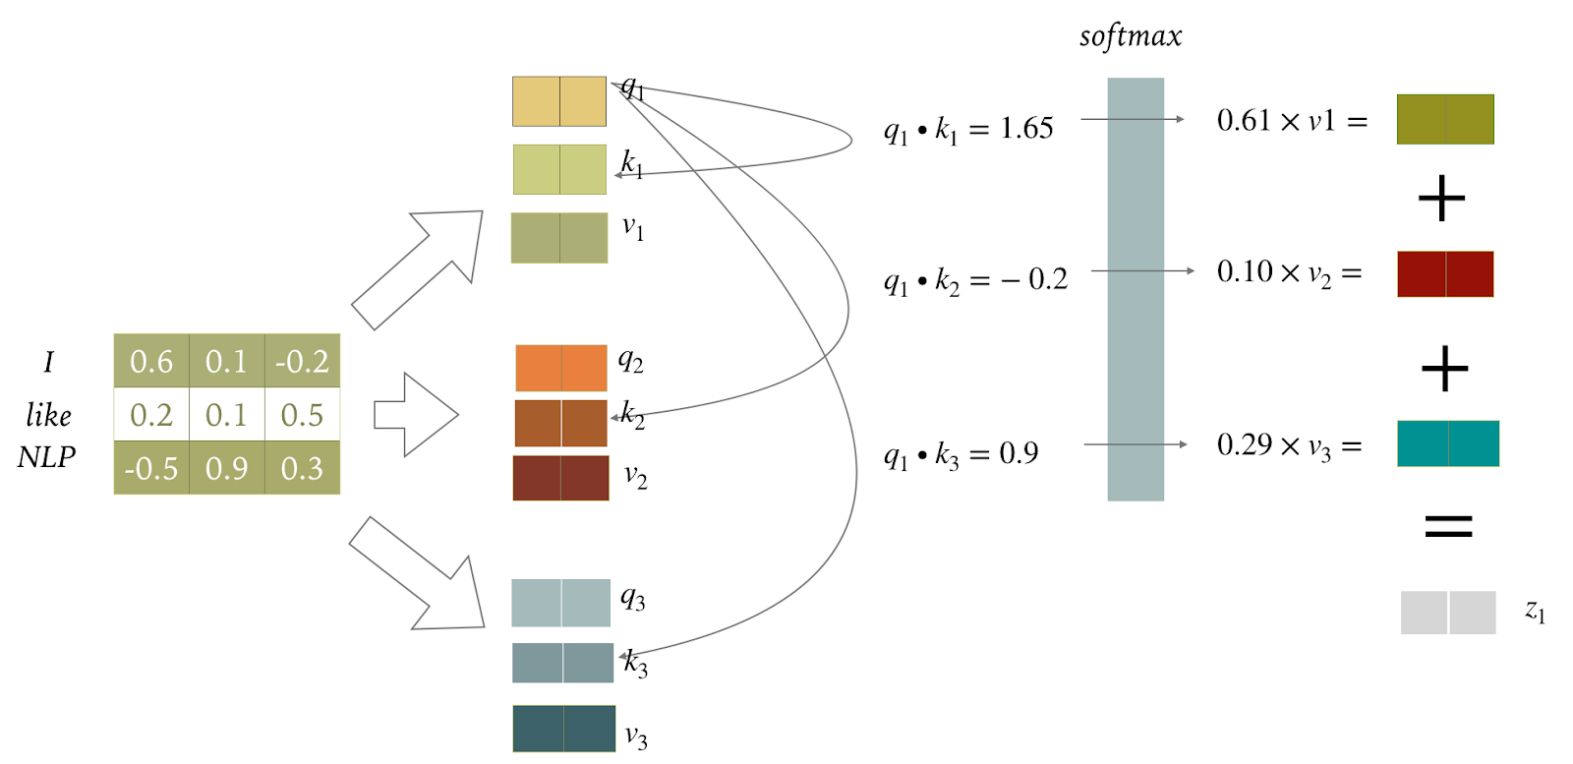
Self-Attention

Slide 15
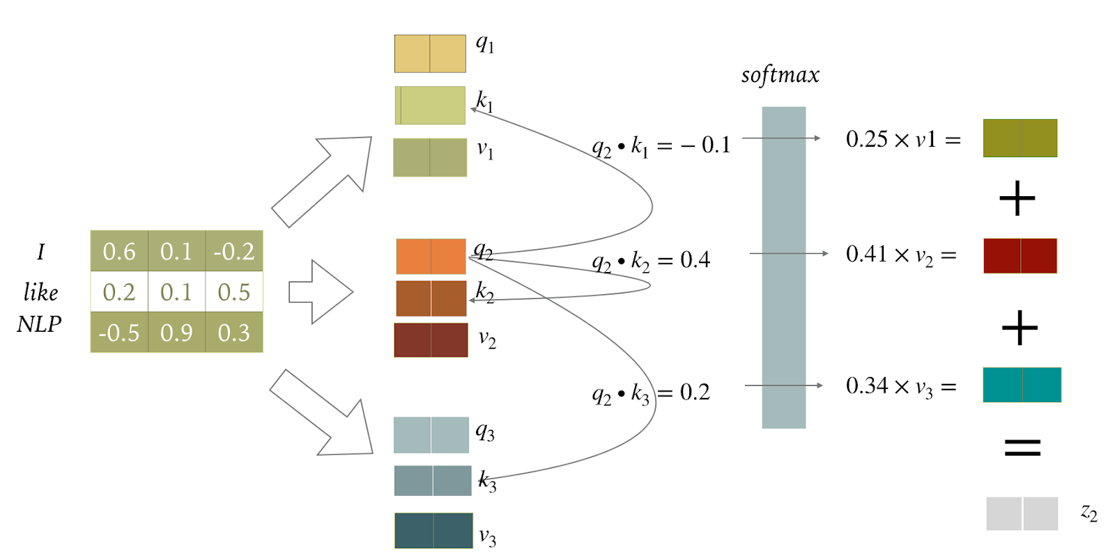
Self-Attention

Slide 16
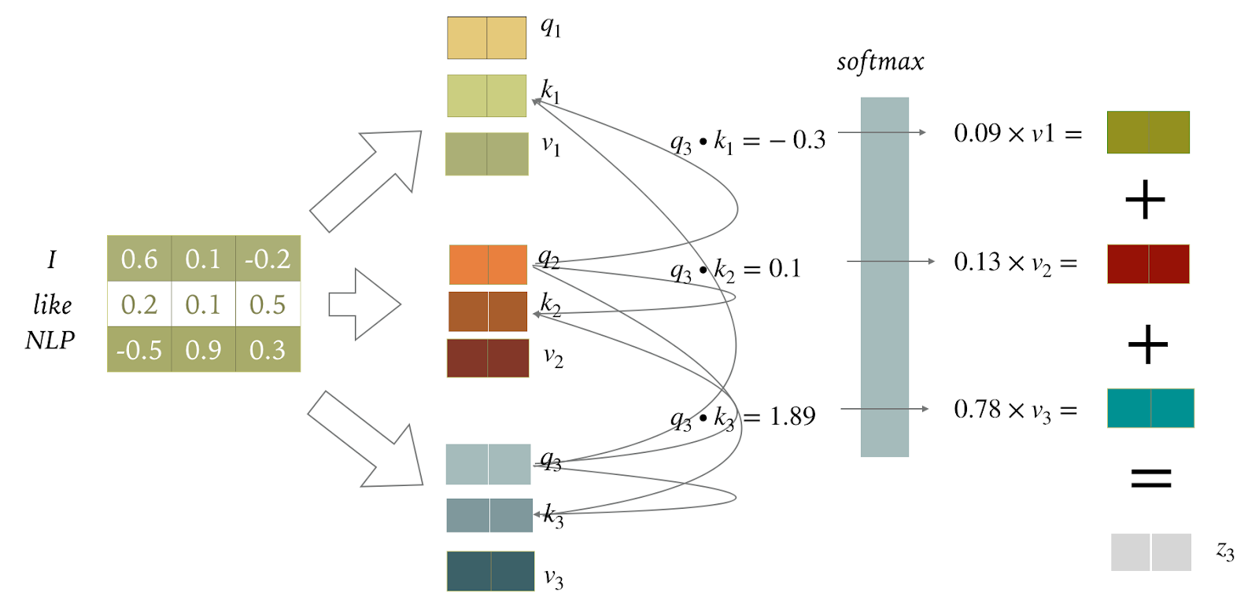
Self-Attention

Slide 17
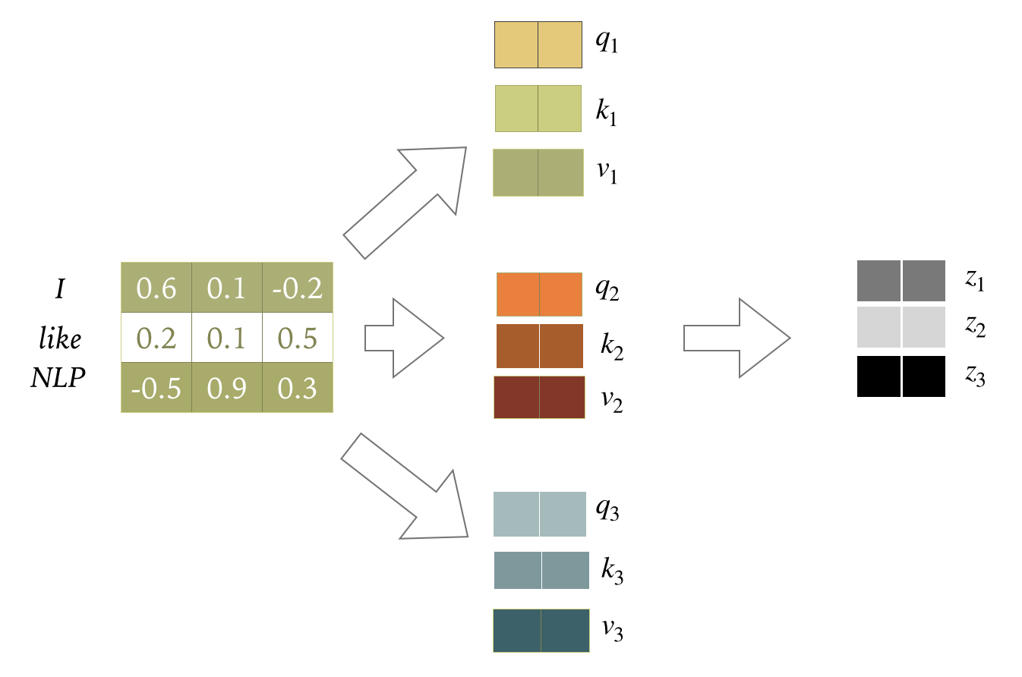
Self-Attention
Output of the self-attention layer at all the three positions

Slide 18
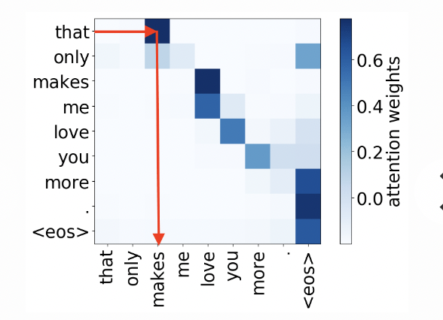
Multi-Head Self-Attention
Several self-attention layers stacked in parallel, with different linear transformations (heads) of the same input
Attend to different positions otherwise dominated by the actual word itself
Operating in multiple representation subspaces - multiple sets of query/key/value weight matrices
https://lena-voita.github.io/posts/acl19_heads.html

Slide 19
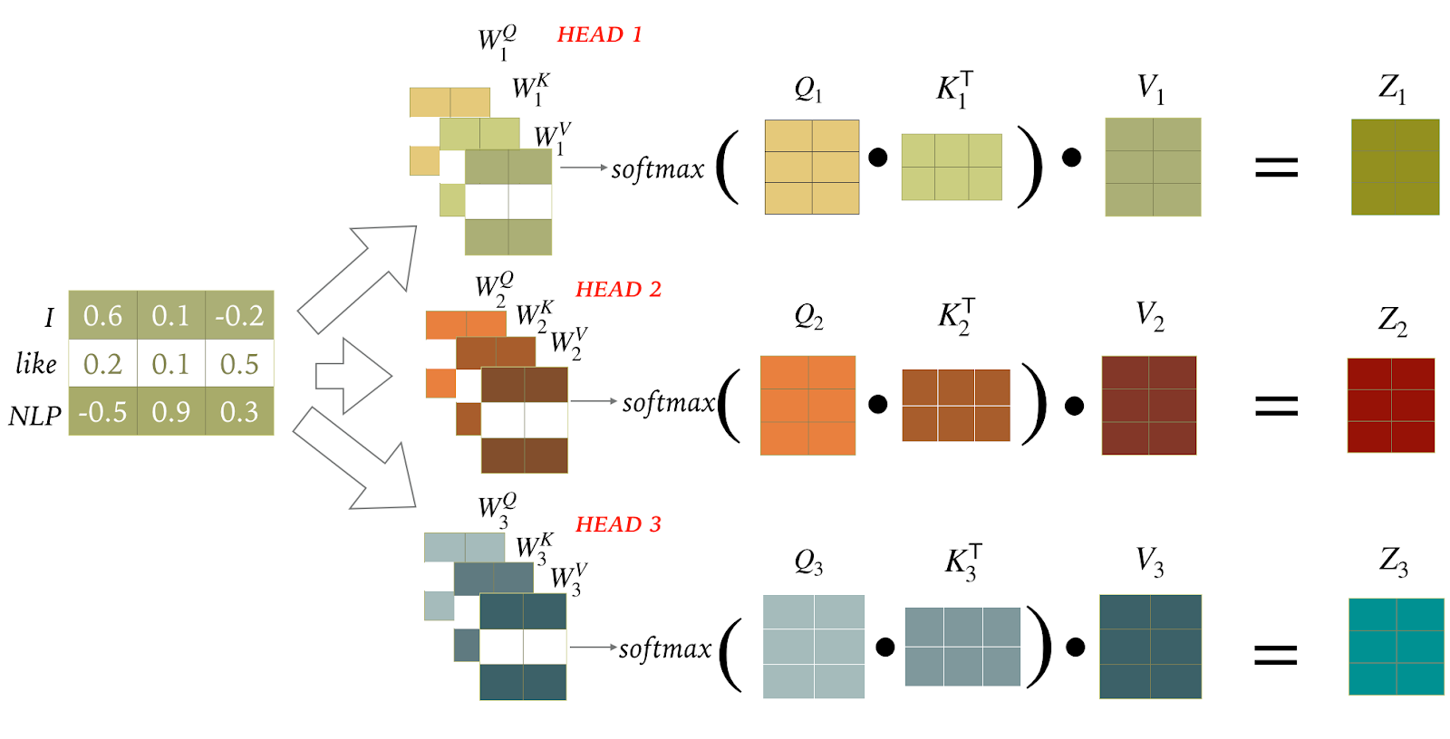
Multi-Head Self-Attention
actual implementation with matrix calculation

Slide 20
Multi-Head Self-Attention
Actual implementation with matrix calculation

Slide 21
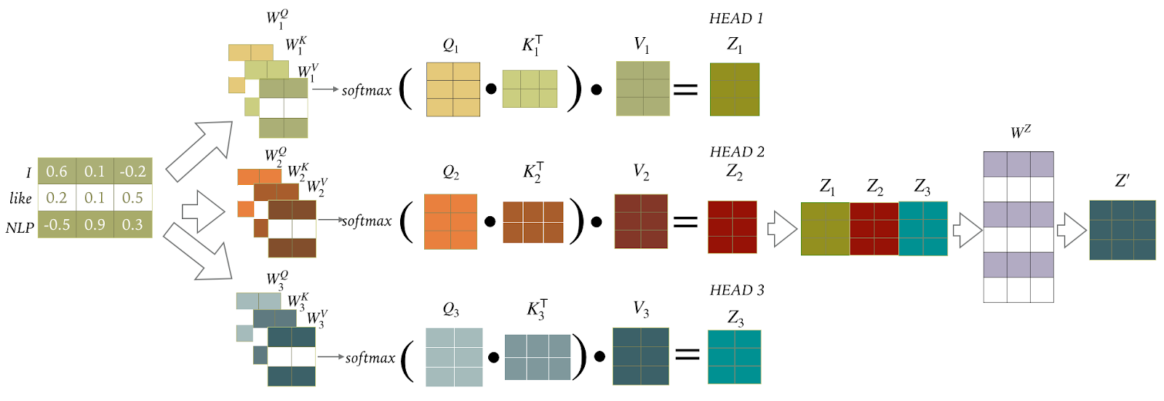
Multi-Head Self-Attention

Slide 22
Multi-Head Self-Attention

Slide 23
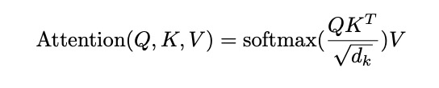
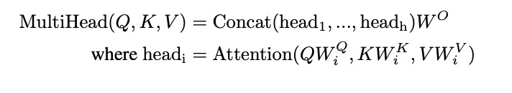
Multi-Head Self-Attention
Operating in multiple representation subspaces - multiple sets of Several self-attention layers stacked in parallel, with different linear transformations (heads) of the same input
Scaled Dot-Product Attention in Transformers
Query Q is encoder state (for self-attention/attention)
Key K and value V are encoder hidden states
d_{k} is the dimensionality of the query/key vectors

Slide 24
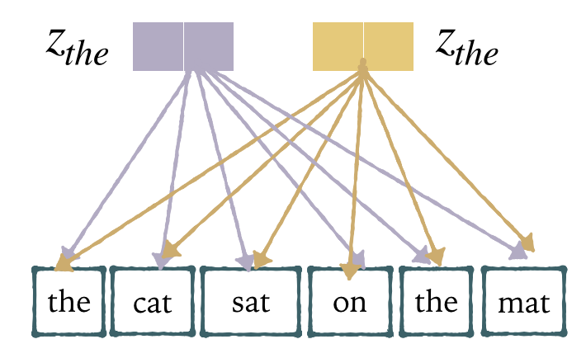
Positional Encoding
Architecture intrinsically has no notion of word order
How to give the model some sense of word order ?

Slide 25
Positional Encoding
Assign an ordinal number ? 1, 2, 3 …..
Deterministic
Position of a word
Distance between words
Scales to unseen lengths

Slide 26
Positional Encoding
d-dimensional vector that contains position information
Each dimension of the positional encoding is a sine or cosine wave with a different frequency
Keep the original embedding dimensionality: PE are summed with input embeddings
Learn to attend to relative positions: PE(pos+k) can be represented as a linear function of PE(pos)

Slide 27
Positional Encoding
We add three more tasks to our initial task of computing the compatibility of query and key:
Compatibility of query and key given key position
Compatibility of query and key given query position
Compatibility of positions of query and key
Why use sinusoidal functions?
Distances between the neighboring values of the sine/cosine positional embeddings are symmetrical and decay with distance

Slide 28
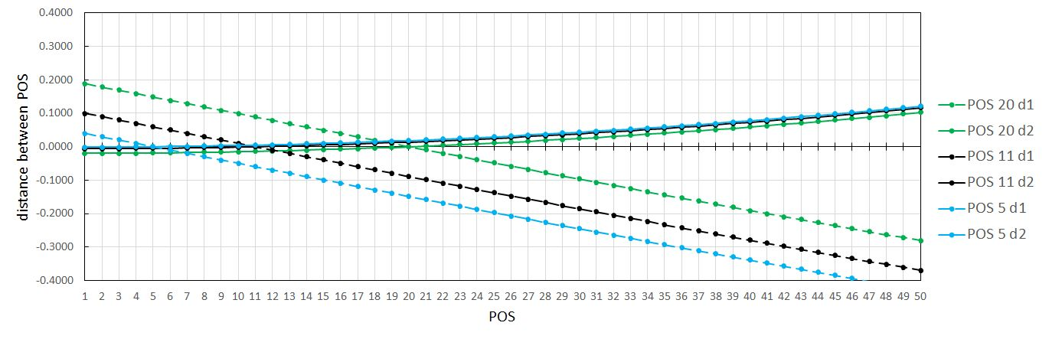
Positional Encoding
Sinusoidal functions for:
Compatibility of query and key given key position
2-dimensional vector; 50 tokens in a sentence

Slide 29
Positional Encoding
d-dimensional vector that contains position information
Deterministic
Position of a word
Distance between words
Scales to unseen lengths

Slide 30
Key Takeaways
Model that relies entirely on an attention mechanism to learn dependencies between input and output
Self-attention is the core of the model and allows the model to relate different positions of a single sequence in order to compute a representation of the same sequence
Multi-head self-attention allows the model to jointly attend to information from different representation sub-spaces at different positions
Positional encoding allows the model to easily learn to attend by relative position since the model intrinsically has no notion of the order of inputs

