Slide 1
Summarisation Task
Julia Ive

Slide 2
Session Outline
Task definition & types
Standard datasets
Pre-neural summarisation techniques
Neural summarisation
NMT architecture
Pointer-Generator Networks
Summarisation with content selection
Summarisation with pre-trained models
Task-specific Summarisation
Evaluation
Key Takeaways
Learning Outcomes
Being familiar with main types of summarisation
Being familiar with main approaches to summarisation

Slide 3
Task Definition & Types
Given input text, generate its summary containing salient elements relevant for the downstream task
Types:
Single-document summarisation (SDS) summarises a single document
Multi-document summarisation (MDS) summarises multiple documents
Extractive summarization selects relevant parts of the original text
Abstractive summarization generates new text using NLG
Currently most of the models are extractive-abstractive

Slide 4
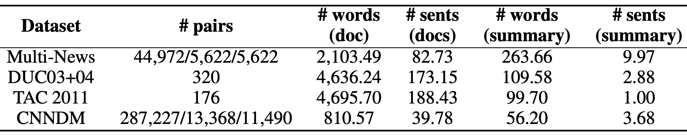
Standard Datasets
DUC & TAC: pioneering datasets for the summarization task
CNN/Daily Mail: large-scale dataset for SDS on news articles
MultiNews (Fabbri et al.,2021): large-scale dataset for MDS on news articles
+ Many other domains: Product Reviews (He and McAuley, 2016), Twitter (Bilal et al., 2022), Scientific Articles (Lu et al., 2020), Dialogue Transcripts (Chen et al.,2021) etc.
Multi-News: a Large-Scale Multi-Document Summarization Dataset and Abstractive Hierarchical Model, Fabbri et al., 2021

Slide 5
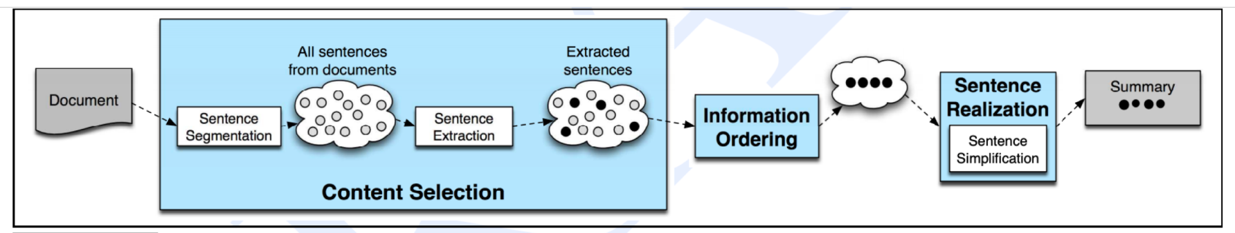
Pre-neural Summarisation Techniques
Pre-neural summarization systems were mostly extractive
Typical pipeline included:
Content selection: choose some sentences to include
Presence of topic keywords (TextRank, TF-IDF)
Feature + ML (e.g., sentence position in the sentence)
Information ordering: choose an ordering of those sentences
Sentence realisation: edit the sequence of sentences (e.g. simplify, remove parts)
Speech and Language Processing, Jurafsky and Martin

Slide 6
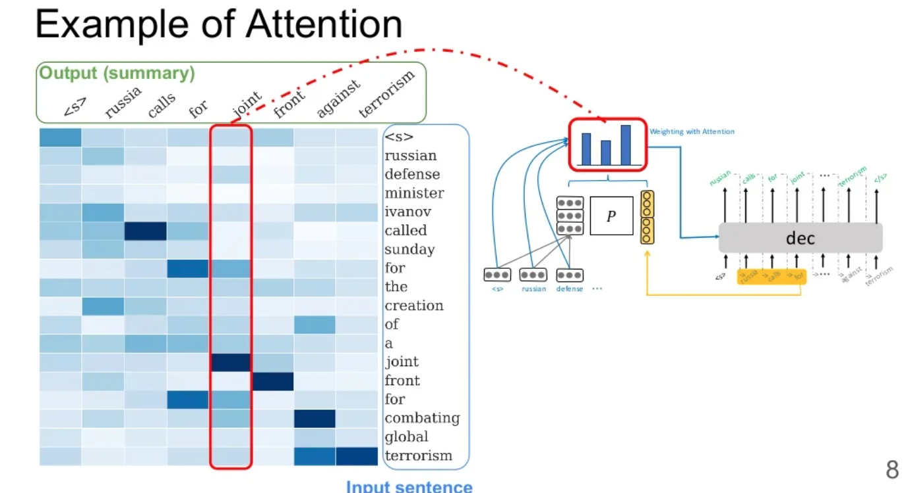
Neural summarisation
2015: Rush et al. A Neural Attention Model for Abstractive Sentence Summarization – first neural architecture
Weighted representation of input
https://www.slideshare.net/MENGSAYLOEM1/a-neural-attention-model-for-sentence-summarization-248488855

Slide 7

Neural summarization: Copy Mechanism
Seq2seq systems generate fluent but bad at copying - extractive-abstractive summarisation
Copy mechanisms
On each decoder step, calculate p_{gen} - probability of generating the next word
Final distribution is a mixture of the generation distribution and the copying (i.e. attention) distribution
Get To The Point: Summarization with Pointer-Generator Networks, See et al, 2017

Slide 8
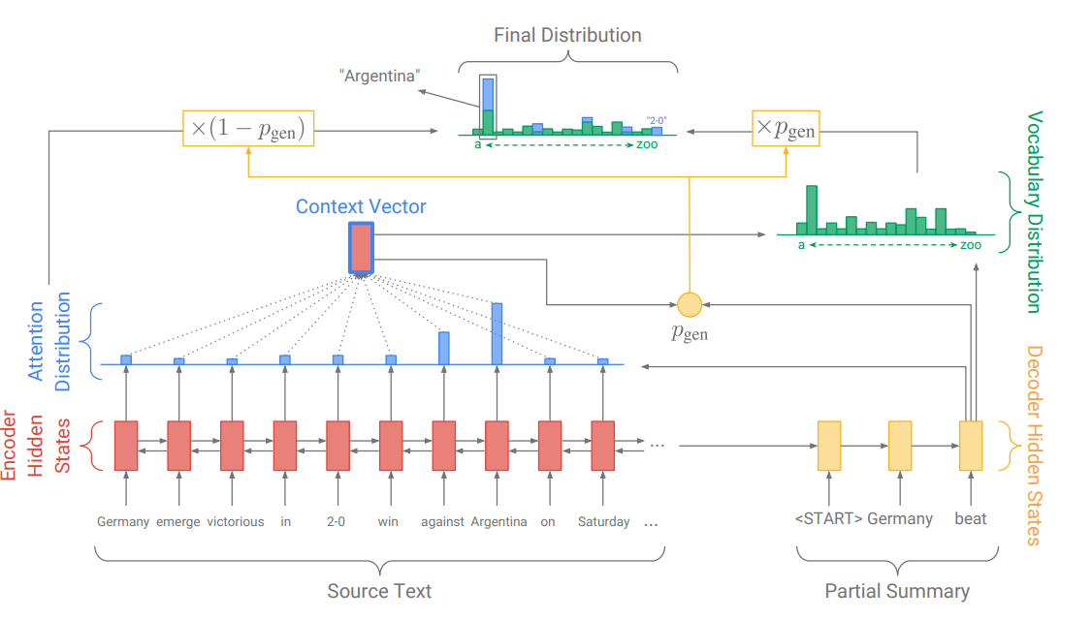
Neural summarization: Copy Mechanism
Tendency to overcopy
Word-level content selection (attention) - no global content selection strategy
Get To The Point: Summarization with Pointer-Generator Networks, See et al, 2017

Slide 9
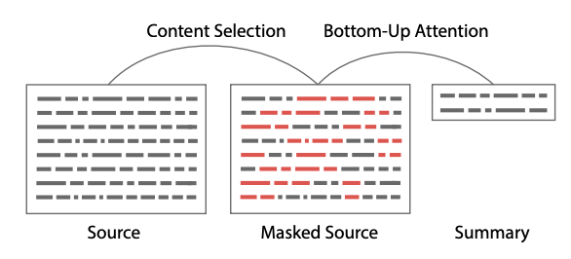
Neural summarization: Content Selection
Pre-neural summarization had separate stages for content selection and surface realization (i.e. text generation)
Bottom-up neural summarisation
Step1. Content selection stage: Use a neural sequence-tagging model to tag words as include or do not-include
Step2. Bottom-up attention stage: seq2seq model can not attend to words tagged (masked)
Bottom-Up Abstractive Summarization, Gehrmann et al, 2018

Slide 10
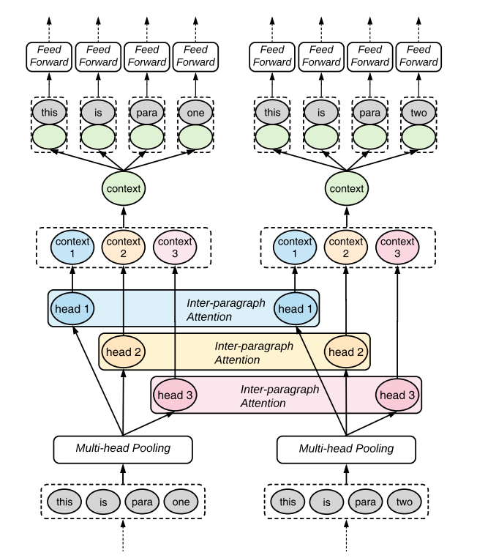
Neural summarization: Content Selection
Difficulties to factor multiple documents
Transformer architecture encodes multiple documents in a hierarchical manner
Learn cross-document relationships via an attention mechanism
Hierarchical Transformers for Multi-Document Summarization, Liu et Lapata, 2019

Slide 11
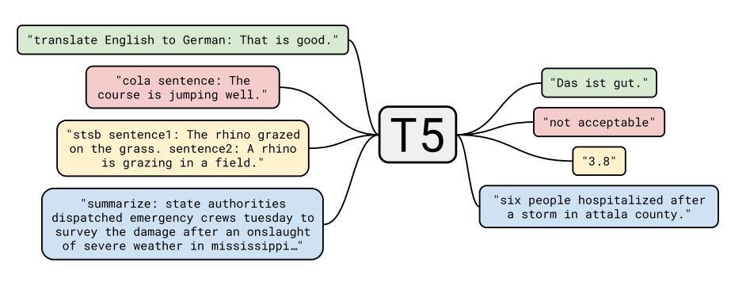
Neural summarization: T5
Train a single network to perform several tasks
Some network parts are shared for all tasks
Enable model to generalise better on tasks especially if tasks are closely related, learning is mutually beneficial
Exploring the Limits of Transfer Learning with a Unified Text-to-Text Transformer, Raffel et al, 2020

Slide 12
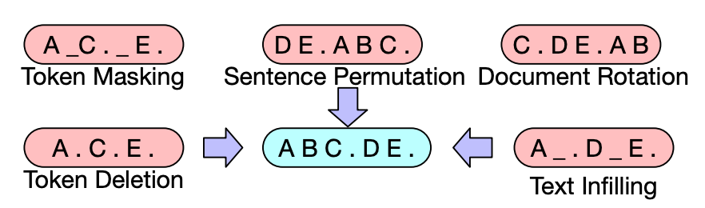
Neural summarization: BART
BART: sequence-to-sequence model trained as a denoising autoencoder
BART: Denoising Sequence-to-Sequence Pre-training for Natural Language Generation, Translation, and Comprehension, Lewis et al, 2019

Slide 13
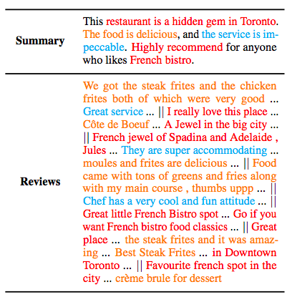
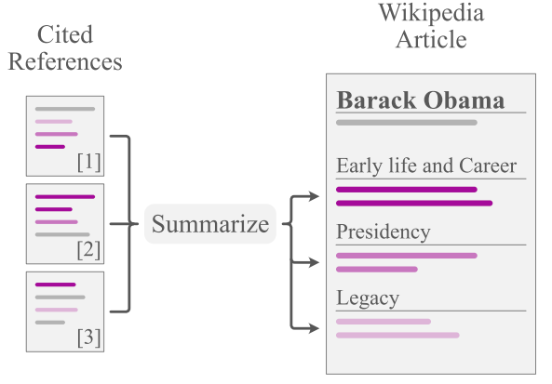
Task-Specific Summarisation
Opinion Summarisation
MDS method introduced for customer reviews (Amazon, Yelp, Rotten Tomatoes)
Goal: review-like summary which captures the consensus about a particular product
Aspect-based Summarisation
Aspects are domain-specific (sentiment, opinions, product features etc.)
Summary may follow a proposed structure
Goal: focused summary on specific points of interest
Unsupervised Opinion Summarization as Copycat-Review Generation, Brazinskas et al.,2020
WikiAsp: A Dataset for Multi-domain Aspect-based Summarization, Hayashi et al.,2020

Slide 14
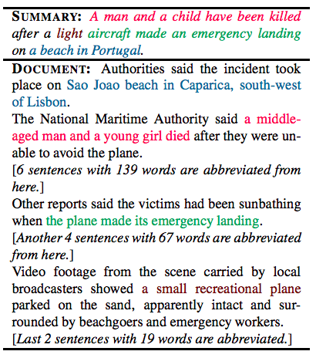
Task-Specific Summarisation
- Extreme Summarisation
SDS method which favours abstractive approaches
Goal: one-sentence summary which captures most salient points in source
Summarisation as Explanations
Emerging task
Goal: summary which explains classification model decisions
Challenge: ensure summarisation module is faithful
Don’t Give Me the Details, Just the Summary!
Topic-Aware Convolutional Neural Networks for Extreme Summarization, Narayan et al.,2018

Slide 15
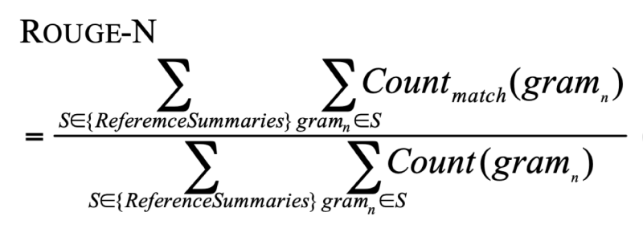
Evaluation: ROUGE
ROUGE (Recall-Oriented Understudy for Gisting Evaluation) – Lin, 2004
Recall-based metric
ROUGE scores are reported separately for each n-gram
ROUGE-1: unigram overlap
ROUGE-2: bigram overlap
ROUGE-L: longest common subsequence overlap
F1 (combination of precision and recall) version is often reported

Slide 16
Evaluation
Semantic Similarity
SDS method which favours abstractive approaches
Exact matching between n-grams can be unreliable (‘happy kid’ ≠ ‘joyful child’)
Metrics from machine translation: BERTScore (Zhang et al., 2020), BLEURT (Sellam et al., 2020)
Rely on contextualized word embeddings
Informativeness
Question-Answering task: SummaQA (Scialom et al.,2019)
QA pairs are generated from the input source/ reference summary
An informative summary should contain the answers to the relevant questions

Slide 17
Key Takeaways
Summarisation is extractive or abstractive
Summarisation can focus on one document (SDS) or several (MDS)
There is a wide diversity of domains for summarisation datasets
Pre-neural system were mostly extractive
Neural system employ strategies such as copy mechanisms and content selection
T5 and BART are examples of neural summarisation models
Different summarisation tasks correspond to very different goals for the final summary
Evaluation is traditionally done via ROUGE metrics, but other quality dimensions should also be considered

