Slide 1
Multi-Task Learning
Julia Ive

Slide 2
Session Outline
Motivation
Advantages
Types of multi-task learning (MTL)
Parallel architectures
Hierarchical architectures
Hyperparameter tuning
Key Takeaways
Learning Outcomes
Familiarity with the principle of MTL and its types
Familiarity with the hyperparameter tuning for MTL

Slide 3
Motivation
Data-driven models usually require a large amount of labeled training samples
Computing power requirements of learning a large neural network
No single blocking task in natural language:
NLP requires many types of reasoning: logical, linguistic, emotional, visual etc.
Need for the background knowledge
Many separate tasks

Slide 4
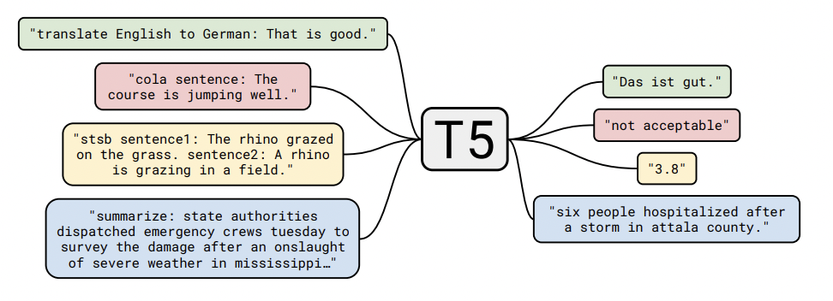
Advantages
MTL trains a model on multiple related tasks simultaneously or enhances it for a specific task using auxiliary tasks
Sufficiently related tasks can provide an inductive bias
Potential of performance improvement due to the learnt shared knowledge
Ability to reach similar or better performance with less training samples
Focus on multiple tasks at the same time
Raffel et al. 2020. Exploring the Limits of Transfer Learning with a Unified Text-to-Text Transformer

Slide 5
Parallel Architectures
Architectures implemented by sharing certain intermediate layers
There is no dependency between tasks and hence no constraint on the order of training samples from each task
During training, the shared parameters receive gradients from samples of each task
Usually tasks share a base feature extractor followed by task-specific encoders and output layers
For example:
POS tag and NER
Parsing and translation
Task A
Task B
Task C
Task-specific layers
Shared layers

Slide 6
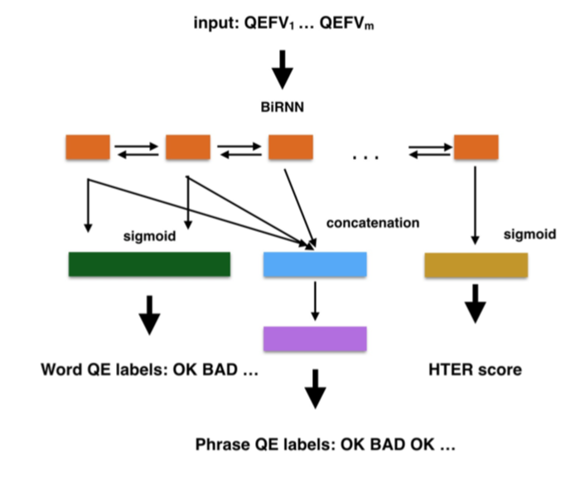
Parallel Architectures: Examples
Tasks may concern features at different abstraction levels
For example, word-level tasks receive supervisions at lower-layers while sentence-level tasks receive supervision at higher layers:
Prediction of machine translation quality at different linguistic levels
Ive et al., 2018. DeepQuest: a framework for neural-based quality estimation.

Slide 7
Parallel Architectures: Examples
Shared modules learn shared features from multiple tasks to generalise better
Task-specific modules learn features that are specific to a certain task, chance of overfitting is small
For example:
Shared encoder in multi-lingual MT, decoders are language-specific
Decoder FR
Input FR, ZH, AR
Shared Encoder
Decoder ZH
Decoder AR

Slide 8
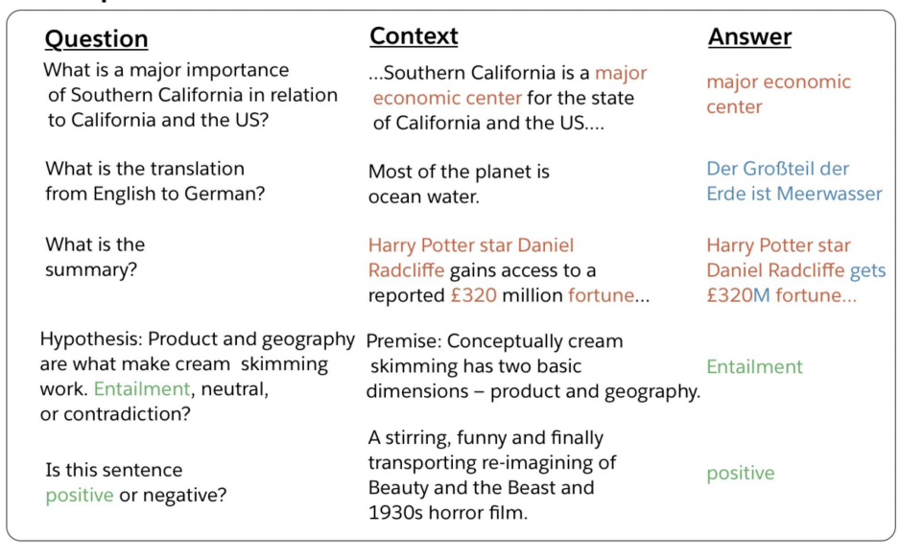
Parallel Architectures: All Tasks as One Task
We can frame all tasks as question answering by allowing task specification to take the form of a natural language question: all inputs have a context, question and answer
McCann et al., 2018. The Natural Language Decathlon: Multitask Learning as Question Answering.

Slide 9
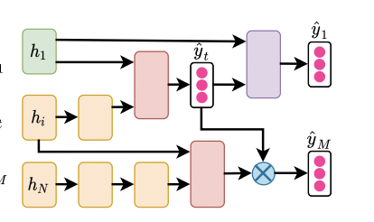
Hierarchical Architectures
Consider hierarchical relationships among multiple tasks
Features and outputs of one task can be used by another, usually related task as an extra input
For example:
Lower-level POS tagging, chunking, dependency parsing tasks and higher level entailment and relatedness classification tasks
Output of a question-review pair recognition model to help the question answering model
Chen et al. 2021. Multi-Task Learning in Natural Language Processing: An Overview

Slide 10


Hyperparameter Tuning: Loss
Most common approach is to linearly combine loss functions of different tasks into a single loss function
For example, cross-entropy loss for the relation identification task and the ranking loss for the relation classification task
Weights $w$ are chosen as hyperparameters
Weights could be adjusted during training depending on the training stage
Adaptive losses can be used as well
F(x) = $\sum_{m=1}^{M}{wm}$f_{m}(x)

Slide 11

Hyperparameter Tuning: Data Sampling & Task Scheduling
Given $T$ tasks and their datasets {D₁, . . . , D$T$}, a sampling weight 𝑝_{𝑡} is assigned to task 𝑡 to control the probability of sampling a data batch from D_{𝑡} in each training step
Sampling can be proportional to the size of its dataset
To prevent favoring, task-oriented sampling randomly samples the same amount of instances from all tasks
Batches can be formed with examples from all the tasks
Scheduling determines the order of tasks in which an MTL model is trained
Shuffling between tasks: randomly, according to the validation loss or an uncertainty criterion
Sequential learning according to task dependencies or difficulty levels

Slide 12
Various setups
Auxiliary MTL improves the performance of primary tasks by introducing auxiliary tasks, e.g., extractive summarization model helped by auxiliary document-level classification
Joint MTL optimise its performance on several tasks simultaneously, e.g., learning MT with multiple translation directions
Multi-lingual machine learning allows involves interaction of inputs of different types at once, e.g., end-to-end speech translation model
Key is how to properly choose a set of tasks for MTL

Slide 13
Key Takeaways
MTL is a powerful tool to improve performance and address the data sparcity problem in NLP
Enable model to generalise better on tasks especially if tasks are closely related, learning is mutually beneficial
It consists in training a single network to perform several tasks while some network parts are shared for all tasks
Different combinations of losses and task scheduling techniques are possible
Tasks could be combined:
In parallel, so that some layers are shared and some are task-specific
Hierarchically, so that outputs of some tasks serve as inputs to other tasks

