Slide 1
Algorithms and tools for mitigating bias
Julia Ive

Slide 2
Session Outline
Bias definition
Types of bias in NLP
Data bias
Overamplification
Semantic bias
Key Takeaways
Learning Outcomes
Spot bias problems
Awareness of methods to address them

Slide 3

Bias Definition
Language reflects the demographics, backgrounds, experience and personalities of humans
This variation can lead models to pick up on non-generalisable patterns and rely on undesirable relationships
Undetected and unaddressed, biases can lead to negative consequences
Predictive bias is a situation in which AI is found to give systematically different predictions for subgroups of population that are in reality identical
https://lattice.com/library/how-to-reduce-unconscious-bias-at-work

Slide 4
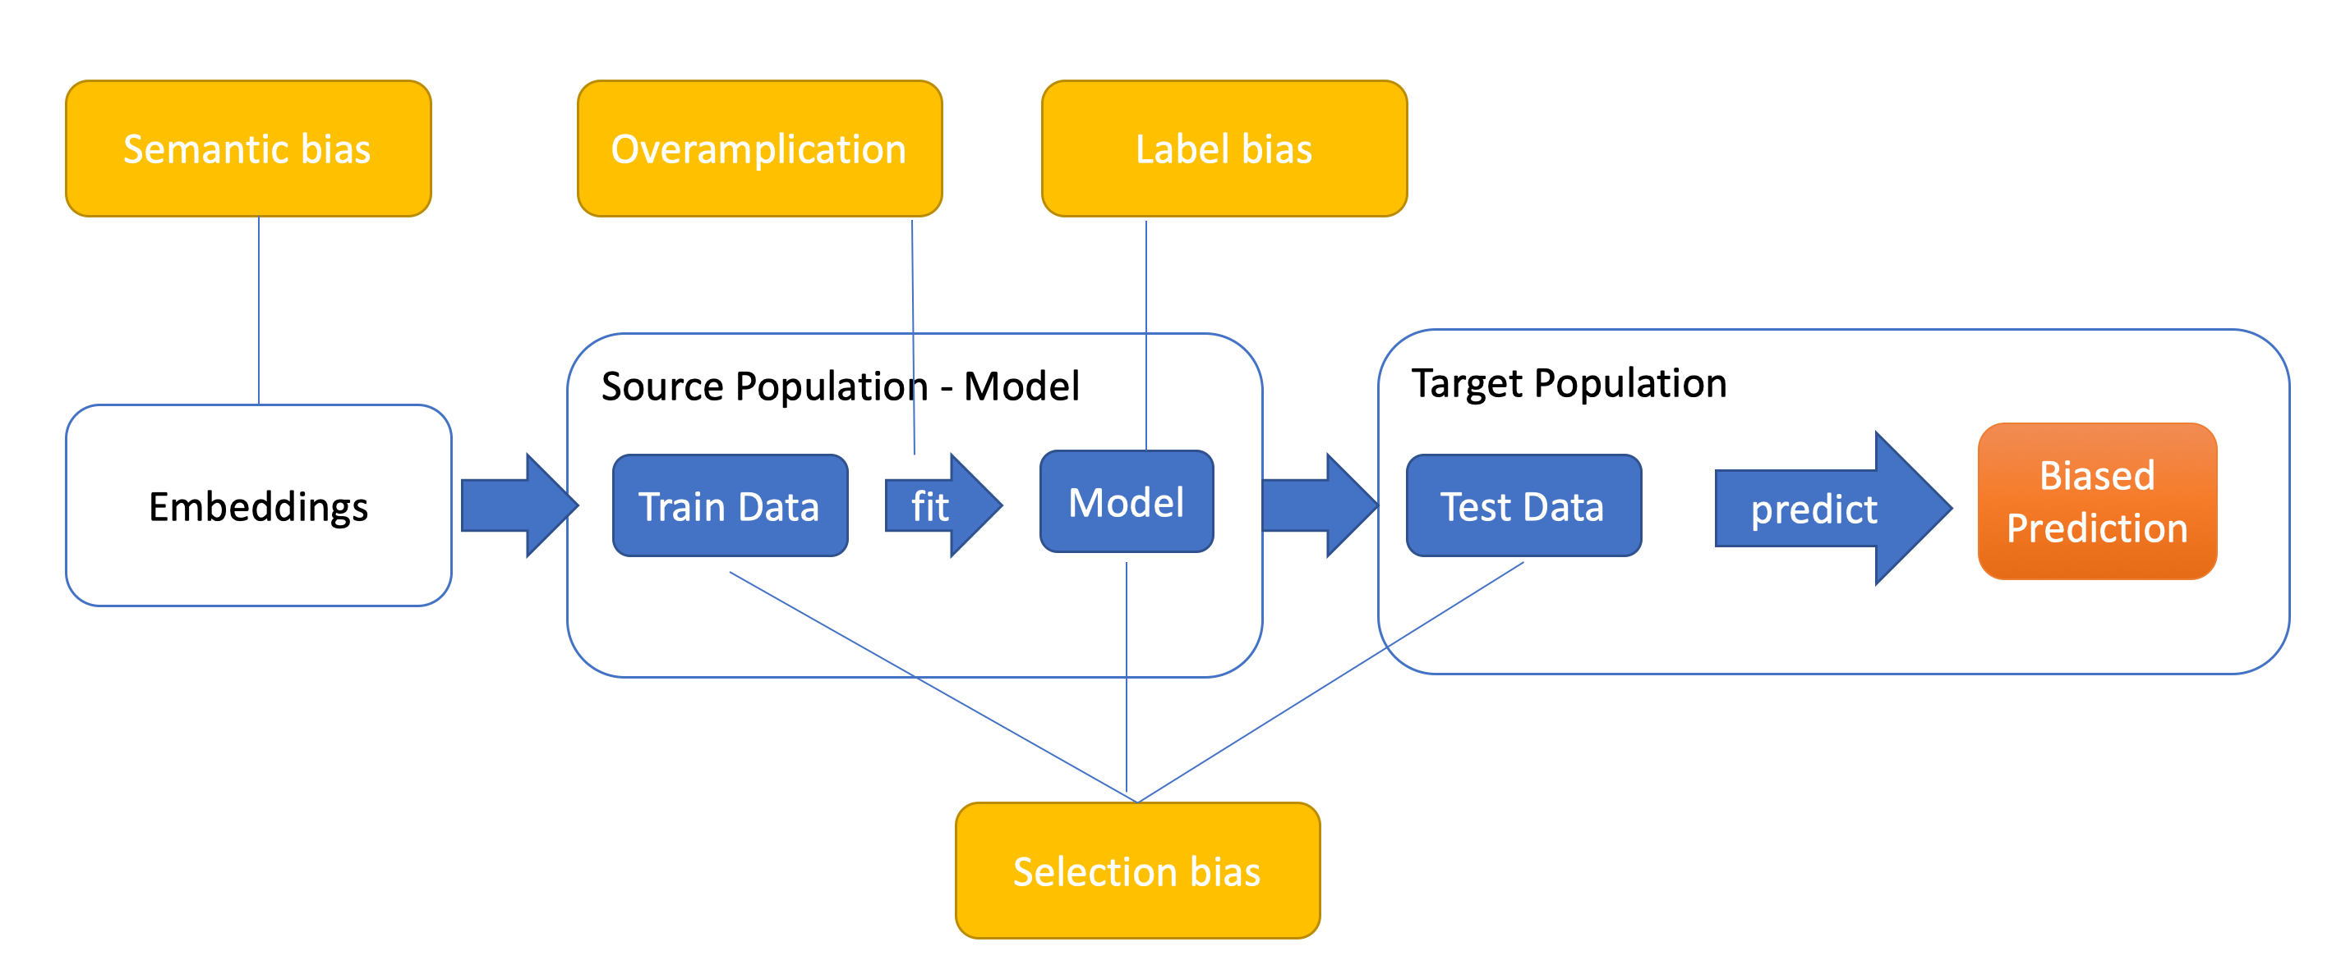
Types of Bias
https://aclanthology.org/2020.acl-main.468v2.pdf
Bias may originate:
Training labels - label bias
Training and testing data - selection bias
Text embeddings - semantic bias
Model training - overamplification

Slide 5
Origins of bias
Label bias:
Lack of domain expertise
Stereotypes held by annotators
Selection bias:
Training examples differ from the testing data
For example, syntactic parsers and part-of-speech taggers are most accurate over language written by middle-aged white men
Model may have selection bias for one application but not for another
We can not know a priori what sort of attribute will need to be controlled
Age and gender are well-studied

Slide 6
Controlling Label & Selection Bias
Controlling for biases of the annotators:
During collection: attaching confidence scores to each annotator
During training: weighting updates by the amount of disagreement on the labels
Controlling selection bias
Re-stratify the data to match the ideal distribution
This often involves downsampling the majority class, which may lead to data sparsity
Reweighting examples during training

Slide 7
Origins of bias
Overamplification:
Model relies on small differences of features with respect to the objective, but amplifies this difference in the predicted outcomes
For image, image captioning data set, 58% of captions mention women in kitchen
Standard models trained on such data predict people depicted in kitchens as women 63% of the time
Semantic bias
Embeddings often contain unintended societal stereotypes
For example, connecting medical doctors more frequently to male pronouns than female pronouns
This bias is related to words in contexts rather than real-life situations

Slide 8
Controlling bias: Overamplification
Semantic bias
Downweighting the biased instances during training to discourage the model from exaggerating the effects
Synthetic text:
“The doctor went to the room and he grabbed the syringe” could be augmented to “The doctor went to the room and she grabbed the syringe”
Example of a method:
Step 1: List of relevant words indicating profession
Step 2: Apply coreference resolution model
Step 3: Apply swapping rules: “her → him” and “her → his”
Professions associated with stereotypes: carpenter, driver, farmer, janitor, cook, CEO, editor, accountant, baker, clerk, teacher, cleaner, secretary

Slide 9
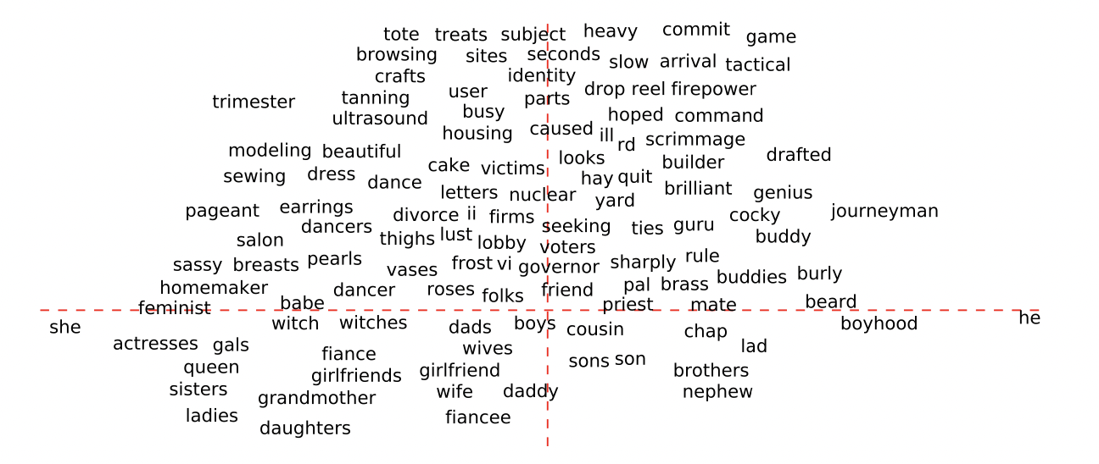
Controlling bias: Semantic bias
Analogies and vector arithmetic
Puzzle “man is to king as woman is to x”
man − woman ≈ king − queen
man − woman ≈ computer programmer − homemaker
Classified gender-neutral
“She” subspace proximity
“He” subspace proximity
Classified gender-specific
https://arxiv.org/pdf/1607.06520.pdf

Slide 10
Controlling bias: Hard Debias Algorithm
Bolukbasi et al. Man is to Computer Programmer as Woman is to Homemaker? Debiasing Word Embeddings
https://github.com/uvavision/Double-Hard-Debias
Step1: Identification of Gender Subspace
Take embeddings of words indicating opposite genders
Stereotype and gender words are defined by humans
Compute their principal components (PCs) to obtain the direction or subspace of this bias
This is to address the effect of different meanings of some words, e.g. “grandfather” as in to “grandfather a regulation”
daughter - son
mother – father
gal – guy
girl – boy
female -male

Slide 11
Controlling bias: Hard Debias Algorithm
Step2: Neutralise
Gender-neutral terms are made equidistant from genderpairs like “he-she”
Projection of the embedding on the bias subspace is subtracted from the vector
Gender-specific terms are averaged out to have the same vector length
This is done to ensure that the neutral terms are equidistant to all equality pairs
For example, the term doctor should be equidistant to both guy-girl and man-woman
Other Dimension
Programmer
Gender Dimension
Woman
Other Dimension
Man
Gender Dimension

Slide 12
Controlling bias: Hard Debias Algorithm
Step2: Neutralise
Gender-neutral terms are made equidistant from genderpairs like “he-she”
Projection of the embedding on the bias subspace is subtracted from the vector
Gender-specific terms are averaged out to have the same vector length
This is done to ensure that the neutral terms are equidistant to all equality pairs
For example, the term doctor should be equidistant to both guy-girl and man-woman
Other Dimension
Programmer
Gender Dimension
Woman
Other Dimension
Man
Gender Dimension

Slide 13
Use Case: Gender and Race Bias in Sentiment Analysis
Assess scoring differences in ~200 sentiment analysis systems by switching names and pronouns (Kiritchenko & Mohammad, 2018)
Switching between male and female pronouns, and between prototypical white and black American first names based on name register
Amanda feels angry
Lakisha feels angry
Results show that male pronouns are associated with higher scores for negative polarity, and prototypical African American names with higher scores for negative emotions
https://aclanthology.org/S18-2005.pdf

Slide 14
Use Case: Differential Diagnosis in Mental Health
Differentiating post-traumatic stress disorder (PTSD) and depression is difficult
Early work on this task produced AUCs greater than 0.85 (Coppersmith et al., 2015)
Labels of depression and PTSD were automatically derived from profile data of individuals who stated their diagnosis
Label balance was 50/50
Classifiers primarily picked up on differences in age or gender
Subjects with PTSD were more likely to be older than those with depression
Classifiers predicted nearly older individuals to have PTSD and younger to have depression, despite the 50/50 split

Slide 15
Key Takeaways
Biases can originate from the data, language or model
Monitoring of the data collection and annotation procedure is important
There are established techniques to address model bias issues, including biases coming from language
Only some type of biases (e.g., age, gender) are well-studied
Anticipation and data analysis are important

